Slide 1
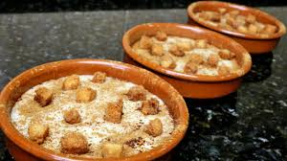
GACHAS

Slide 2
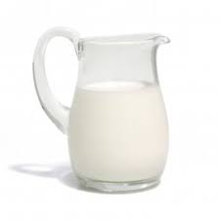
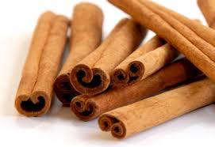
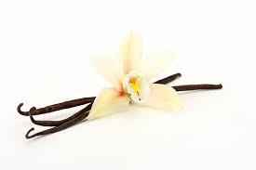
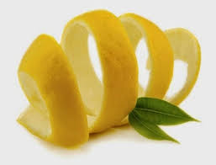
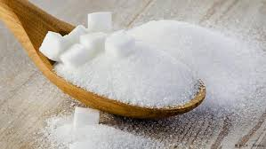
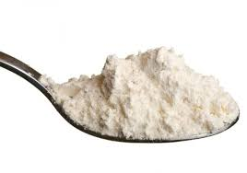
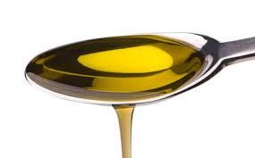
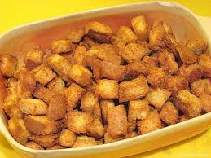
INGREDIENTS
1 litre of milk
1 cinnamon´s stick
1 pod of vanilla
Lemon´s rind
Sugar
4 spoonfuls of flour
3 spoons of olive oil
Some bread (in Spain, we call the bread “tostones”

Slide 3
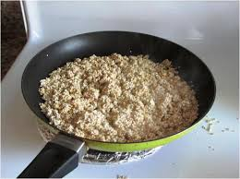
1st STEP
We put olive oil in a frying pan. Then we add the flour and when it looks golden we move it away from the fire.

Slide 4
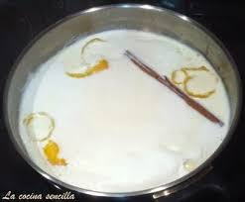
2nd STEP
We put a pot with milk to boil and we also put the lemon´s rind, the cinnamon and the vanilla. Then, we add sugar (4 spoons more or less)

Slide 5
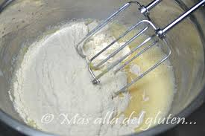
3rd STEP
In this step, we have to put the boiled milk in the pot where we have the flour. Then, we have to shake the mixture (it will be better if you do this with a whisk)

Slide 6
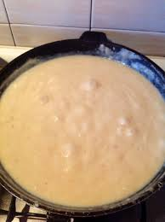
4th STEP
When you think that the milk is ok, you move the frying pan away from the fire.

Slide 7
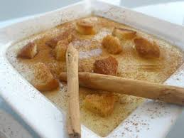
LAST STEP
THAT´S ALL, ENJOY IT!
Finally, we add the bread or “tostones” and some cinnamon

