Slide 1
European Path (e) Motion
Literature Path

Slide 3
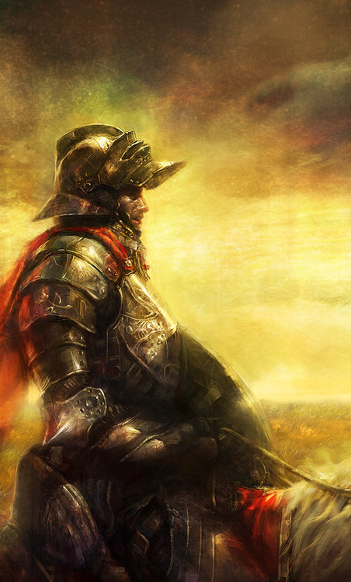
The Knight in Rusty Armor
A novel written as a fair tale that speaks directly to the heart of those who are seeking a deeper meaning in their lives. A response and an outlet to our fears, to our concerns and our loneliness.
Speaking for our "rusty armor", which (we think) protects us from the pain that the others cause, the writer creates a travel adventure that leads us to get to know, accept and change ourselves for the better.

Slide 4
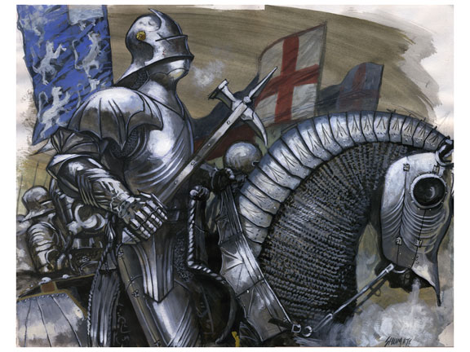
Summary
This book begins with a knight who thought he was the hero of the city. He was so proud of his armor that he never took it off and not even when he was with his son Christopher and his wife Juliet; they were so tired of his attitude that they walked away from him until he takes off his armor.
The capricious knight came to seek help in order to remove it ,because he couldn´t take off his armor.

Slide 5
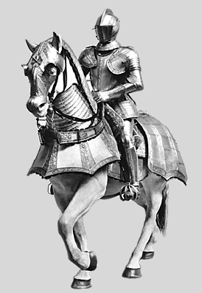
After searching and searching he found a buffoon who mentioned that the only way to remove it would be finding the magician Merlin. Merlin tells him that he must go on and pass through three castles : “The castle of silence”, “The castle of knowledge and wisdom”, and “The castle of will and courage”.
When he went to the castles the armor started to melt and when the armor was completely destroyed, he changed into a sentimental person , so that he could go with his family.

Slide 6
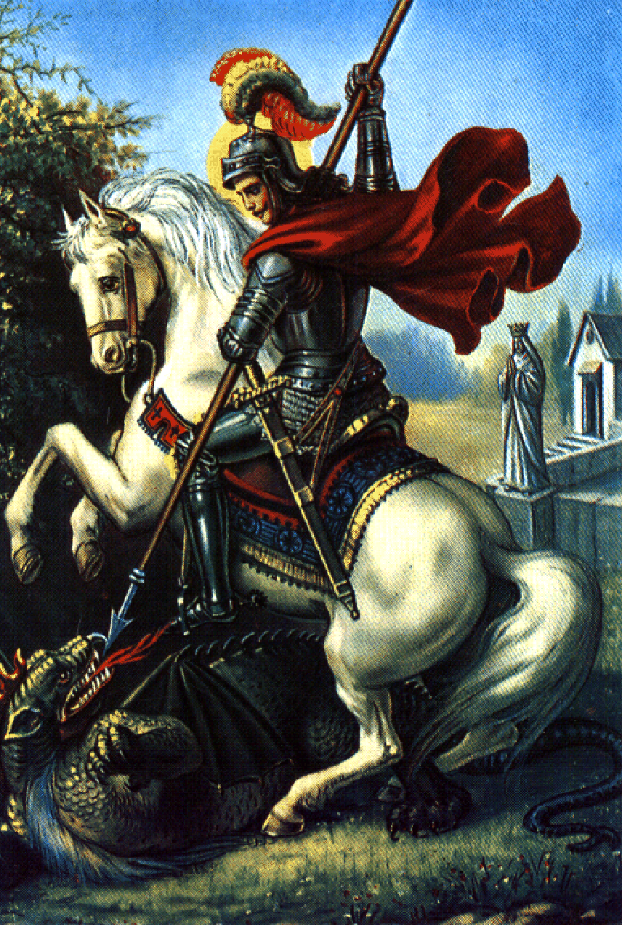
Motivating messages
This book makes you want to dare to leave yourself in your memories, to confront your mistakes, to identify the errors and to reconcile with them so that you don't repeat them. If it takes time and effort to build up and raise your walls in a miserable, cruel and inhospitable world, you only need to carry on this long journey to the truth to get rid of it. You don't have to prove anything to anyone to find happiness.
By reading this book, we learn that if we love ourselves, we will be able to love other people, we learned that only if we really know ourselves we will be able to overcome our fears and if we accept ourselves we can live happily.

