Slide 1
RECIPE BOOK
I.I.S. CAMINITI-TRIMARCHI
LINGUISTIC AND SCIENTIFIC SECONDARY SCHOOL
GIARDINI NAXOS - ITALY
TRIUMPH OF THE CITRUS GROVE

Slide 2
Starter Orange and fennel salad
Ingredients:
Orange
Fennel
Pepper
Lemon juice
Salt
Oil

Slide 3
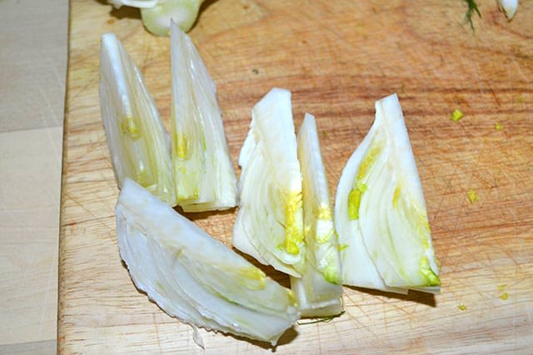
Directions:
Peel the orange and cut it into small pieces;
Wash and peel the fennel, then cut it in thin slices;
Put all in a bowl, then add salt, oil, pepper and lemon juice;
Mix all and serve it in a plate.

Slide 4
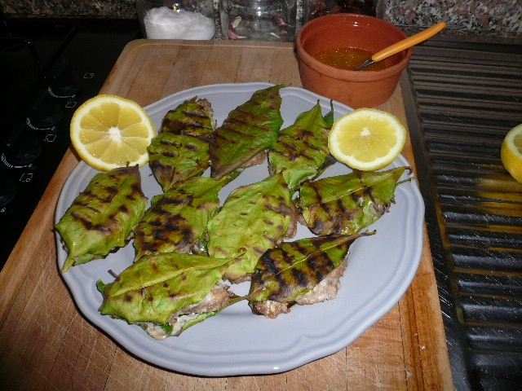
Main Course Lemon Leaves Meatballs
Ingredients:
Meat
Bread
A splash of milk
Lemon zest
Parmesan cheese
Wild fennel
Lemon-tree leaves
Salt and pepper

Slide 5
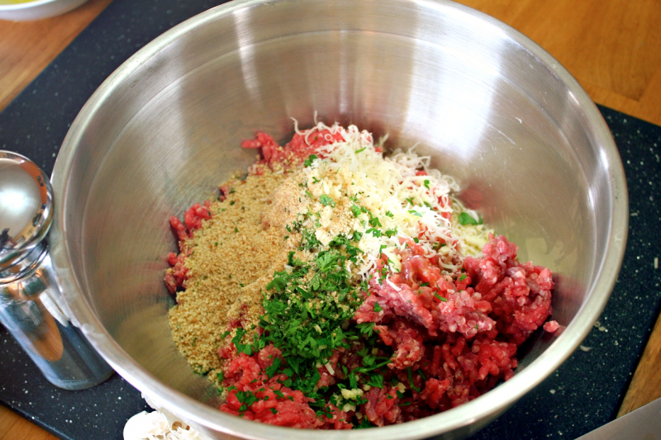
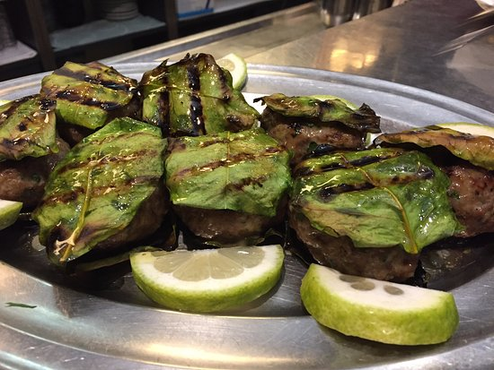
Directions:
Cut away and discard the crusts of the bread. In a small bowl, soak the white part of the bread with some milk. When the bread becomes soft and has absorbed the milk, squeeze out the excess milk and set it aside. Discard the milk
In a large bowl, mix meat, bread, lemon zest, cheese, lemon juice, salt and pepper. Mix the ingredients well until the mixture becomes compact.
Get about a tablespoon of the meat and shape it into a ball. Do the same thing to the rest of the meat.
Put each meatball between two lemon leaves, then secure on top with a toothpick.
On a grill, line the meatballs together and grill them on both sides.

Slide 6
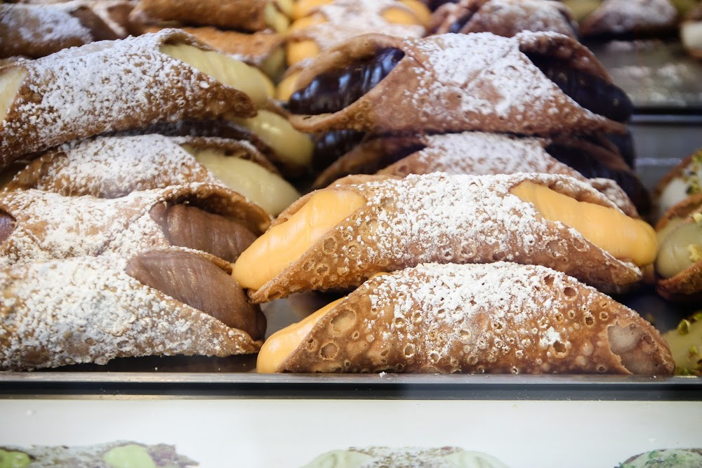
Dessert Il Cannolo Siciliano
RICOTTA CREAM
1 kg. of fresh sheep ricotta
600 g sugar
A pinch of cinnamon powder
150 g dark chocolate drops
Candied cherries (2 per cannolo)
Candied orange peels (1 per cannolo)
INGREDIENTS FOR THE RIND (CASING)
400 g flour
75 g butter
40 g caster sugar
2 eggs
1 egg white
a pinch of salt
15 g unsweetened cocoa powder
60 g dry Marsala
60 g white vinegar
metal rods to make cannoli
Peanut oil for frying

Slide 7
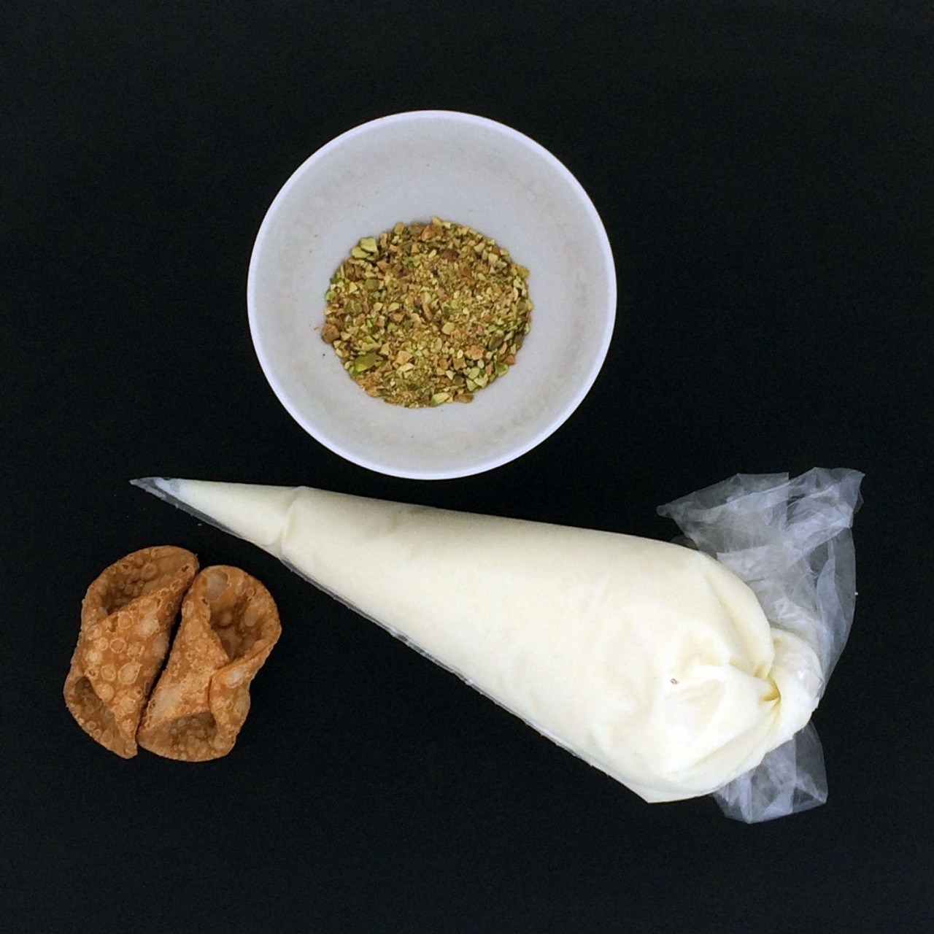
Directions:
FOR THE RIND
Use a mixer to mix flour, sugar, cocoa and salt.
Add the butter to the flour mixture and mix well, then add the eggs, let them combine well to the mixture and finally keep on working by adding the Marsala and the vinegar until the mixture is not too soft but firm.
Make a ball, wrap it in plastic wrap and put it into refrigerator for at least an hour.
Flatten the dough to a thin thickness.
When you reach the desired thickness, make disks having a diameter of about 10 cm.
Wrap the little disks around the metal rods greased with oil, joining the edges, brushing them with beaten egg white.
Deep fry in hot oil, two to three at a time. As soon as the rind is of a nice dark gold, drain them and place them to cool down on food oil absorbing paper towels.
FOR THE RICOTTA
If the ricotta is very moist, as it should be, make it drip in order to remove most of the serum. Mix well the ricotta with the sugar.
Leave it stand for an hour and then sift it.
Now add the cinnamon and the dark chocolate.
Fill the rinds with cream, place a candied cherry on the ends, put it on a tray and sprinkle with powdered sugar.
Then lay the candied orange peel on the top.

Slide 8
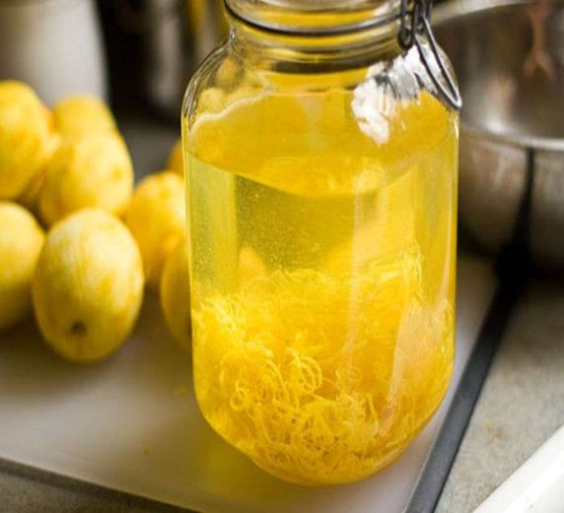
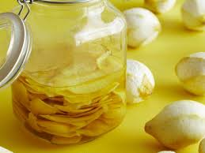
Drink Limoncello
Ingredients:
5 biological lemons
500 ml alcohol 95°
600 g sugar
750 ml water

Slide 9
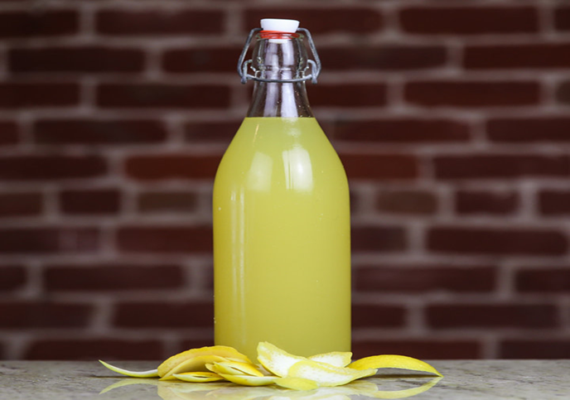
Directions:
ALCOHOLIC BEVERAGE :
Peel the lemons with a potato peeler to obtain the skin with as little white as possible.
Put the peels in a jar, add the alcohol and close well.
Place the jar in a saucepan with the water just below the level of the cap of the jar.
Bring the water to about 55°, turn off, cover with a lid and leave to cool.
SYRUP
In the meantime pour some water and sugar, bring to the boil to completely dissolve the sugar.
Pour the rest of the water and wait for it to cool.
LIQUOR
After about 2-3 hours, strain the alcohol by pouring it into a bottle and add the sugar syrup.
Leave the bottle a couple of hours in the refrigerator and then transfer it to the freezer.
The liqueur obtained will be around 40°.
The proportion in doses is 30 grams of leaves per 100 ml of alcohol.

Slide 10
ENJOY YOUR MEAL!

Slide 11
ERASMUS+ PROJECT
EUROPEAN PATH (e)MOTION
I.I.S. CAMINITI-TRIMARCHI
LINGUISTIC AND SCIENTIFIC SECONDARY SCHOOL
GIARDINI NAXOS - ITALY
Class IV BL Class IV AS – School year 2018/19

