Slide 1
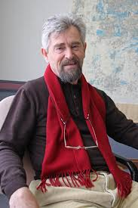
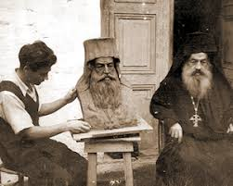
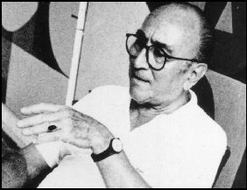
Modern artists
in Epirus
Athina Tsapakidi
Eirini Tsatsou
Panagiota Dalagianni

Slide 2
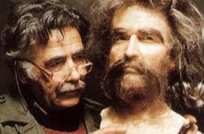
Pavlos Vrellis
1923-2010
Born in Ioannina on 25 March 1923.
His artistic nature had already begun to show from his early childhood, when he drew and carved on wood or stone his favourite heroes.
When he was 23 before he got to the School of Fine Arts he took to making busts.

Slide 3
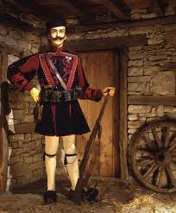
Pavlos Vrellis
In 1954, he graduated having both a Theoretical and a Practical Degree.
In 1983,60 years old at the time he bought with the retirement payment a land in Bizani village.
The building which would accommodate the museum was given the style of the urban fort architecture of Epirus mainland of the 18th century.

Slide 4
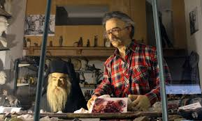
The museum
The museum hosts 37 themes and 150 wax models which represent various historical events.
There are three thematic units in the Museum:
Exhibits prior to 1821 war of independence
Exhibits from 1821 unit 20th century
References and dedications.

Slide 5
Yiannis Moralis
1916-2009
Born in Arta on 23 April 1916.
In 1936 he received a grant from the Athens School Of Fine Arts.
He went to Paris to study fresco and mural.
He was an important Greek visual artist and part of the so-called “Generation of the 30s”

Slide 6
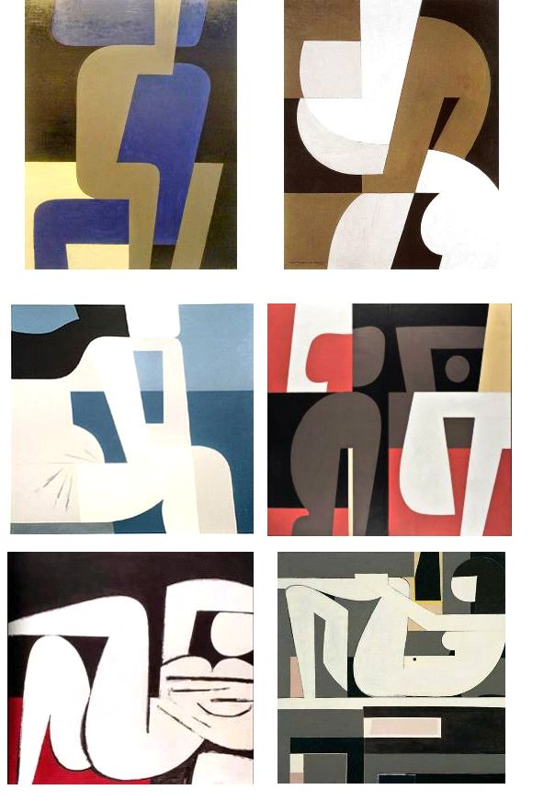
Works of Art
Some of Moralis’ most famous works include:
Two Friends (1946)
Pregnant woman (1948)
Seated Nude(1952)
Funeral Composition (1958)

Slide 7
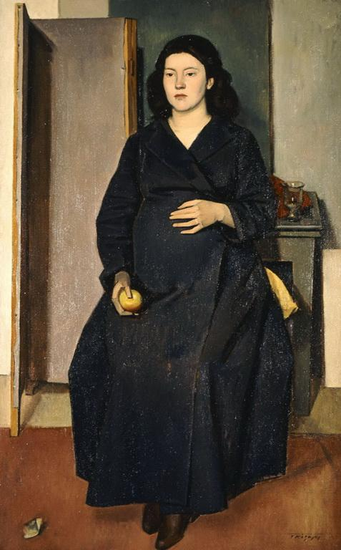
Pregnant Woman

Slide 8
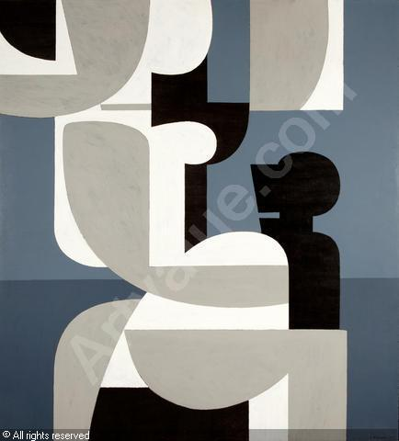
Seated Nude

Slide 9
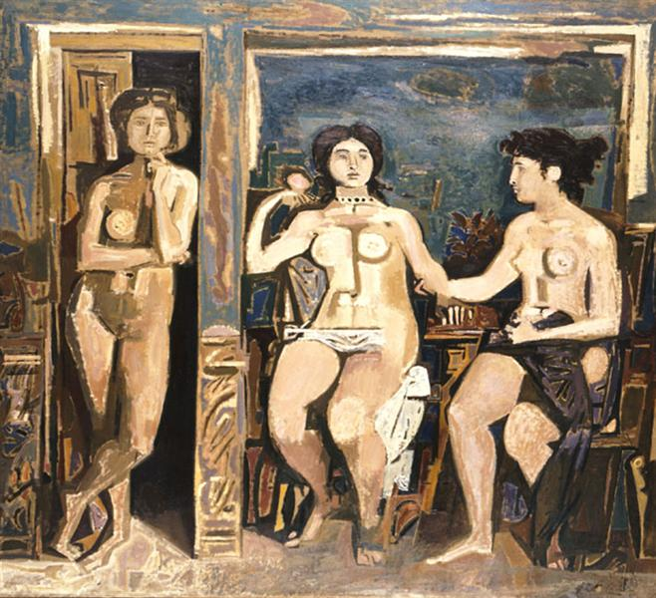
Funeral Composition

Slide 10
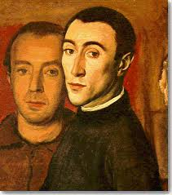
Works of Art
There are 151 works by Yiannis Moralis in the National Gallery collection.
Yiannis Moralis was one of the most popular artists of 20th century in Greece.

Slide 11
Theodoros Papagiannis
1942-
Theodoros Papagiannis born in Elliniko,Ioannina in 1942.
From 1961-1966 he studied at the Athens School Of Fine Arts on a scholarship.
In 1967 he studied ancient Greek Art and the Art of Mediterranean Basin on a two year domestic Scholarship Service.
His Mediterranean journeys took him to Egypt,Sicily,Cyprus

Slide 12
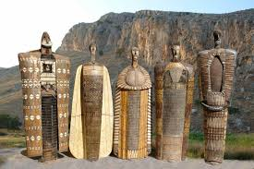
Works
His work includes busts and statues of prominent personalities,medals,coins and large sculptural compositions.
Some of his incredible works are:
1986 Eleftherios Venizelos,Ioannina
Brother Samuel,Moscho Tzavella,Souli
Themistocles Rigas,Paramythia.

Slide 13
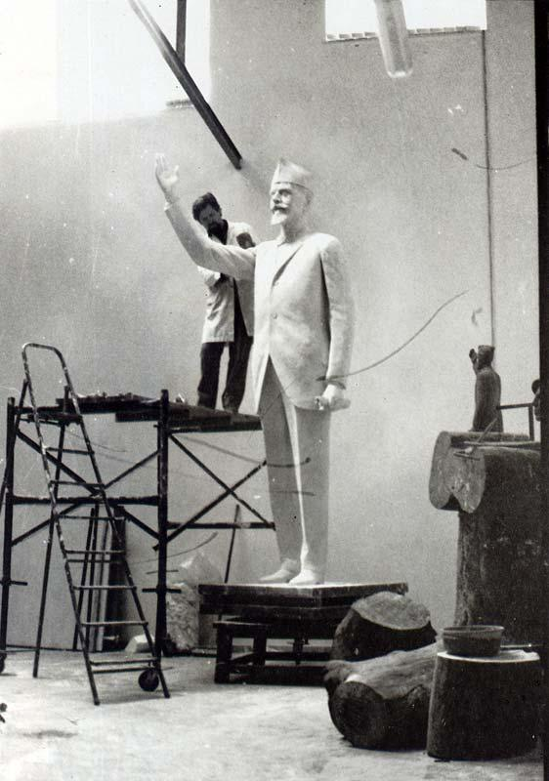
Eleftherios Venizelos,1986

Slide 14
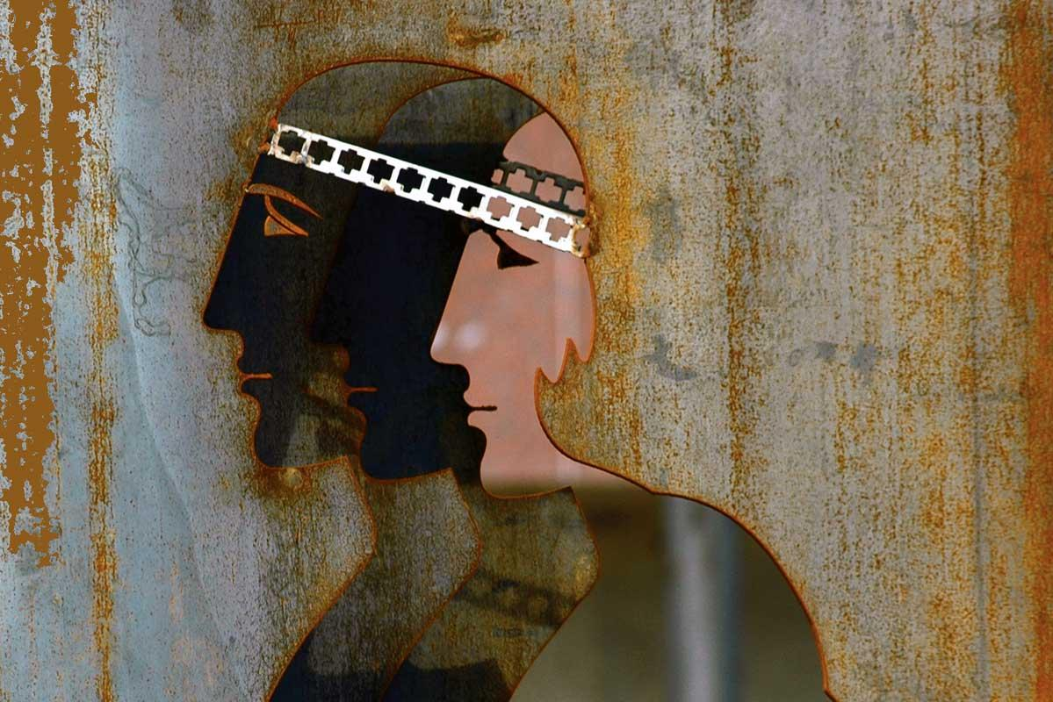
Brother Samuel

Slide 15
Works
Papagiannis has exhibited his work in 30 solo exhibitions and in many group exhibitions in Greece and in other countries.

