Slide 1
Sports activities along local paths Oradea and bihor county

Slide 2
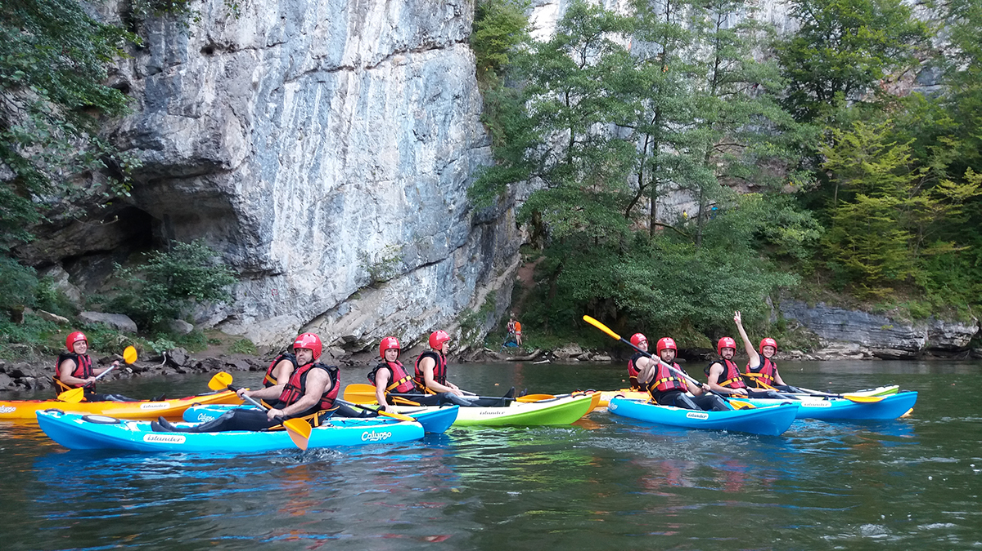
Kayaking
Kayaking is practised in the so-called whitewater, fast water rivers, inspired with waterfalls and thresholds, which gives the spectacular and extreme part of this dynamic sport. The experience of practising kayaking means adrenaline, beauty, fun, comradeship, physical challenge, and adventure.

Slide 3
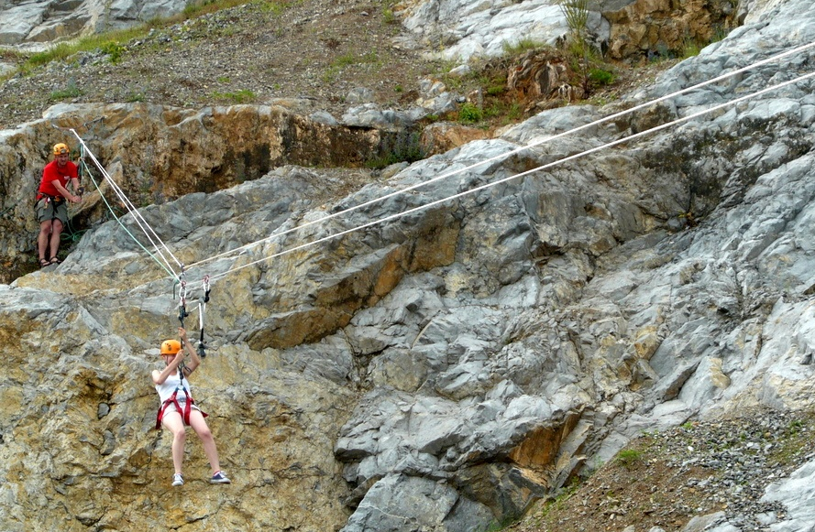
Mountaineering
The mountaineering/climbing programmes include:
initiation in speleological technique;
climbing courses for children and beginners;
climbing on rock walls;
rappeling;
tyrolean.
The routes are suitably
arranged with varying
degrees of difficulty and different lengths, thus satisfying all categories of users.

Slide 4
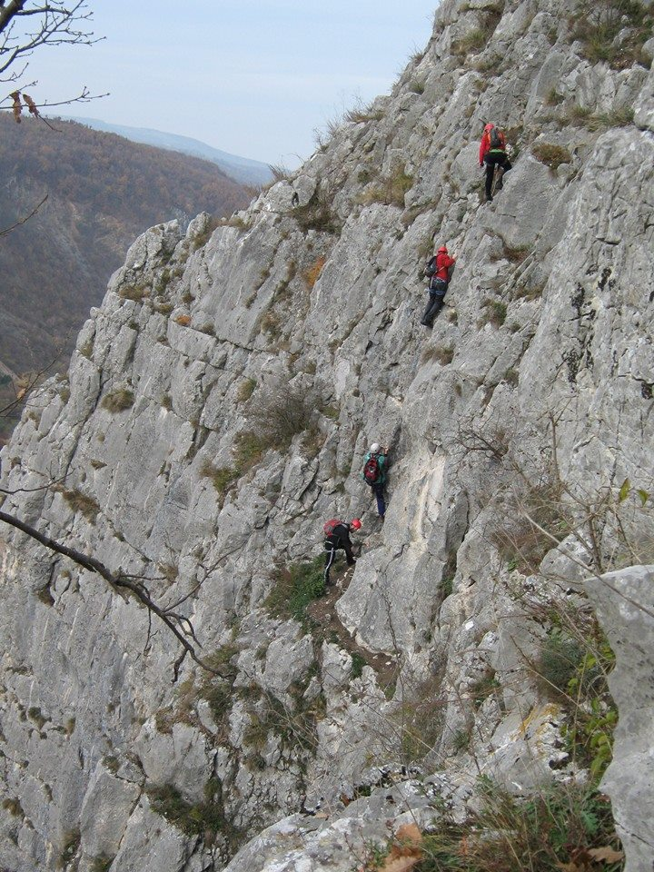
Via ferrata route
The Vadu Crisului Ferry Route – The Crişul Repede Gorge is a spectacular route that offers an extraordinary view over the valley and its walls.
It was inaugurated in 2015.
It is a rather difficult route that addresses people who have travelled ferry routes or who are accompanied by guides.

Slide 5
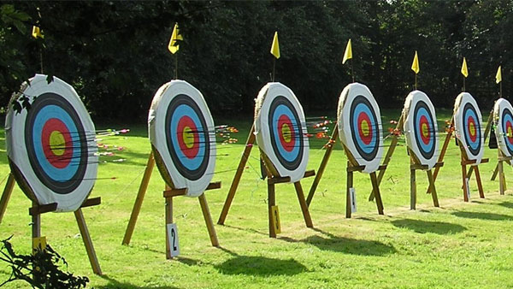
Archery
Archery is a healthy sport, aimed at young people, trying to create addiction to a smart, consolidated and elitist hobby.
Ideal in outdoor activities and team building programmes, it can be practised in the form of a contest, to get points within the team or individually, or as a recreational leisure activity.
Archery became an Olympic sports discipline at the 1900 Olympics in Paris.

Slide 6
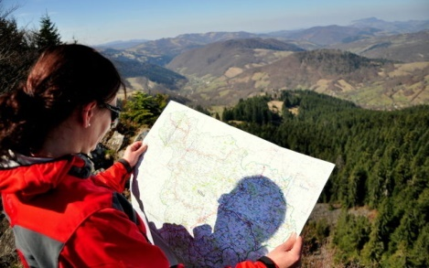
Trekking
Trekking in the area of Vadu Crisului – Suncuius is characterized by a medium difficulty level with numerous points of view with a special beauty.
Most routes can be approached regardless of the season.
Necessary transport and consultations during the tours are offered.

Slide 7
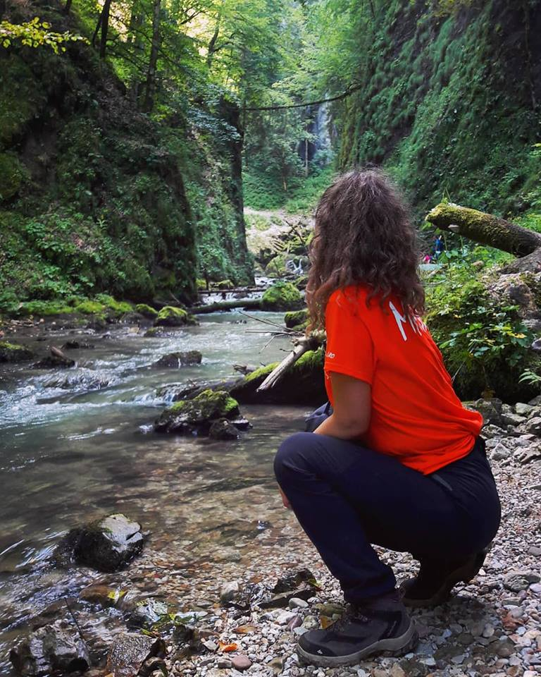
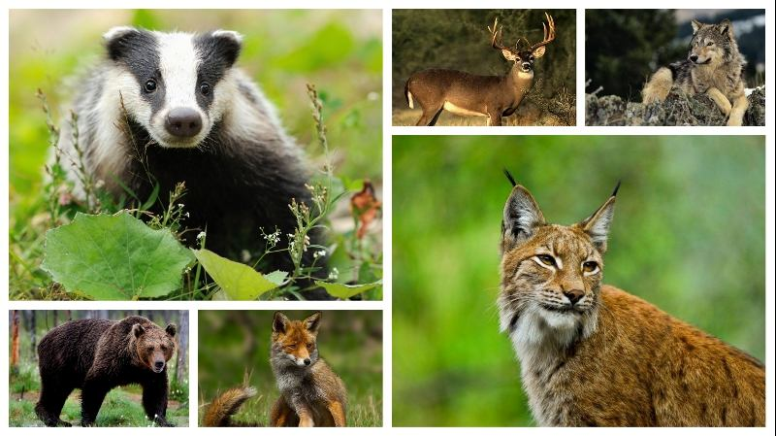
Photo hunting
Photo hunting is a pleasant combination of trekking and hunting with the camera.
In these beautiful areas, one can meet deer, rabbits and foxes, pheasants, pimples and a lot of other birds, animals and insects.

Slide 8
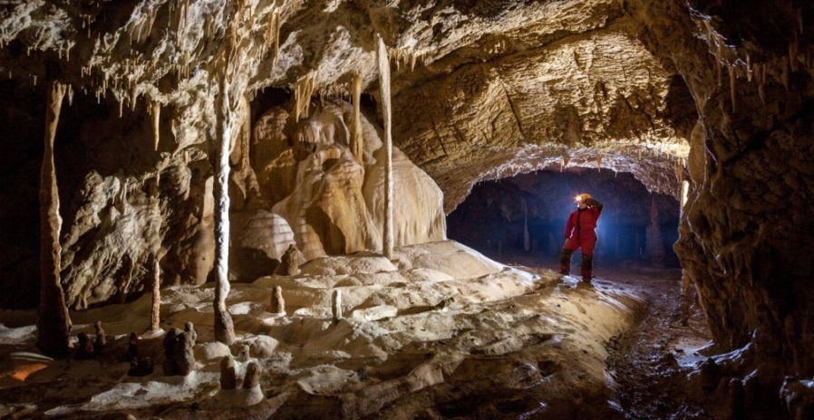
Speoturism
Speoturism consists of visiting the caves of Big Hungarian Cave, Vadu Crisului Cave – arranged for tourists.
Others such as Goat’s Cave and Old Man Cave (which require a higher level of technical and physical training) are not arranged for tourist but are accessible. Other caves in the area can be visited on request.
Collective and individual technical equipment is provided by the organizer.

Slide 9
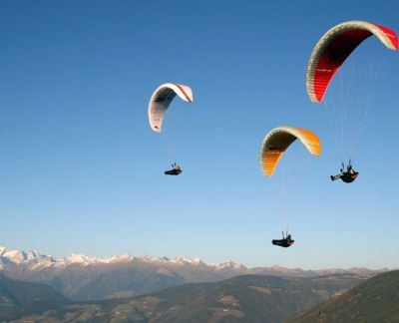
Paraplaning
Paraplaning is often seen as a more risky sport than it really is.
Safety in this sport is directly proportional to the pilot’s skill and sense. It is important to know that almost all paragliding accidents are due to flight errors.
Paraplaner equipment is very well built and if used with care , it will never yield.

Slide 10
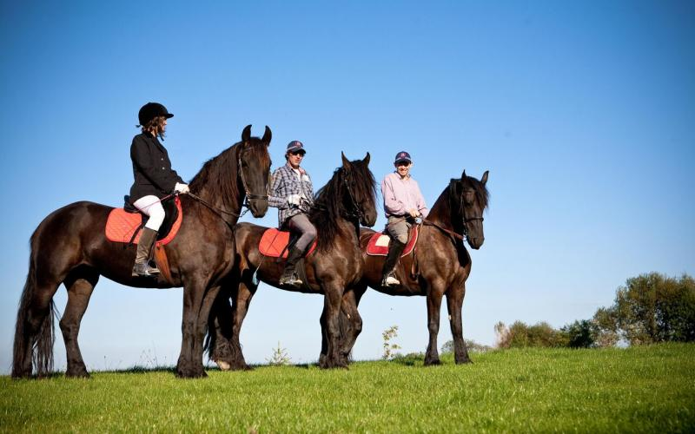
Horse riding
The Mentor Equitation Centre was set up in the summer of 2011, out of love and passion for horses, representing the accomplishment of a childhood dream.
The centre addresses all lovers of horse riding and nature.
It offers:
carriage rides;
horse riding lessons;
therapeutic horse riding;
relaxing walks in nature.
The equestrian centre
has a modern stable and a large number of gentle horses that are suitable for working with children.

Slide 11
“ioan alexandrescu” Olympic Swimming Pool
It is a water polo centre that holds 1,035 people.
It’s an Olympic pool home of the local polo team.
Swimming can be practised here during certain daily hours based on a monthly subscription fee.

Slide 12
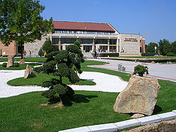
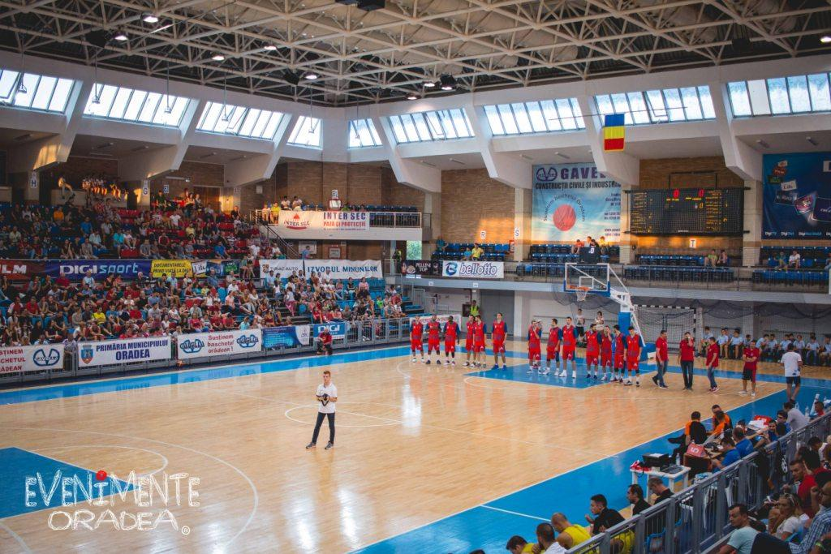
“Antonio Alexe” Stadium, Arena, Sports Venue
It is an indoor arena – home of the men’s professional basketball and handball clubs.

Slide 13
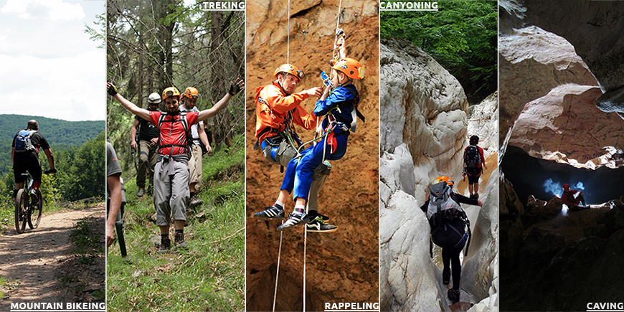
Thank you for your attention.
LTT
GREECE
May 2019
Student: Andrada TARCE
Teacher coordinator: Carmen CHIRA

