Slide 1
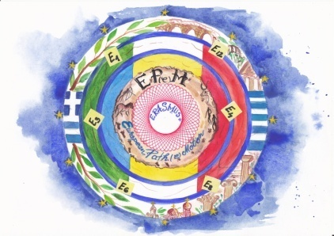
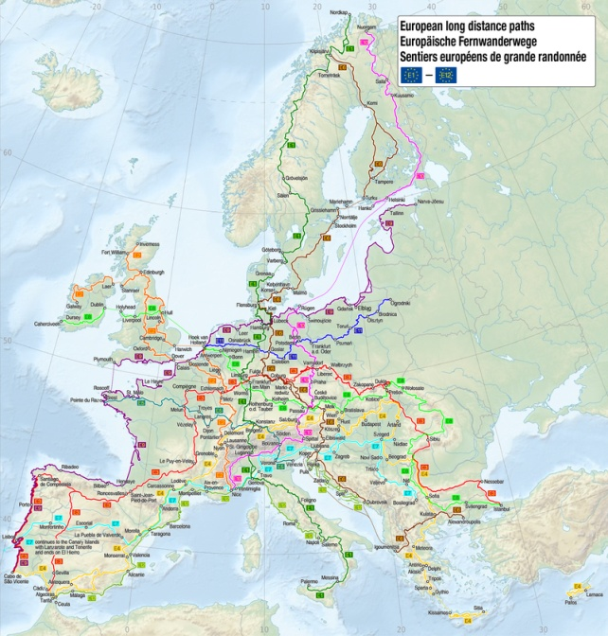
May 31st2018

Slide 2
1st LEARNING TEACHING TRAINING ACTIVITY

Slide 3
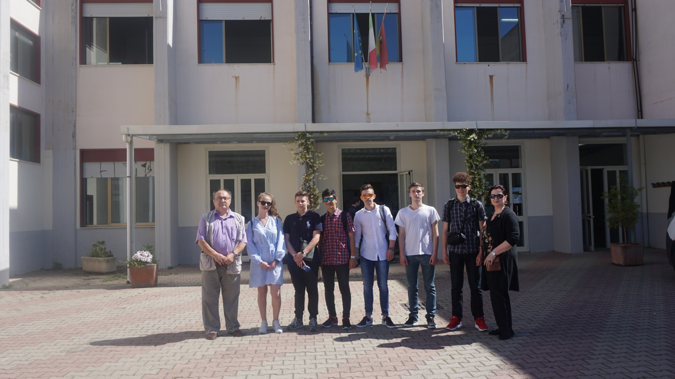
Istituto Superiore di Istruzione “Caminiti –Trimarchi”
Giardini Naxos
Sicily - ITALY

Slide 4
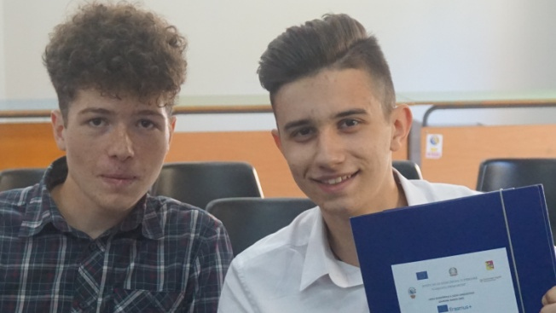
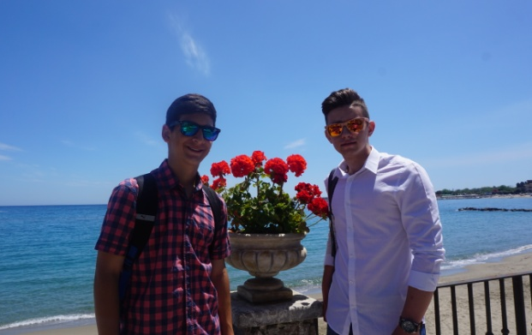
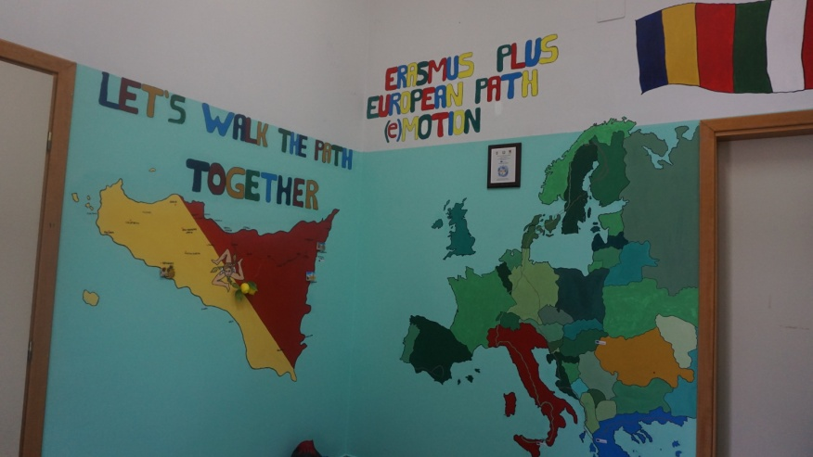
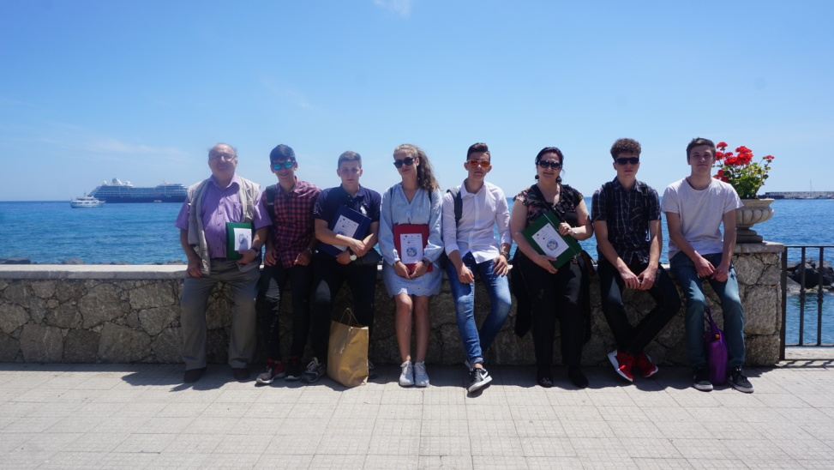

Slide 5
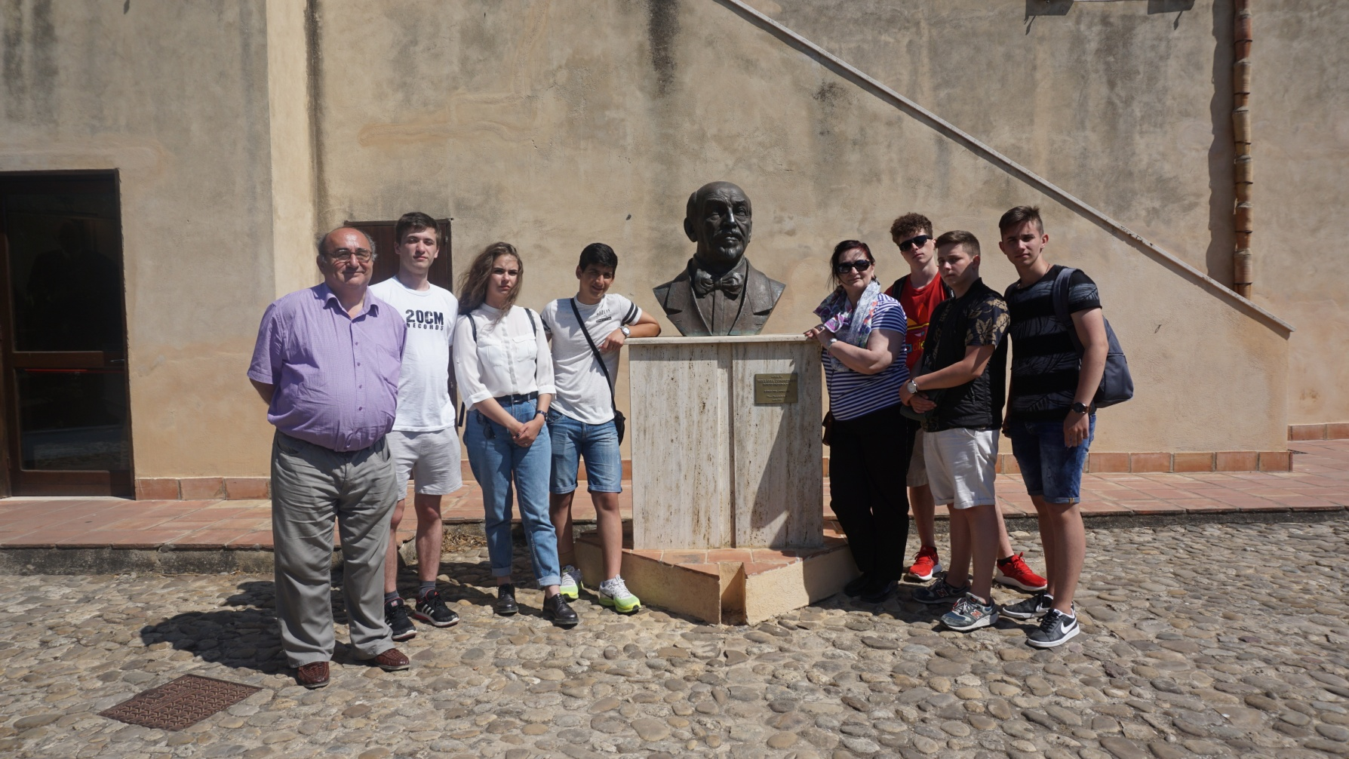
LITERARY PATH
“LUIGI PIRANDELLO” MEMORIAL HOUSE

Slide 6
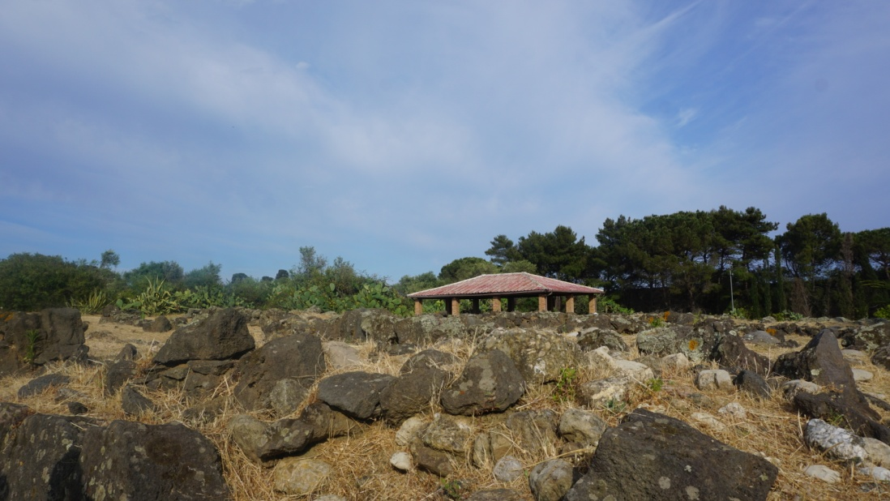
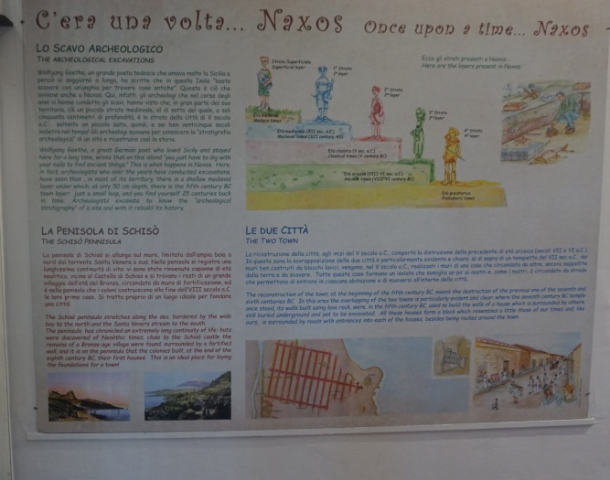
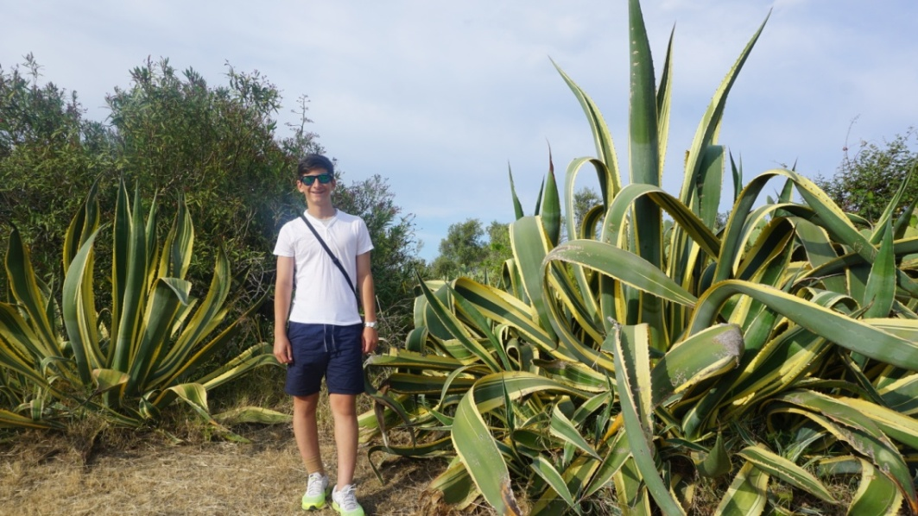
ARCHEOLOGICAL MUSEUM IN NAXOS
ARCHEOLOGICAL PATH

Slide 7
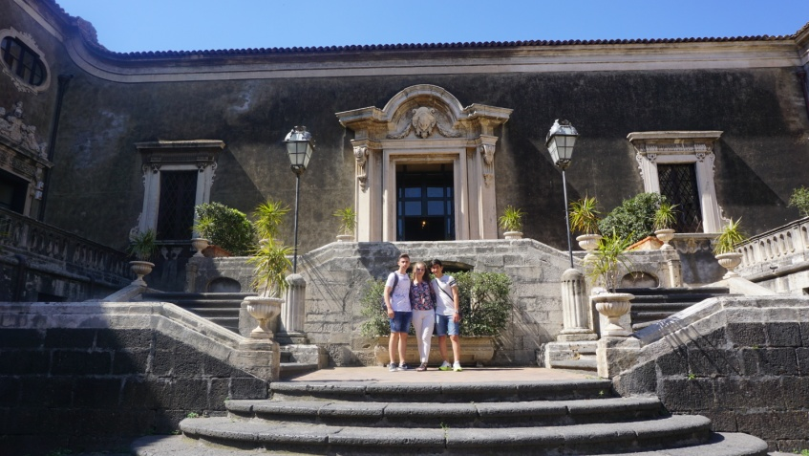
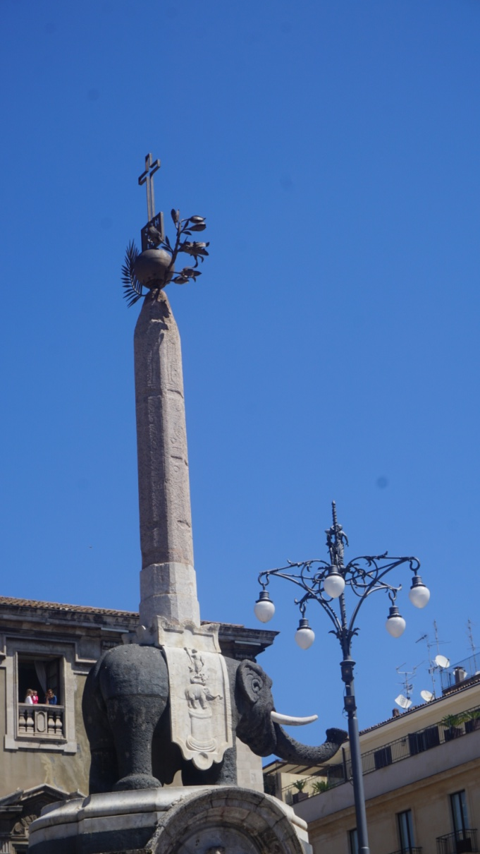
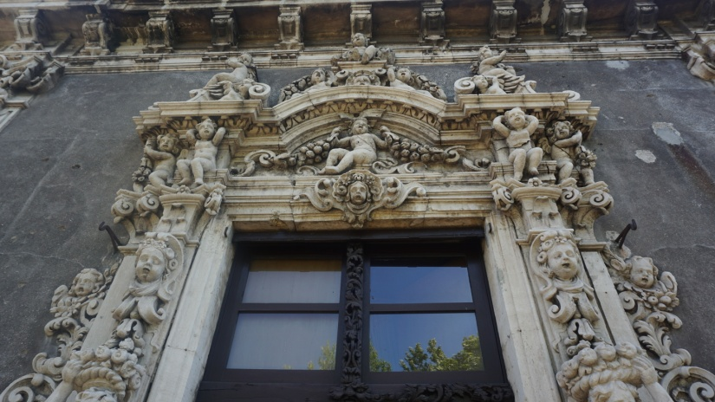
CATANIA
HISTORICAL PATH
Palazzo Biscari
ARTISTIC PATH

Slide 8
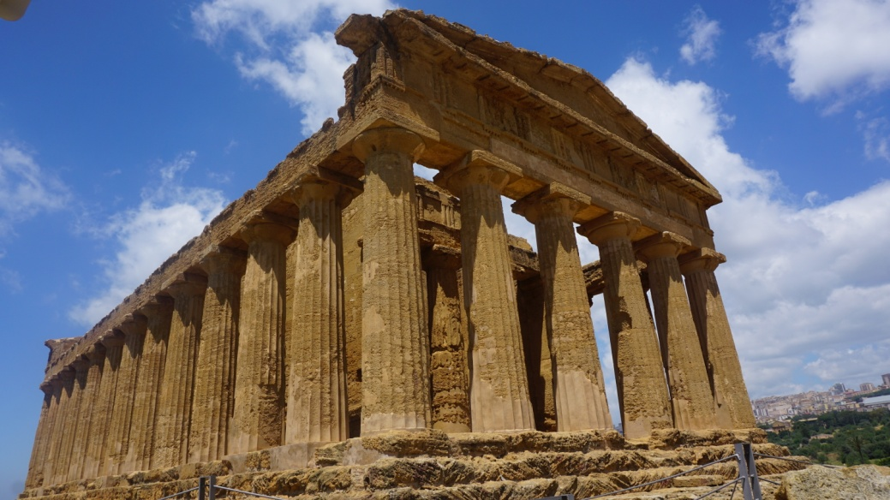
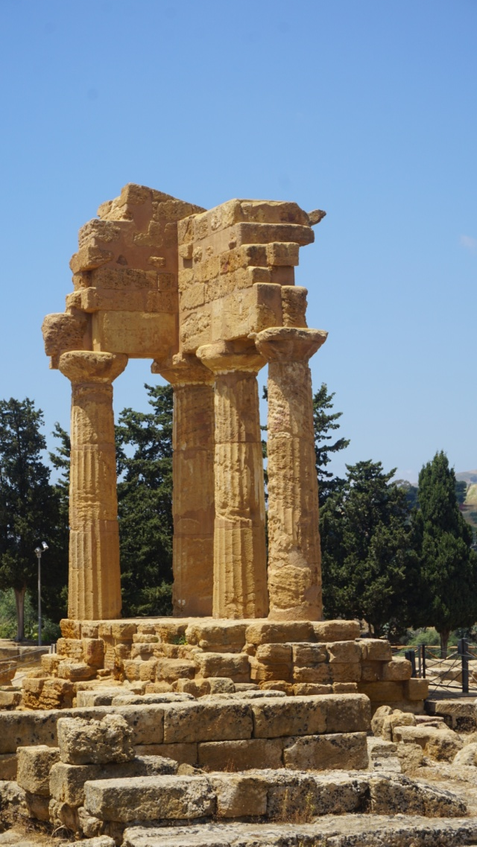
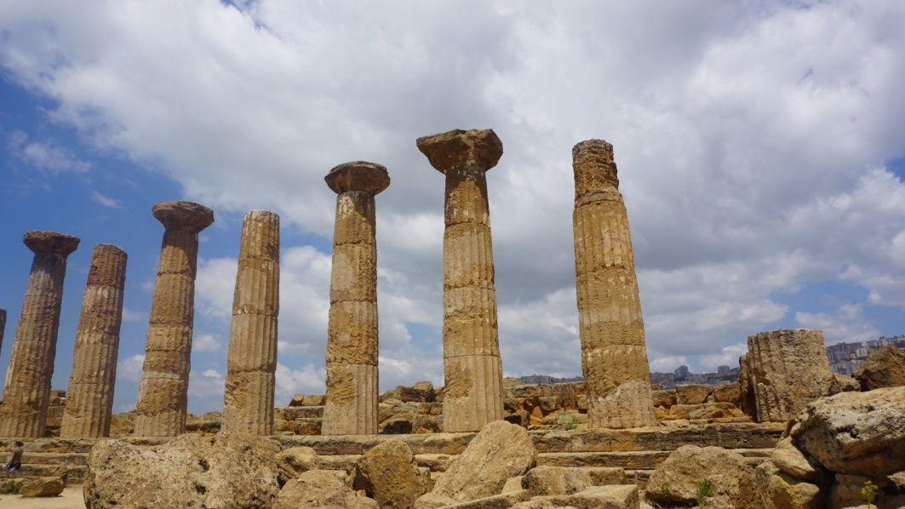
ARCHEOLOGICAL PATH
VALLEY OF TEMPLES
IN AGRIGENTO

Slide 9
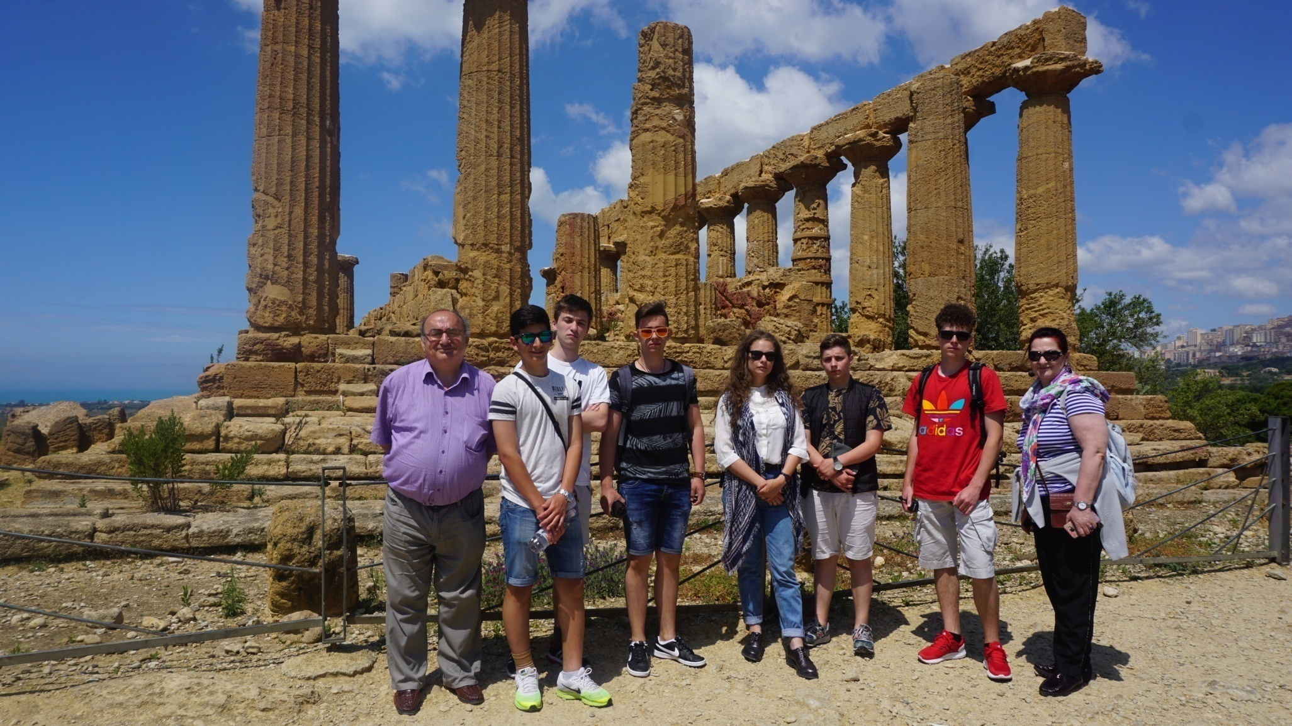

Slide 10
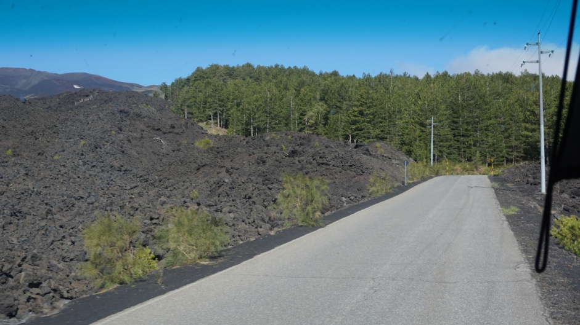
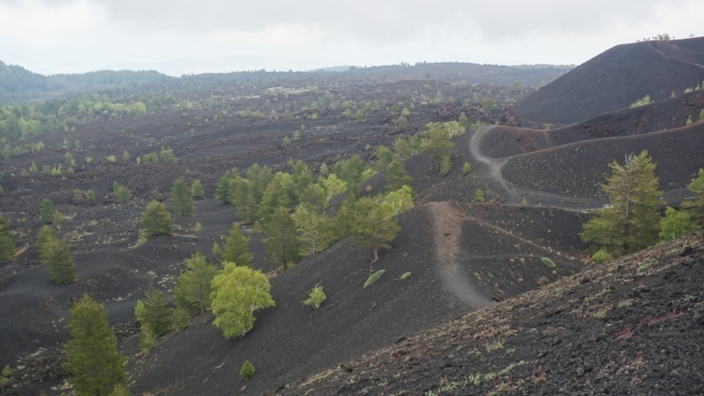
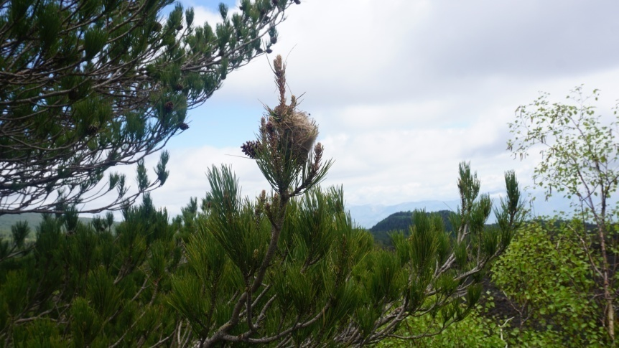
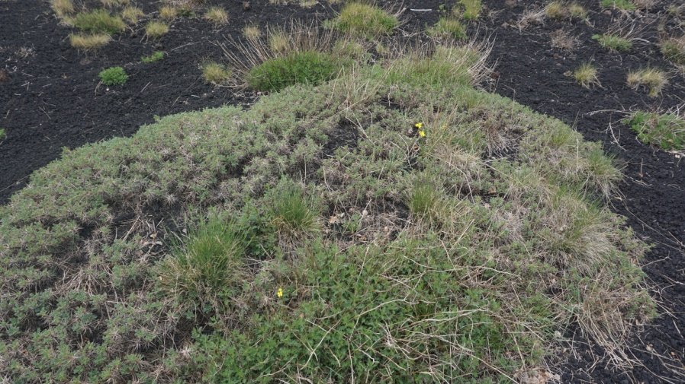
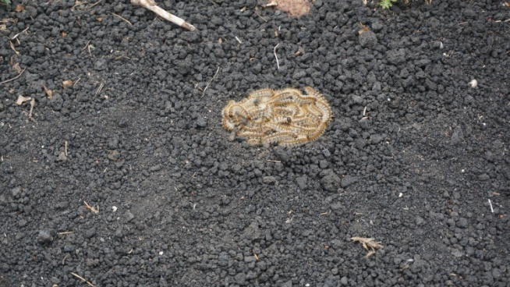
GEOLOGICAL PATH
MOUNT ETNA

Slide 11
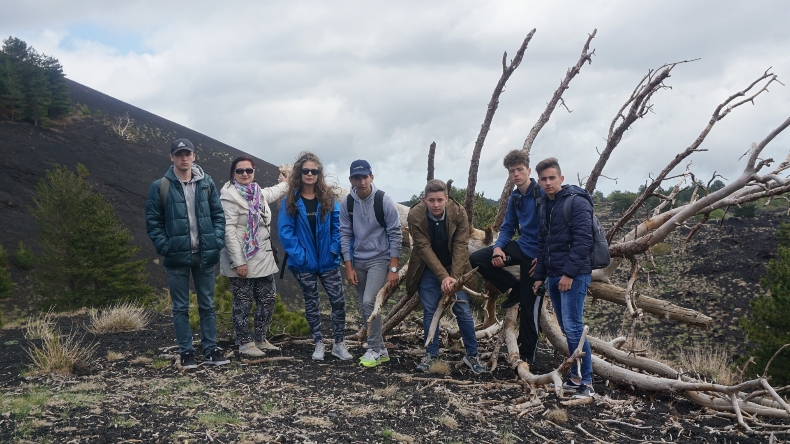

Slide 12
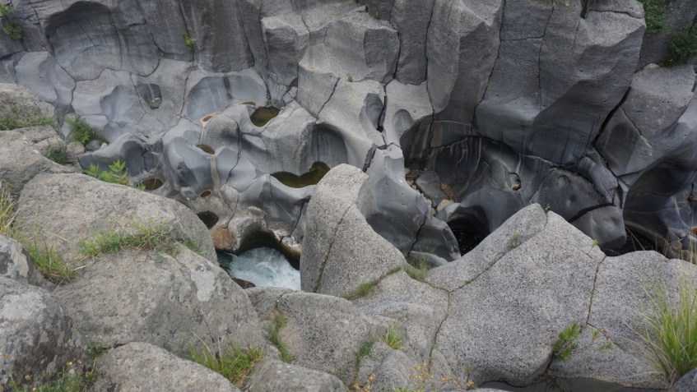
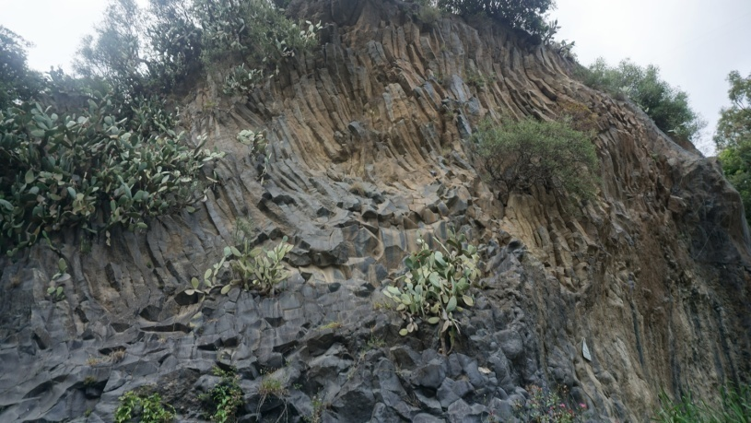
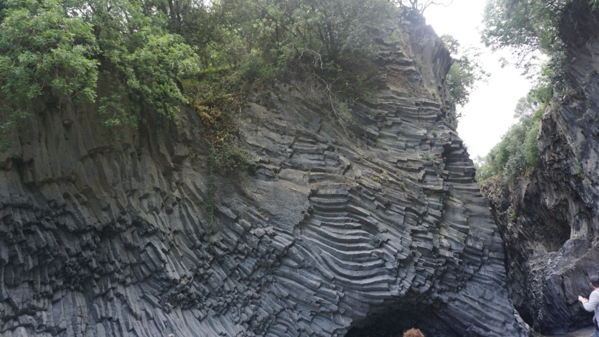
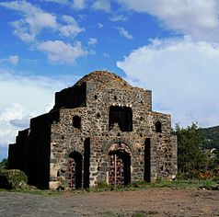
NATURALISTIC PATH
ALCANTARA GORGE
BYZANTINE PATH
Ancient Byzantine Church

Slide 13
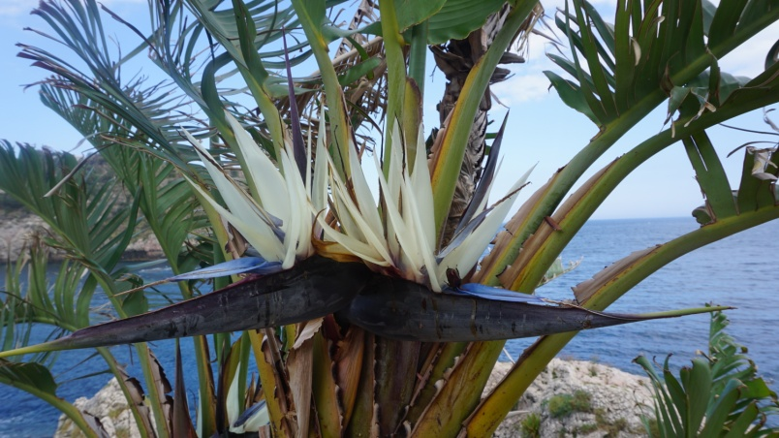
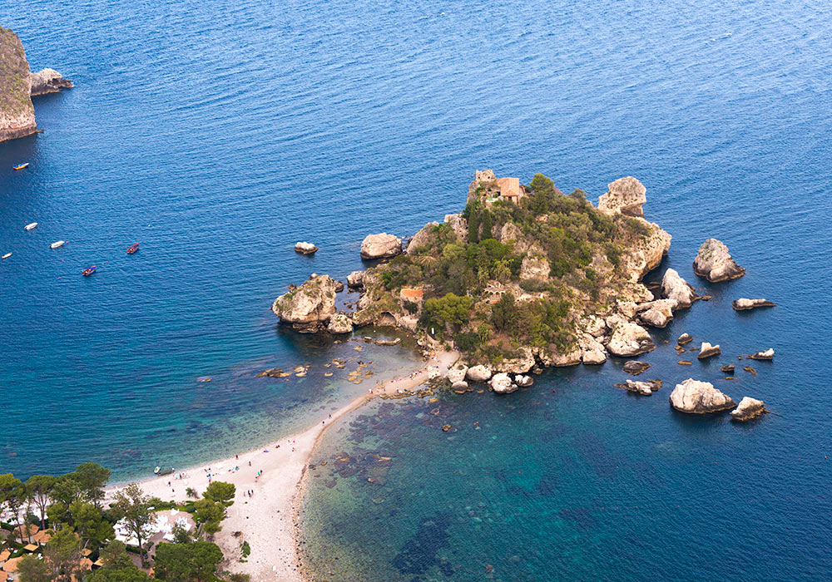
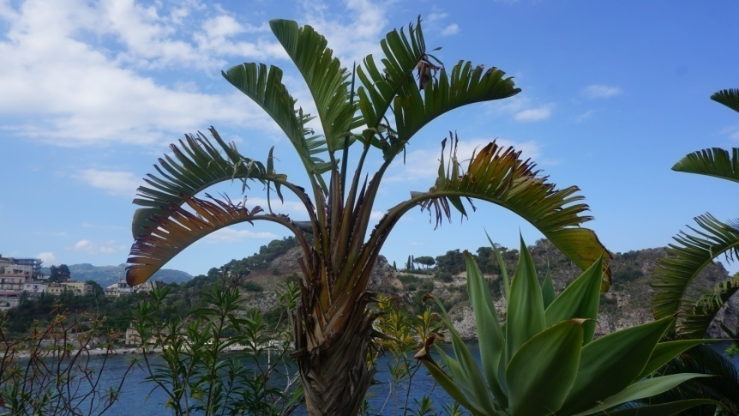
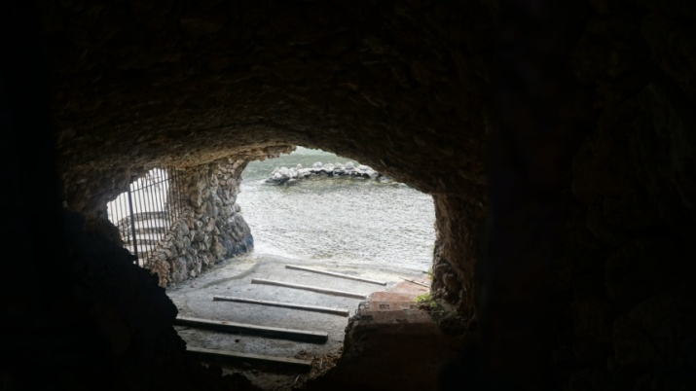
NATURE RESERVE
ISOLA BELLA
CULTURAL PATH

Slide 14
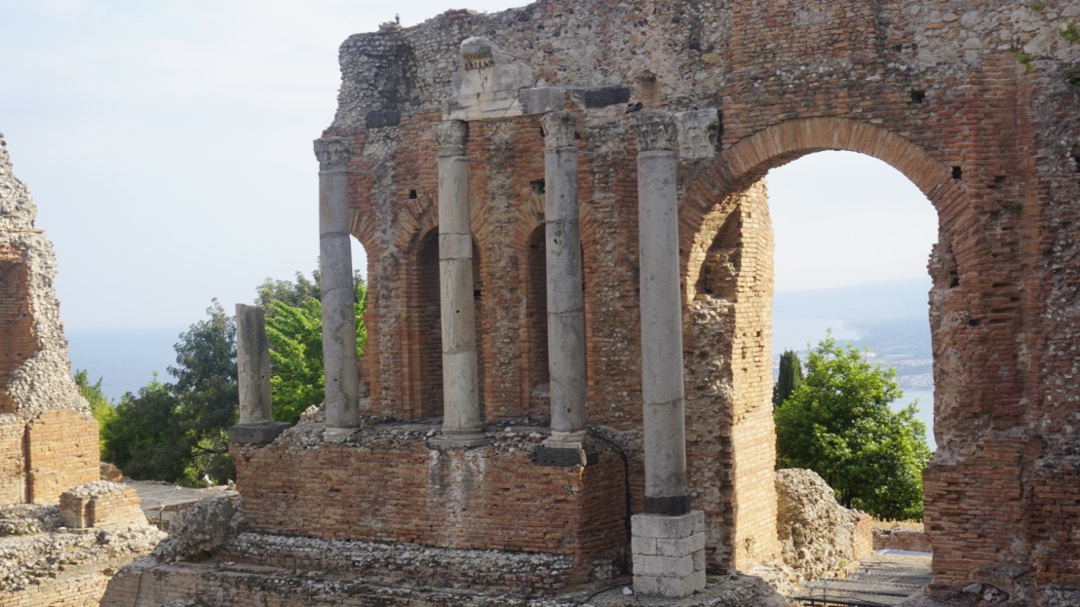
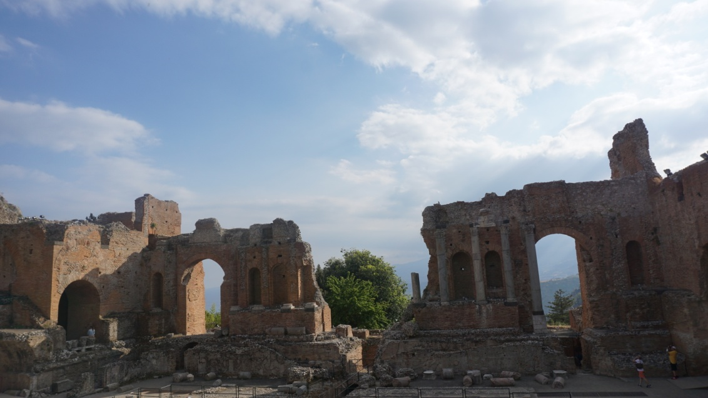
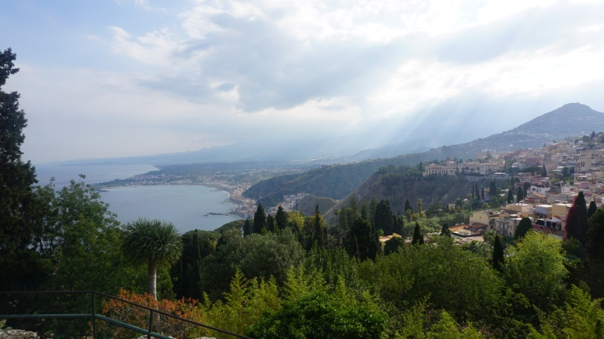
TAORMINA
THE ANCIENT THEATRE

Slide 15
CROSSROADS
EUROPEAN & LOCAL PATHS
2017-2018

Slide 16
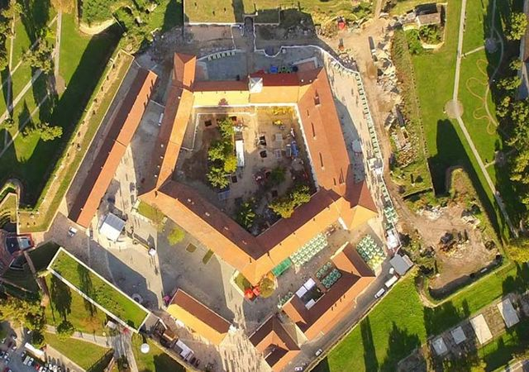
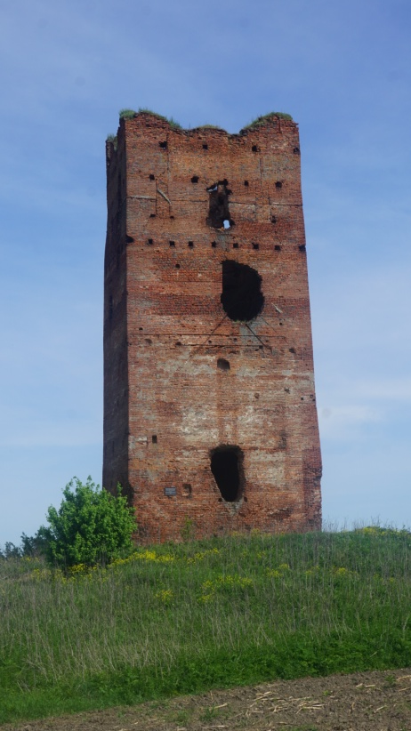
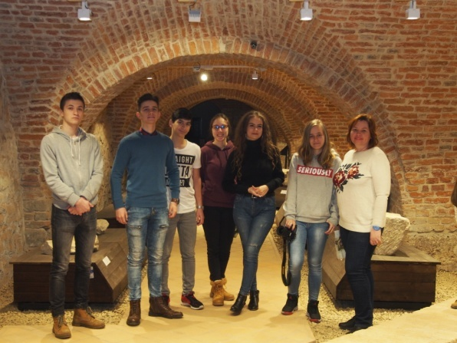
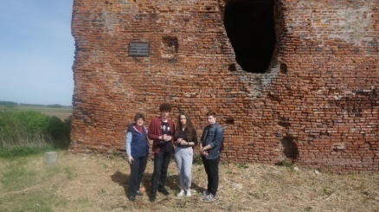
ARCHEOLOGIC AND HISTORIC PATH

Slide 17
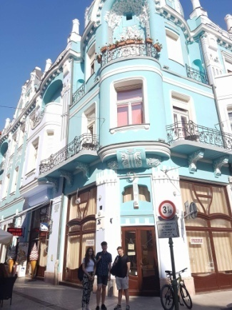
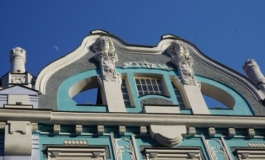
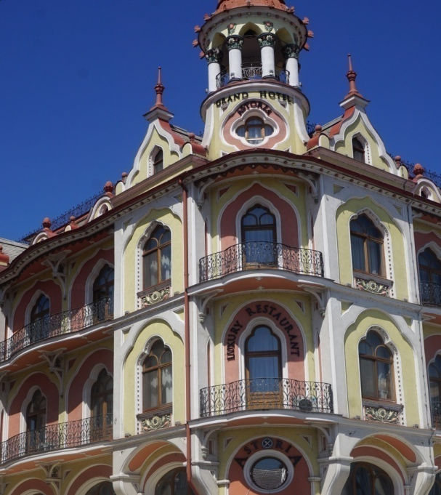
ARCHITECTURAL PATH
ART NOUVEAU

Slide 18
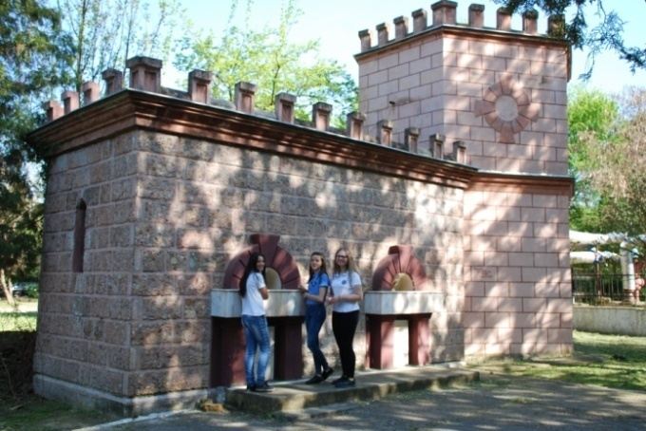
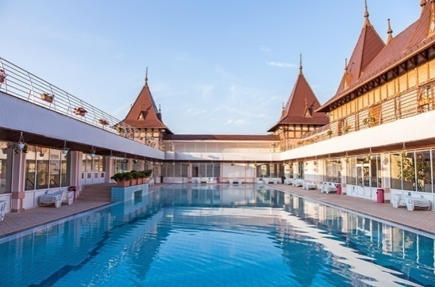
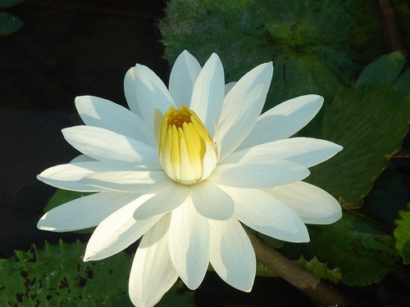
GEOTHERMAL WATER PATH

Slide 19
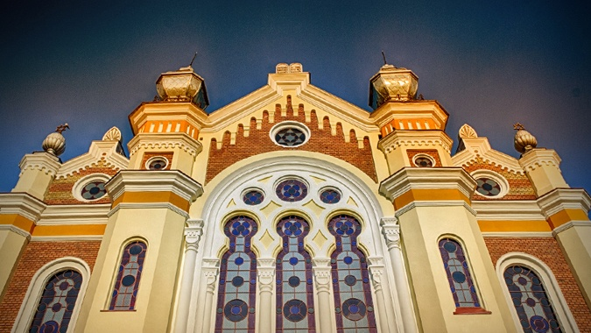
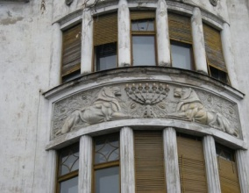
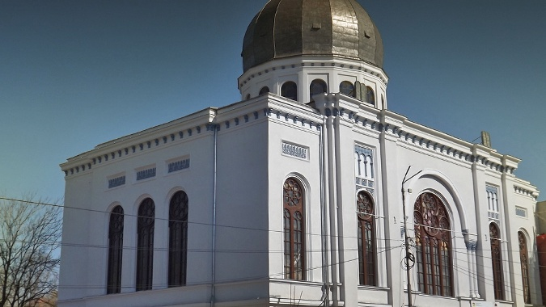
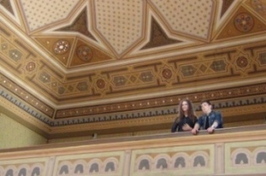
JEWISH PATH

Slide 20
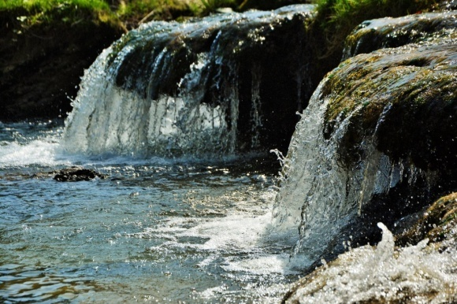
LITERARY PATH
THE FORTRESS OF ORADEA AND ITS LEGENDS
THE STORY OF THE THREE CRIȘ BROTHERS
THE LEGEND OF THE SPRING AND MIRACLE OF STÂNA DE VALE
THE LEGEND OF TWO BROTHERS: SOMEȘ AND CRIȘ

Slide 21
COSMOPOLITAN AND MULTICULTURAL PATH
ORADEA – A “MELTING POT” CITY

Slide 22
SPIRITUAL PATH
ORADEA – THE TOWN OF CHURCES

Slide 23
RURAL SETTLEMENTS PATH
WINEMAKING PATH

Slide 24
CREATIVITY PATH
“WHAT SHOULD BE DONE ?”
(a modern fairy tale)

Slide 25
(a play)

Slide 26
FIELDWORK
“SEE THE WORLD THROUGH AN ECOLOGIST’S EYE”
ORADEA – AN OVERALL PICTURE
ALTERNATIVE SOURCES OF ENERGY
ARDUINO RADAR PROJECT

