Slide 1
Study Book
I.I.S. CAMINITI-TRIMARCHI
Linguistic and Scientific Secondary School
Giardini Naxos - Italy
ERASMUS + PROJECT
EUROPEAN PATH (e)MOTION
Herbs of Sicily

Slide 2
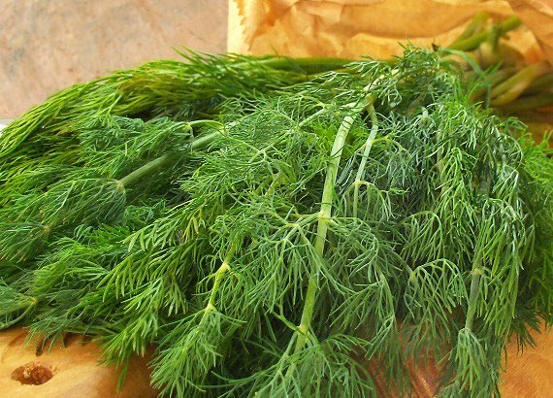
Wild fennel
Foeniculum vulgare
Fennel (Foeniculum vulgare) or “finocchio selvatico” is a flowering plant species in the carrot family. It is a hardy, perennial herb with yellow flowers and feathery leaves. It is indigenous to the shores of the Mediterranean, especially along the Sicilian coasts. It is found in arid places and Sicily seems to be the ideal territory for the development of this plant but has become widely naturalized in many parts of the world, especially on dry soils near the sea-coast and on riverbanks.
It is a highly aromatic and flavorful herb used in cookery and, along with the similar-tasting anise, is one of the primary ingredients of absinthe. Florence fennel or ‘’finocchio’’ is a selection with a swollen, bulb-like stem base that is used as a vegetable, used for example for the famous “orange and fennel salad”
Fennel is used as a food plant by the larvae of some Lepidoptera species including in its native range the mouse moth and the Old-World swallowtail.

Slide 3
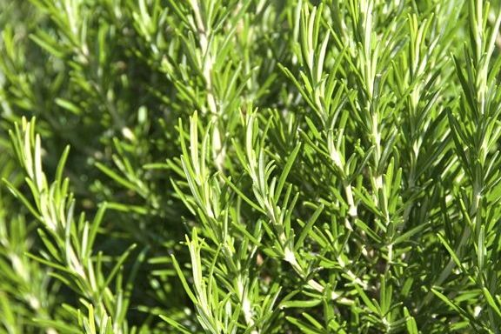
Wild rosemary Rosmarinus officinalis
Rosmarinus officinalis, commonly known as rosemary, is a woody, perennial herb with fragrant, evergreen, needle-like leaves and white, pink, purple, or blue flowers, native to the Mediterranean region.It is a member of the mint family Lamiaceae, which includes many other herbs. Typical of Sicily is the dried rosemary, found in the Etna valley. The name "rosemary" derives from the Latin for "dew" (ros) and "sea" (marinus), or "dew of the sea". The plant is also sometimes called anthos, from the ancient Greek word ἄνθος, meaning "flower".Rosemary has a fibrous root system. Rosmarinus officinalis is one of 2–4 species in the genus Rosmarinus. The other species most often recognized is the closely related, Rosmarinus eriocalyx, of the Maghreb of Africa and Iberia. The name of ros marinus is the plant's ancient name in classical Latin. Elizabeth Kent noted in her Flora Domestica (1823), "The botanical name of this plant is compounded of two Latin words, signifying Sea-dew; and indeed Rosemary thrives best by the sea."

Slide 4
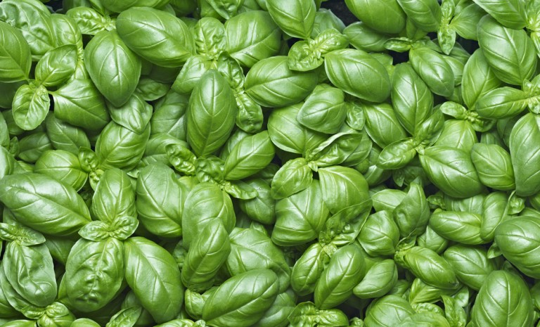
Basil Ocimum basilicum
Basil is a culinary herb of the family Lamiaceae (mints).Basil is native to tropical regions from central Africa to Southeast Asia. It is a tender plant, and is used in cuisines worldwide. Depending on the species and cultivar, the leaves may taste somewhat like anise, with a strong, pungent, often sweet smell. There are many varieties of basil. The type used commonly as a flavor is typically called sweet basil (or Genovese basil). The name "basil" comes from Latin, basilius, "royal/kingly plant", possibly because the plant was believed to have been used in production of royal perfumes. The Latin name has been confused with basilisk, as it was supposed to be an antidote to the basilisk's venom. In Sicily basil is used in several recipes, for example in the “Bruschetta” or in the “Pasta alla Norma”.

Slide 5
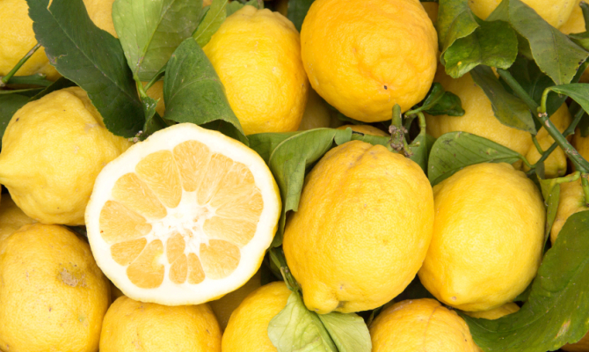
Lemon Citrus Limon
The lemon, Citrus Limon, is a species of small evergreen tree in the flowering plant family Rutaceae, native to South Asia, primarily North eastern India. The tree's ellipsoidal yellow fruit is used for culinary and non-culinary purposes around the world, primarily for its juice, which has both culinary and cleaning uses. The pulp and rind (zest) are also used in cooking and baking. The lemon juice is about 5% to 6% citric acid, with a pH of around 2.2, giving it a sour taste. The distinctive sour taste of lemon juice makes it a key ingredient in drinks and foods such as lemonade and lemon meringue pie. The origin of the lemon is unknown, though lemons are thought to have first grown in Assam (a region in northeast India), northern Burma or China. Probably the lemon is a hybrid between bitter orange and citron. Lemons entered Europe near southern Italy, during the time of Ancient Rome. However, they were not widely cultivated. It was distributed widely throughout the Arab world and the Mediterranean region between 1000 and 1150. In Sicily lemons are used to make the “Granita” or the “Limoncello”. The lemon juice is usually used to season fish, meat or salads.

Slide 6
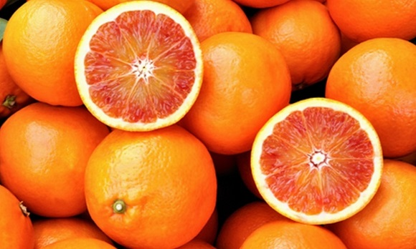
Orange Citrus sinensis
The Citrus aurantium includes the commonly cultivated sweet oranges, including blood oranges and navel oranges. Orange blossom essence is an important component in the making of perfume. Orange blossom petals can also be made into a delicately citrus-scented version of rosewater, known as "orange blossom water" or "orange flower water". In some Middle Eastern countries, drops of orange flower water are added to disguise the unpleasant taste of hard water drawn from wells or stored in qullahs. In the United States, orange flower water is used to make orange blossom scones and marshmallows. Orange blossom honey is obtained by putting beehives in the citrus groves while trees bloom. This type of honey has an orangey taste and is highly prized. Oranges grow in Sicily and they are common fruits of this land. They are used to make orange juice or salads and some sweets.

Slide 7
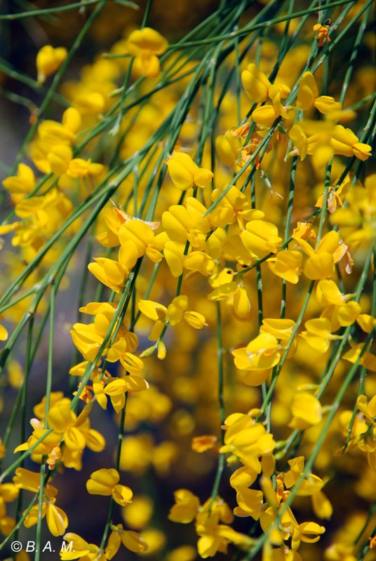
Broom Genista aetnensis
Genista aetnensis or Mount Etna broom is a species of flowering plant in the legume family Fabaceae. It is a large shrub or small tree endemic to Sicily and Sardinia where it is associated with sunny, open landscapes and poor, stony soil. It is a very common constituent of the garigue plant communities, Mediterranean shrubby vegetation, around the lower slopes of Mount Etna, hence its Latin specific epithet aetnensis. The young plant is typical of brooms, clothed in narrow linear leaves which soon drop off leaving almost bare branches. As it ages the shrub develops into a shapely small tree with a greenish bark, growing to 8 metres (26 ft) if given room to develop. The terminal branches have a tendency to droop and weep. Abundant pea-like, yellow, jasmine-scented flowers cover the whole crown in late summer. It is sometimes grown in gardens and landscaping, both for flower and for its attractive shape when mature. It is hardy down to −15 °C (5 °F).

Slide 8
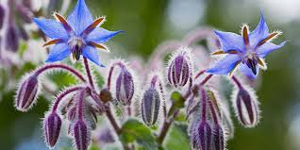
Borrage Borago officinalis
Its leaves are deeply lines and pointed, the stem being covered by pungent hairs but it is worthwhile cultivating it for the beauty of its flowers. The clumps easily grow to more than half a metre in height and can be placed in vases only if outside. The intense, shiny blue colour star-shaped unforgettable bunches of flowers at the tip of the stem appear between May and September. They are sometimes pink or white. Used for decorating dishes and drink. Popular medicine attributes many qualities to this herb. It is an excellent tonic for the nervous system and an infusion can calm. Leaves and flowers put into wine "blow your cares away". They contain potassium, calcium and vitamin C, being also a depurative, diuretic and softener. In March and April in Eastern Sicily, blue borage grows shoulder high and offers an amazing sight.

Slide 9
IIS CAMINITI-TRIMARCHI
LINGUISTIC AND SCIENTIFIC SECONDARY SCHOOL
GIARDINI NAXOS – ITALY
ERASMUS+ PROJECT «EUROPEAN PATH (e)MOTION»
Class IV BL – Class IV AS
School year 2018/19

