Slide 1
Activities in Epirus
Vassios Panagiotis
Sioumalas Dimitris
Oikonomou Maria

Slide 2
Activities in Epirus
Epirus is an area with many natural beauties which is located between Pindos mountain range and the Ionian sea.
Specifically, in Epirus there are many evaluated activities that are separated in three categories :
Soil Activities
Water Activities
Air Activities

Slide 3
Soil Activities
Horse Riding
You can take a ride both around the area of Voidomatis river, on the boundary of the Vikos-Aoos national park and the river of Acheron.

Slide 4
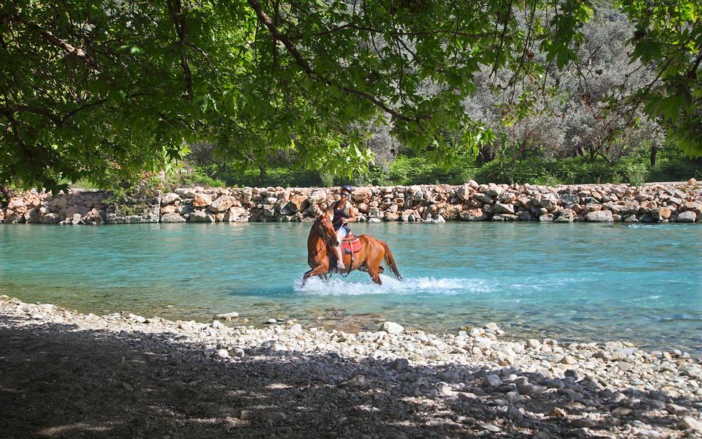
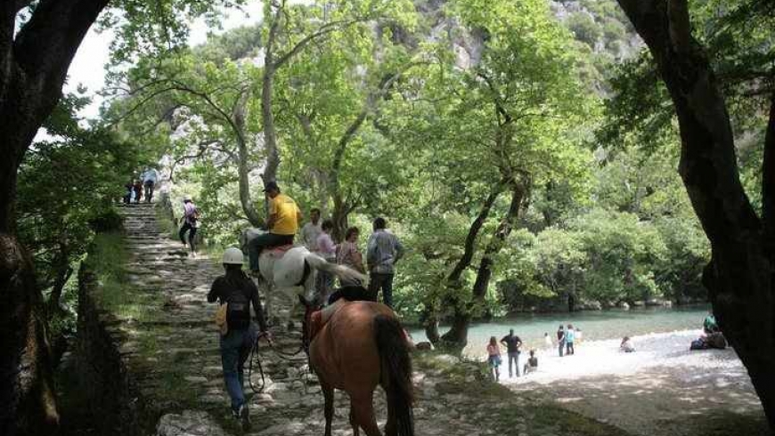
Soil Activities
Horse Riding
~ Acheron River ~ Voidomatis River

Slide 5
Soil Activities
Hiking
You can enjoy the hiking experience in Epirus with spectacular hikes in the mountain Tymfi, around Dragon lake and in the impressive Vikos Gorge which is the second deepest gorge in the world according to Wikipedia and Guiness Record.

Slide 6
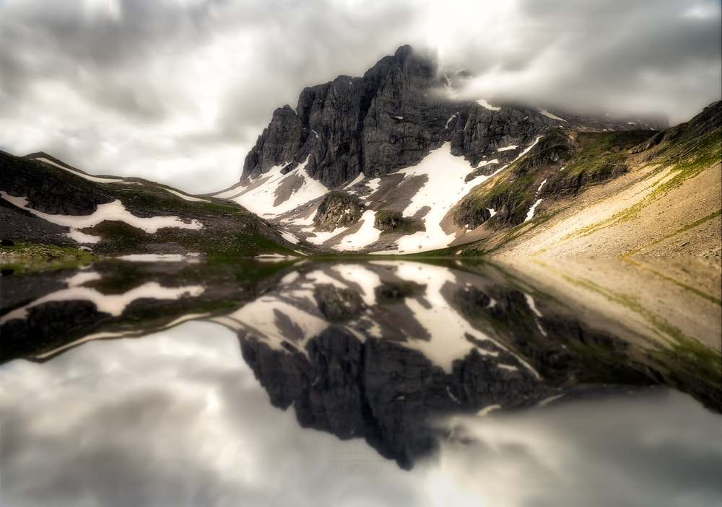
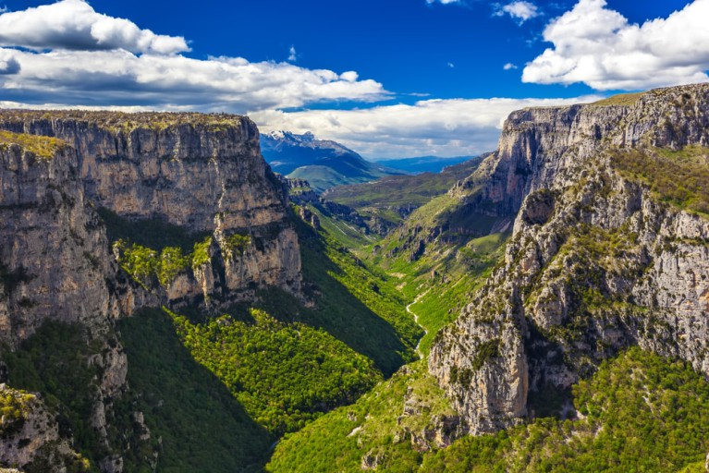
Soil Activities
Hiking
~ Dragon lake ~ Vikos Gorge

Slide 7
Soil Activities
Canyoning
The region of Zagorohoria is a premier destination for a number of outdoor activities, including canyoning.Vikaki canyon offers a unique opportunity to explore the gorge.

Slide 8
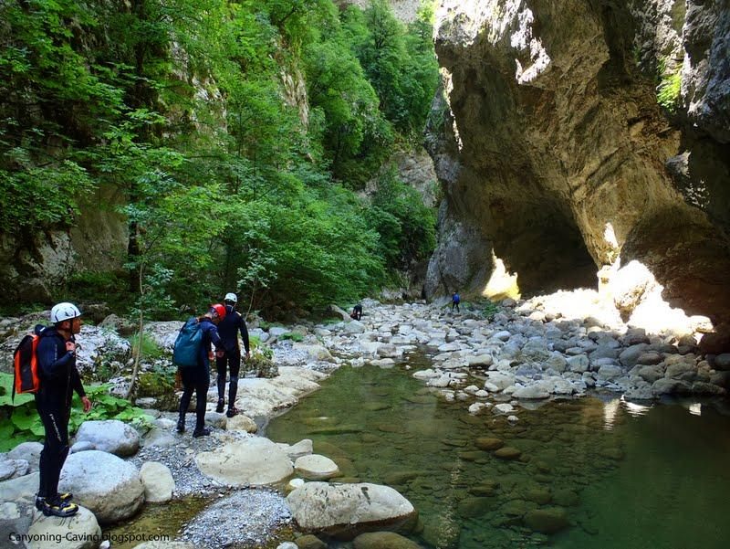
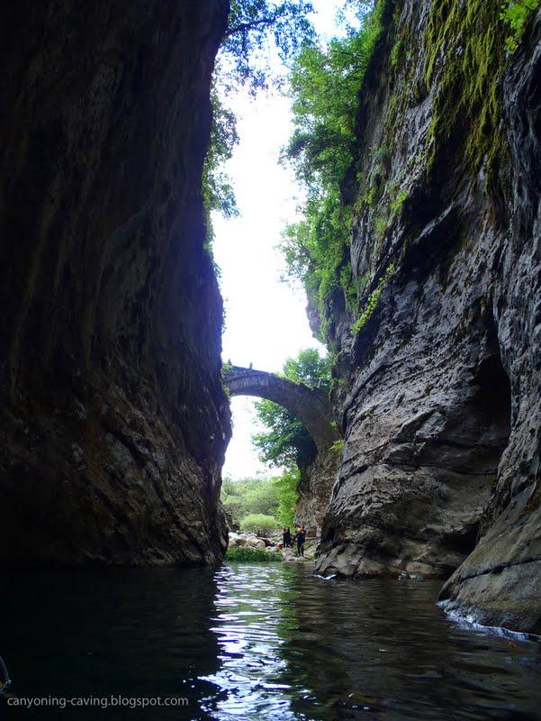
Soil Activities
Canyoning
~ Vikaki canyon

Slide 9
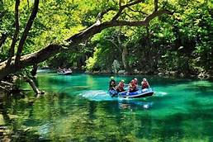
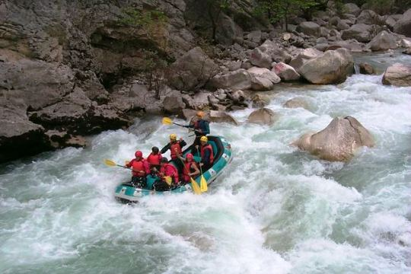
Water Activities
Rafting
You can join the rafting experience at the rivers Acheron, Voidomatis and Arachthos.
~ Acheron ~ Voidomatis ~ Arachthos

Slide 10
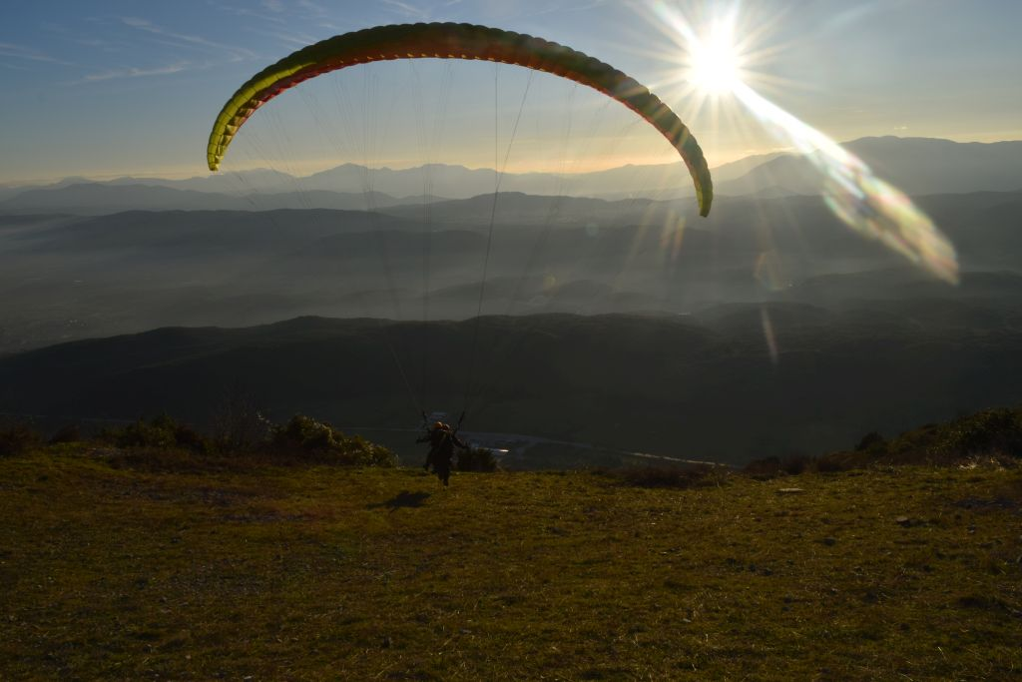
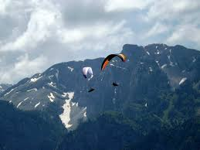
Air Activities
Paragliding
You can live the experience of paragliding in many areas of Epirus.The most popular places are :
~ Aspraggeloi(in Zagori) ~ Dikorfo(in Zagori)

Slide 11
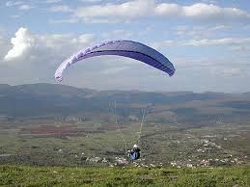
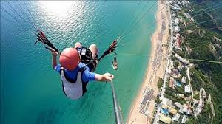
Air Activities
Paragliding
~ Chanopoulo(Arta) ~ Vrachos-Loutsa Beach(Preveza)

Slide 12
Activities in Epirus
Thank you
for your
attention

