Slide 1
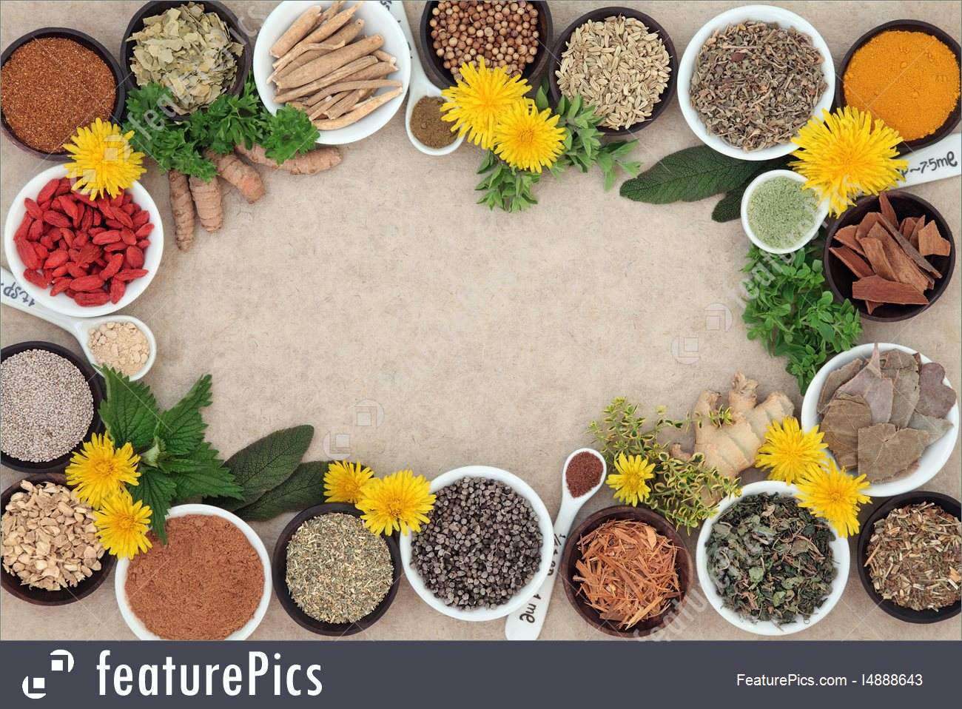
HERBS
USED IN HERBAL MEDICINE
LTT – Greece
May, 2019

Slide 2
Herbal medicine – also called botanical medicine or phytotherapy – refers to using a plant’s seeds, berries, roots, leaves, bark, or flowers for medicinal purposes.
Herbalism has a long tradition of use outside of conventional medicine. Modern medicine recognizes herbalism as a form of alternative medicine.
Herbal medicines are one type of dietary supplement. They are sold as tablets, capsules, powders, teas, extracts, and fresh or dried plants.

Slide 3
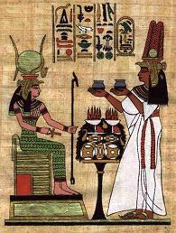
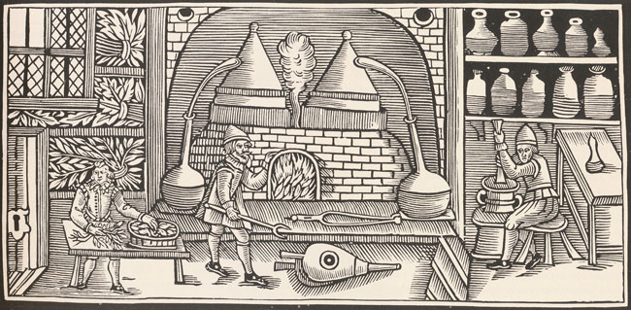
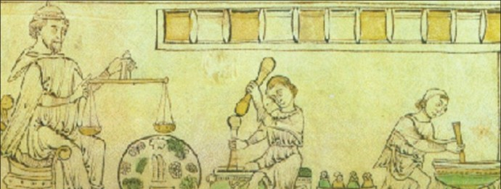
Herbal medicine has been used since before the beginning of recorded history. The ancient Egyptian medical document Ebers Papyrus, which is about 3,500 years old, lists 700 medicinal herbs as well as how to use them to treat many diseases and maladies.
Throughout Asia, Europe, South America, Africa and North America, people have relied on herbal remedies for wellness and therapeutic use for centuries.

Slide 4
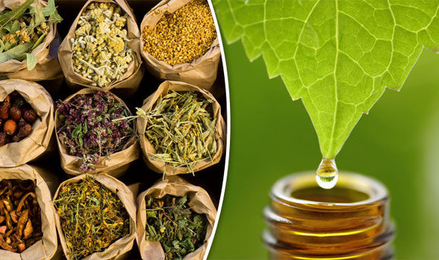
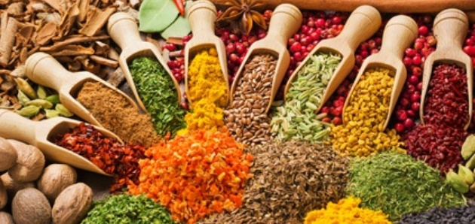
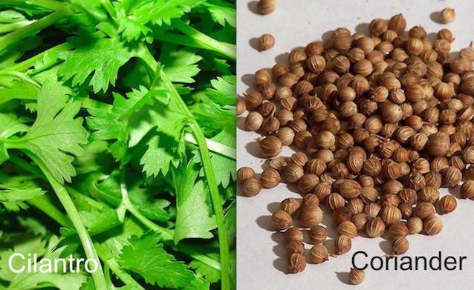
WHAT IS A HERB?
Herbs are simply the leaves of a plant.
HERBS and SPICES get mixed up a lot.
Spices come from the roots, bark, or seeds. So basically, any part of a plant that is not a leaf is automatically considered a spice.
Some plants have both. Take the cilantro plant, for example.
The herb is called the cilantro (leaves).
The spice is called coriander (the seeds of the cilantro plant).

Slide 5
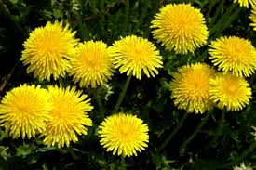
DANDELION
Scientific name: Taraxacum officinale
Uses:
it treats infections, bile and liver problems
it has anti-inflammatory, anti-carcinogenic, anti-oxidative action

Slide 6
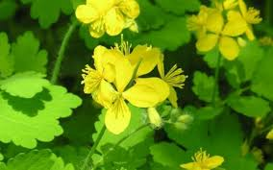
GREATER CELANDINE
Scientific name: Chelidonium majus
Usage:
the root chewed relieves toothache
in the treatment of gallstones and dyspepsia

Slide 7
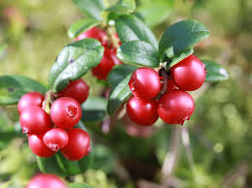
LINGONBERRY
Scientific name: Vaccinium vitis-idaea
Usage:
urinary tract problems including irritation, kidney stones, and infections
it treats gout, arthritis, and infections caused by viruses

Slide 8
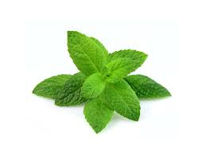
MINT
Scientific name: Mentha
Usage:
it increases bile secretion and encourages bile flow, which helps to speed and ease digestion
peppermint tea is a common home remedy for flatulence

Slide 9
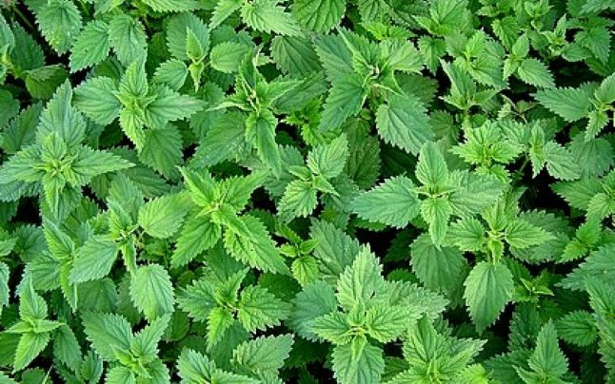
NETTLE
Scientific name: Urtica dioica
Uses:
it treats disorders of the kidneys and urinary tract, gastrointestinal tract, locomotor system, skin, cardiovascular system, hemorrhage, influenza, rheumatism, and gout

Slide 10
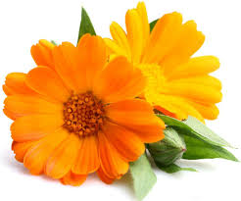
POT MARIGOLD
Scientific name: Calendula officinalis
Uses:
it protects the skin
it helps scratches and shallow cuts to heal faster

Slide 11
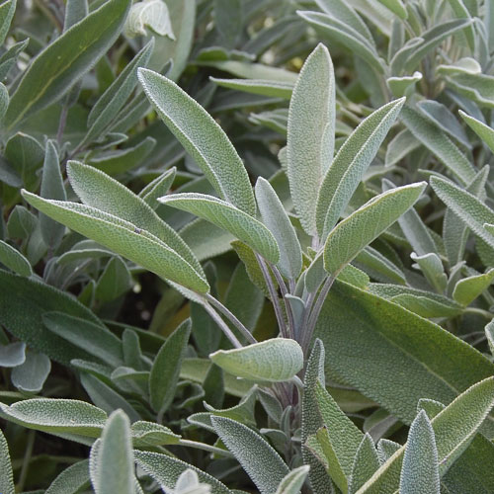
SAGE
Scientific name: Salvia officinalis
Usage:
it has anti-microbial effects
it improves memory
it treats excessive sweating

Slide 12
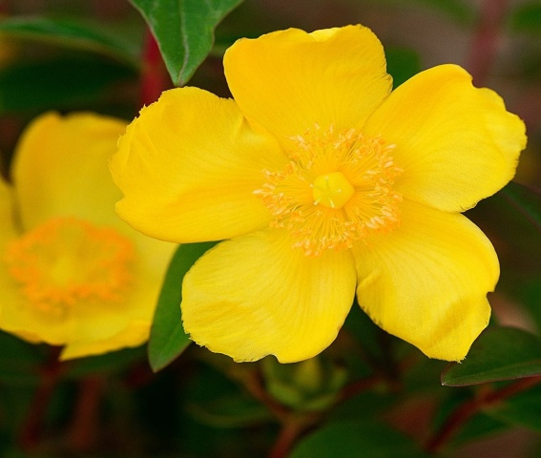
ST. JOHN’S WORT
Scientific name: Hypericum perforatum
Usage:
it improves mood and decreases nervousness and tiredness related to depression
it improves wound healing and reduce scar formation after a Cesarean section

Slide 13
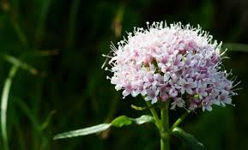
VALERIAN
Scientific name: Valeriana officinalis
Usage:
it has sedative and anxiolytic effects
it relieves mild nervous tension
it aids sleep

Slide 14
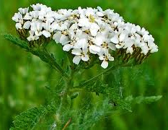
YARROW
Scientific name: Achillea millefolium
Usage:
it encourages proper bile secretion from the gallbladder, which can then improve digestion and keep gallstones from forming
it helps wounds stop from bleeding

Slide 15
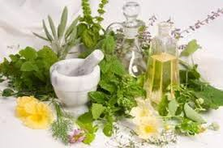
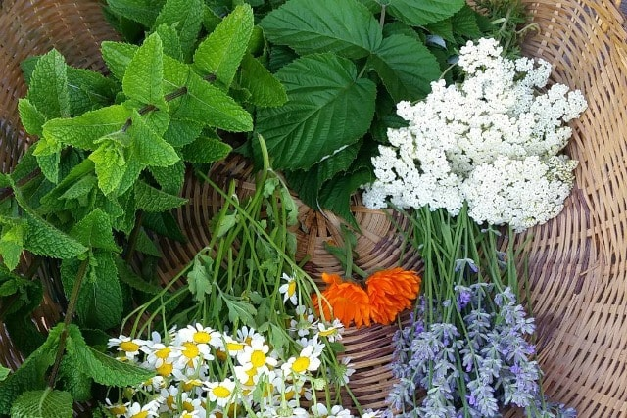
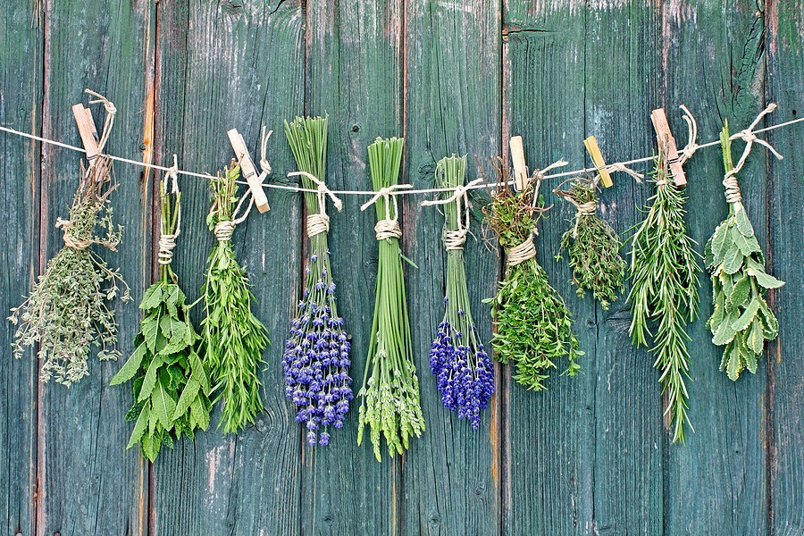
Thank you for your attention .
Teacher coordinator: Carmen CHIRA
Student: Teodora MORAR

