Slide 1
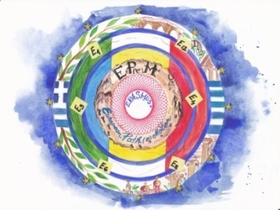
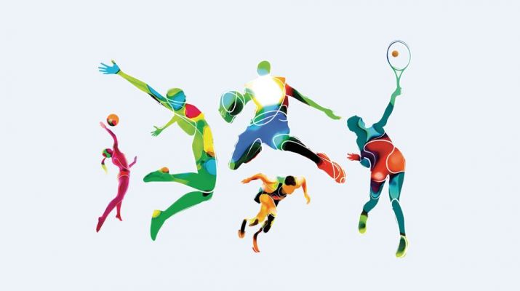
ROMANIAN SPORTS STARS

Slide 2
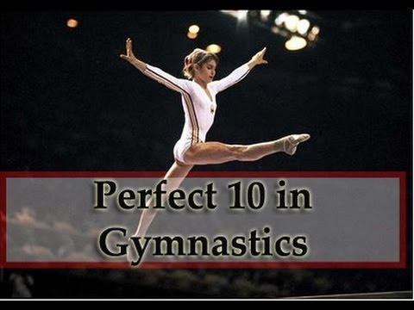
NADIA COMĂNECI 1961
winner of three Olympic gold medals at the 1976 Summer Olympics in Montreal and the first female gymnast to be awarded a perfect score of 10 in an Olympic gymnastic event.
in 2000 she was named as one of the athletes of the century by the Laureus World Sports Academy

Slide 3
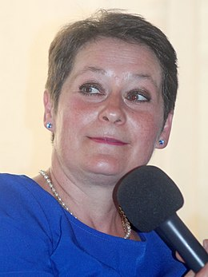
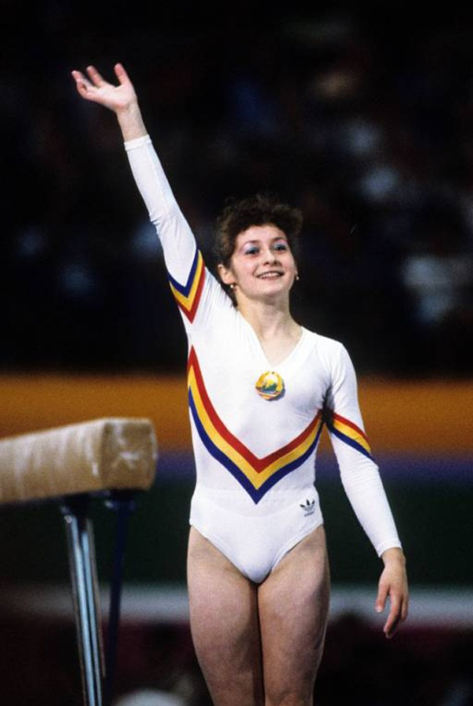
ECATERINA SZABO 1967
a former artistic gymnast won 20 Olympic, world and continental medals.
won gold medals in the 1984 Olympics in three individual events (vault, balance beam (tie), and floor exercise), won the all-around silver medal, and contributed to the team gold
in 2000 she was inducted into the International Gymnastics Hall of Fame.

Slide 4
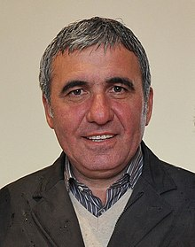
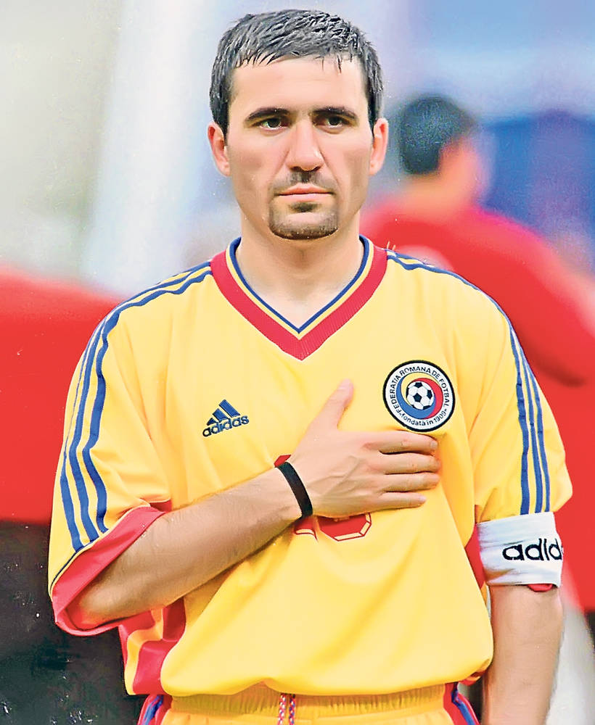
GHEORGHE HAGI 1965
former footballer
one of the best attacking midfielders in Europe during the 1980s and 1990s and is considered the greatest Romanian footballer of all time
in November 2003, to celebrate UEFA’s Jubilee, he was selected as the Golden Player of Romania by the Romanian Football Federation as their most outstanding player of the past 50 years

Slide 5
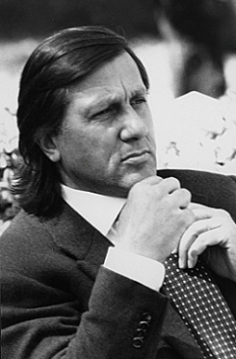
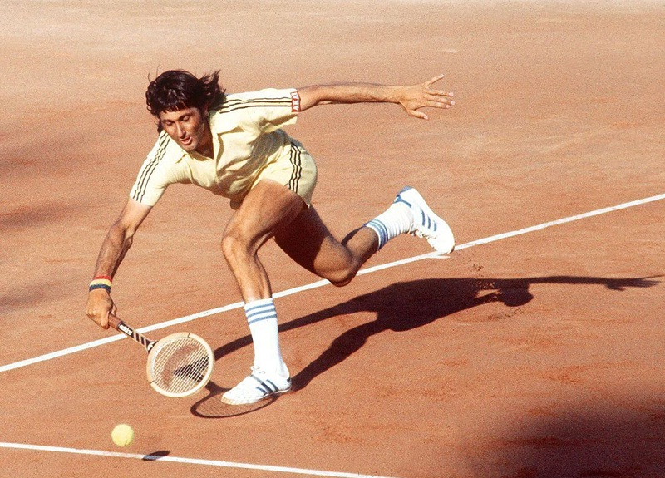
ILIE NĂSTASE 1946
former world no. 1 professional tennis player, one of the world’s top players of the 1970s
was ranked world no. 1 between 1973 and 1974
one of the five players in history to win more than 100 ATP professional titles (57 singles and 45 in doubles).
in 2005, Tennis magazine ranked him as the 28th-best player of the preceding 40 years.

Slide 6
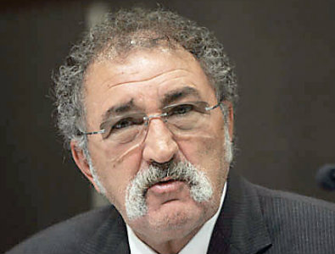
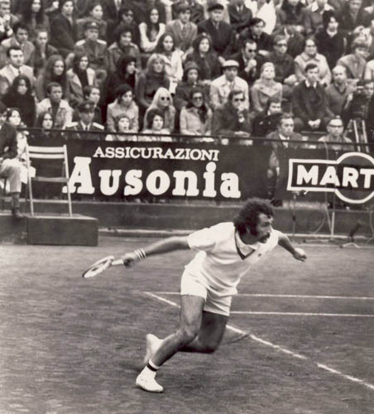
ION ȚIRIAC 1939
first appeared on the international sports scene as an ice hockey player at the 1964 Winter Olympics. Shortly after that he switched to tennis as his main sport
with fellow Romanian Ilie Năstase, he won the men’s doubles in the 1970 French Open and reached the Davis Cup finals several times in the 1970s
in 2013 he was elected into the International Tennis Hall of Fame

Slide 7
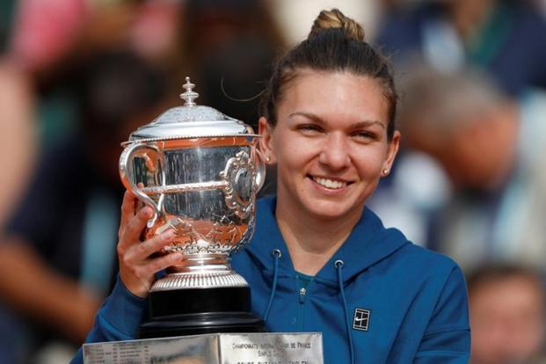
SIMONA HALEP 1991
a proffesional tennis player
the Women's Tennis Association (WTA) ranked her world no. 1 in singles on two separate occasions between 2017 and 2019
in total, she has been no. 1 for 64 weeks, which ranks tenth in the history of female tennis
currently ranked world no. 2 on the WTA Tour, and has won 18 WTA singles titles

Slide 8
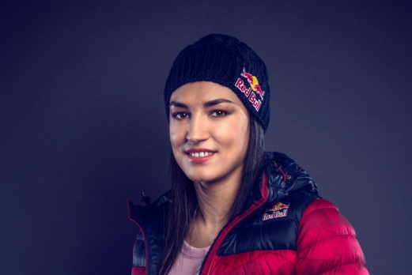
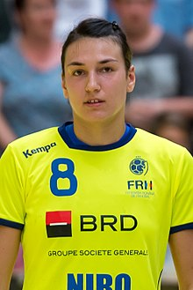
CRISTINA NEAGU 1988
a professional handballer who plays as a left back for CSM București and the Romanian national team
often considered the best player in the world and rated by many in the sport as the greatest of all time, she is the only female handball player in history to win three IHF World Player of the Year awards (in 2010, 2015 and 2016)

Slide 9
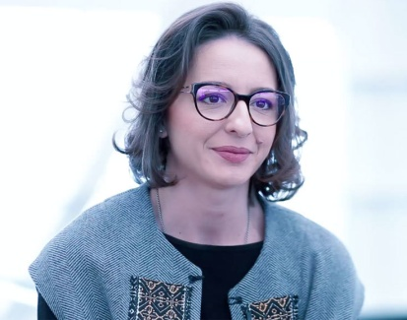
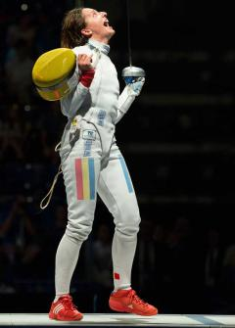
ANA MARIA BRÂNZĂ 1984
an épée fencer
won the silver medal in the individual épée event at the 2008 Summer Olympic Games and the gold medal in the 2013 European Fencing Championships
won the women’s épée World Cup series three times (2007/8, 2008/9, and 2012/13), with thirteen World Cup titles to her name
in the 2004/5 season she reached her first podium in the Fencing World Cup with a silver medal at the Budapest Grand Prix

Slide 10
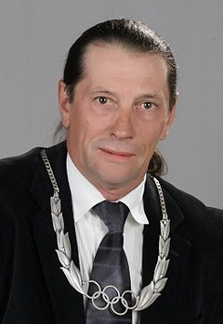
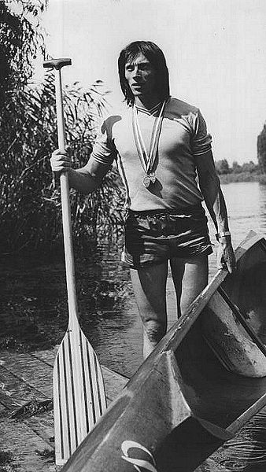
IVAN PATZAICHIN 1949
a canoe racing coach and retired sprint canoeist
took part in all major competitions between 1968 and 1984, including five consecutive Olympics, and won seven Olympic and 22 world championship medals, including four Olympic gold medals
the most decorated Romanian canoeist of all times

Slide 11
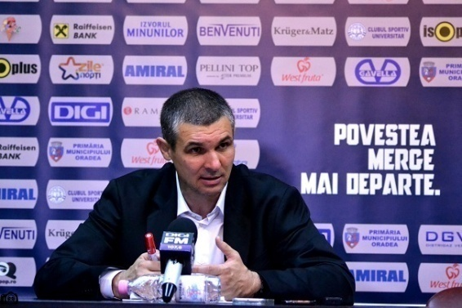
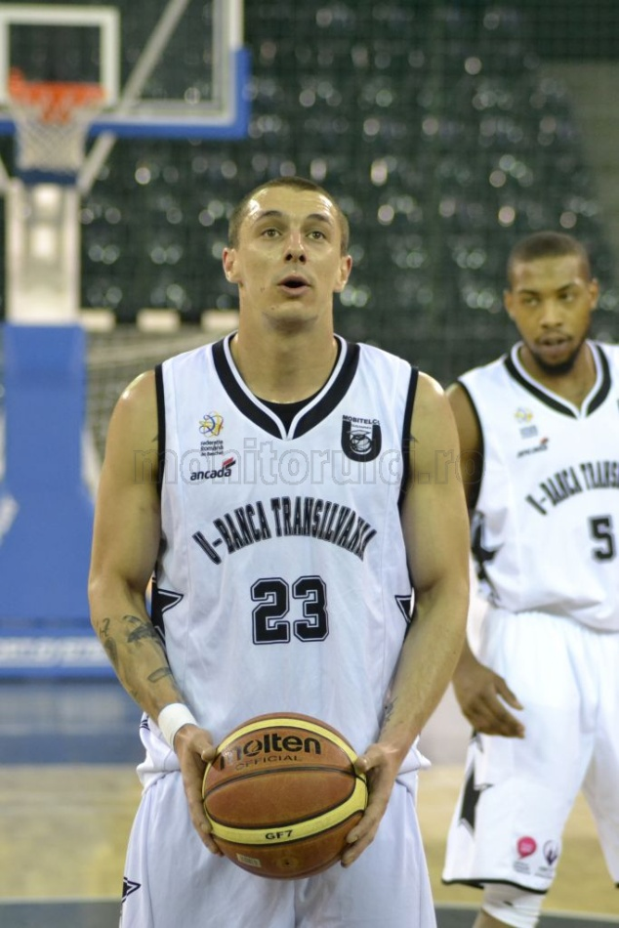
ANDREI MANDACHE 1987
a professional basketballer who plays for CSM Oradea as team captain
represented Romania’s national basketball team at the 2015 Eurobasket qualification
was also part of the roster of Romania at EuroBasket 2017

Slide 12
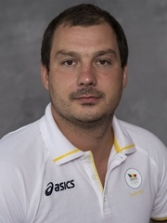
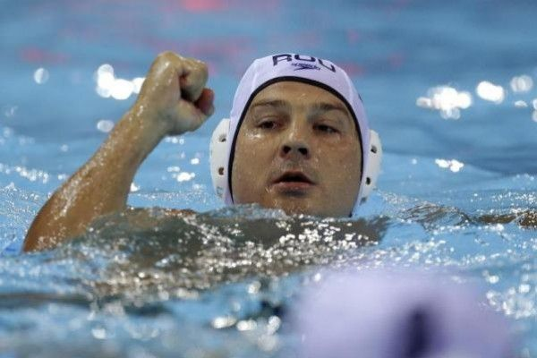
NICOLAE DIACONU 1980
born in Oradea
a professional water polo player, performing at CSA Steaua Bucharest
was part of Romania's national polo team at the 2012 Summer Olympics

Slide 13
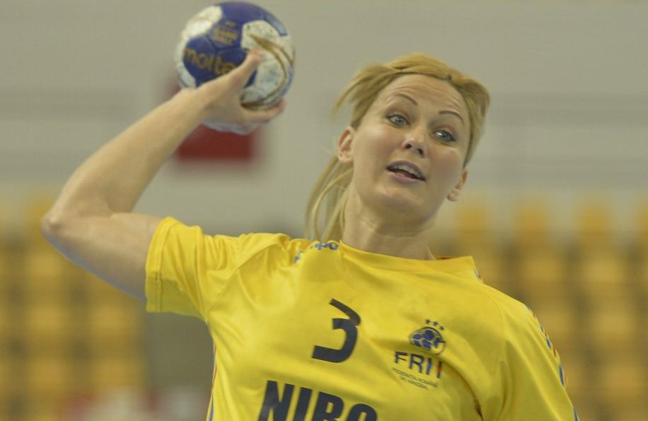
GABRIELL A SZŰCS 1984
born in Oradea
professional handball player for the Romanian national team
was also member of the team which finished fourth on the Olympic Games in Beijing

Slide 14
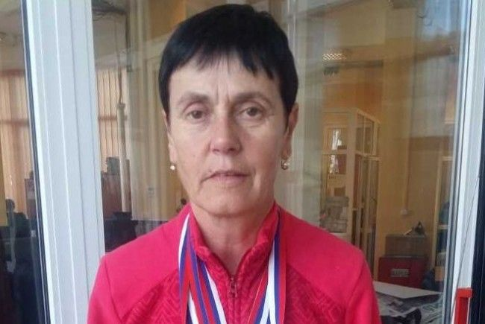
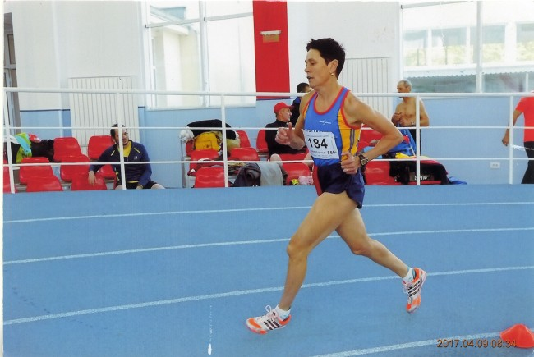
ILEANA BEREȘ 1961
born in Oradea
European champion – 2010
won three gold medals at the Romanian Masters Championships – 2017
won five gold medals at the Balkan Masters Athletics Championships – Celje (Slovenia) – 2018

Slide 15
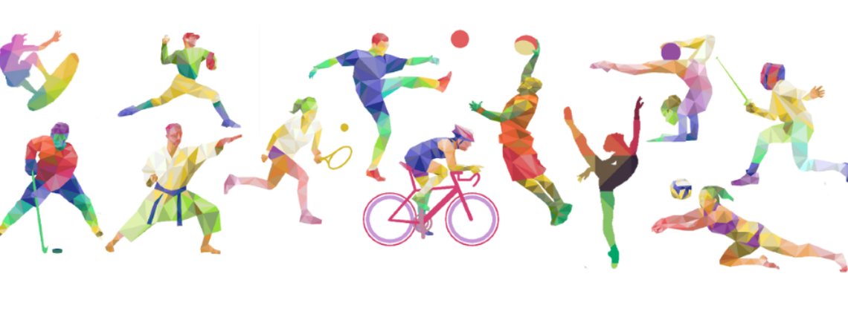
Thank you for your attention.
LTT
GREECE
May 2019
Student: Oana MUSTEAȚĂ
Techer coordinator: Carmen CHIRA

