Slide 1
Our Herbarium
Athina Tsapakidi
Eirini Tsatsou

Slide 2
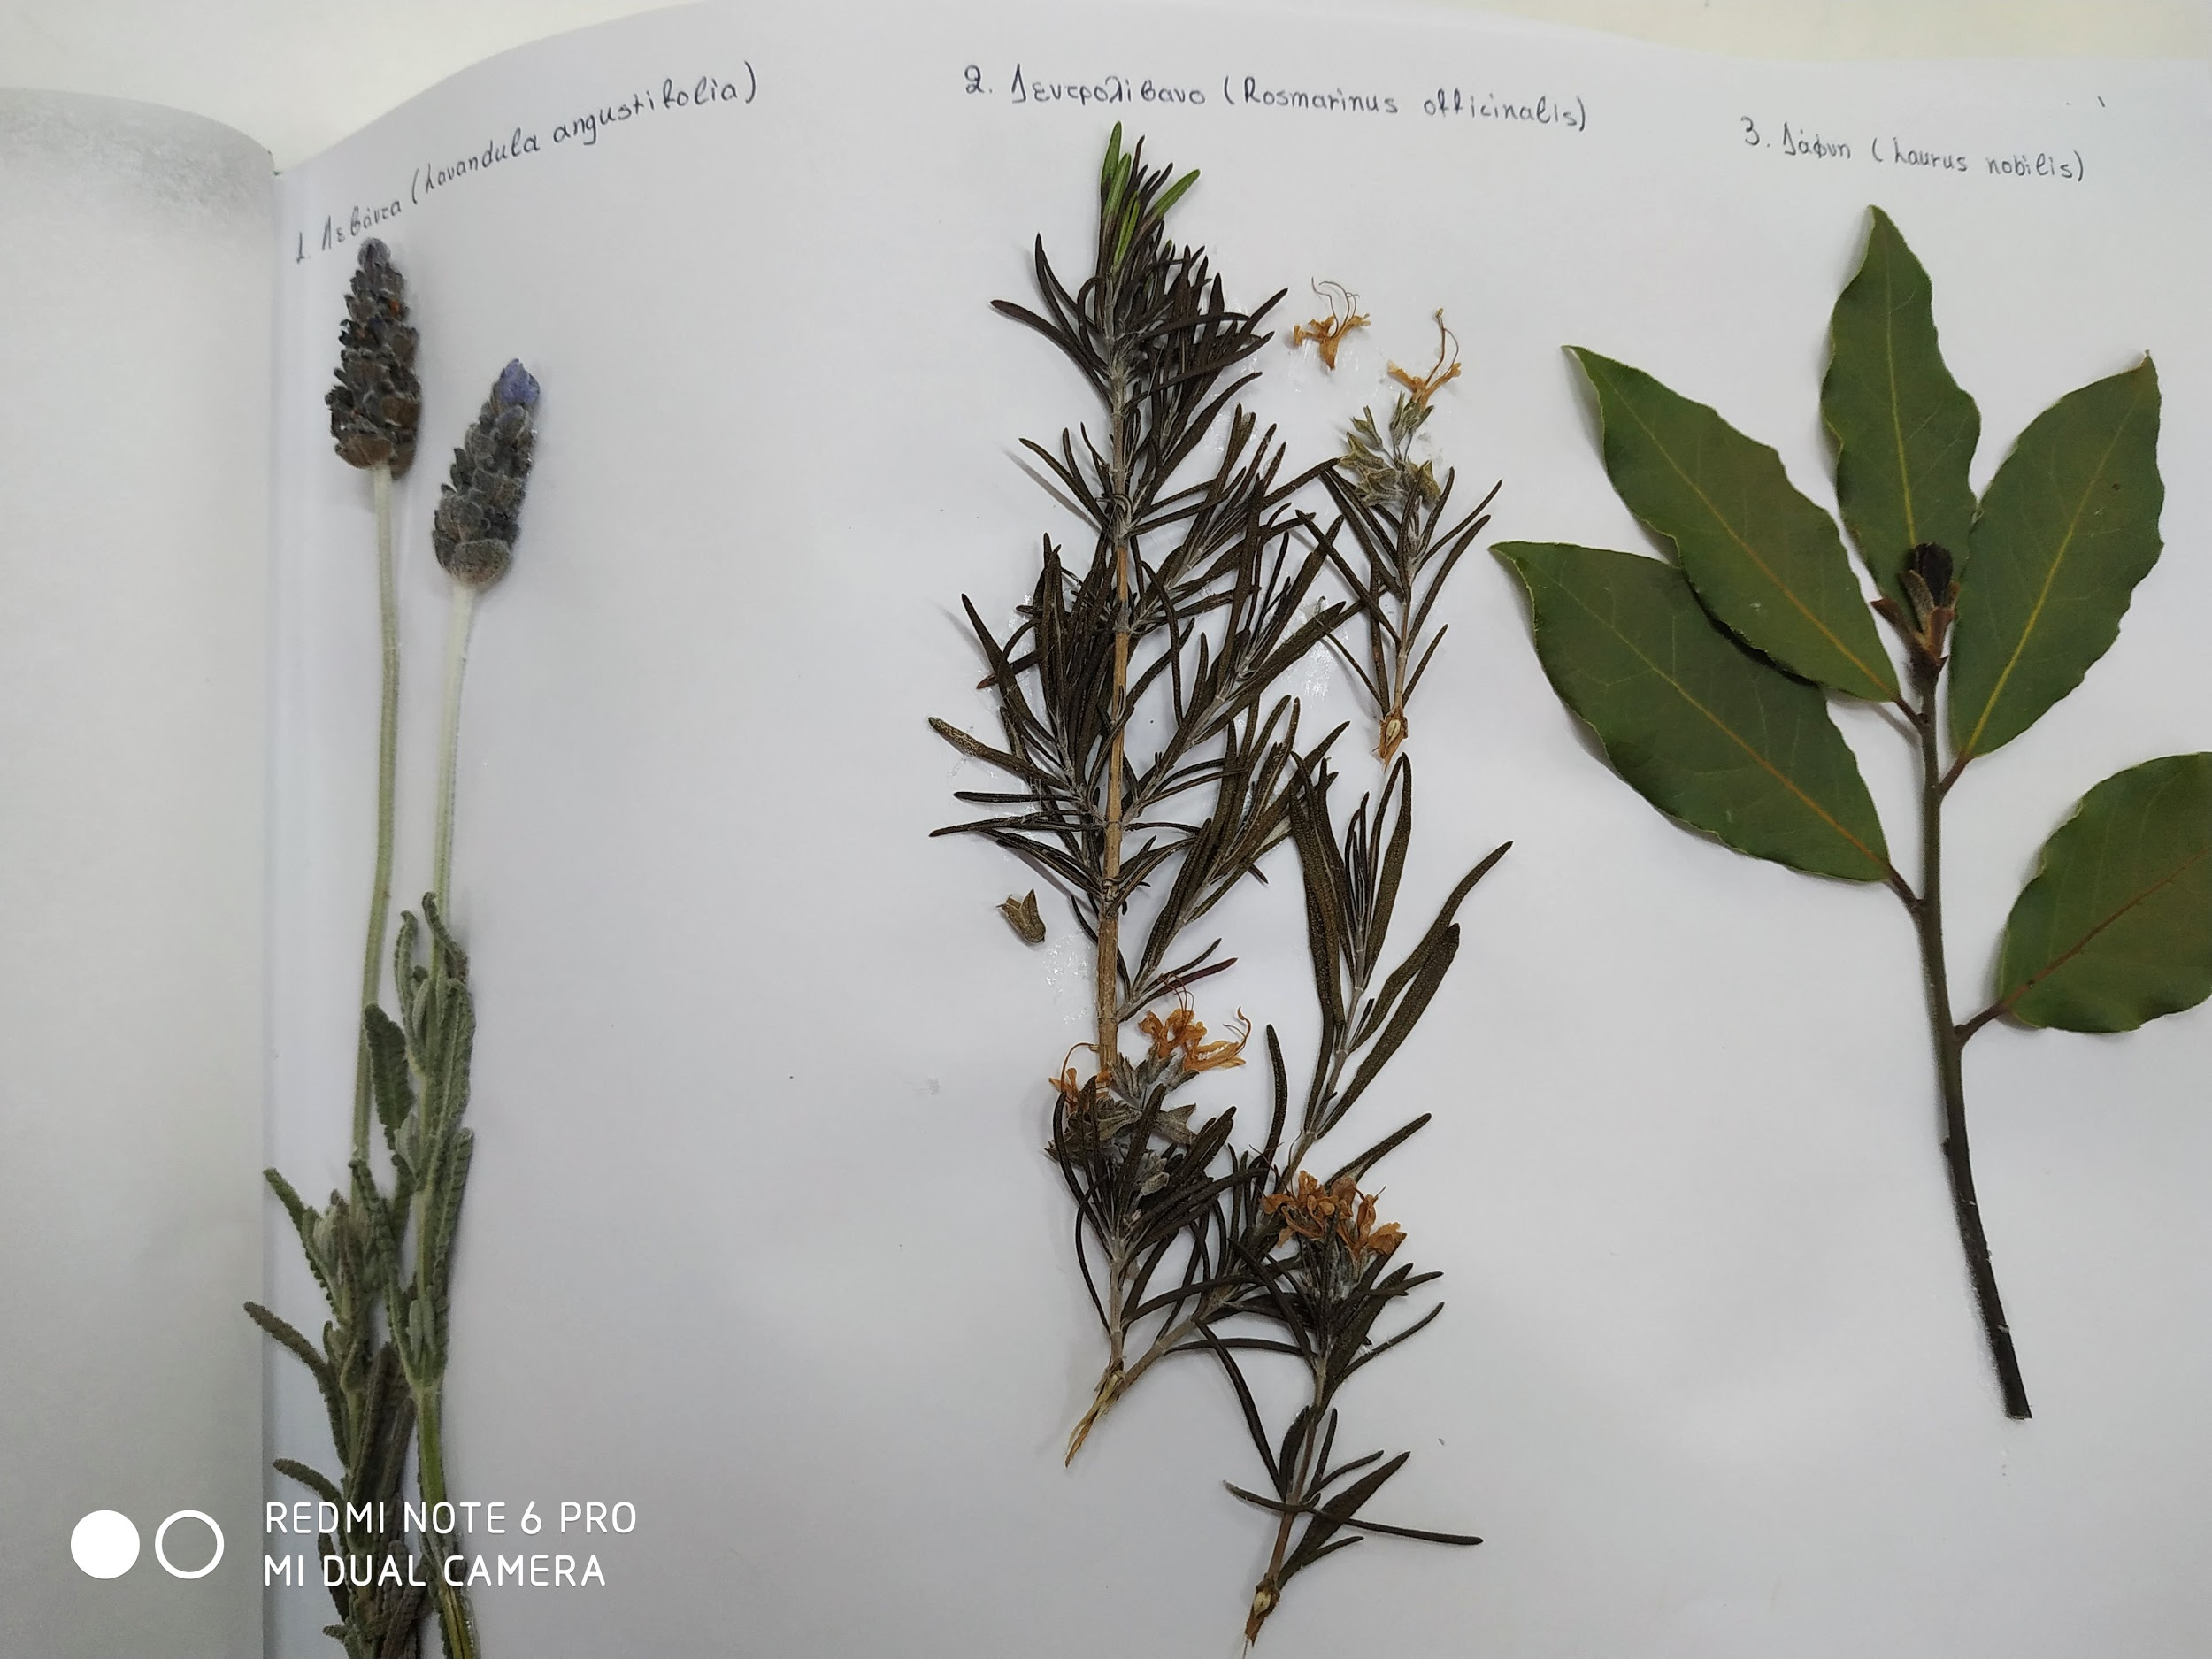
.
1.Lavandula angustifolia
2.Rosmarinus officinalis
3.Laurus nobilis

Slide 3
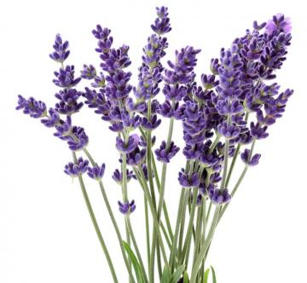
1.Lavandula angustifolia (lavender)
The plant has antiseptic, antispasmodic, appetizing, cholagogue, diuretic, soothing, sedative, tonic and anxiolytic properties. The herbal tea is recommended for the treatment of dyspepsia, cough, asthma, pertussis, influenza and laryngitis. Lavender is used as antispasmodic and to relieve neuropathic abdominal pain. It is administered against insomnia, stress, migraines and headaches, while in folk medicine it is also recommended to control blood pressure. Finally, it is applied externally to the skin against acne, burns, wounds and skin lesions.

Slide 4
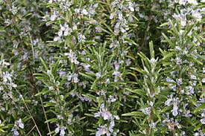
2.Rosmarinus officinalis (rosemary)
The whole plant has tonic, anticonvulsive, energizing and antiseptic properties and it is administered for the treatment of intestinal infections, diarrhea, colitis, flatulence, liver disorders and jaundice. The herbal extract stimulates the circulatory system as increases blood flow in the vessel. Also it is effective in healing the wounds in the oral cavity. Finally, it is administered in the form of herbal tea against influenza, colds, rheumatism and indigestion.

Slide 5
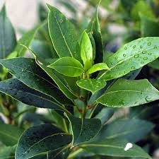
3. Laurus nobilis (Bay tree)
Laurus nobilis is used in the form of infusion as antirheumatic, antiseptic, diuretic, diaphoretic, antispasmodic and emmenagogue. It is administered for the treatment of colic, indigestion, flatulence, anorexia, catarrhal rhinitis, cough and cold. Also, it is applied to the skin against bruises, dandruff, sprains, rheumatism and herpes. In veterinary medicine the plant is used to eliminate lices and mites.

Slide 6
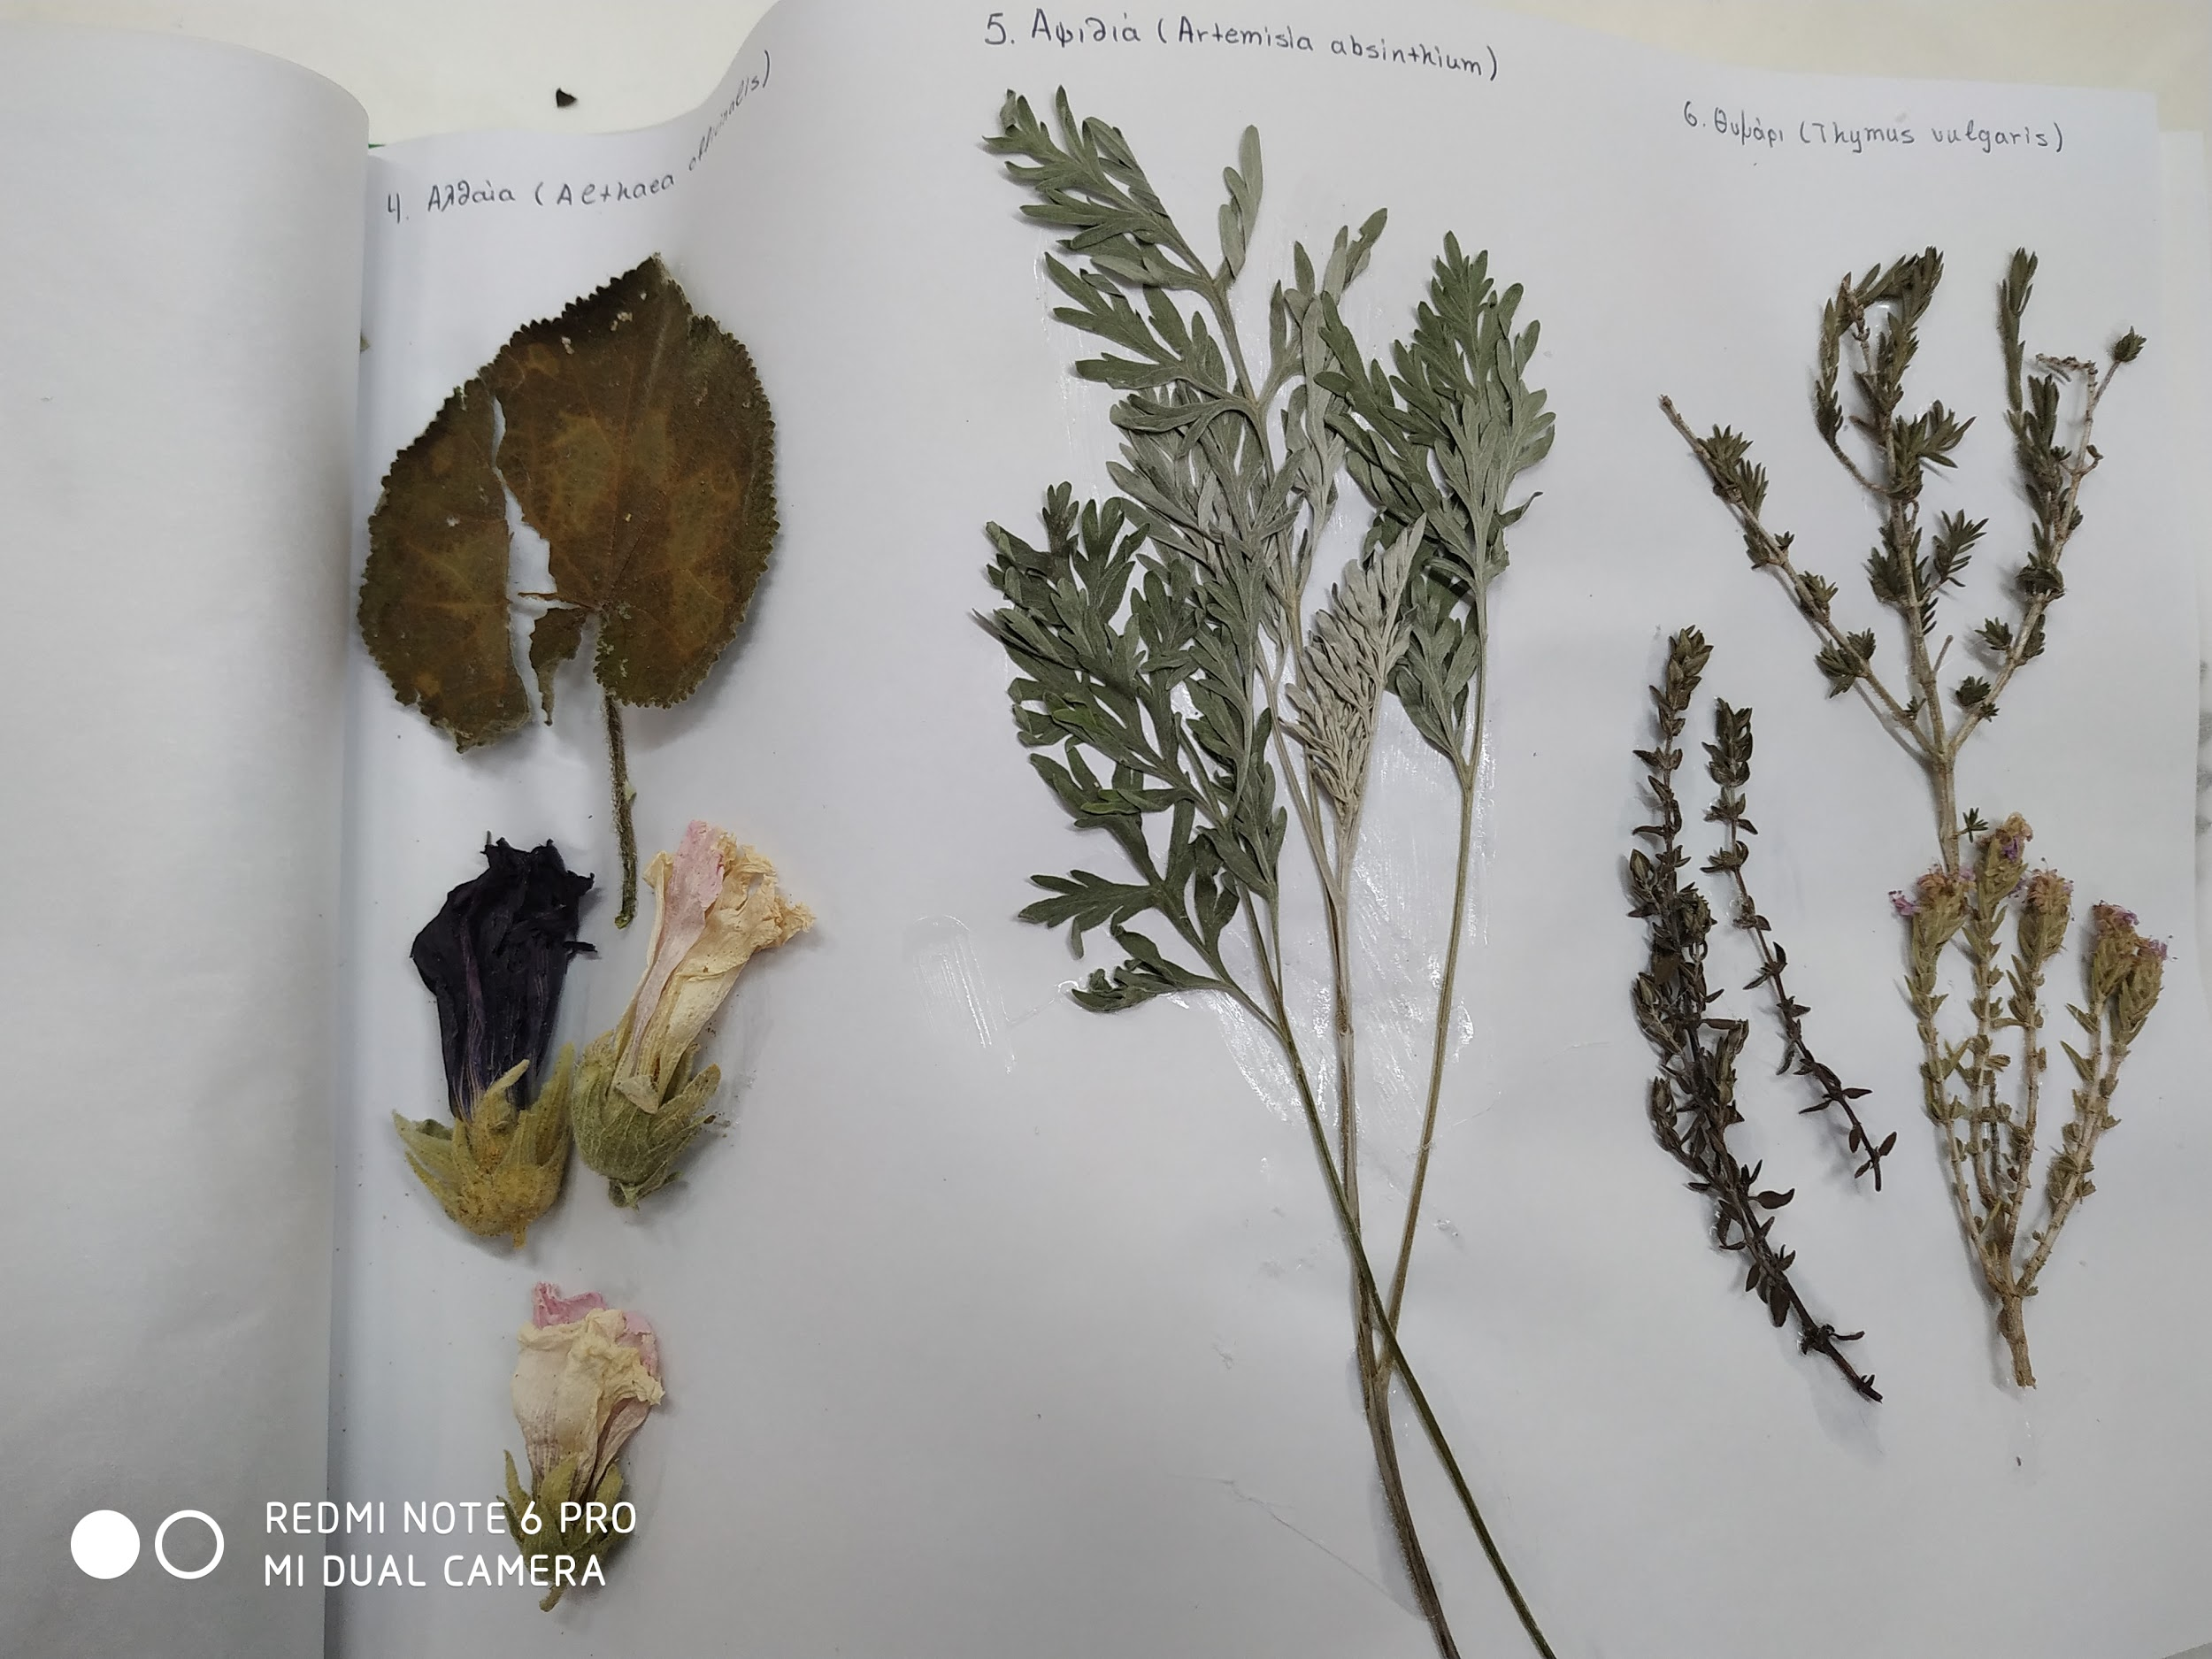
4. Althaea officinalis
5. Artemisia absinthium
6.Thymus vulgaris

Slide 7
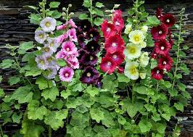
4. Althaea officinalis (Marsh Mallow)
The root has emollient, sedative, diuretic and healing properties. It is recommended against digestive disorders and oral inflammation (gingivitis, periodontitis, gastritis, peptic ulcer). The leaves have anti-inflammatory and expectorant actions and are used for treatment of respiratory problems (bronchitis, cough, runny nose).

Slide 8
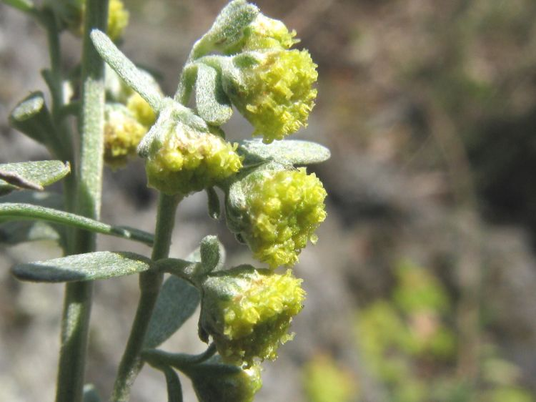
5.Artemisia absinthium(artemisium)
The whole plant is used as antimalarial, in combination therapy with other chemical antimalarial drugs, as malaria parasites develop resistance to artemisinin (the antimalarial substance). Also, it has antipyretic, antiseptic, diuretic, emmenagogue and anthelmintic properties. It is recommended to stimulate the stomach and for the treatment of dyspepsia, stomach pain and liver failure. Finally, it is administered against anemia, pulmonary tuberculosis, arthritis, as well as abortifacient

Slide 9
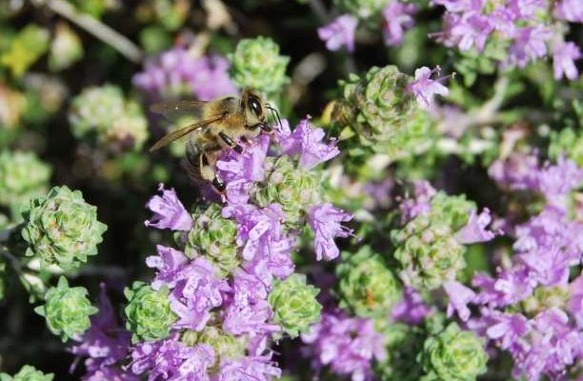
6.Thymus vulgaris(thyme)
The whole plant has anthelmintic, antiseptic, spasmolytic, antiseptic, sudorific, antitussive and expectorant properties. It is recommended for the treatment of laryngitis, bronchitis, productive and dry cough, pertussis and asthma. Also, due to the plant's extract astringent action it can be applied externally to disinfect the contaminated skin wounds. Finally, it is administered in the form of herbal tea against dyspepsia, gastritis, diarrhea and involuntary urination in children.

Slide 10
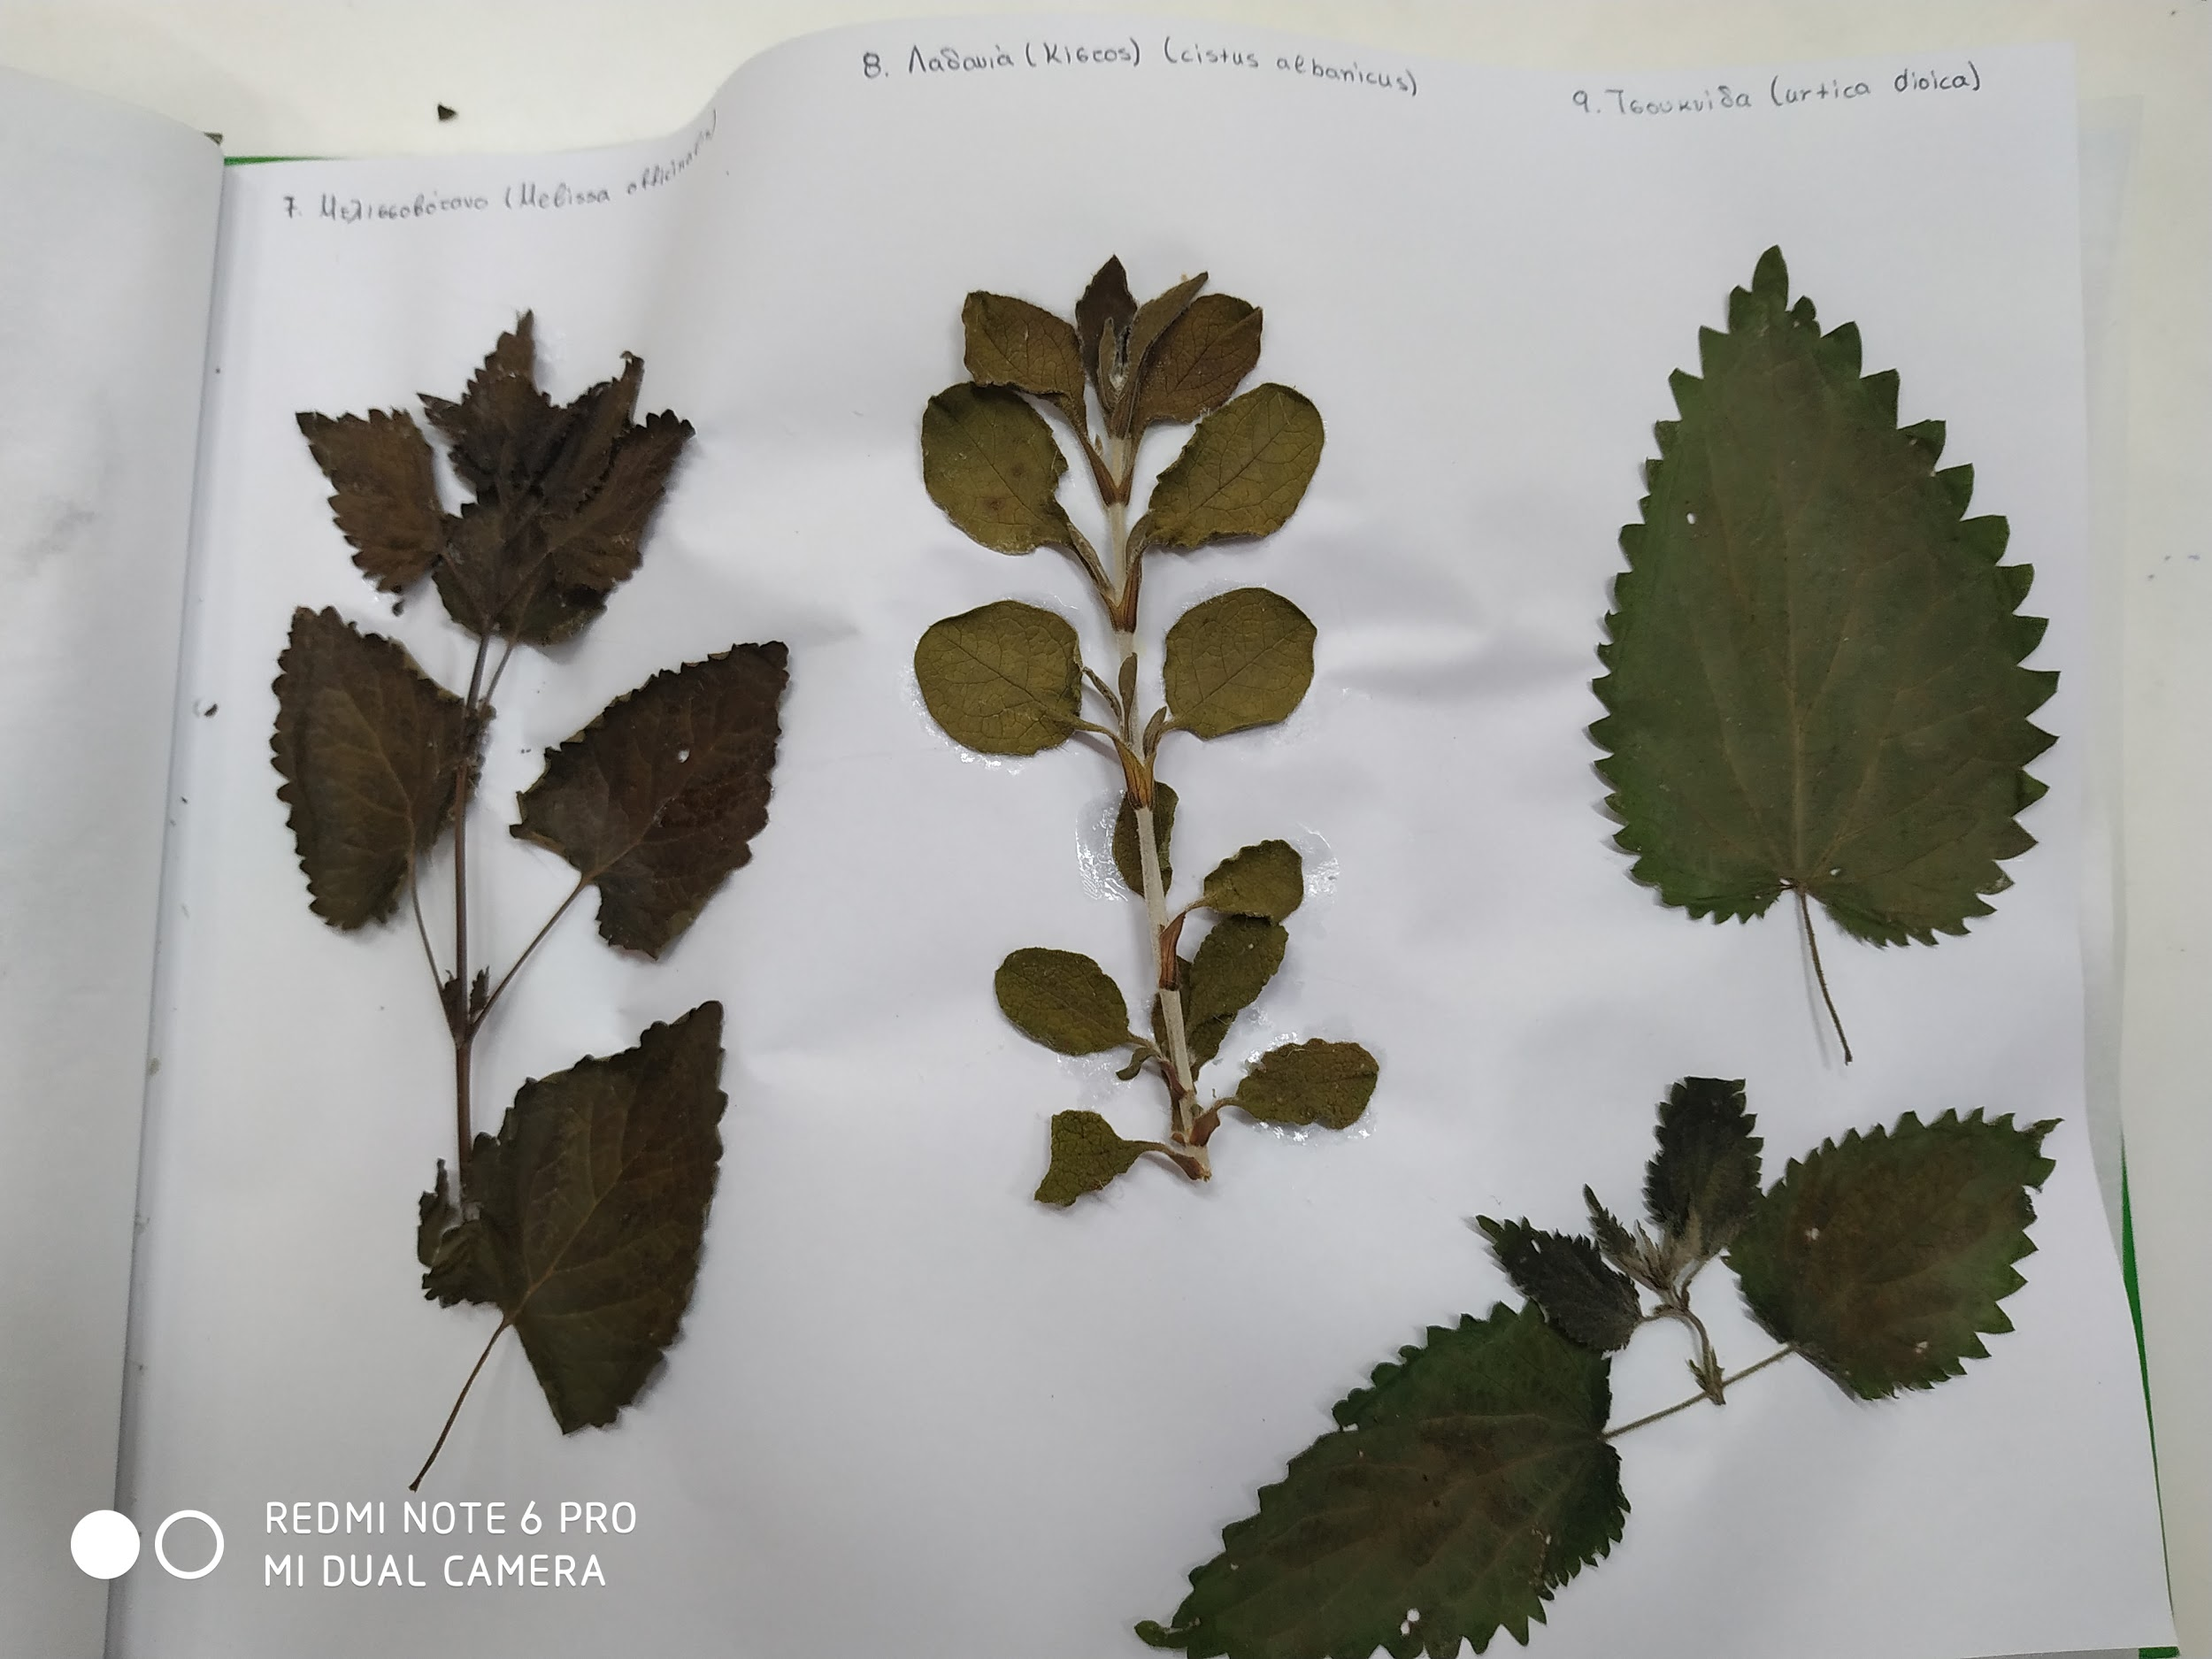
7. Melissa officinalis
8. Cistus albanicus
9. Urtica dioica

Slide 11
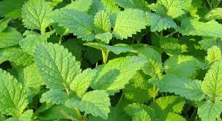
7.Melissa officinalis(balm mint)
The plant is administered in the form of infusion as digestive, diaphoretic, sedative, antispasmodic, anti-inflammatory, antimicrobial and sedative. In folk medicine it is recommended for the treatment of stomach and duodenal ulcers, kidney and liver colic, dyspepsia and vomiting during pregnancy. Also, the herbal tea from the leaves may be used against depression and anxiety. It is applied externally to treat headaches, dental pain, edema and skin wounds. Recent studies suggest that the plant extract enhances the memory and can be effective against amnesia and Alzheimer's disease.

Slide 12
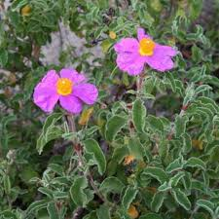
8.Cistus albanicus(cistus sintenisii)
The whole plant is administered in the form of herbal tea as expectorant, antitussive, antidiarrheal and emmenagogue. The herbal tea is recommended for the treatment of duodenal and stomach ulcers, dental pain, runny nose, diarrhea, as well as immune stimulant especially against several bacterial infections. In homeopathy the plant is used due to its particular antioxidant action to prevent heart diseases and to reduce stress and anxiety. Finally, it has anti-wrinkle and regenerating properties and it is used in the form of ointment in cosmetics and against various skin problems.

Slide 13
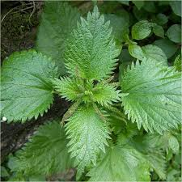
9. Urtica dioica (nettle leaf)
The whole plant has anti-asthmatic, antirheumatic, anti-seborrheic, astringent, diuretic galaktagogo, haemostatic and hypoglycaemic properties. It is recommended in the form of herbal tea against arthritis, asthma, urinary bladder infections, bronchitis, gingivitis, gout, kidney stones, laryngitis, multiple sclerosis, sciatica and tendinitis. It is applied externally against oily hair, dandruff, eczema, skin irritation and minor injuries. The root has diuretic action and it is administered for the treatment of benign prostatic hyperplasia (BPH) and other prostate problems. Also it is used in the form of infusion for the treatment of anemia, menstruation, hemorrhoids and allergic symptoms.

Slide 14
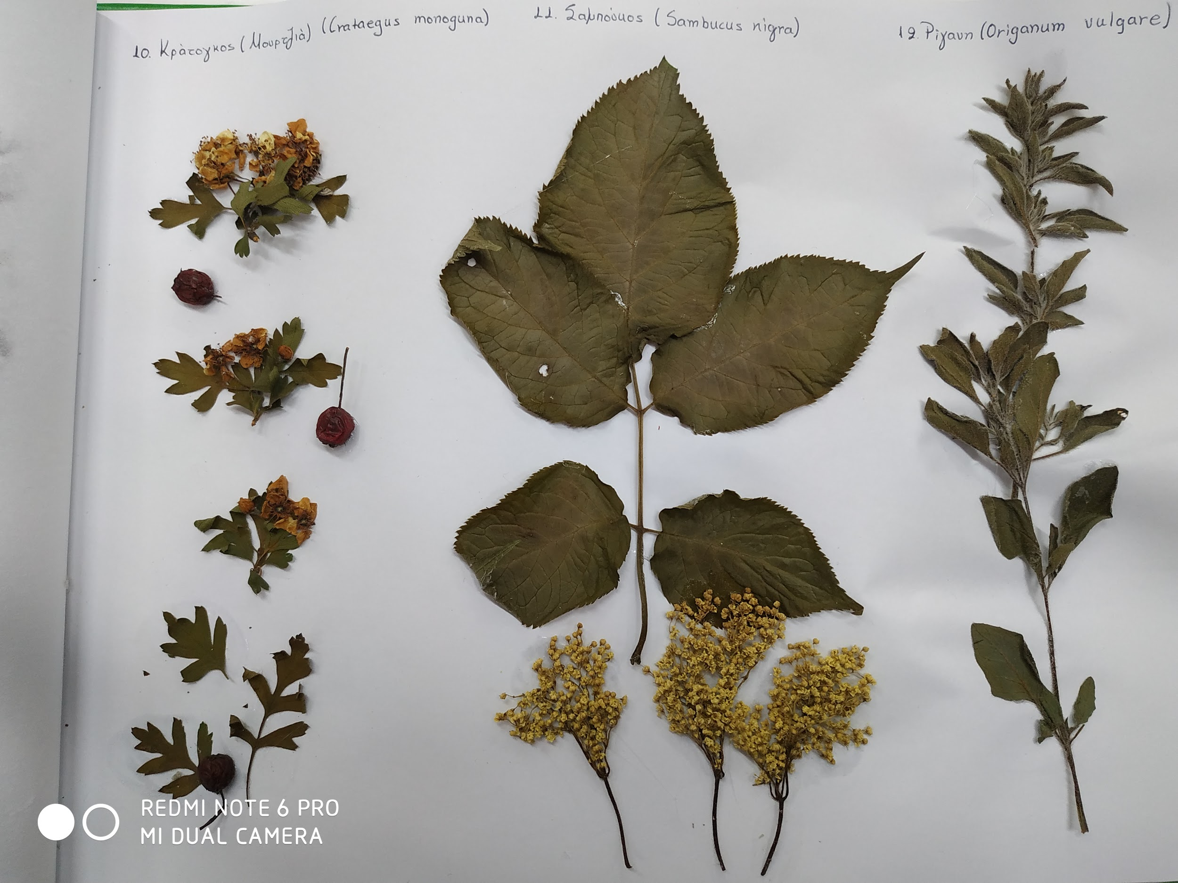
10. Crataegus monogyna
11. Sambucus nigra
12. Origanum vulgare

Slide 15
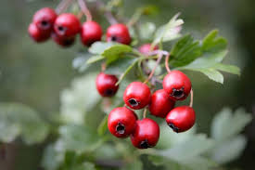
10. Crataegus monogyna( Mayblossom)
The whole plant is cardiotonic and is recommended for the treatment of heart's diseases, as tachycardia, cardiac arrhythmia, heart failure and heart degenerative diseases. It may be used to reset to normal blood pressure in case of hypertension or hypotension, as it dilates the arteries and increases the heart rate. It relieves the symptoms of angina and reduces the blood cholesterol levels. Also, the plant is administered as anticonvulsant against asthma, diarrhea and uterine contractions, as well for the treatment of insomnia due to its sedative action. Finally, it has astringent properties and it is used to treat edema, kidneys' diseases and sore throat.

Slide 16
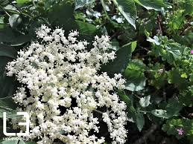
11. Sambucus nigra (Elder)
The bark has laxative, emetic and diuretic properties. The poultice made from the fresh leaves is applied externally as emollient and healing. Also, it is administered in the form of herbal tea as laxative, expectorant, diuretic and diaphoretic. The flowers are used proactively to stimulate the respiratory system and against the allergic symptoms. The fruit extract has diaphoretic, diuretic and laxative properties. Finally, the herbal tea made from the leaves and the flowers is recommended for the treatment of bruises, sprains, injuries, cold, influenza, runny nose, inflammations of the upper respiratory system and rheumatism.

Slide 17
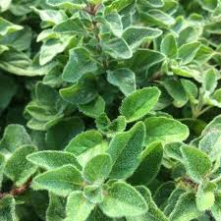
12. Origanum vulgare (Oregano)
The leaves have antirheumatic, antiseptic, antispasmodic, cholagogue, sweating, emmenagogue, expectorant, tonic, anti-diarrheal, anti-inflammatory and antibacterial properties. They are recommended for the treatment of respiratory infections (bronchitis, tonsillitis), cough, asthma, common cold, flu, fever, dyspepsia, stomach and menstruation's disorders. They are applied externally to the skin against arthritis, muscle pain and edema. Finally, the herbal extract is used as gargling against toothache and gum diseases.

Slide 18
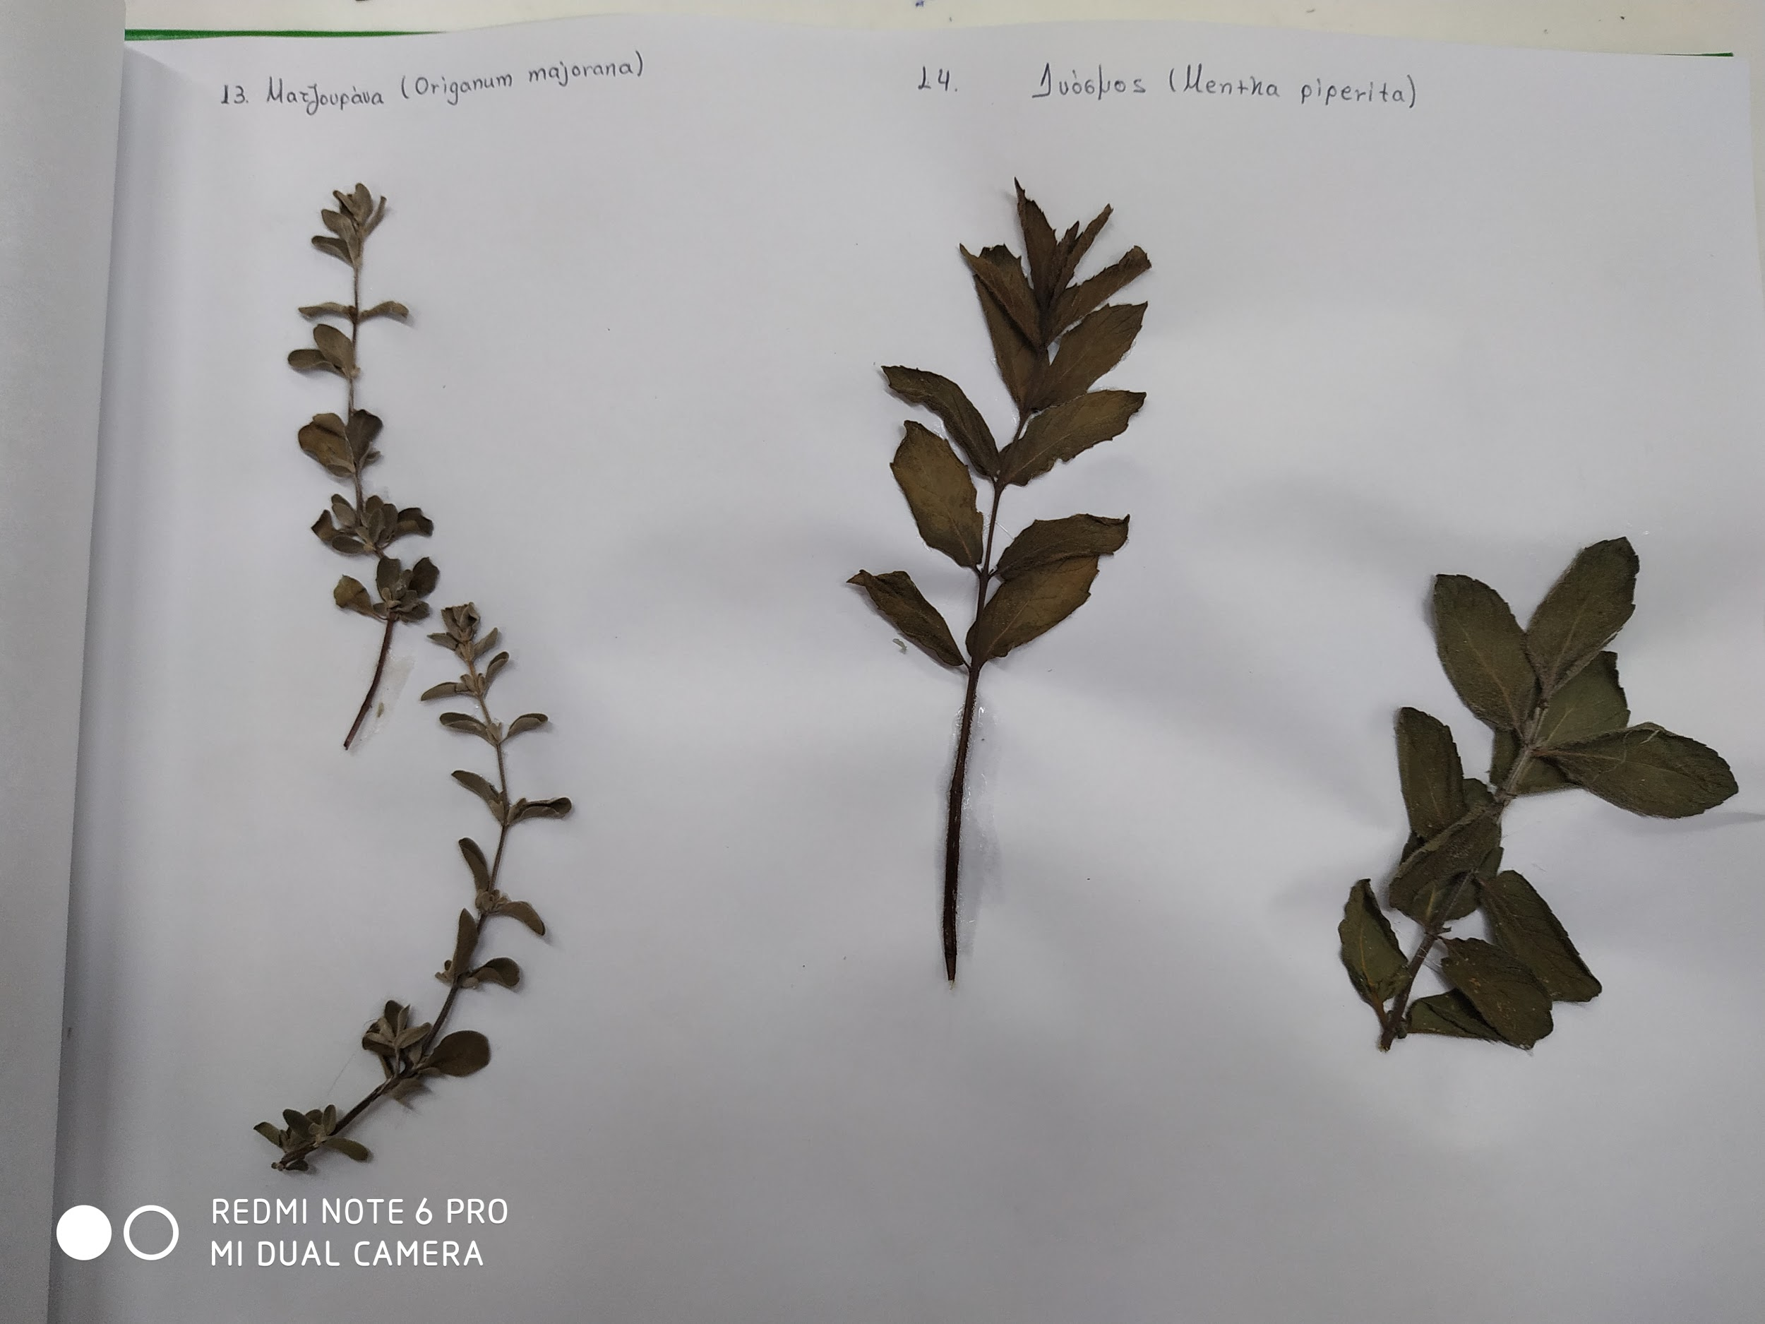
13.Origanum majorana
14. Mentha piperita
15.calendula officinalis

Slide 19
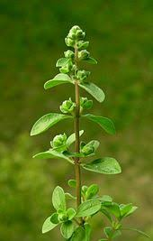
13. Origanum majorana (majoram)
Asthma.
Painful menstrual cramps (dysmenorrhea)
Coughs.
Colds.
Stomach cramps.
Liver problems.
Improving appetite and digestion.
Improving sleep.

Slide 20
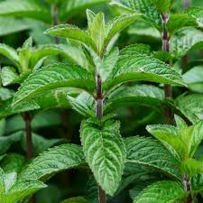
14. Mentha Piperita (Peppermint)
The whole plant is administered as antispasmodic, diaphoretic, antiemetic, antiseptic, analgesic and aphrodisiac in the form of infusion. It is recommended for the treatment of intestinal colic , dyspepsia, flatulence, colitis, travel sickness and vomiting during pregnancy, as it promotes relaxation of the intestinal muscles and stimulates the secretion of bile and other digestive juices. Also, it is used to treat common cold, flu, fever and migraines, as well against stress, tension and insomnia.

Slide 21
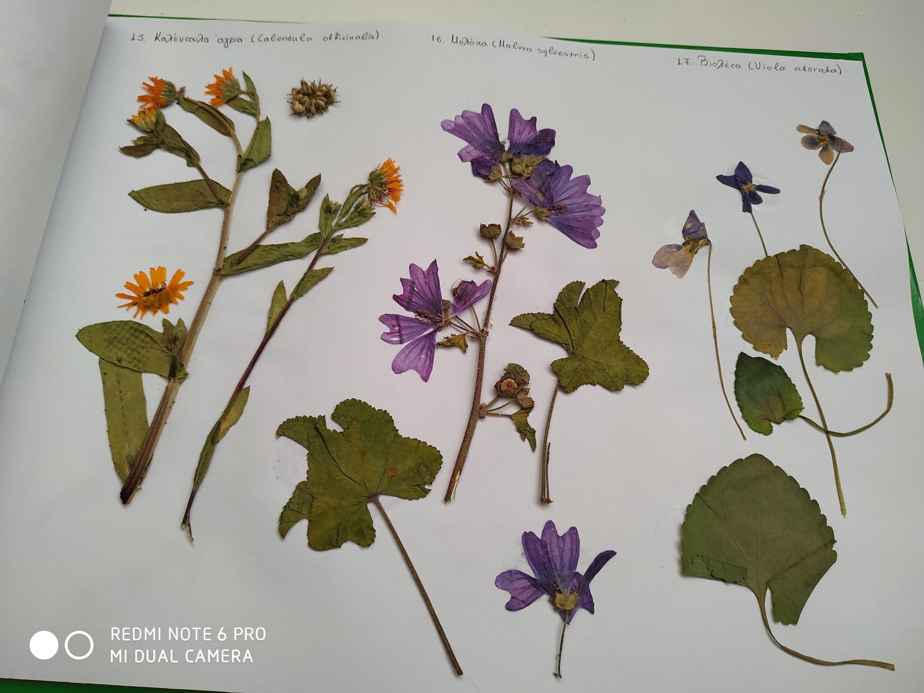
15. calendula officinalis
16. malva sylvestris
17. viola adorata

Slide 22
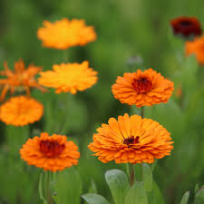
15. Calendula officinalis ( English Marigold)
The whole plant has anti-inflammatory, healing, antiseptic, antispasmodic, astringent, cholagogue, sudorific and emmenagogue properties. It is applied externally to the skin for the treatment of various skin problems, such as injuries, abscesses, acne, psoriasis, eczema, pruritus, sinusitis, phlebitis, sprains and varicose veins. It is recommended in the form of herbal tea against gingivitis, stomatitis, conjunctivitis, stomach and duodenal ulcer, cholelithiasis, dyspepsia and gonococcal leucorrhoea. Finally, it has been used as emmenagogue and in cases of late and painful menstrual.

Slide 23
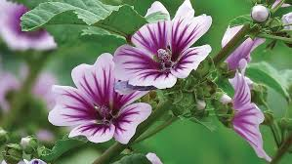
16. Malva sylvestris(Mallow)
The plant is administered in the form of infusion and herbal tea as emollient, expectorant, laxative, intestinal tonic and diuretic. The plant is applied externally in the form of poultice from the leaves and the flowers for the treatment of skin inflammations and insect bites. Also, it is recommended against diseases of the respiratory and digestive system, such as cough, bronchitis, constipation and gastroenteritis

Slide 24
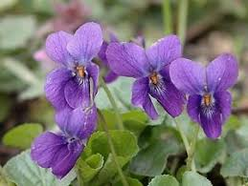
17.Viola odorata(English Violet)
The whole plant has anti-inflammatory, diuretic and anti-cancer properties. As a herbal tea is taken for the treatment of bronchitis, dry cough, asthma, respiratory and urinary infections. Externally, it is used to treat mouth and throat infections.

Slide 25
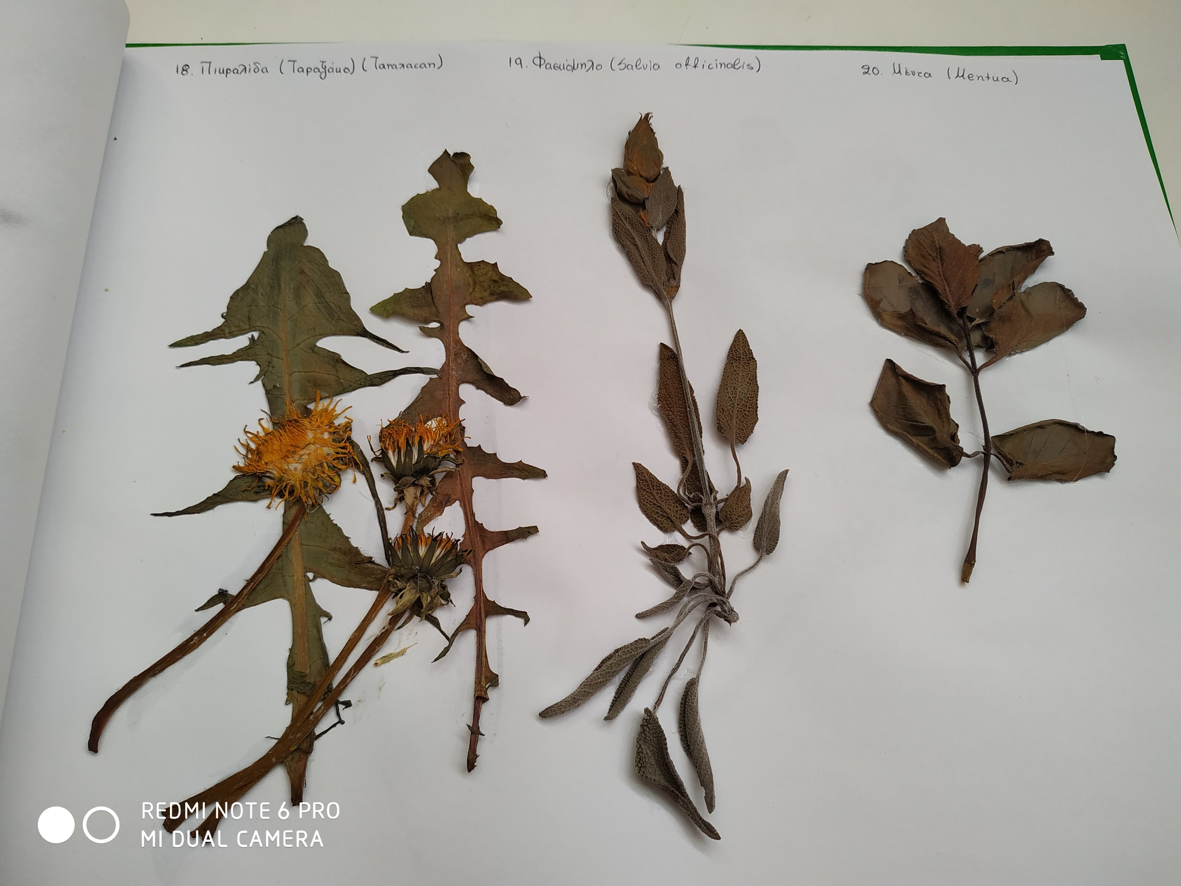
18. taraxacum officinale
19. salvia officinalis
20 mentha

Slide 26
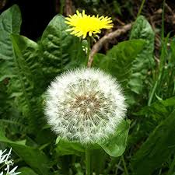
18.Taraxacum officinale(Common Dandelion)
The plant is administered in the form of herbal tea as cholagogue, tonic, diuretic, digestive, anti-inflammatory and antitussive. It is recommended for the treatment of gallstones, constipation, dyspepsia, chronic arthritis and rheumatic diseases. Also, it is applied externally in the form of infusion against chronic dermatitis, eczema, acne, hives (urticaria), wounds and warts.

Slide 27
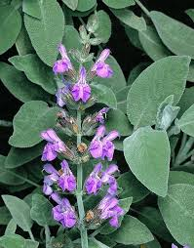
19. Salvia officinalis( sage)
The herbal tea made from the leaves has tonic, antidiarrheal, anti-bacterial, antiseptic, antispasmodic and cardial properties. It is administered for the treatment of injuries, aphthous, pharyngitis and gingivitis, while due to its estrogen action is recommended against amenorrhea, dysmenorrhea and leucorrhoea. Also, the whole plant has neurotonic properties and it is used against nervous disorders, depression, vertigo, neuralgia and to improve memory (sharpness). Finally, plant's infusion is applied externally to the skin against acne, infections, wounds, lesions, alopecia and muscle cramps.

Slide 28
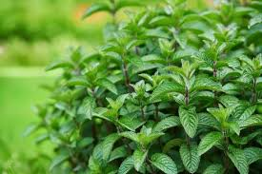
20. Mentha (mint)
Allergies
Breast-feeding
Common cold
Indigestion and gas
Pain relief
Skin
Oral health

Slide 29
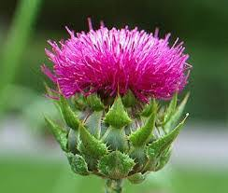
21. Silybum marianum(Mary Thistle)
The herbal tea is used as cholagogue and choleretic. It is recommended to prevent damage to the liver caused by excessive alcohol consumption and chemotherapies. Also, it is administered for the treatment of hepatitis, jaundice, liver cirrhosis, runny nose and pleurisy. It is applied externally to the skin against psoriasis. A lot of recent studies have shown that the plant has anticancer, neuroprotective and cardioprotective actions, which are mainly related to cholesterol reduction.

