Slide 1
Sport activities in Thesprotiko area
VASILEIOS GOULAS
PANAGIOTA DALAGIANNI
TRIANTAFYLLOS DAKOULAS

Slide 2
Sport activities in Thesprotiko area
There is a variety of outdoor activities for all the different capacity levels you can choose from, in order to meet with all the unique natural beauties of Thesprotiko and around it. The small town of Preveza is indeed a big surprize for the new visitors in terms of memories, imagery, feelings.
One of the best ways to meet the hidden treasures of Thesprotiko is to be a part of the well organized activities.
One of the most beautiful challenges of the area of Preveza is to experience the alpine landscape of Ziros lake, and ideal destination for lovers of:

Slide 3
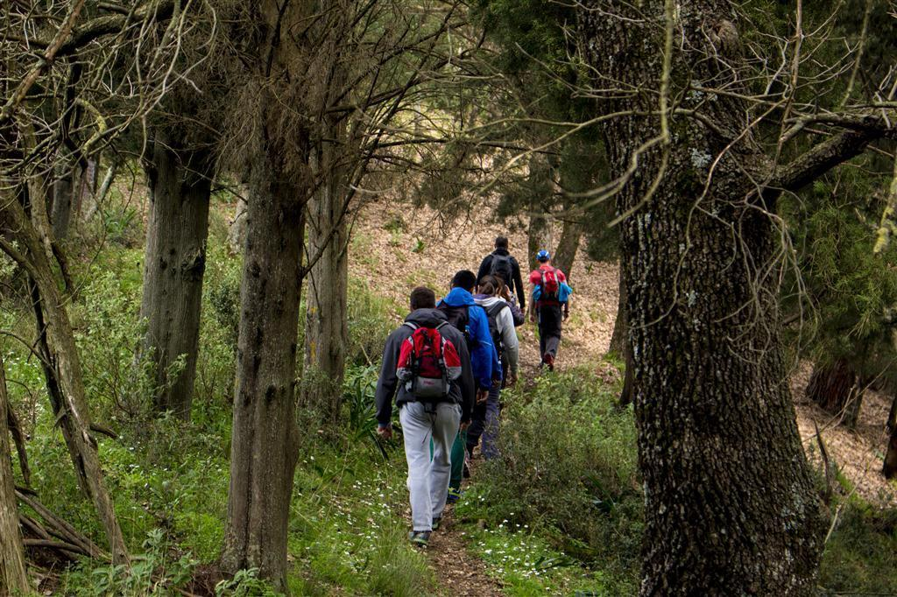
Hiking
The majesty of Greek nature unfolds in a surprising way the hiking route as it combines Alpine scenery of Lake Ziros with unique geological phenomenon of red clay. It is a good chance to admire,discover and learn.

Slide 4
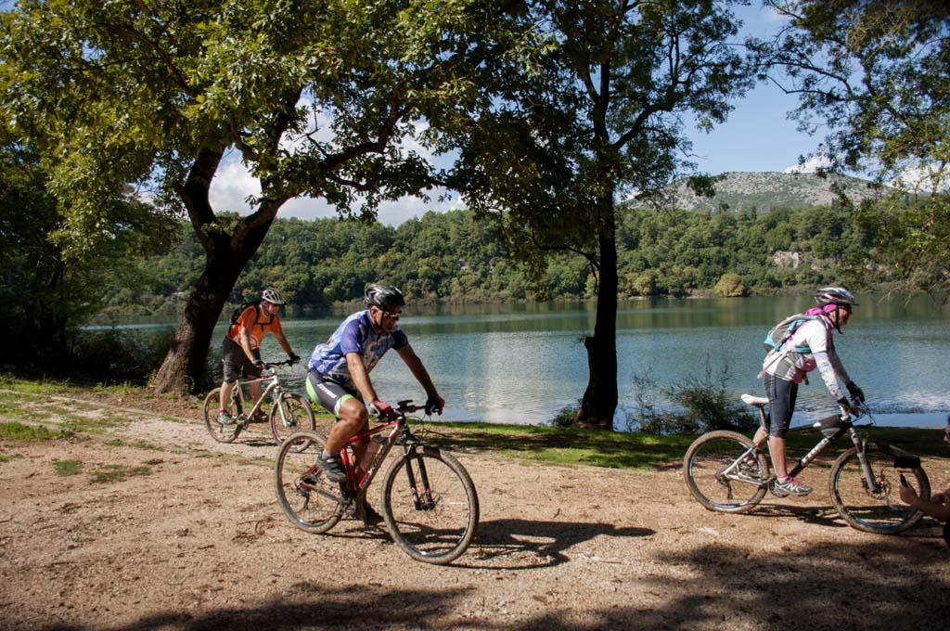
Cycling
The area of Ziros Lake is an ideal cross country arena for cycling excursions as the impressive and diverse relief enables bicycle lovers to explore with special excitement this continental canvas.

Slide 5
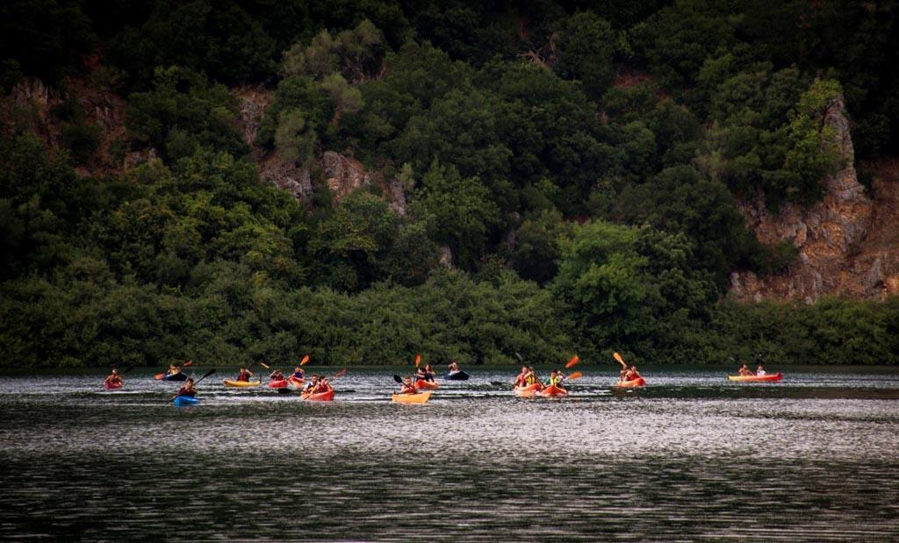
Rowing
And who would not want to try anything like rowing, something that would make him remember this time for his whole life?

Slide 6
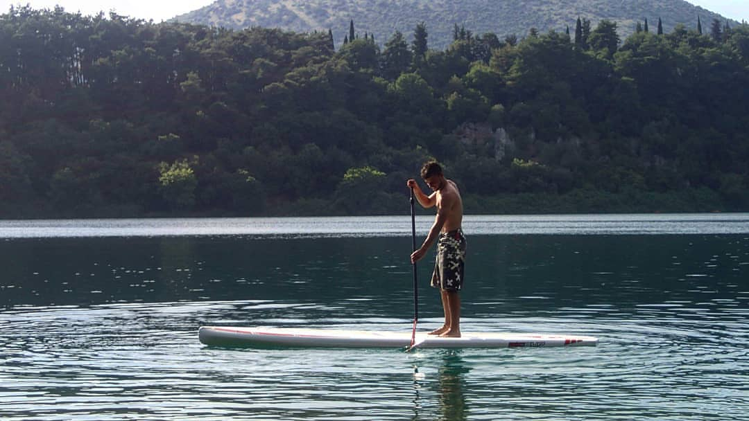
SUP
One of the most ideal places for starting with, is the magical Lake Ziros. In this calm and clear water you will enjoy cruising safely the board and harmonize with the peaceful landscape which excites you in this route.

Slide 7
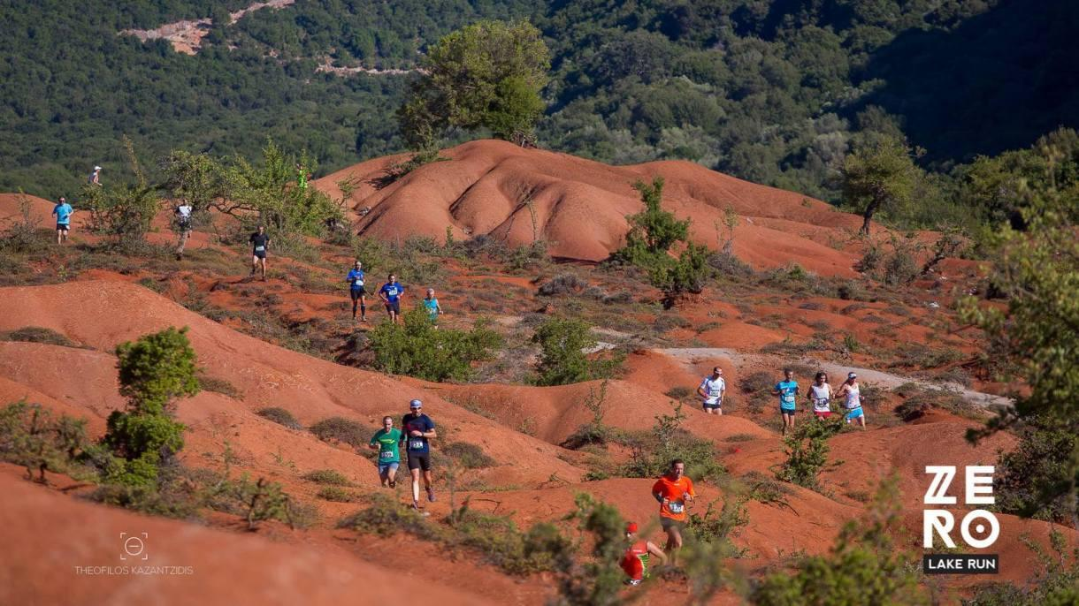
Running
Nothing is better from running around the Ziros Lake, bypassing that bright-red hills. It is something unique!

Slide 8
Ziros Lake activities
In conclusion, we can see that this area has a lot of interesting sport activities and a good memorable experience to offer!

Slide 9
Paragliding
Another sport activity, and specifically, an air-sport activity near Thesprotiko, is Paragliding in Pappadates.
Paragliding* is the recreational and competitive adventure sport of flying paragliders: lightweight, free flying, etc.
*Paragliding in Greek is called also <<Para-Pede>>

Slide 10
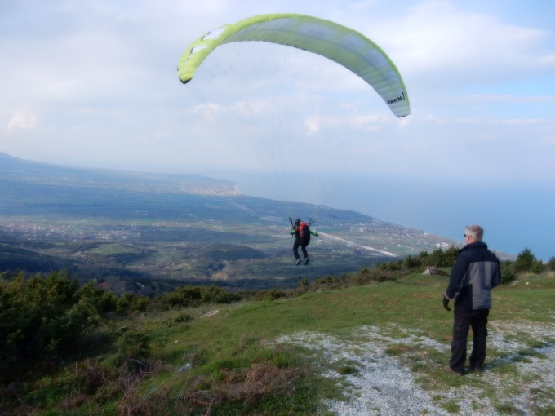
Paragliding in Pappadates

