Slide 1
Local drink for our traditional recipe
Oikonomou Maria
Vassios Panagiotis
Sioumalas Dimitris

Slide 2
Local Drinks
Tsipouro
The preparation of tsipouro is the way to "take advantage" of the grape.The raw material of the tsipouro is the grape marc, that is what remains after the "pressing", the pressing of the grapes for the production of wine, namely the grapes of the grape, the seeds and the flesh.

Slide 3
Local Drinks
Tsipouro
In any case, the raw material that reaches the distillery to become the tsipouro by the distillation method must have undergone an alcoholic fermentation earlier, a process that lasts for 20-40 days. During this time, the must must be in containers open to air and at regular intervals the sugars are measured.Then the tsipouro is produced by the distillation process.

Slide 4
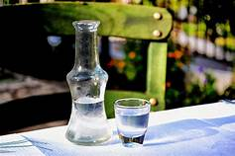
Local Drinks

