Slide 1
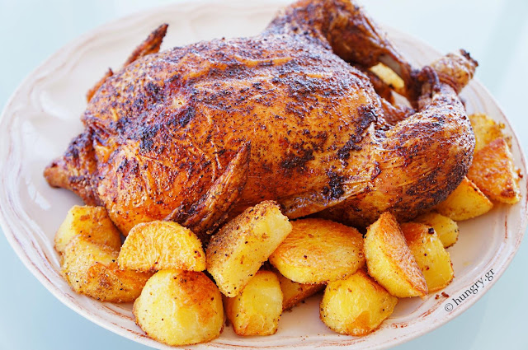
Main course of our traditional recipe
Roast chicken with potatoes

Slide 2
Main course of our traditional recipe
Ingredients:
1 whole chicken
Sea salt
Black pepper
½ fresh thyme
1 head garlic
1 lemon
Olive oil
250g potatoes
6 sprigs fresh rosemary

Slide 3
Main course of our traditional recipe
Method
Preheat the oven to 200 degrees C.
Generously salt and pepper the inside cavity of the chicken and add 4 rosemary sprigs, thyme, garlic and lemon. Tuck the wings back and under the chicken and tie the legs together for even cooking.
Place the chicken, breast side up, on a rack in a roasting pan and brush the sides with olive oil.

Slide 4
Main course of our traditional recipe
4)Roast the chicken in the oven for about 1 hour.
5)Then put the potatoes into a large bowl. In a small bowl, whisk the herbs garlic and oil and then pour over the potatoes.
6)Roast the potatoes about 1 hour the chicken.

Slide 5
Main course of our traditional recipe
7)Remove chicken with potatoes from the oven and cover with foil. Allow to rest for juices to restibute, at least 15 minutes.
8) Carve the chicken with the potatoes and place it on the serving platter.

Slide 6
Main course of our traditional recipe

Slide 7
Main course of our traditional recipe
VASILEIOS GOULAS
PANAGIOTA DALAGIANNI
TRIANTAFYLLOS DAKOULAS

