Slide 1
THE ART OF SILVERSMITH
PANAGIOTIS VASSIOS
TRIANTAFYLLOS DAKOULAS

Slide 2
TECHNICIANS
They create unique art projects.
They contribute to the development and evolution of this art and to the stimulation of the local economy.
They exported their products to Belgrade, to Venice, Bucharest, Prague, Vienna, Skopje and Russia.

Slide 3
MANUFACTURING
MODES
Embossed Decoration
Filigree Decoration
Granular Decoration
Enamel Technique
Savat

Slide 4
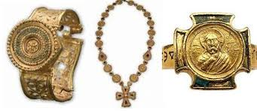
EMBOSSED DECORATION
The silver object,once placed in pitch is worked on its reverse side, so that inflatable decoration is created, without the vibrations affecting the surface as they are absorbed by the tar.

Slide 5
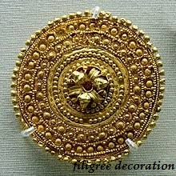
FILIGREE DECORATION
The Filigree Decoration is created using silver wires which are welded to the surface of the object creating a pattern or forming part of it.

Slide 6
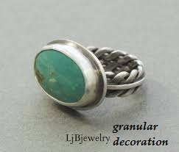
GRANULAR DECORATION
The Granular Decoration consists of complexes of small granules, which are usually bonded onto the wires. Thus, it is very common for the collared decoration to accompany the fillet.

Slide 7
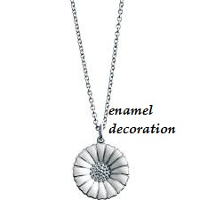
ENAMEL TECHNIQUE
With the Enamel Technique, the necessary quantity of enamel is placed on the surface that the craftsman wants and then baked at high temperature so that it melts and gets the desired shape and color.

Slide 8
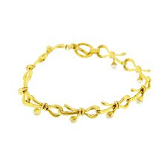
SAVAT
The Savat comes from a metal alloy, which is placed on the engraved surface of the object and melts at high temperature. The craftsman then processes and smoothes it in a solidified form. It is a technique that has been known since antiquity, it has spread greatly during the Byzantine era and during the Ottoman domination.

Slide 9
TOOLS
Hammers: in different sizes
Spitsunia: these are narrow small iron tools for engraving.
Scaffolds: used for carving silver
The latch and the roller: to create silver wires
Mangalas: narrow tool, useful for polishing
Camel - burner: use for welding metals

Slide 10
THANKS FOR YOUR ATTENTION

