Slide 1
Appetizers of our traditional
recipe
Athina Tsapakidi
Eirini Tsatsou
George Papaspyros

Slide 2
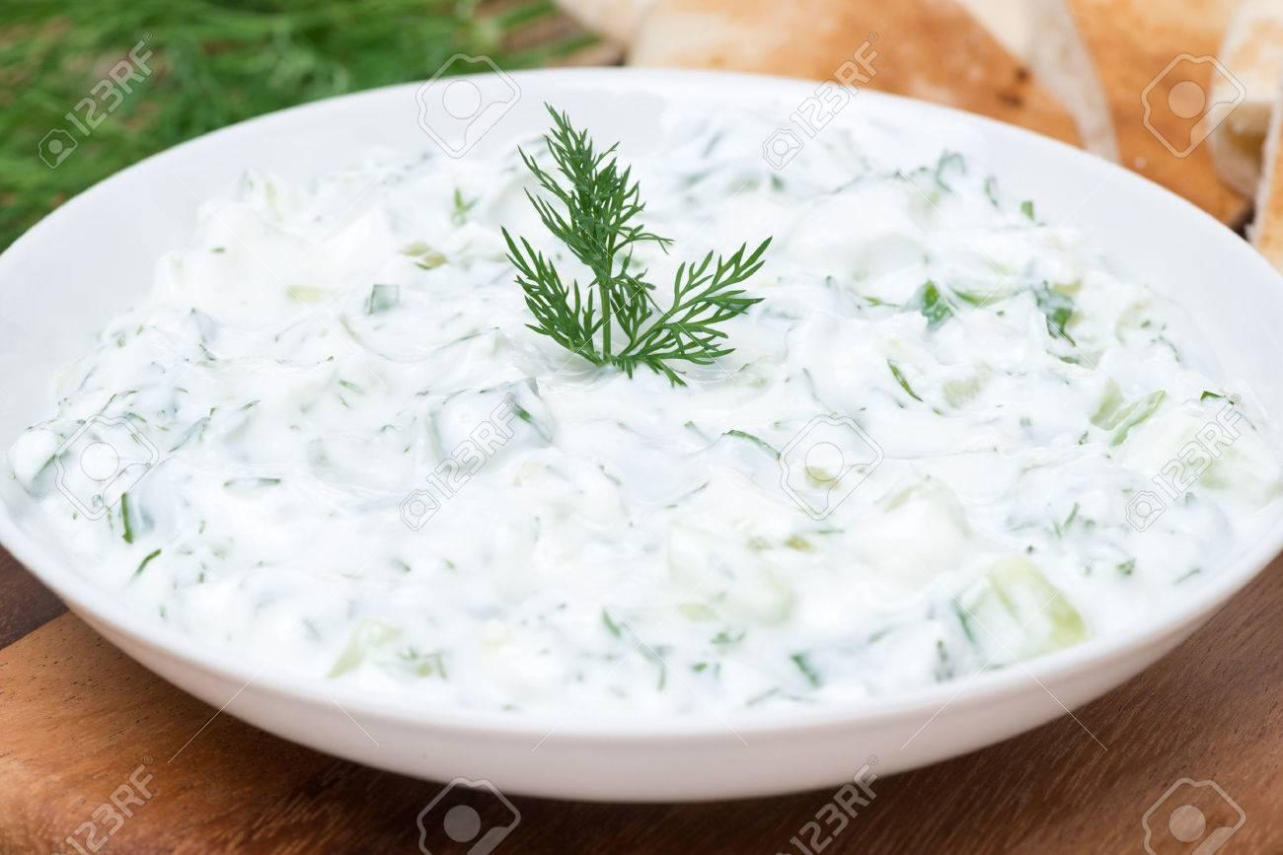
Garlic dips (tzatziki)

Slide 3
Ingredients and Preparation
Ingredients
1 cow’s yogurt
1 sheep’s yogurt
1 authentic Greek yoghurt 2 %
1 carrot
1 medium cucumber
1 beetroot
3 cloves of garlic
6 tablespoons of white vinegar
salt & pepper
Preparation
Put the 3 yogurt in 3 different Bowls.Grate the carrot, cucumber and beetroot.Smash the garlic cloves.

Slide 4
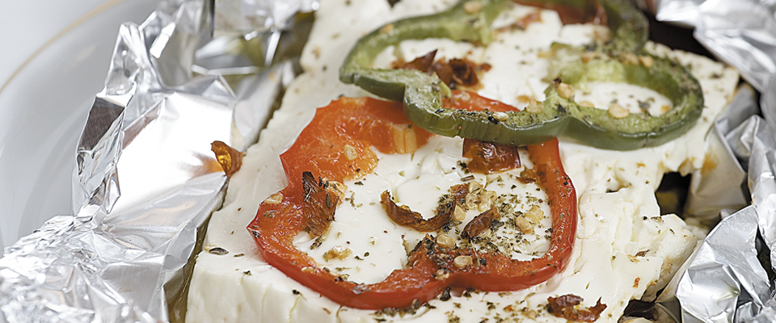
Bouyourdi–Parcels with traditional Feta Cheese

Slide 5
Ingredients and Preparation
Ingredients
400gr. Feta Cheese cut into 4 pieces 2cm thick
2 tomatoes, sliced
1 green pepper sliced into rings
1 red pepper sliced into rings
Salt
A pinch of oregano & pinch of crushed chili pepper
Some olive oil
4 sheets of aluminum foil
Preparation
1. Pre-heat oven to 220°C. Spread the aluminum foil sheets onto the counter
2. Place tomato slices onto the foil, dividing equally, sprinkle with a little sea salt and oregano and place a piece of Feta cheese on top.
3. Evenly divide the rings of green and red pepper over the cheese, sprinkle with oregano and crushed chili peppers, a few drops of olive oil and wrap the foil into the bowl.

Slide 6
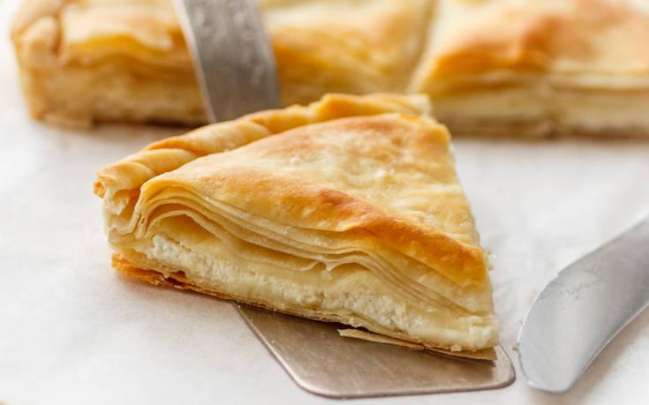
Cheese pie with feta and yoghurt

Slide 7
Ingredients and Preparation
Ingredients
1 sheet pastry pack
0,5kg feta
0,5kg sheep’s graviera
200gr authentic greek yoghurt
4 eggs
500ml fresh milk, 3,5% fat
80gr cow’s butter
olive oil
Whisk in a bowl eggs with yogurt and milk and add pepper. Mix together the cheese and melted butter and set aside. Grease a round pan about 26 cm. Lay one sheet of pastry in the tin, brush or spray with olive oil and layer with another sheet of pastry. Continue the process until you have used half of the pastry sheets. Spend the filling mixture evenly in top. Repeat the layering and oiling process with the remaining pastry sheets. Trim away any excess pastry. Bake in preheated oven at 180°C for 45 minutes or until golden brown. Allow to cool and serve.

Slide 8
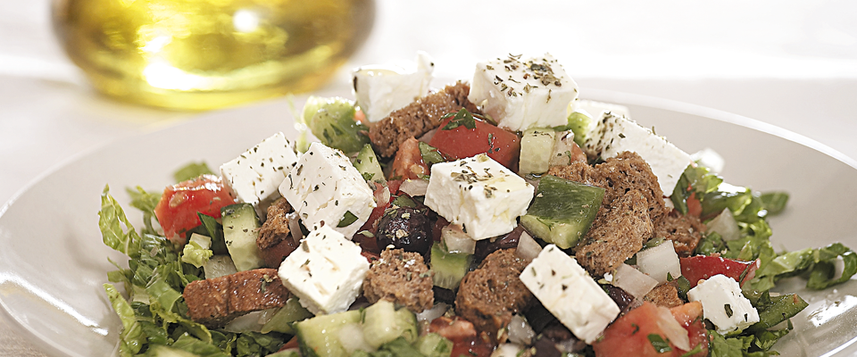
Greek Salad with Feta Cheese

Slide 9
Ingredients and Preparation
200gr Feta cheese, cubed
4 ripe, firm tomatoes
2-3 small cucumbers (or 1 large)
2 green peppers
1 medium-sized onion
½ lettuce
4 tbsp. parsley, finely chopped
100gr Kalamata olives (or other black olive) – pitted and sliced
3 tbsp. capers
A few wholemeal rusks
A pinch of oregano
½ teacup olive oil
Red or white vinegar to taste

Slide 10
Preparation
Preparation
1. Cut the tomatoes, cucumbers and green peppers into 1cm cubes and place in a bowl. Add the onion, finely chopped, and the parsley, season with salt and mix well.
2. Cut the lettuce as finely as you can and lay it in a serving bowl or on individual plates, creating a green basis. Evenly share the remaining ingredients on top of the lettuce.
3. Sprinkle the rusks – broken into bite-sized bits – over the top, along with the capers, the Feta Cheese, the olives and the oregano. Shake the olive oil with the vinegar and a pinch of salt and pour the dressing over the salad.

