Slide 1
Local Desserts
Panagiotis Vassios
Maria Oikonomou
Dimitris Sioumalas

Slide 2
Local Desserts
Walnut
Ingredients
1 pound of green wad 1 kg of sugar 1½ glass of water juice of 1/2 lemon a little nutshells (carnations)

Slide 3
Local Desserts
Walnut
Preparation
Firstly,we choose tender small green nuts.
Secondly,we use a sharp knife in order to clean the thin outdoor.
Then,we cut a little the two peaks of each wick.

Slide 4
Local Desserts
Walnut
4. After,We boil them for 2 to 3 minutes in boiling water. We repeat the process twice more. After, we drain them.
5. When they cool down, we puncture them on the side of the stalk and let them drain well. We are kneading on each of 1 musk-cake.

Slide 5
Local Desserts
Walnut
6. Then,we add the nuts and the sugar in water to boil.Alongside we ‘re weeping them.
7. After,boil them for 15-20 min and then let them cool in a saucepan.

Slide 6
Local Desserts
Walnut
8. Finally,put the sweet to the fire to bind the syrup properly and add the lemon juice.
9. Once it's cool, put the sweet in sterile jars.

Slide 7
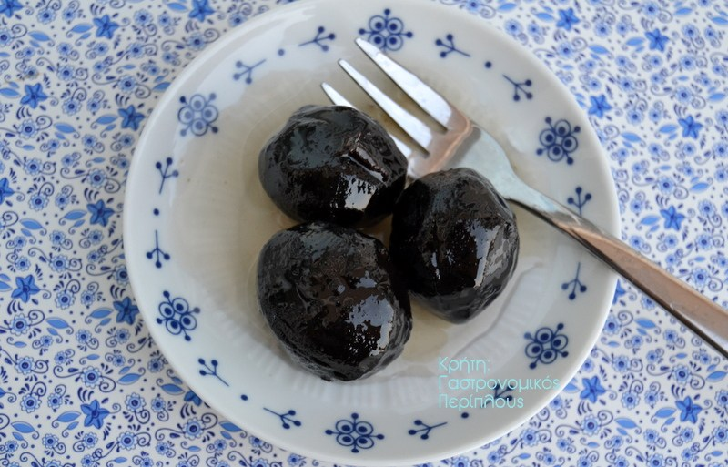
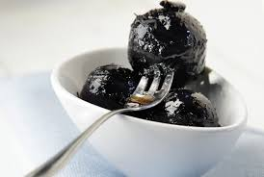
Local Desserts
Walnut

