Slide 1
Doping in Sports
&
Energy Drinks
George Papaspyros
Athina Tsapakidi
Eirini Tsatsou

Slide 2
Doping
Doping is the use of banned athletic performance enhancing drugs by athletic competitors.
However this way to enhance performance is considered unethical.
The reasons of ban are mainly the health risks both physically and mentally

Slide 3
By substance
Stimulants
Stimulants are drugs that usually act on the central nervous system to modulate mental function and behavior.Examples of well known stimulants include caffeine,coccaine and modafinil.
Anabolic steroids
Known side effects include harmful changes in cholesterol levels.

Slide 4
Side effects in Men and Women
Men
acne
impaired liver function
breast formation (gynecomastia)
increase in estrogen
increased sex drive
risk of heart failure
muscle dysmorphia
Women
hair loss
hypertrophy of the clitoris
increased sex drive
irregularities of the menstrual cycle
development of masculine facial traits
increase coarseness of the skin
deepening of the voice

Slide 5
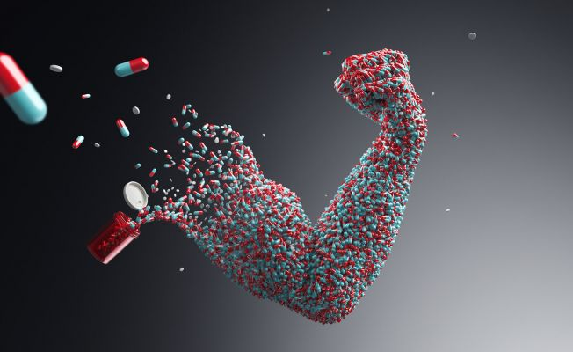
Social Pressures
Social pressure is one of the factors that leads to doping in sport.
Adolescent athletes are influenced by what they see on the media and society’s embracement of the “winning is everything” spirit.

Slide 6
Physical pressures
Athletes use performance enhancement drugs for healing purposes so that they are an able competitor for economic rewards involved with elite sports.The most popular motive for athletes to take supplements is to prevent any nutrient deficiencies and to strengthen the immune system.These factors all focus on improving the body for performance.

Slide 7
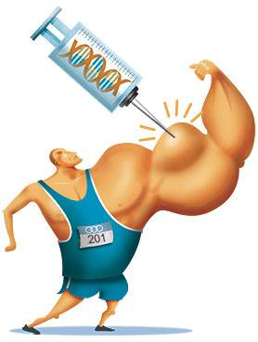
Psychological motivations
Psychological is another factor to take into consideration in doping in sports.It becomes a behavioral issue when the athlete acknowledges the health risks associated with doping.This has to do with the psychological thinking that the drug will make one feel invincible.

Slide 8
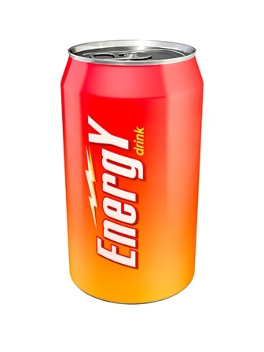
Energy Drinks
Energy drink is a type of drink containing sugar and stimulant, usually caffeine, which is marketed as providing mental and physical stimulation.
Energy drinks are supposed to give you an extra burst of energy.

Slide 9
Energy Drinks
Advertising for energy drinks usually features increased muscle strength and endurance, but there is still no scientific consensus to support these claim.Energy drinks have been associated with health risks and excessive or repeated consumption can lead to cardiac or psychiatric conditions.

