Slide 1
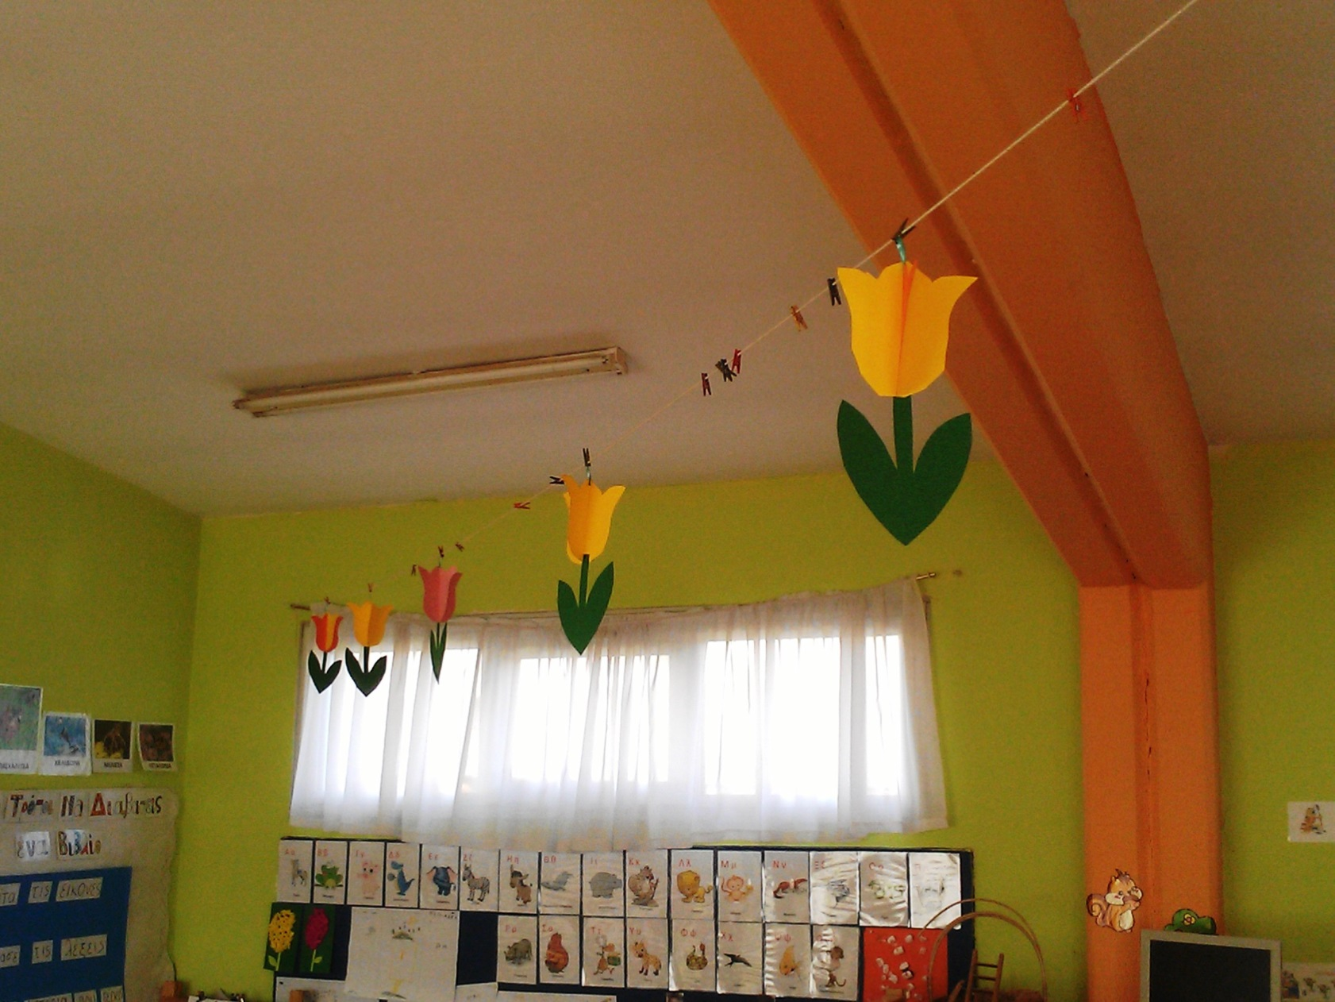
Lovely Paper Toulips 8-03-2016

Slide 2
