Slide 1
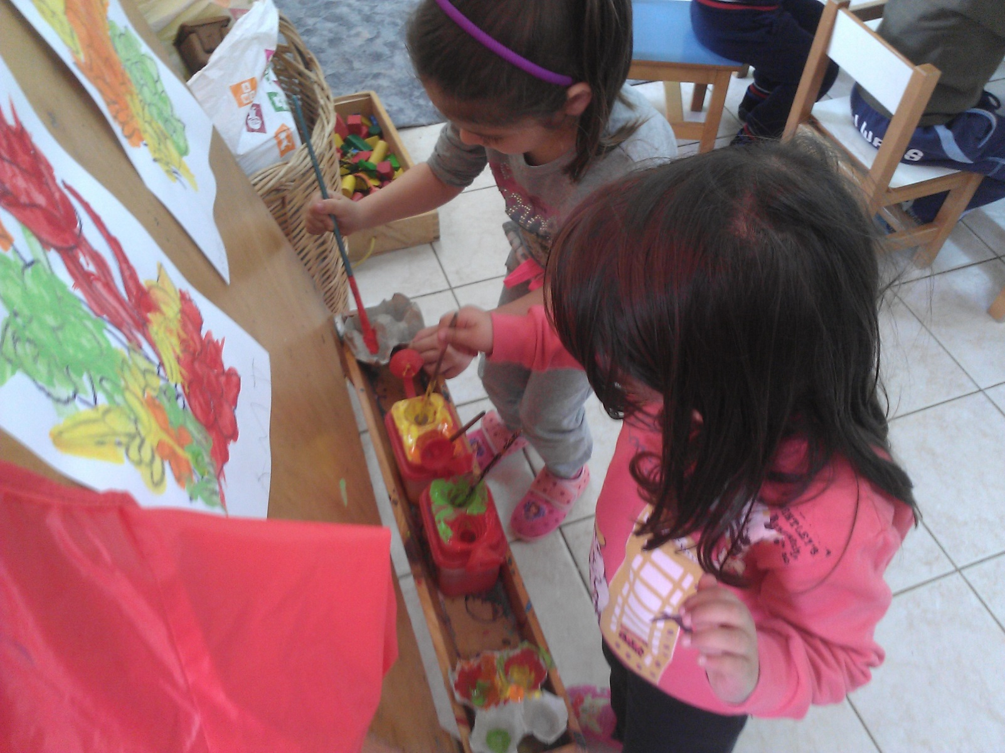
Coloring and drawing flowers. 29-03-2016

Slide 3
