Slide 1
KESTANELİK İLKOKULU
ÇATALCA-İSTANBUL
(2015-2016)

Slide 2
photos

Slide 3
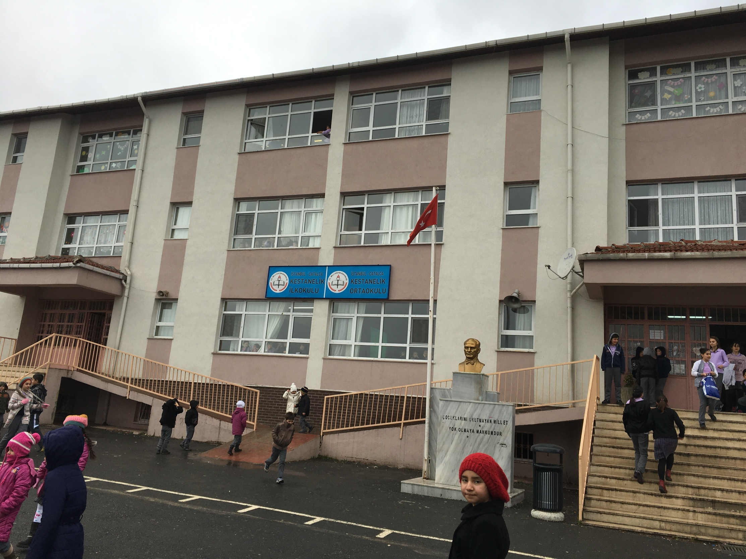

Slide 4
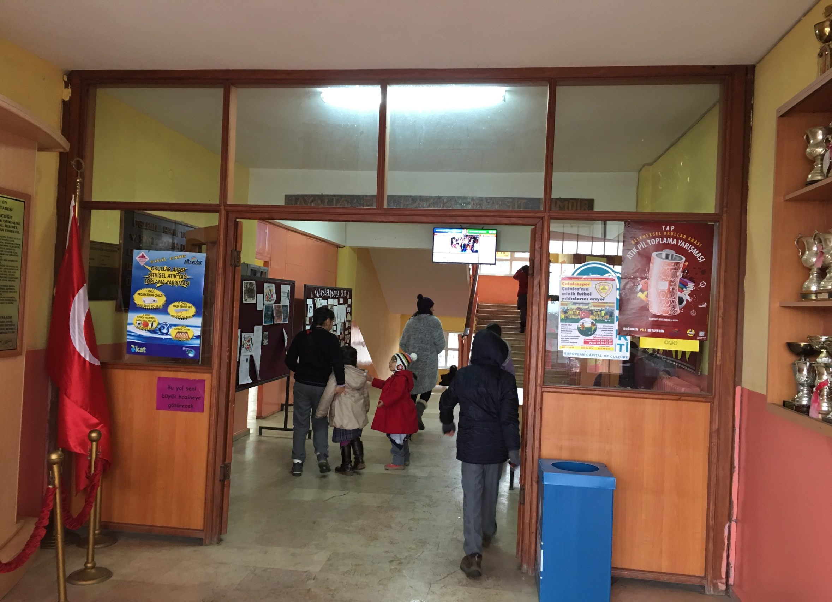

Slide 5
classes

Slide 6
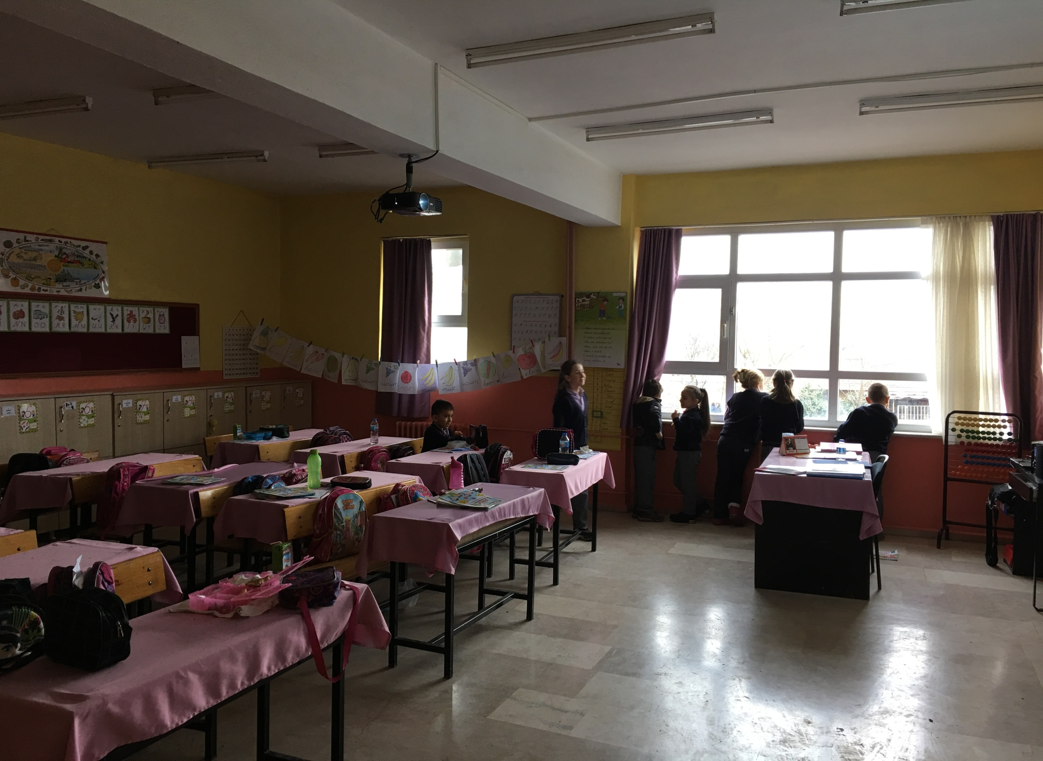

Slide 7
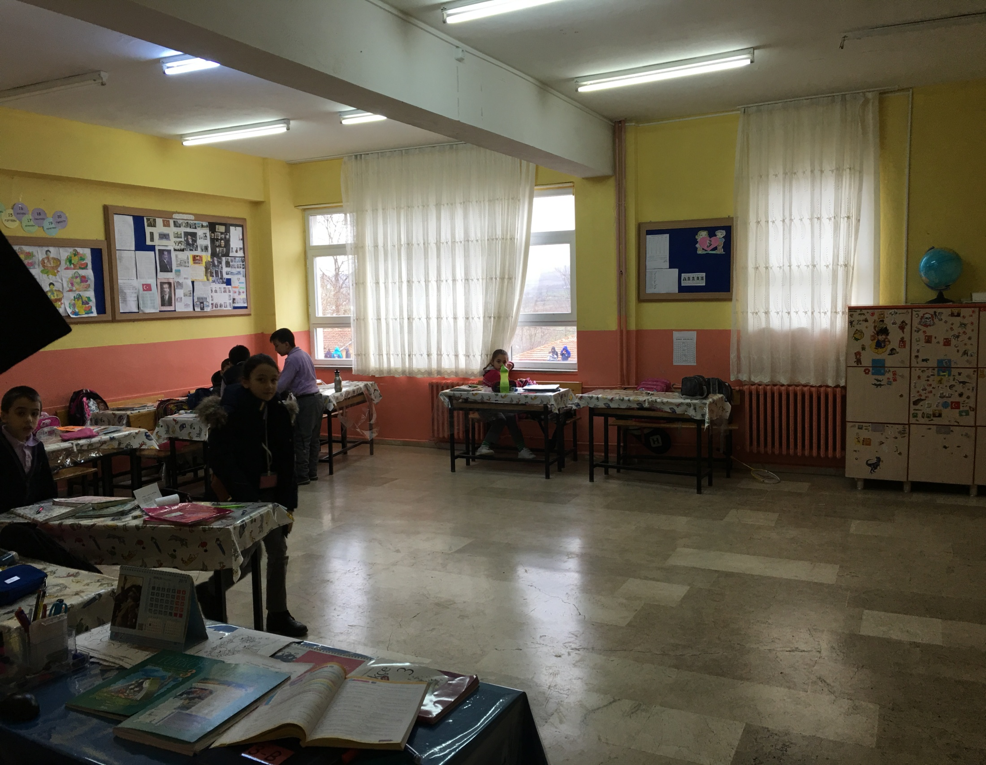

Slide 8
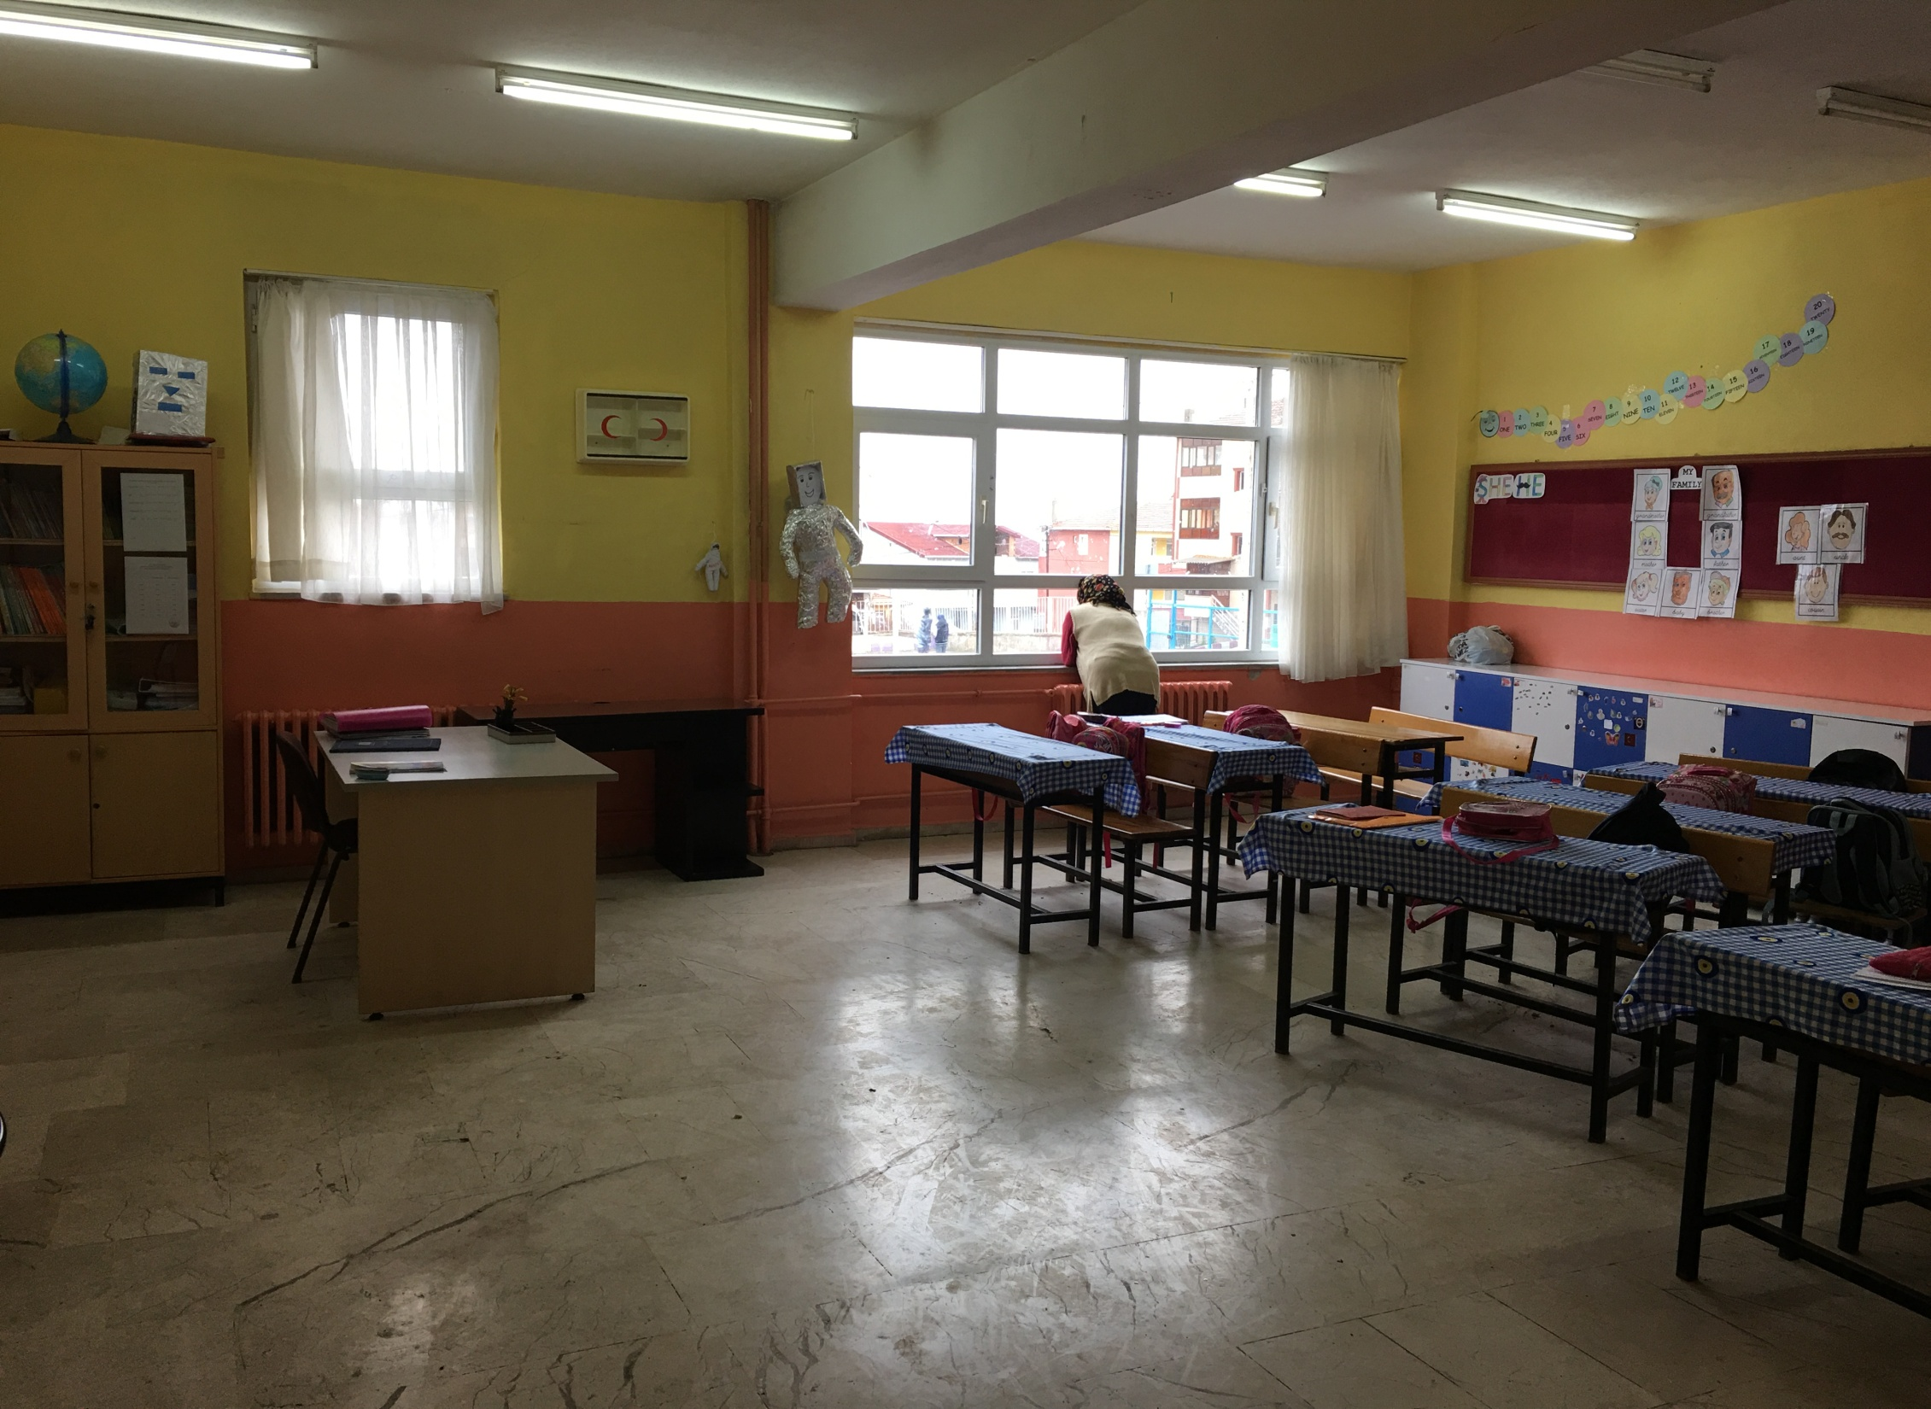

Slide 9
corridor

Slide 10
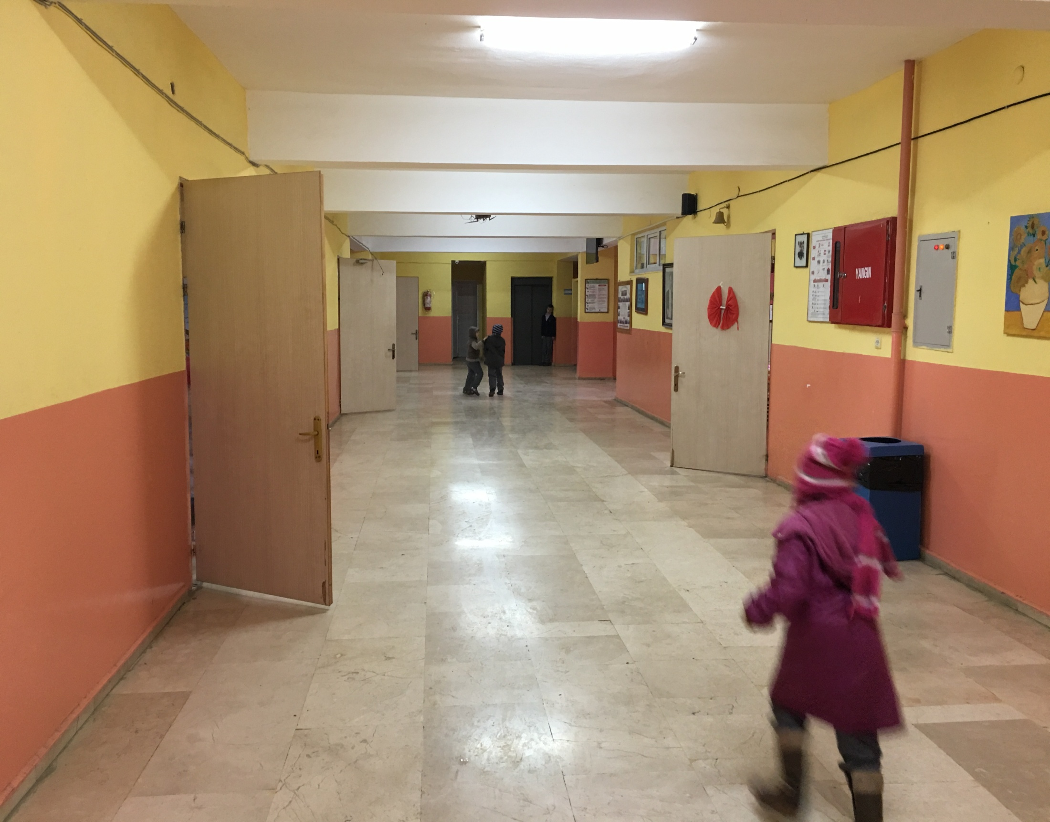

Slide 11
garden

Slide 12
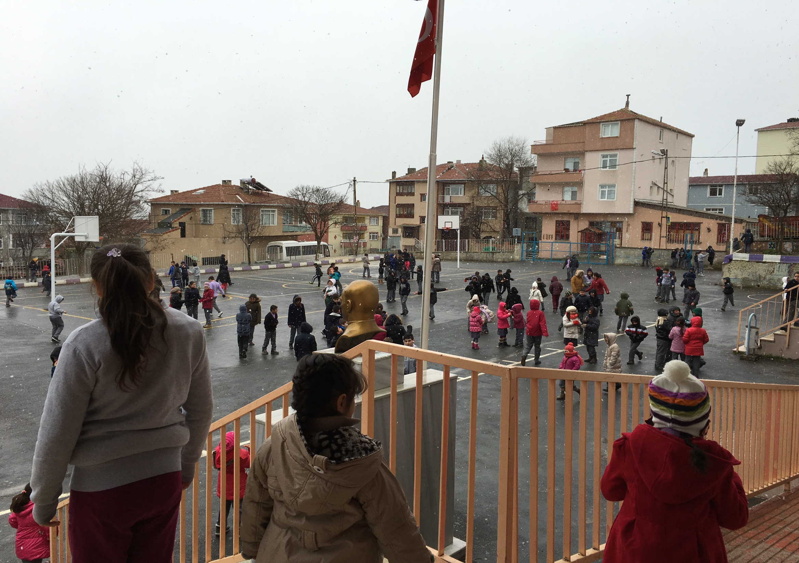

Slide 13
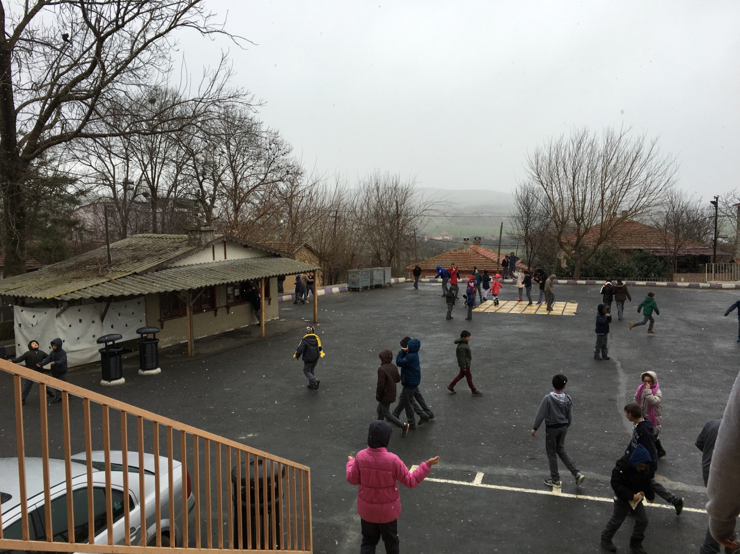
A snowy day

Slide 14
We love our school ☺

