Slide 1
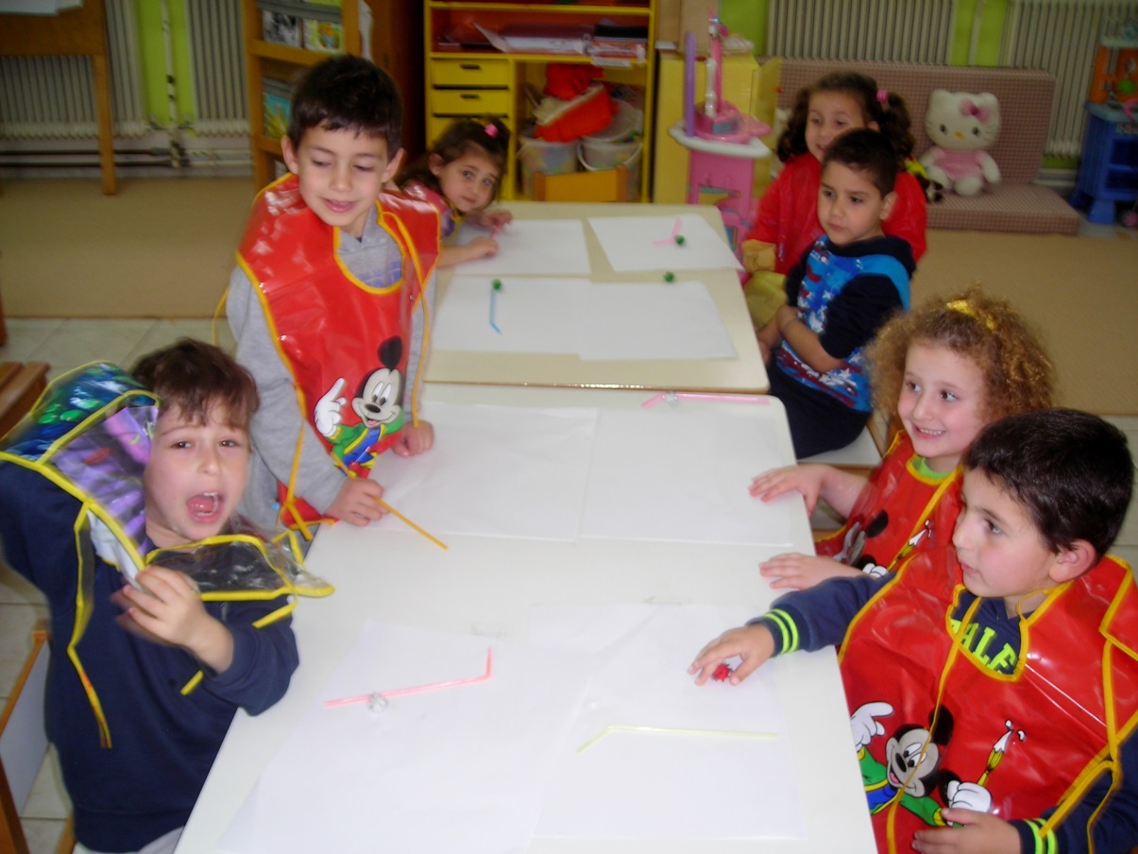
Making flowers by blowing through straw. 17/2/2016 Getting ready…

