Slide 1
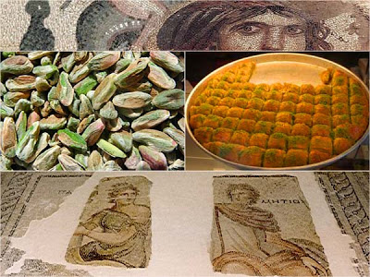
TOWN GAZİANTEP
TURKEY

Slide 2
POPULATION : 1,556 million
POPULATION : 1,556 million
POPULATION : 1,556 million
POPULATION : 1,556 million
POPULATION : 1,556 million
Country - TURKEY
County - GAZİANTEP
Municipality -ŞEHİTKAMİL
POPULATİON : 1,556 Million
Area – 7,642 km²

Slide 3
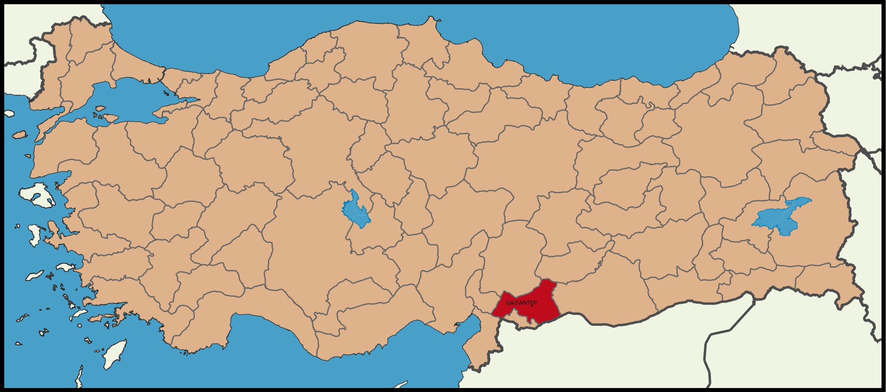
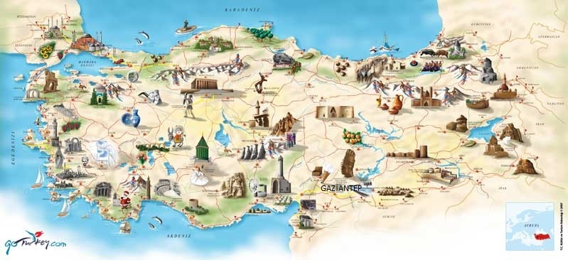

Slide 4
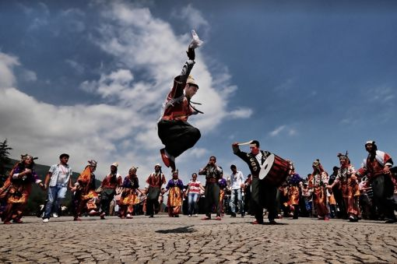
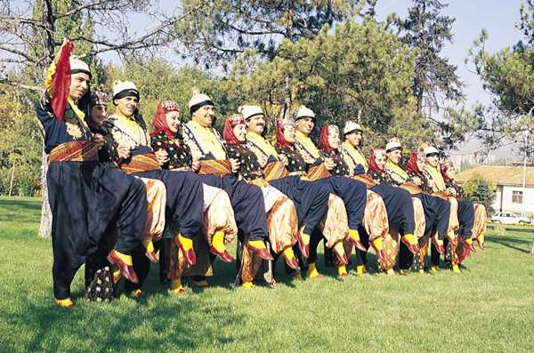
GAZİANTEP folk costumes

Slide 5
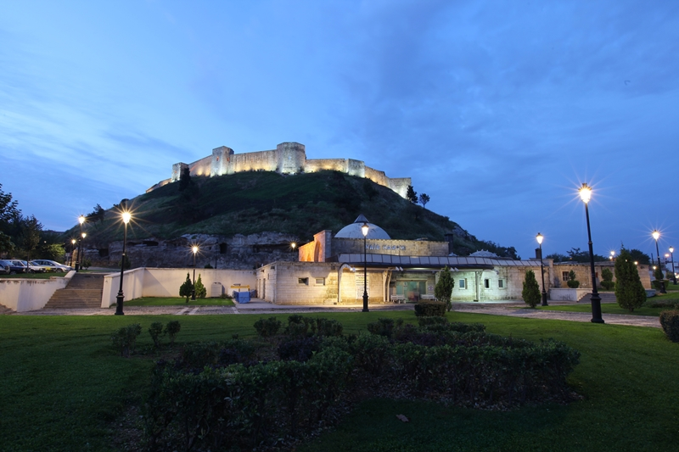
GAZIANTEP CASTLE

Slide 6
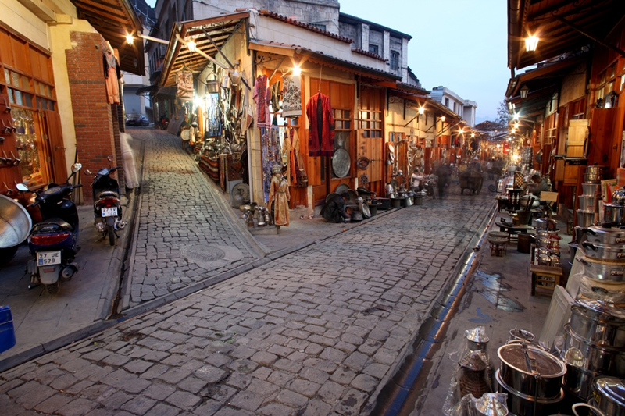

Slide 7
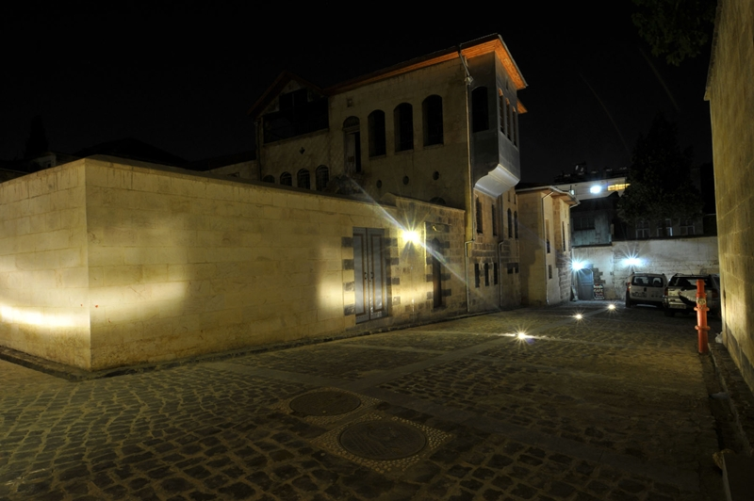
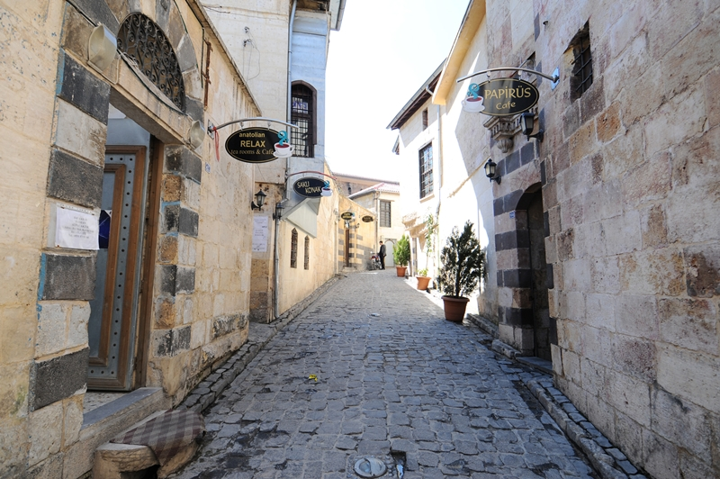
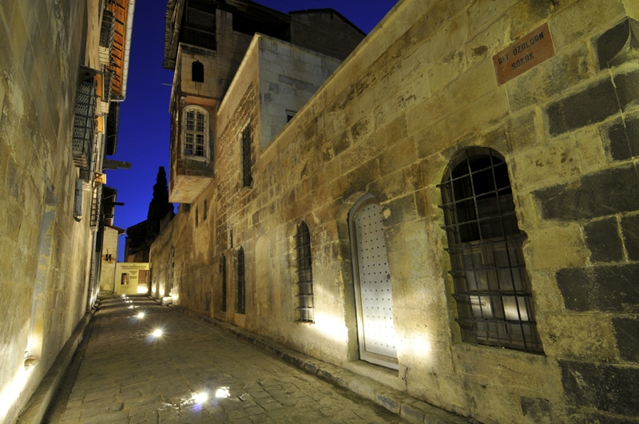
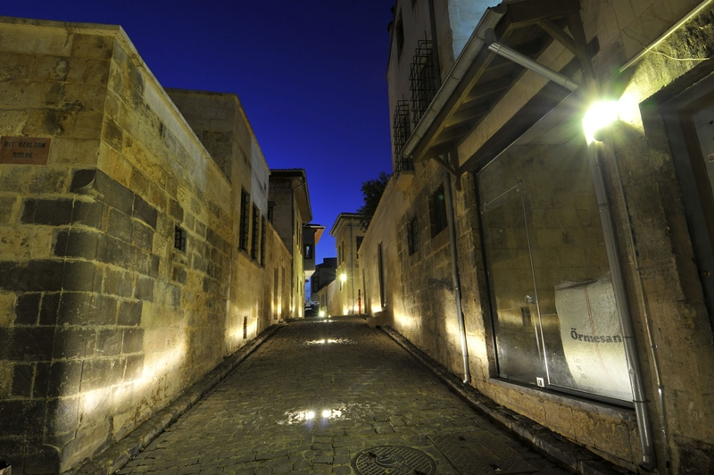
HISTORIC GAZİANTEP HOUSES

Slide 8
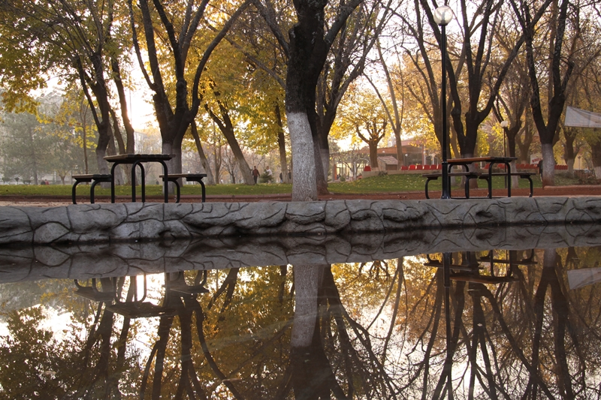
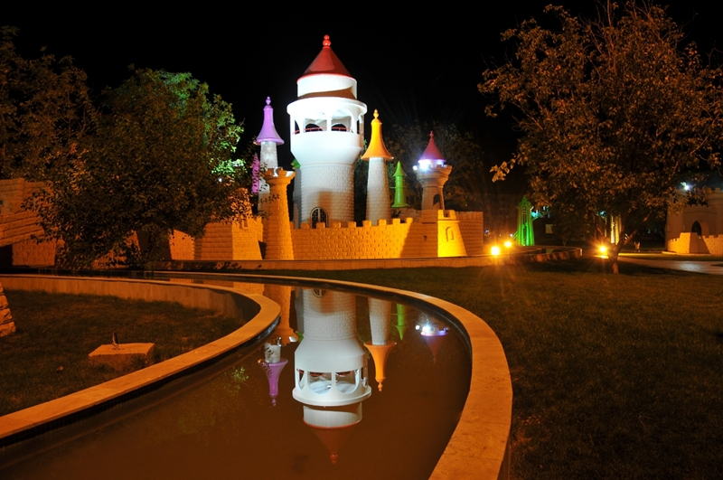
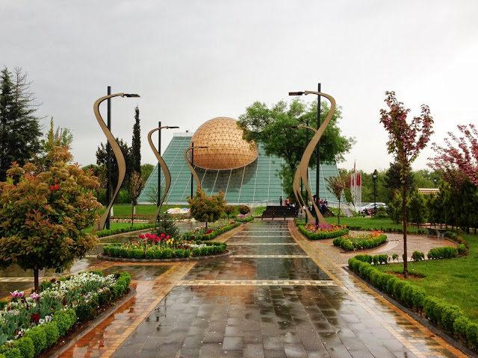
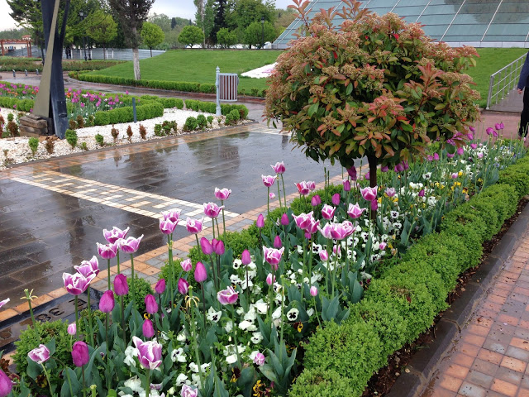
FAIRY TALE PARK
GEZEGEN EVİ ( PLANET HOUSE)
GEZEGEN EVİ ( PLANET HOUSE)

Slide 9
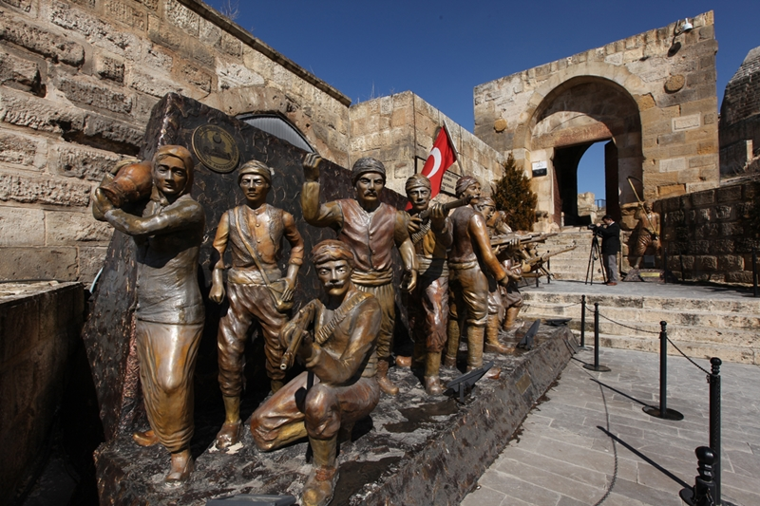
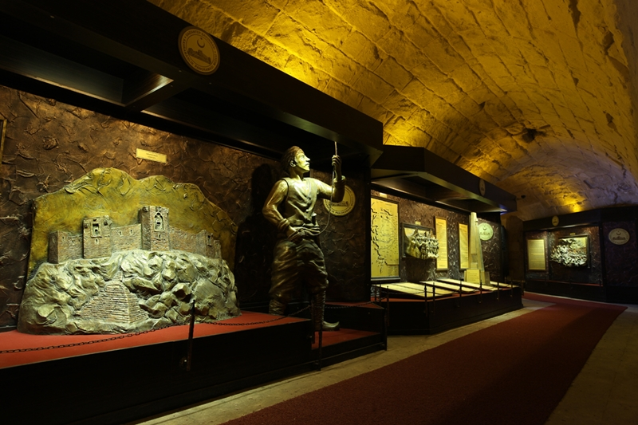
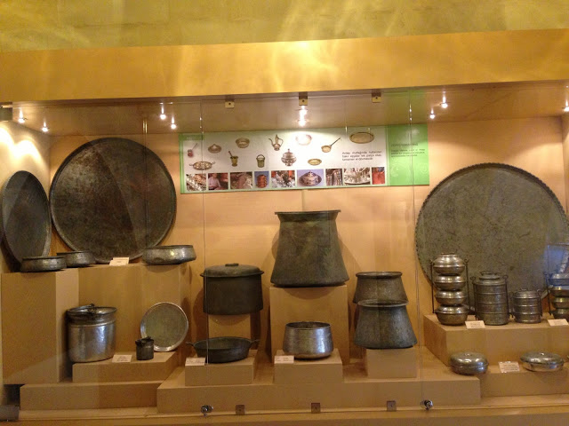
WAR MUSEUM
Emine Göğüş Mutfak Müzesi(Kitchen Museum)

Slide 10
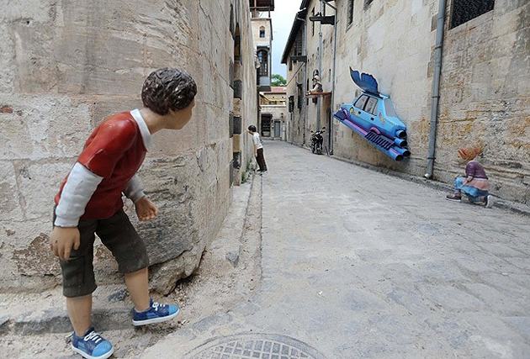
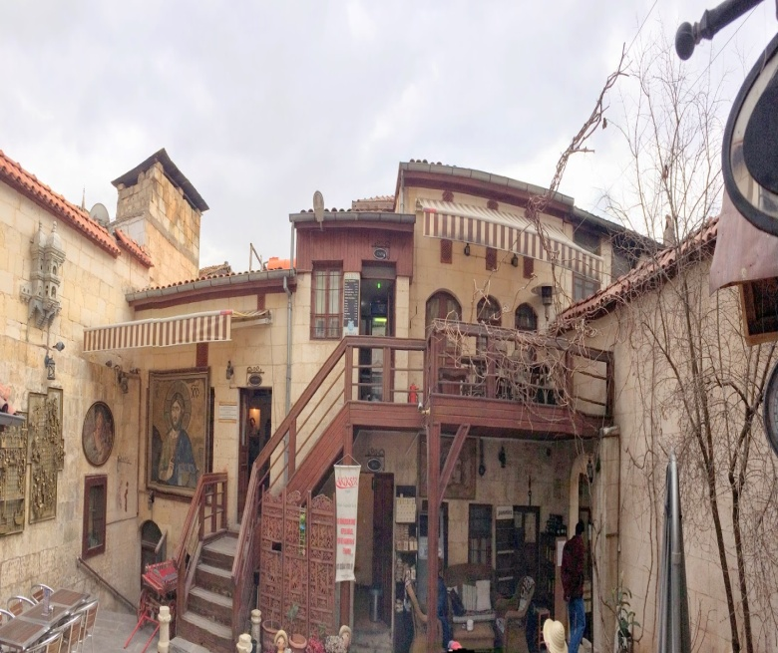
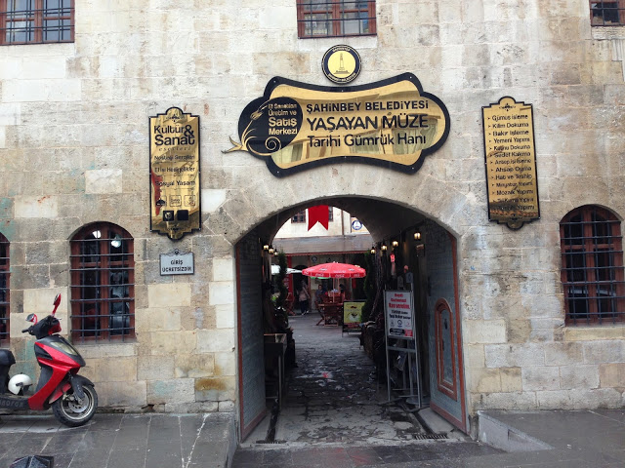
ZEUGMA MUSEUM
TOY MUSEUM
MUSEUM OF GLASS
LIVING MUSEUM

Slide 11
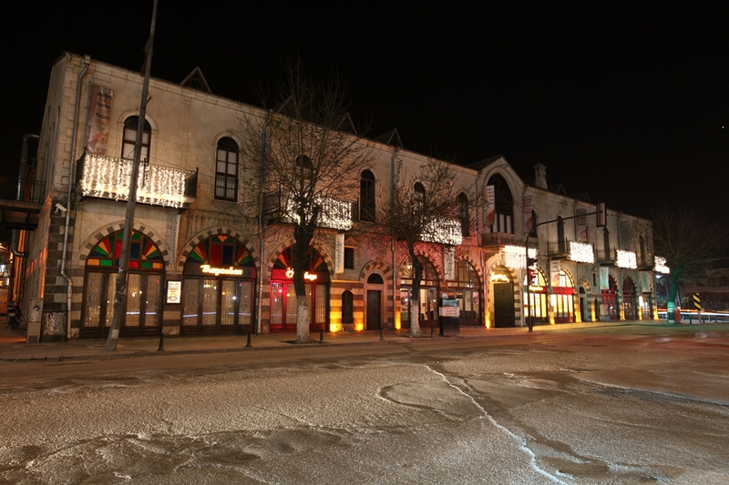
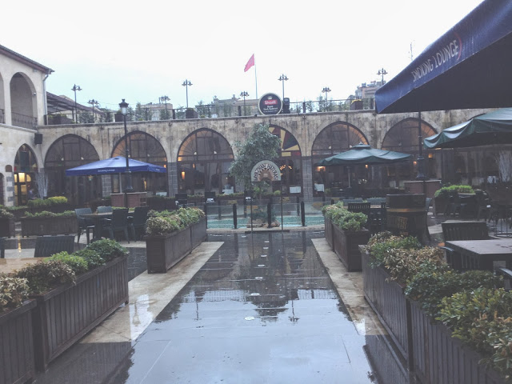
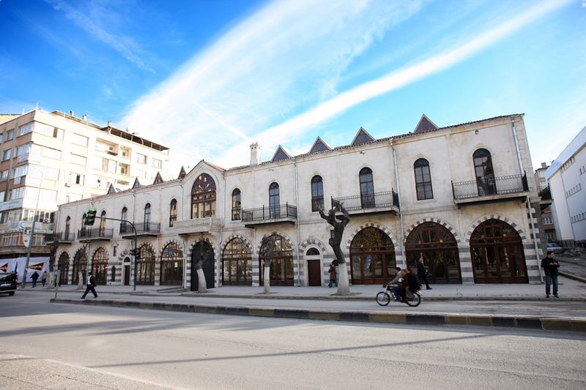
WHITE HAN

Slide 12
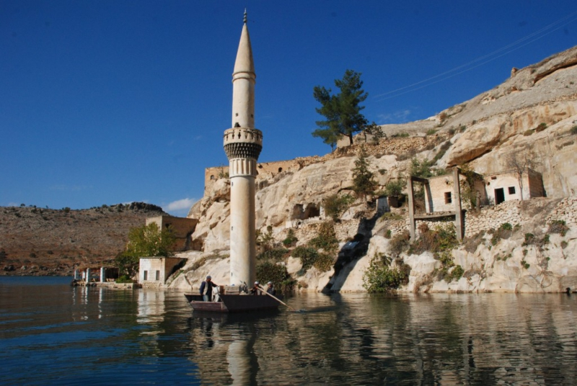
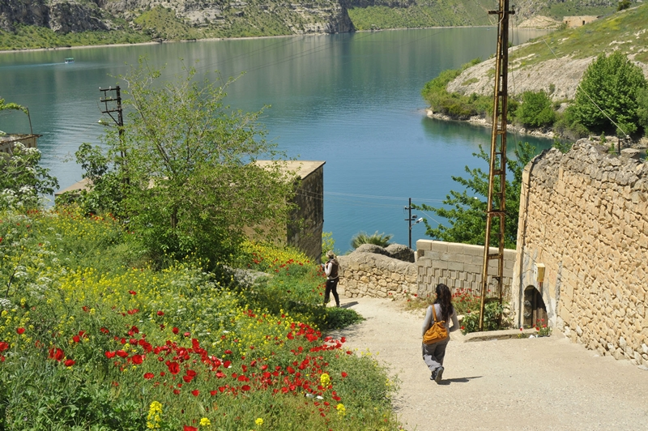
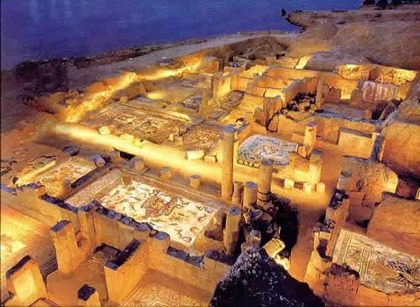
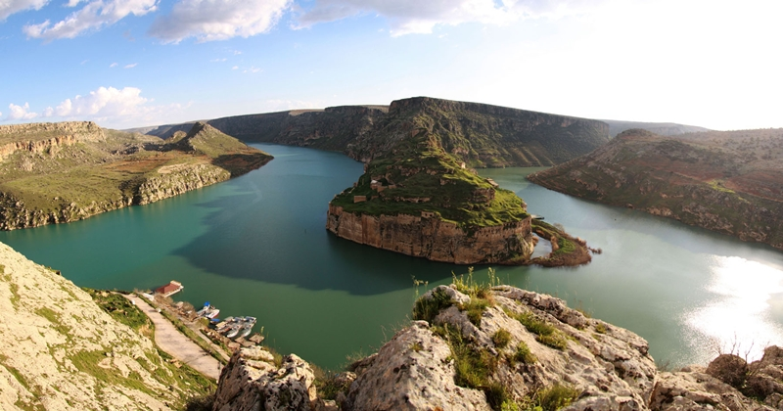
BELKIZ-ZEUGMA

Slide 13
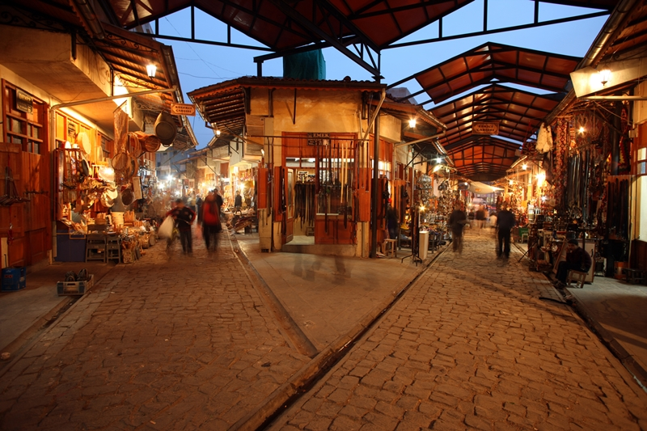
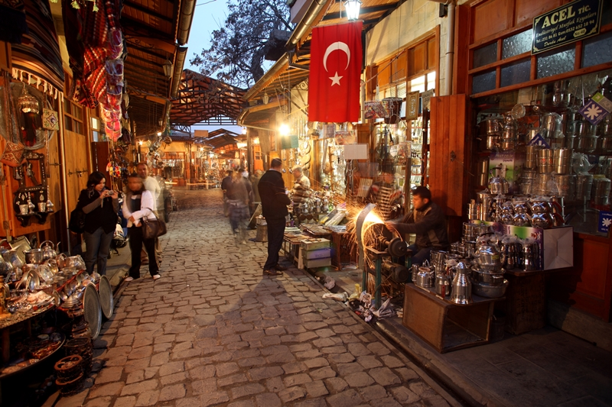
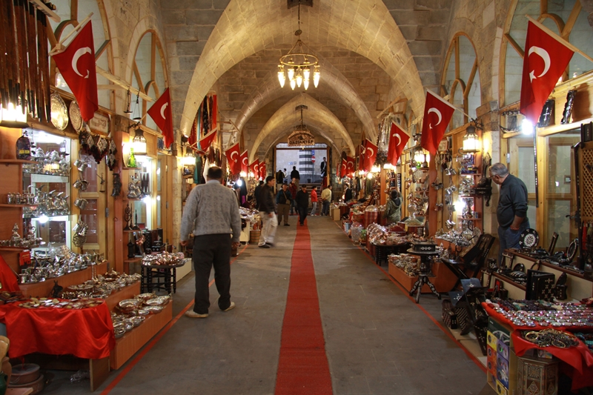
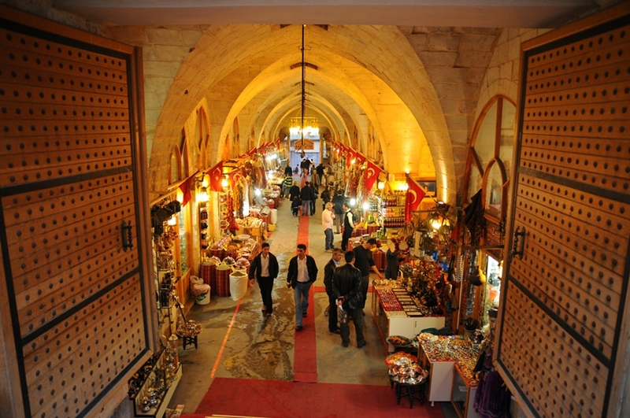
THE COPPERSMITHS'
ZİNCİRLİ BEDESTEN

Slide 14
GAZIANTEP CUISINE
Food in Gaziantep has a separate place outside of normal nutrition. Dishes and desserts made on special occasions, the seasons and social culture of the factors that have created over time in the most beautiful way moves.Depending on the changing conditions of food culture that we already have, new ones continue to be added. Of course meals created by the old culture you're defending yourself to them when the heart is created by the makers of the new food culture continues with the continuity of the new creation.For this reason, only the kitchen which goes by the name of Gaziantep cuisine in the world.

Slide 15
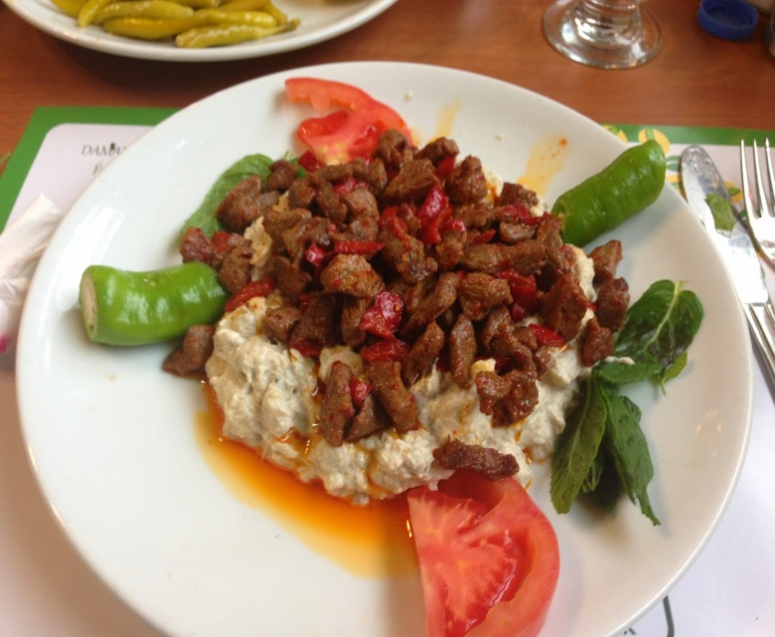
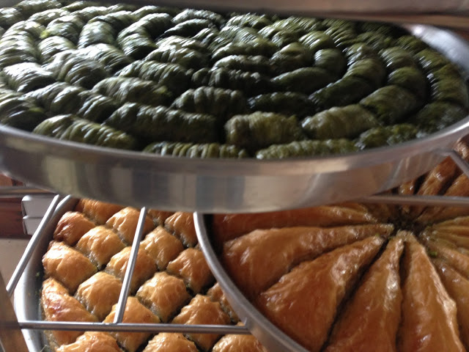
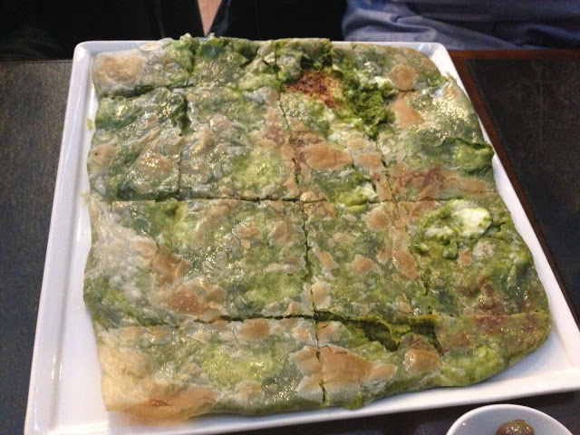
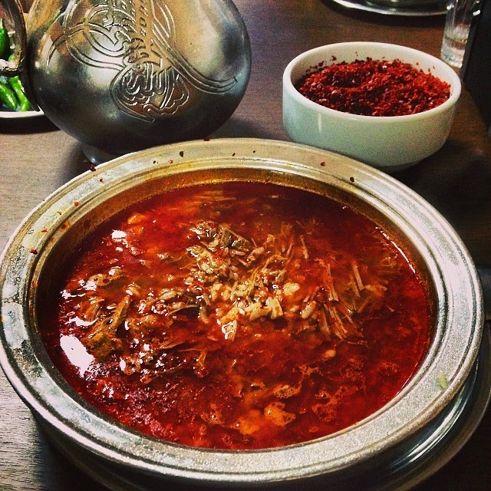
ANTEP BAKLAVASI
ALİNAZİK
BEYRAN
FISTIKLI KATMER

Slide 16
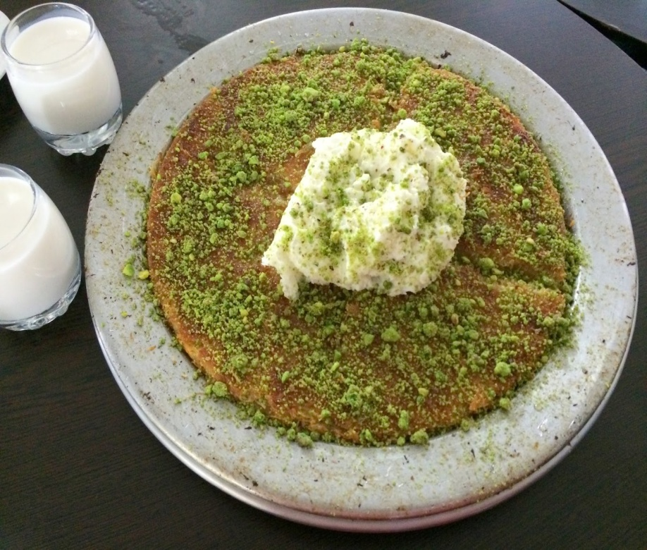
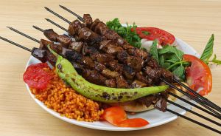
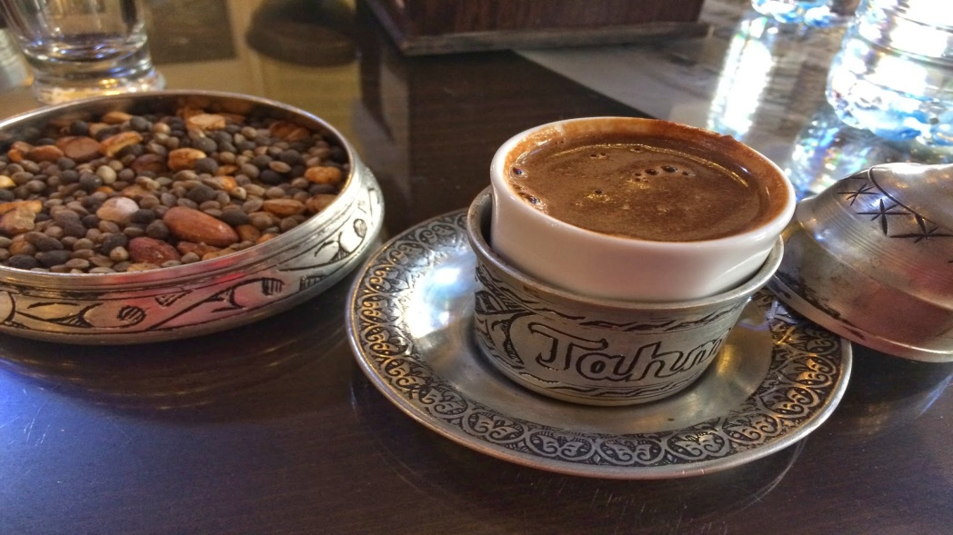
KÜNEFE
KEBAB
TAHMIS COFFEE HOUSE

Slide 17
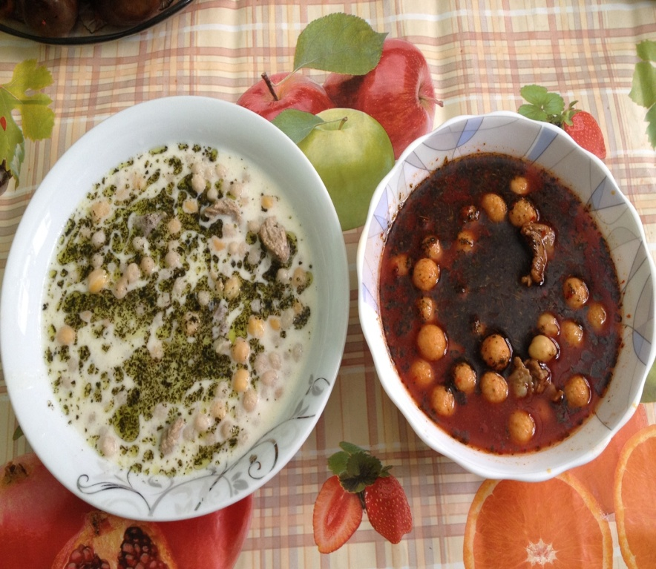
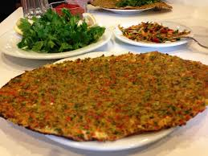
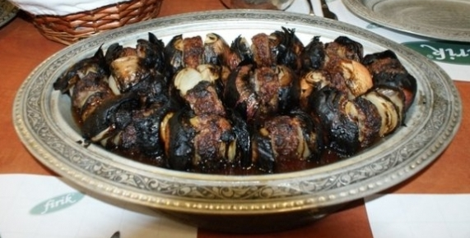
YUVALAMA
LAHMACUN
SOĞAN KEBABI

Slide 18
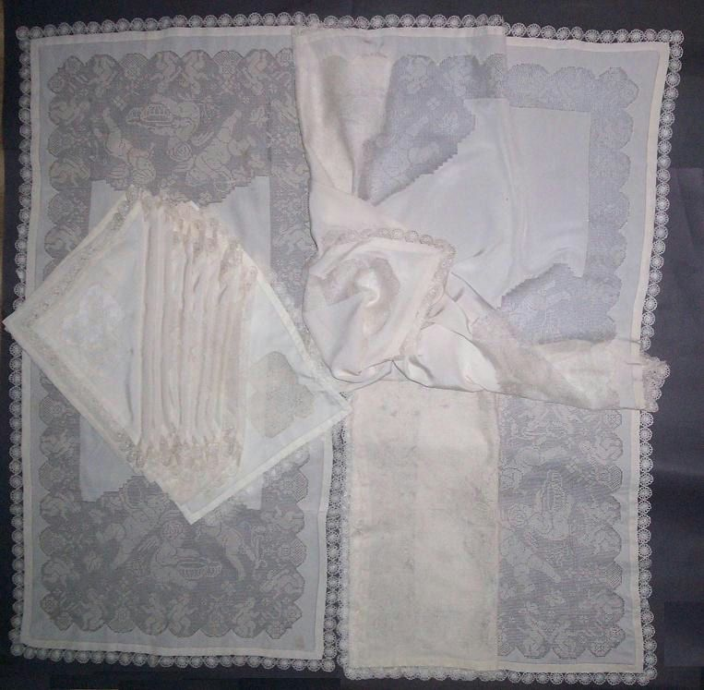
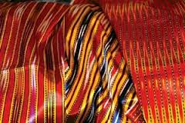
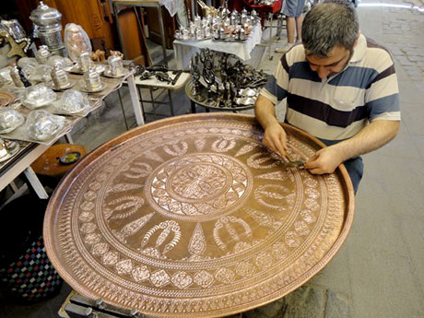
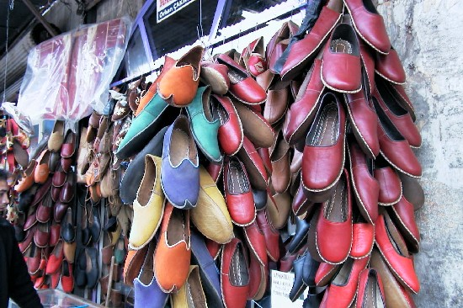
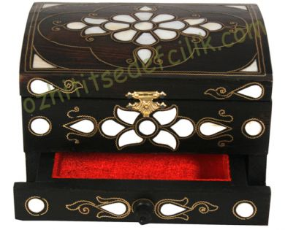
HANDMADE

Slide 19
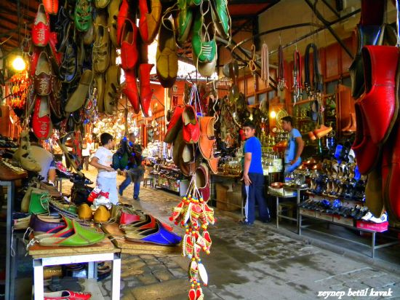
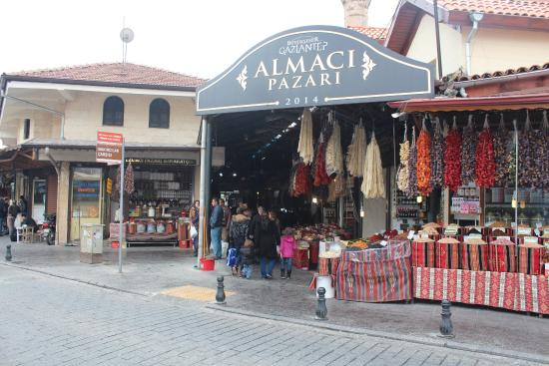
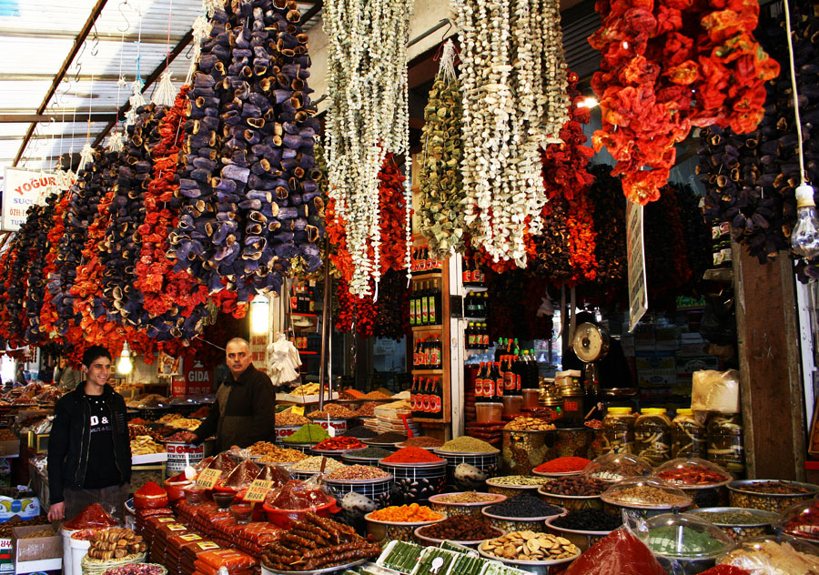

Slide 20
ANTEP PISTACHIOS

Slide 21
Our school
OUR SCHOOL TEACHERS AND I

Slide 22
Dear Colleagues, In The Cıty Of Gazıantep In Southern Turkey In Kındergarten I'm The Dırector Of The School. There Are 200 Learners In Our School . I Am Doıng Thıs Professıon For 10 Years. The Cıty I Lıve In Is Rıch In Culture And Hıstory. Wıth Food In Our Country Is Famous .

