Slide 1
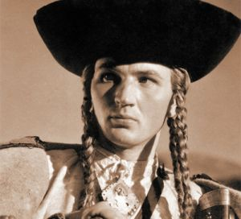
Juraj Jánošík
A folk hero from Slovakia

Slide 2
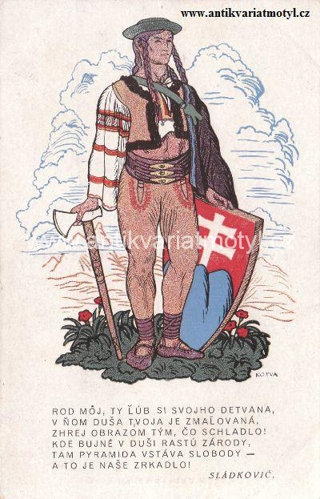
One of the most famous folk heroes in Slovakia is Juraj Jánošík.

Slide 3
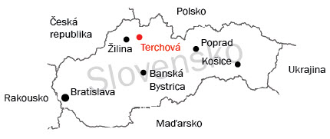
He was born in Terchova in 17th century. He came from a poor family. He had one sister and three brothers.
Terchová

Slide 4
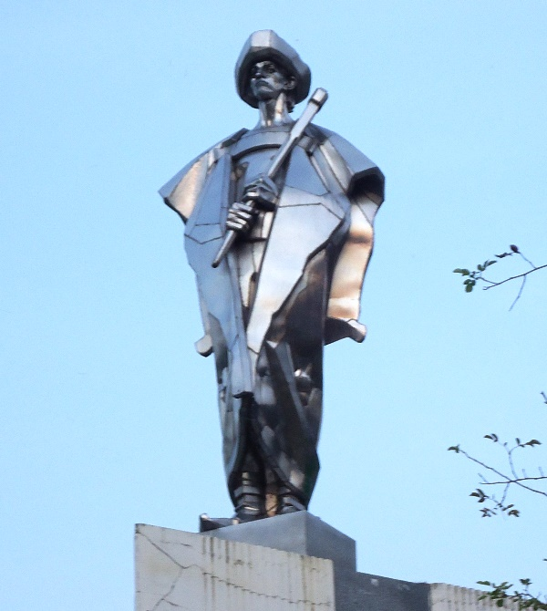
Terchová is the village
in Žilina region. Every
summer there are folk
festivals called
„Janosik´s days.
There is also a big monument
– the statue of Juraj Jánošík.
It´s made of iron and its height
is 7.5 metres.

Slide 5
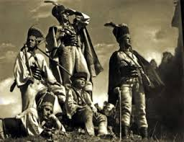
In the past poor people liked Janošík very much. He was brave, strong and clever. He protected them with his
friends.
They robbed
the rich to give
the poor.

Slide 6
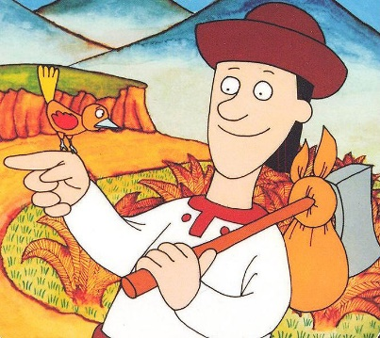
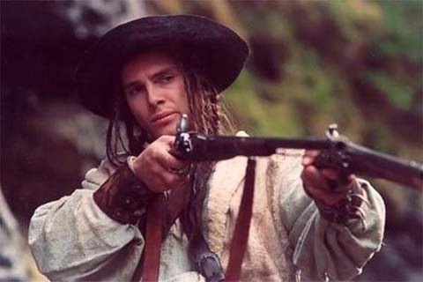
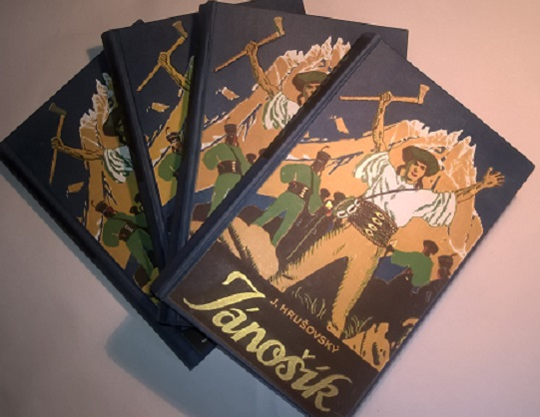
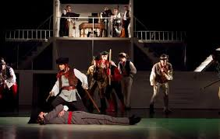
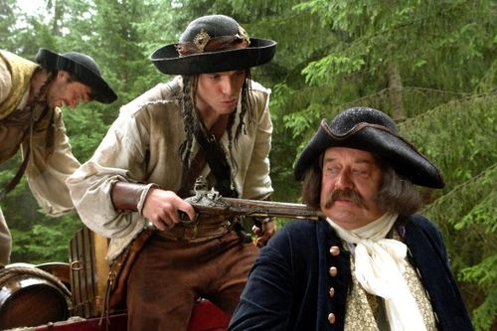
There are many stories, poems, cartoon series,
films and theatre performances about this legendary hero.

Slide 7
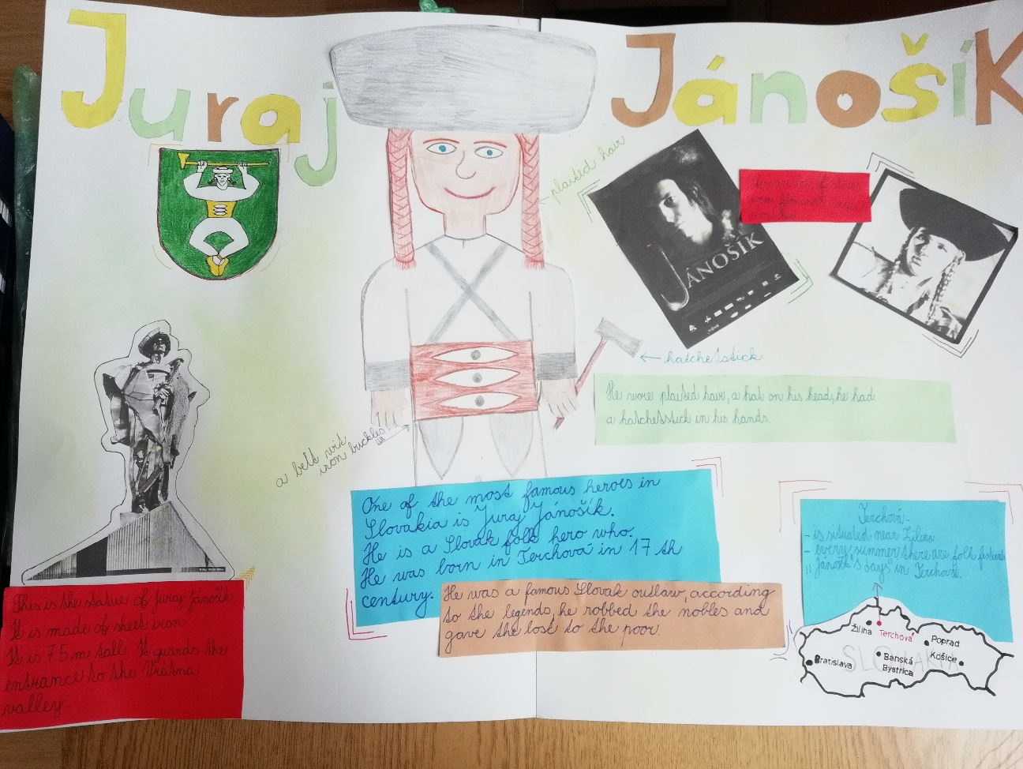
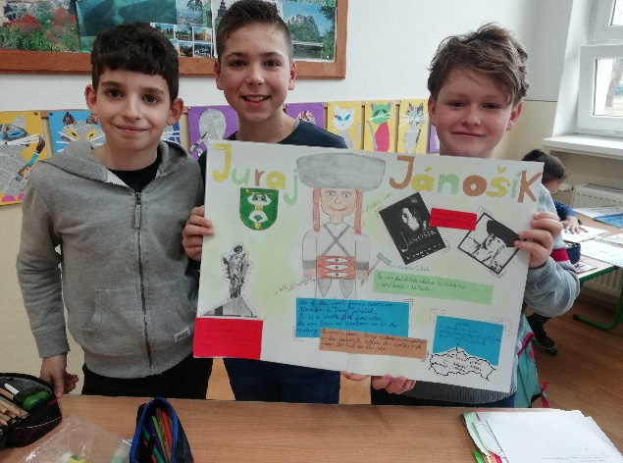
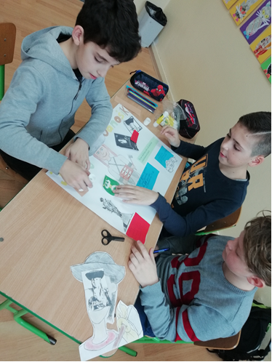
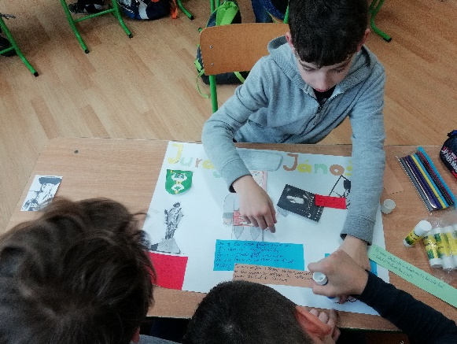
We also like Jánošík so we did a small project about his life and his appearance.
Jacob
Paul
Adam
Class 5. C

