Slide 1
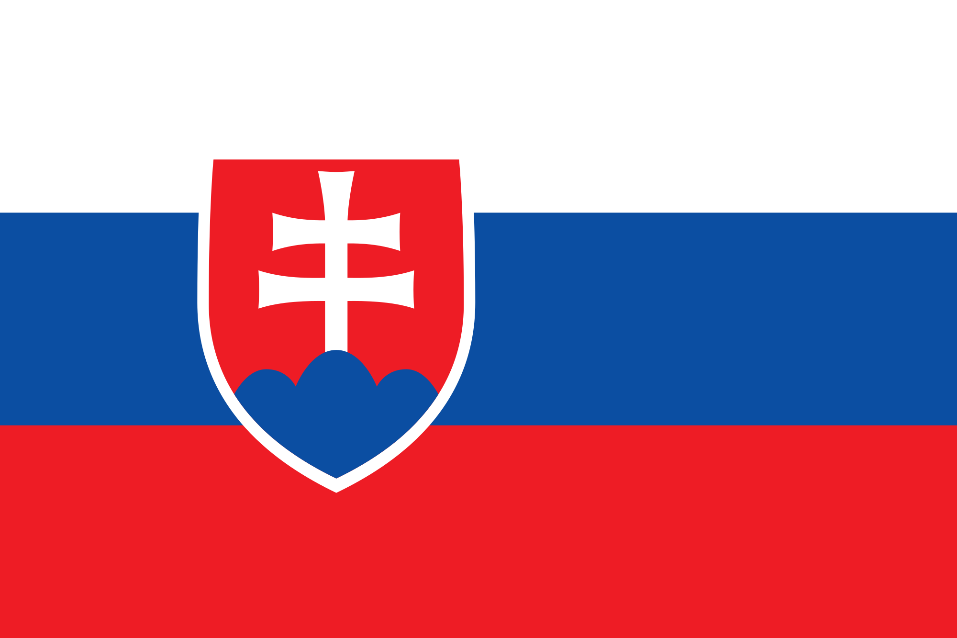
Slovakia

Slide 2
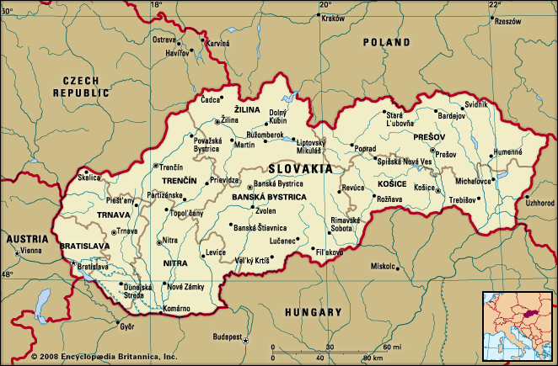
Slovakia or the Slovak Republic is a country in Central Europe. - it is bordered by the Czech Republic, Austria, Hungary, Poland and Ukraine

Slide 3
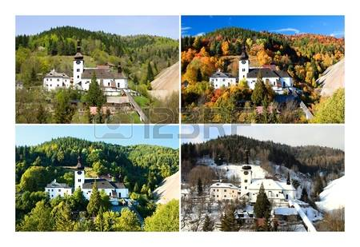
In Slovakia there are four seasons – spring, summer, autumn, winter. Each season lasts three months.

Slide 4
The population is over 5 million. The official language is Slovak.

Slide 5
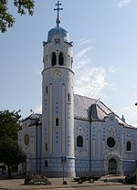
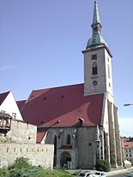
The capital and the largest city is Bratislava. There are many buildings, bridges, the river Donau Danube, Bratislava Castle and others sights – Castle Devin, St Martin's Cathedral, the Church of St. Elisabeth.

Slide 6
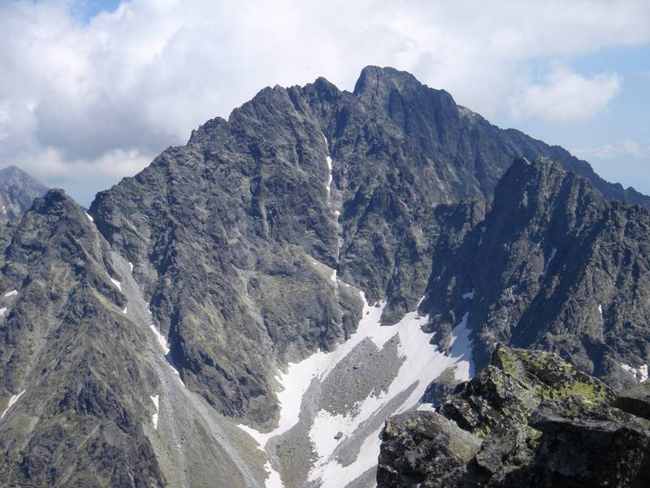
The biggest mountains are the High Tatras, where we can find the highest peaks, many lakes, waterfalls, uniqe plants and animals. The highest peak is Gerlachovský Štít. The other peaks – Kriváň, Lomnický Štít.

Slide 7
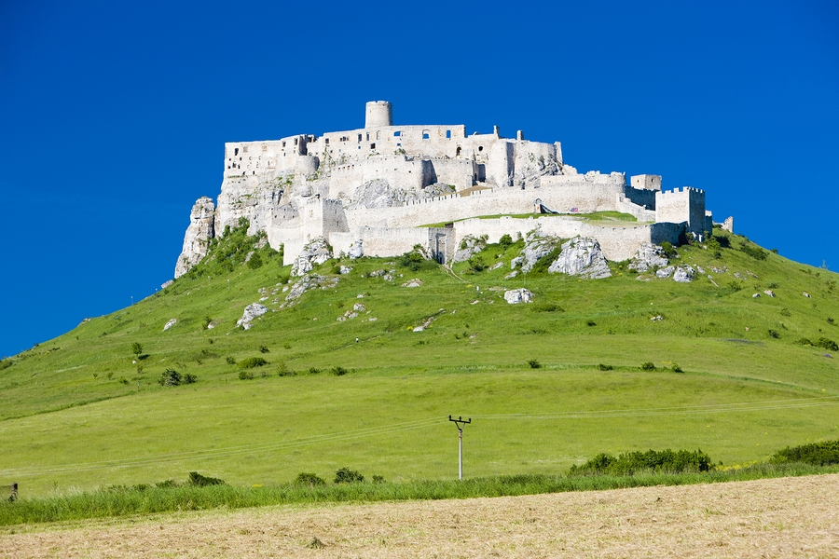
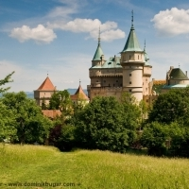
In Slovakia, there are many beautifull castles, churches, historical ruins and others monumensts. The most visited are Spis Castle, Bojnice Castle, Castle Devin, Orava Castle.

Slide 8
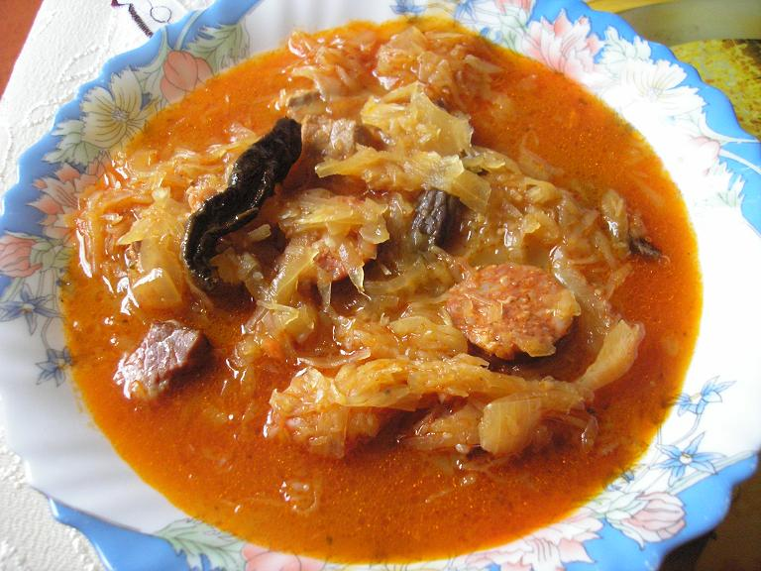
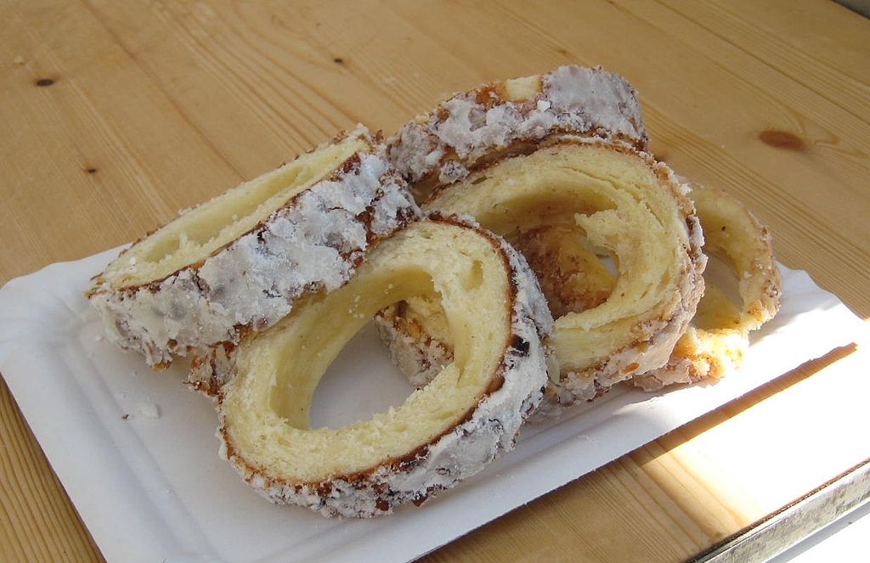
National Slovak food is gnocchi - Halušky, jaternice – tripe, soup Kapustnica - Sauerkraut soup, zemiakové placky – potato pancakes. Traditional sweets and cookies are parené buchty - steamed dumplings, makovník - poppy pie and famous Skalický trdelník.

Slide 9
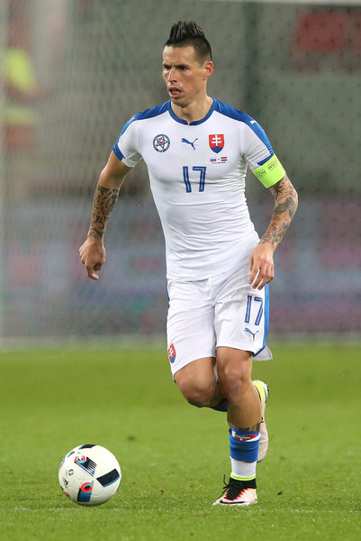
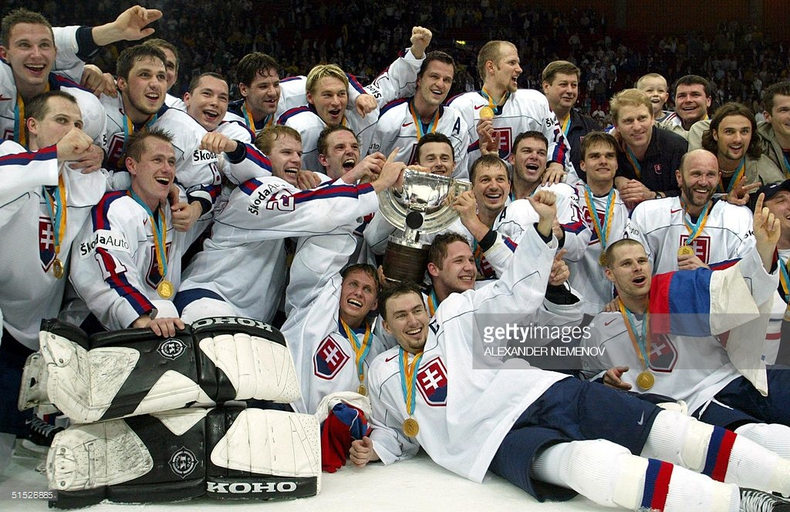
Slovakia has got famous sport athletes, for example: Peter Sagan, Anastazia Kuzmina, Dominika Cibulková, Marek Hamšík, hockey players. We are very proud of them.

Slide 10
Our Country is very beautiful. I am happy I live in Slovakia.

