Slide 1
Lapland

Slide 2
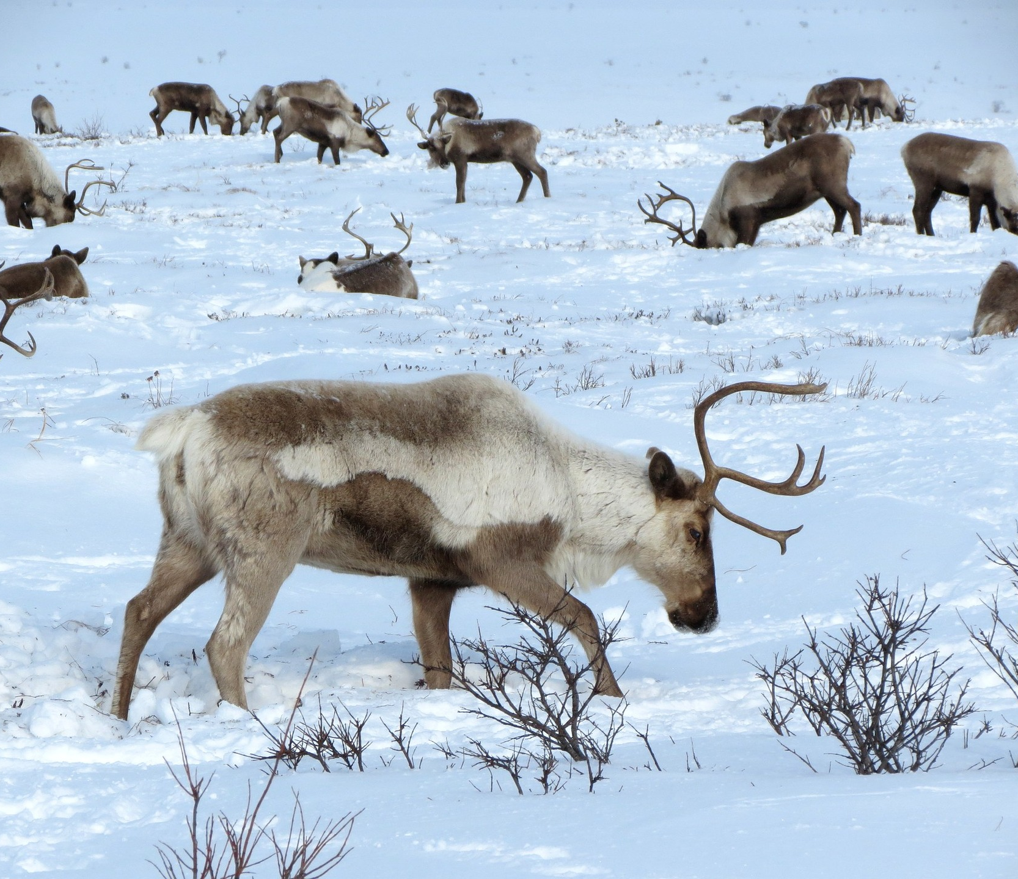
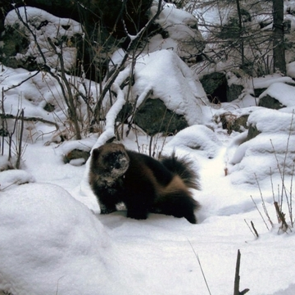
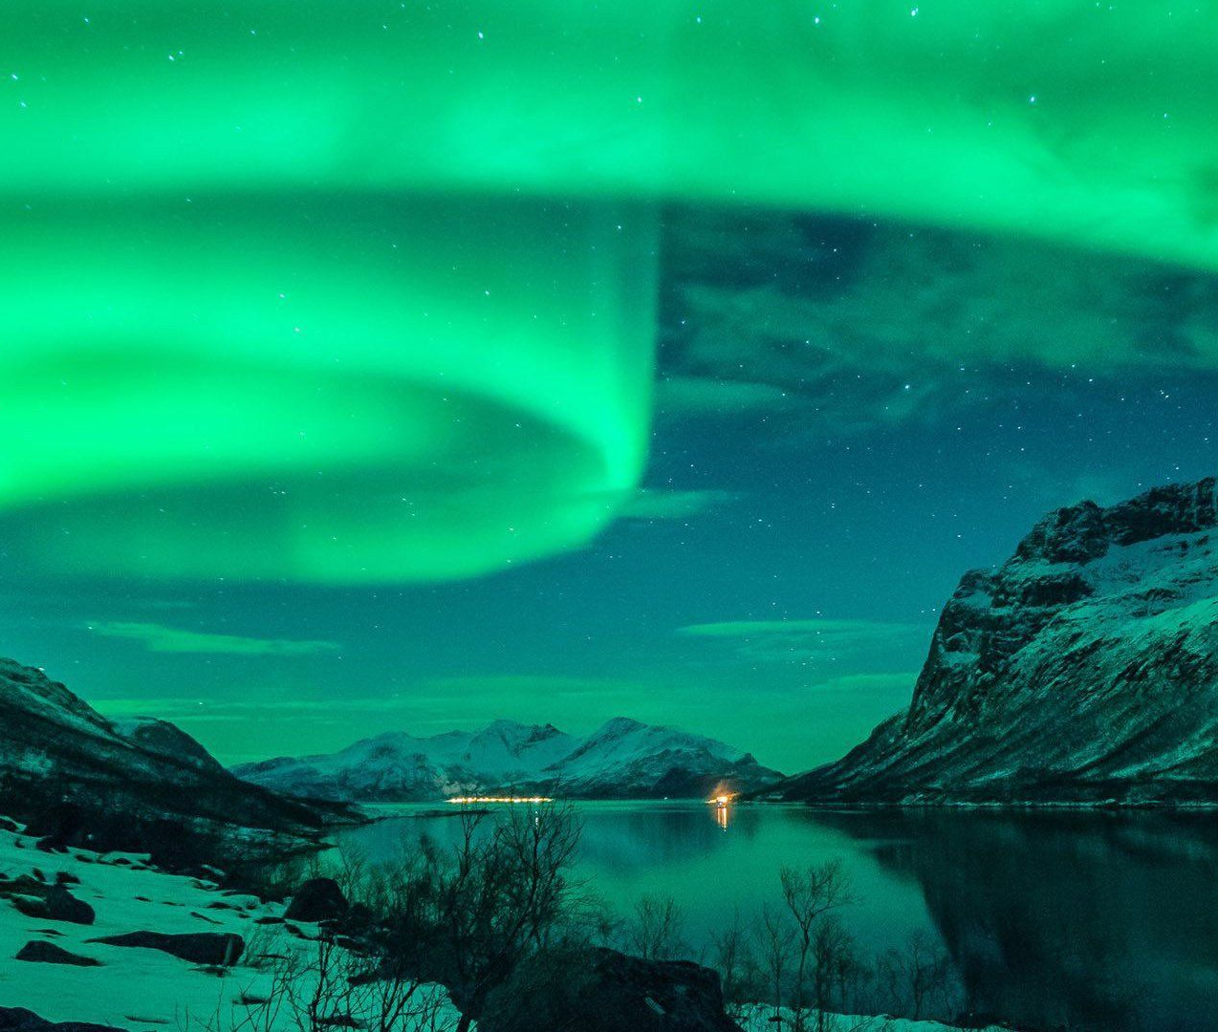
What is in Lapland:
Most of Lapland belangs to taiga.
In taiga there are lot of pinetrees and pruces.
Typical animals in Lapland are reindeers, nests and wolverines.
Santa lives in Lapland.
There are also northern lights.

Slide 3
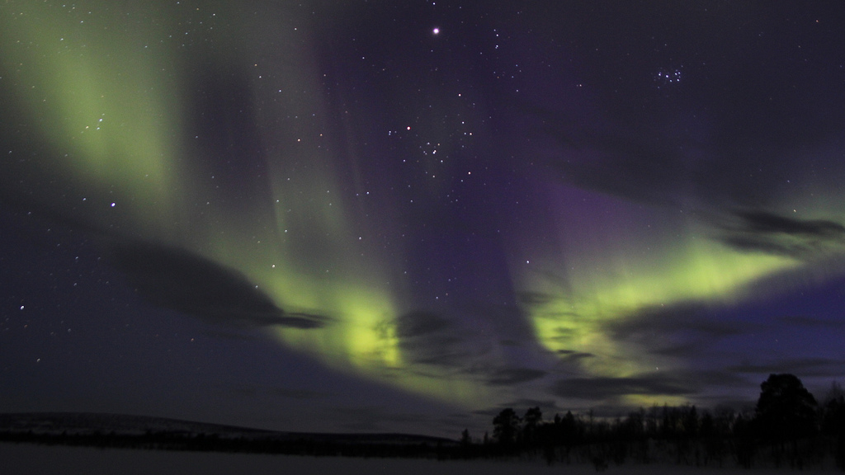
What ist best in Lapland
Lapland is so beautiful place in taiga there are so beautiful colors in the trees and everywhere where you watch.
There are many animals.
In the winter there is a lot of snow.

Slide 4
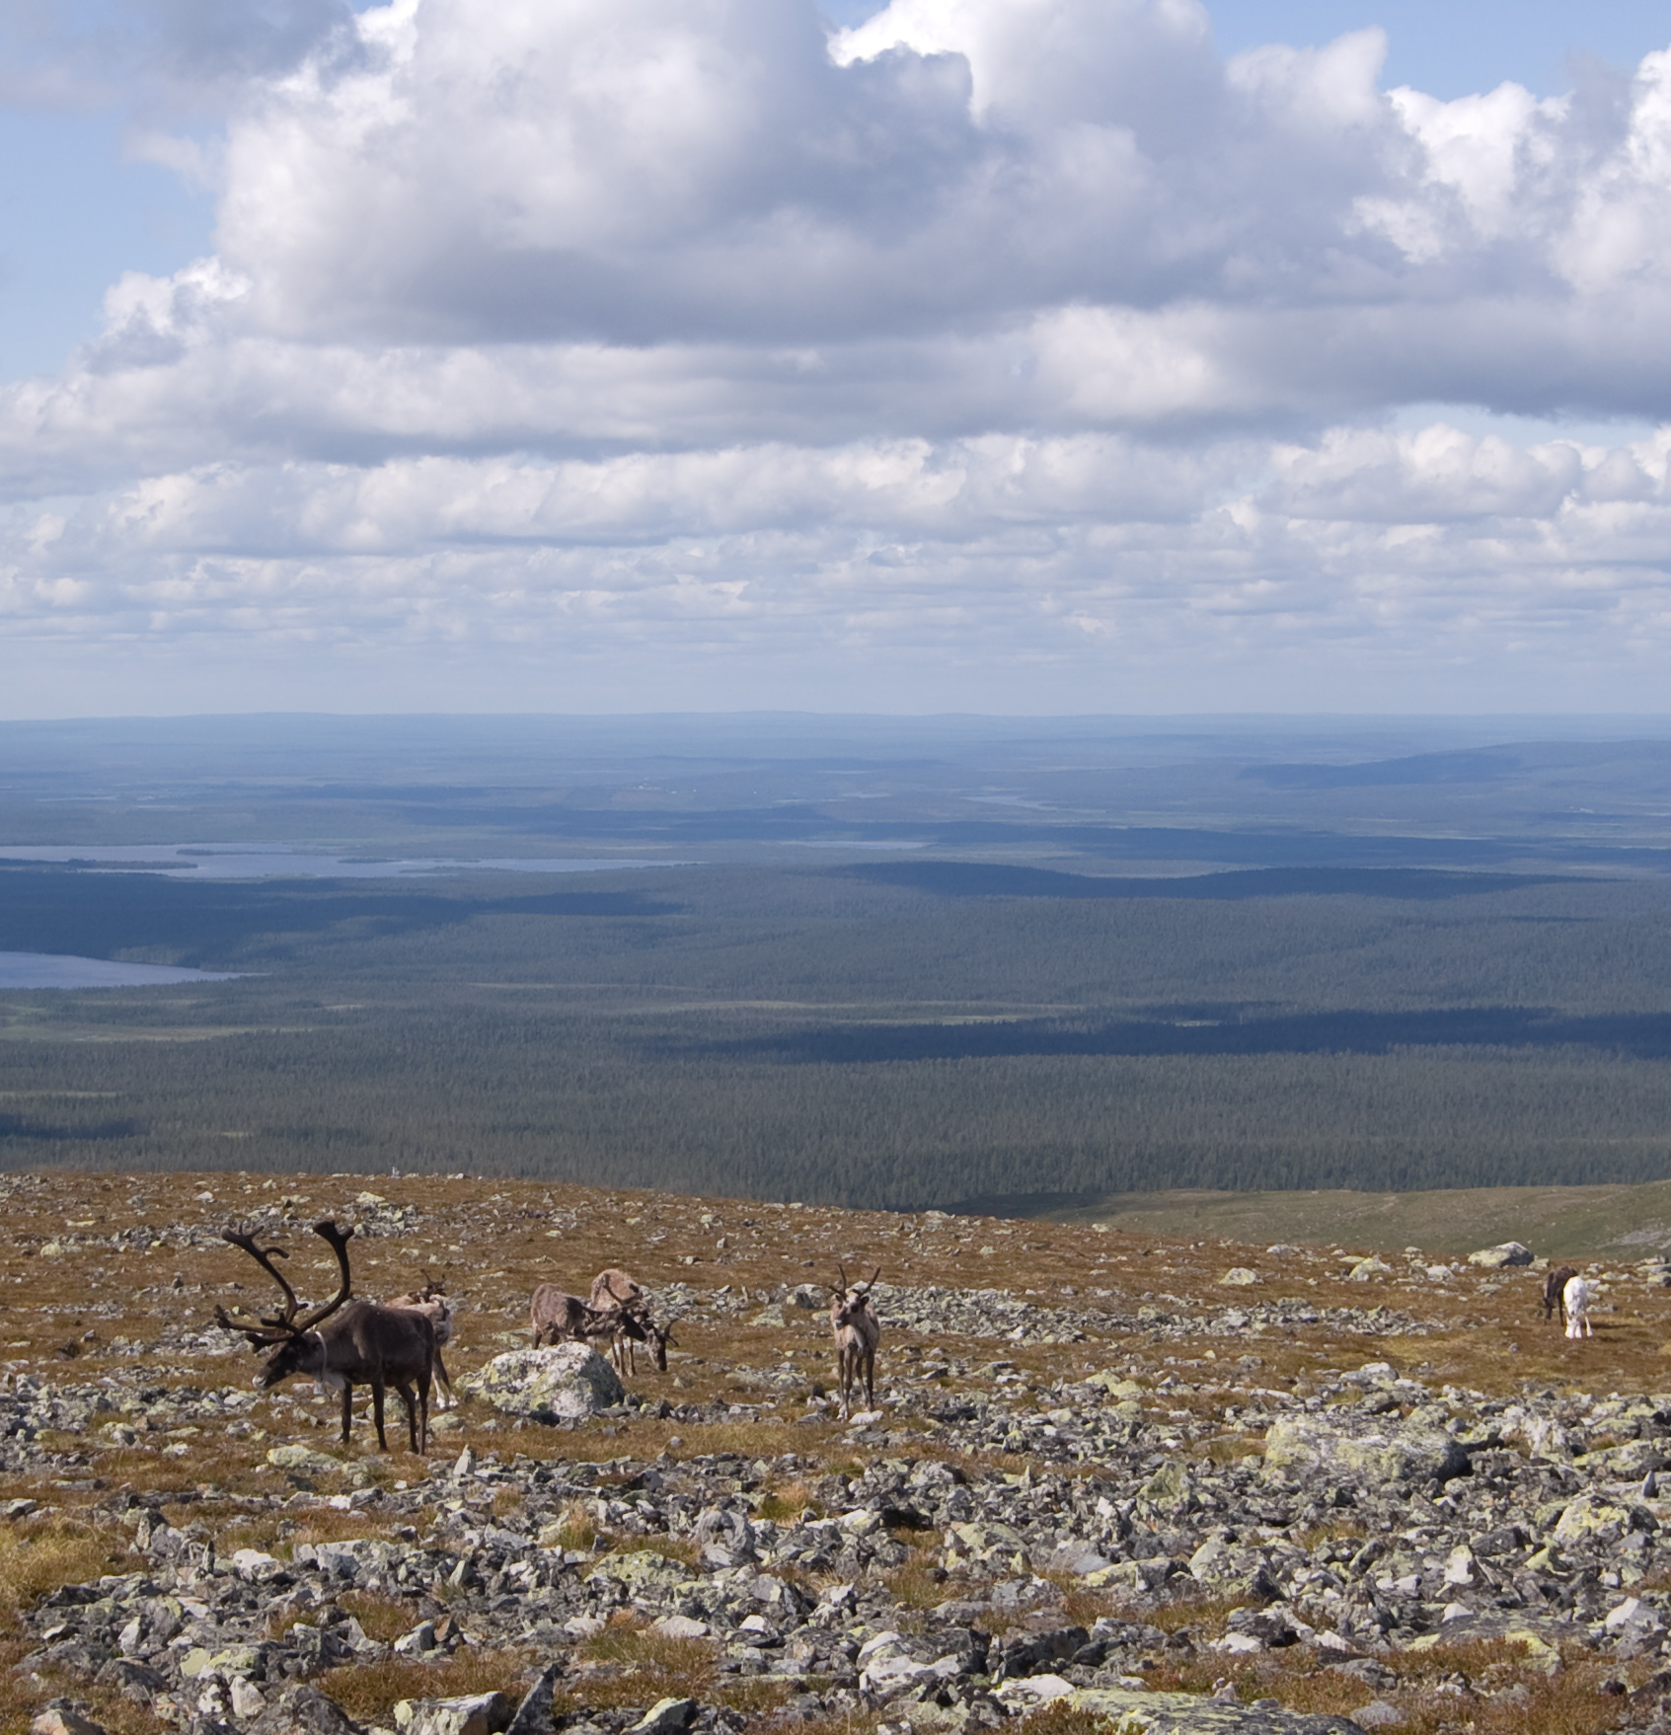
Lapland culture:
Lapland has rich music culture.
Lapland is the cradle of the arts.
Lapland is sport plays they can play ice hockey, go ski and fall.

Slide 5
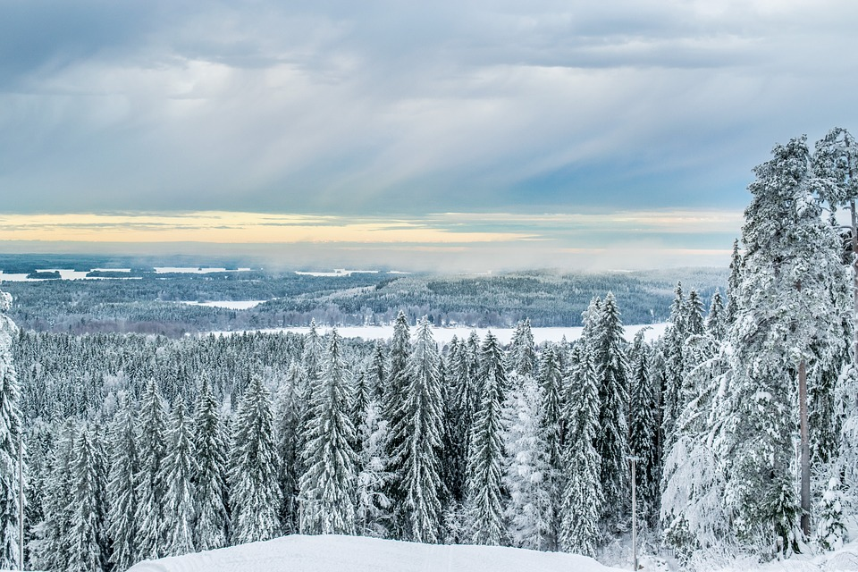
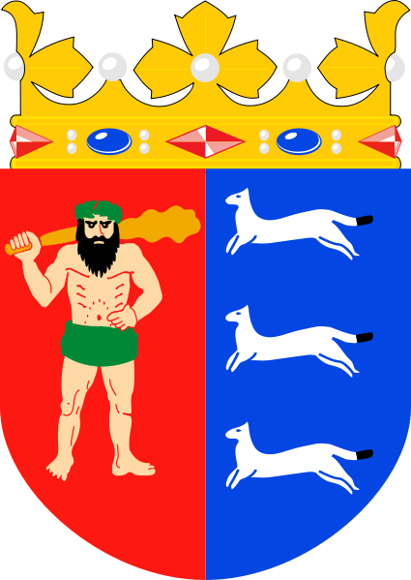
Lapland
Area: 100 366km
Money: euro€
Arms:
Neighboring countries: Norway and Swedish
Language:
saame and Finnish
Population: 179 997

Slide 6
Thanks for watcing
Frida, Venla and Nella

