Slide 1
„Skanzens“ in Slovakia

Slide 2
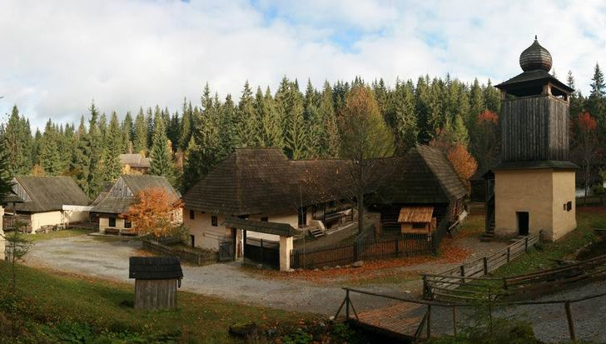
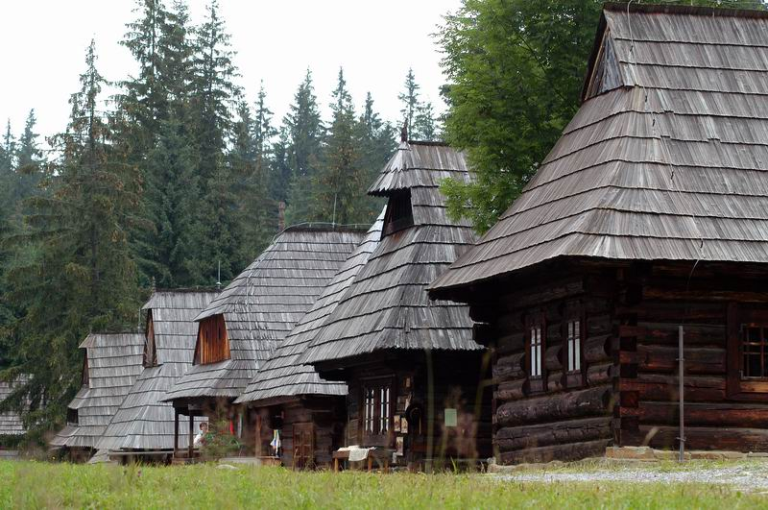
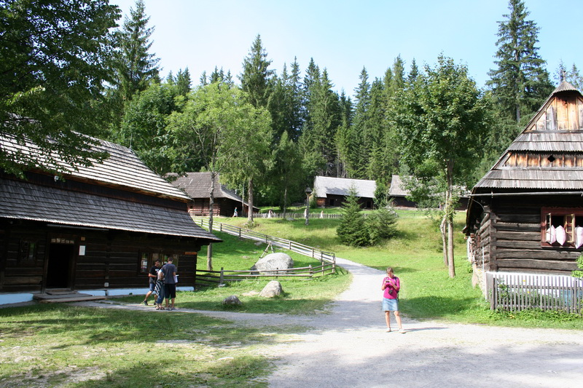
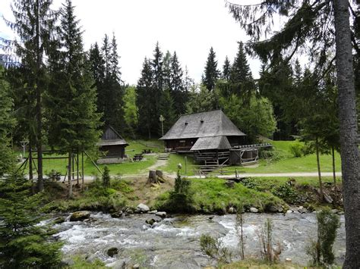
Skanzen. What does it mean?
Skanzens in other words are open-air museum-villages. They show Slovakia's folk history, architecture and basic life of past centuries, high class and low class.
There are traditional buildings with furniture, schools, churches, craftmens' workshops, manor houses in Slovakia´s skanzens. Some of them are even from the 11th century.

Slide 3
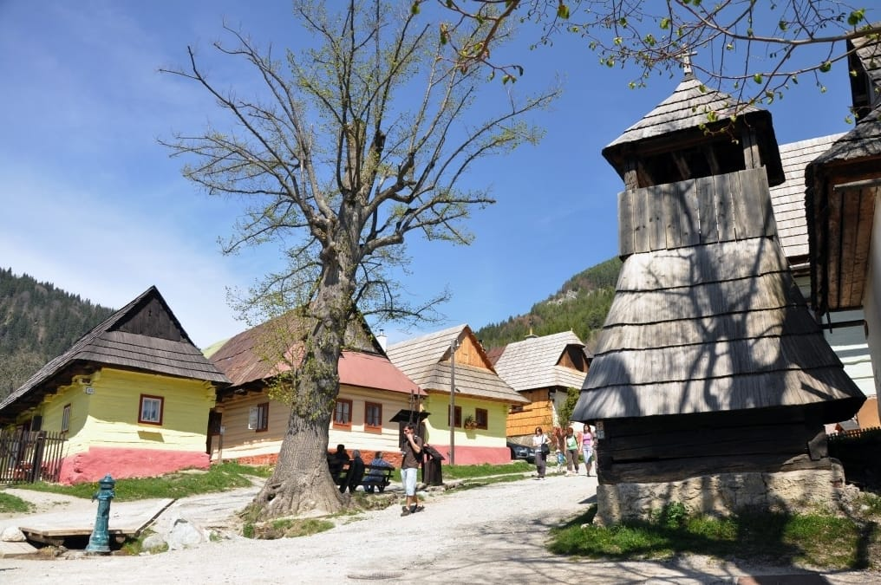
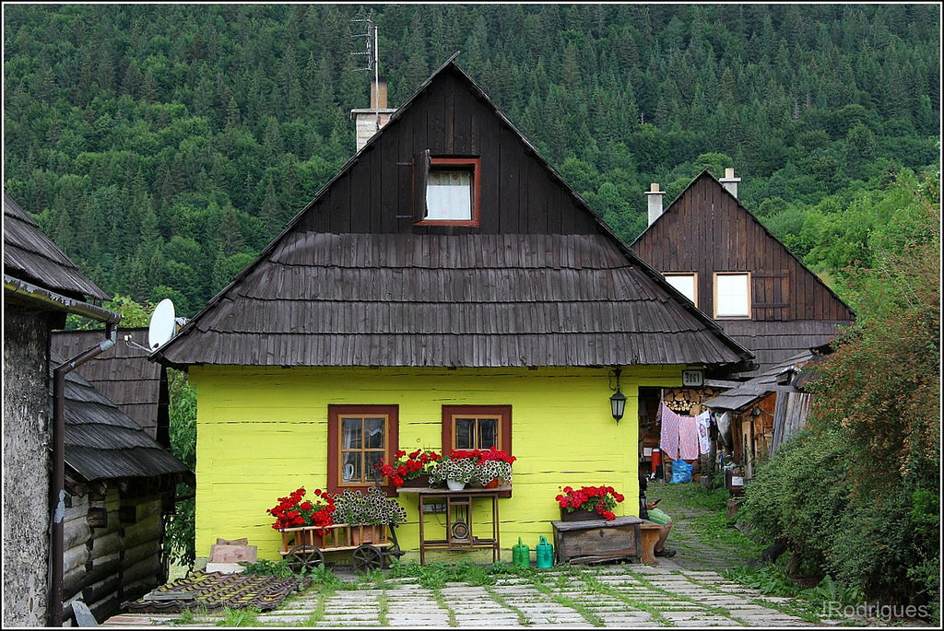
Vlkolínec
Vlkolínec is skanzen in Veľká Fatra It is a village with 45 buildings
where people still live. But there live not more than 20 people.
There are original wooden houses typical for Slovakia in the past.
Vlkolínec was added to the UNESCO in 1993.

Slide 4
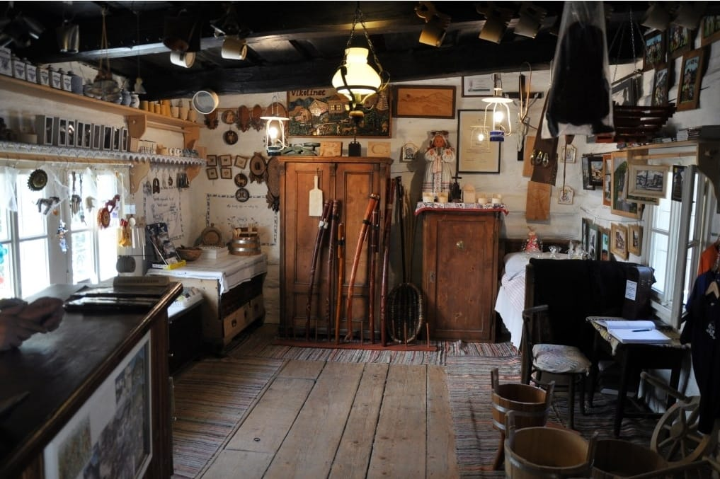
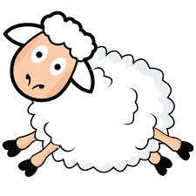
Vlkolínec – inside the houses
The kitchens there are full of typical historical objects. Most of them are made of wood.
Crpak is a special wooden decorated cup for žinčica – a drink made of sheep milk.

Slide 5
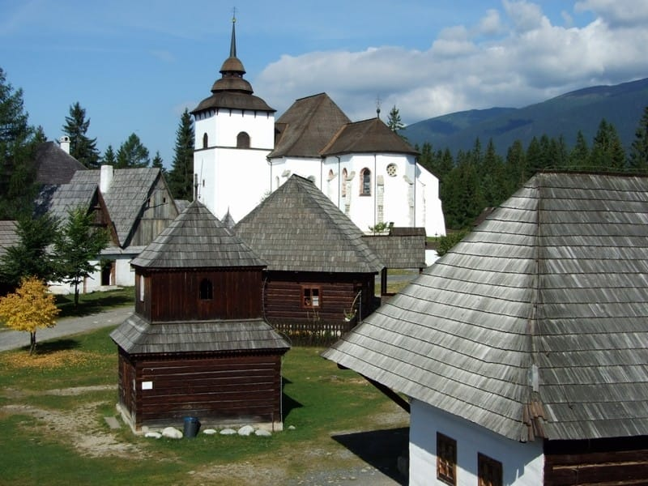
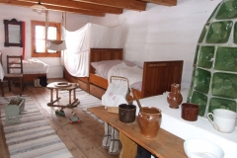
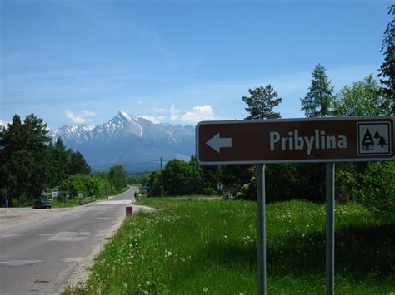
Pribylina
Pribylina is the youngest open-air museum in Slovakia. Pribylina is a very lively place.
There are many seasonal events focused on folklore and handcrafts.

Slide 6
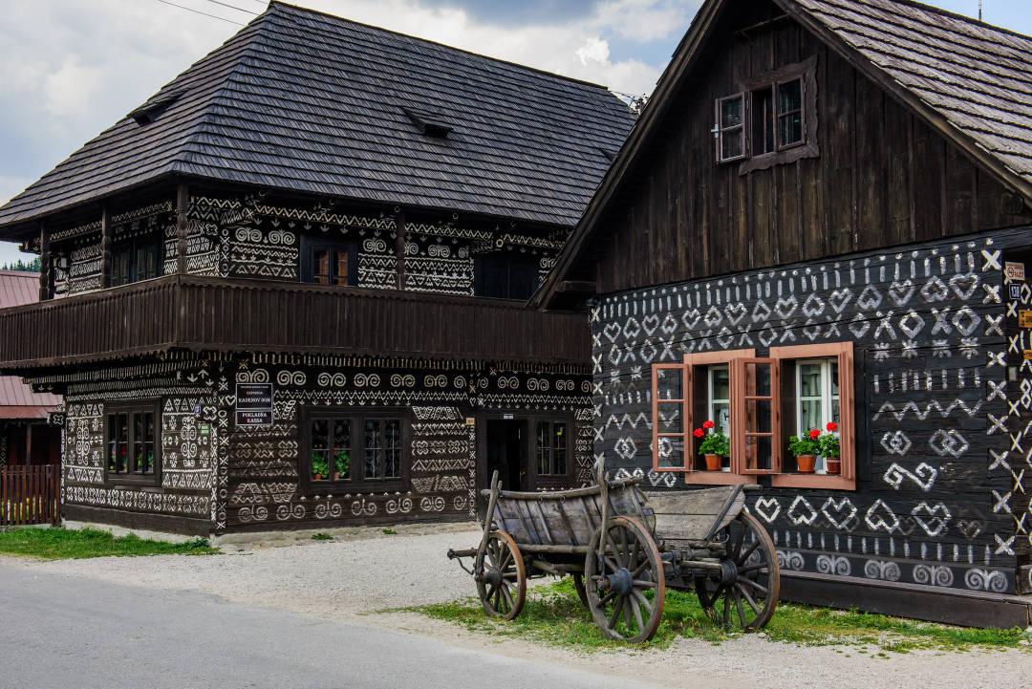
Čičmany
Skanzen Čičmany is situated in Strážov Mountains. It has a historic and unique architecture – painted wooden houses.
They have original appearance – ornaments painted with white lime.

Slide 7
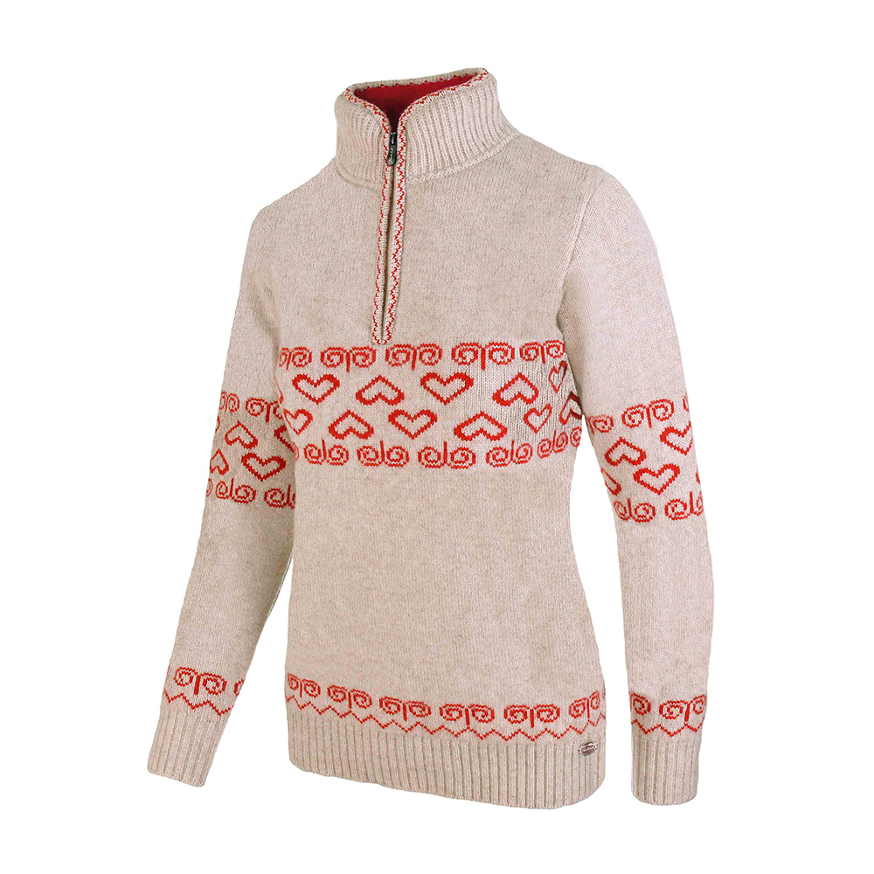
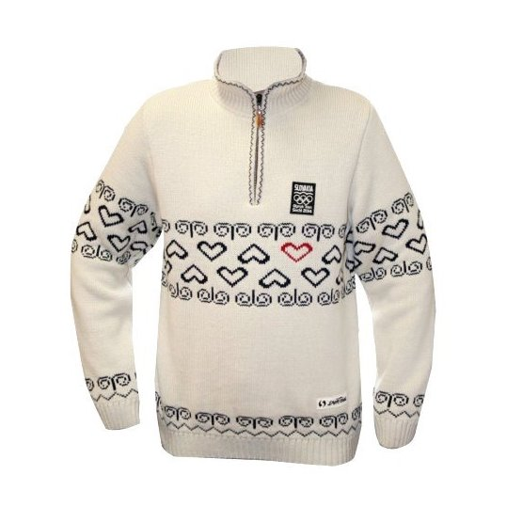
These ornaments are significant treasure of Slovak culture. During the Winter Olympic Games in Sochi ( Russia ) in 2014, the clothes of Slovak Olympic representation were decorated with ornaments from the village Čičmany.

Slide 8
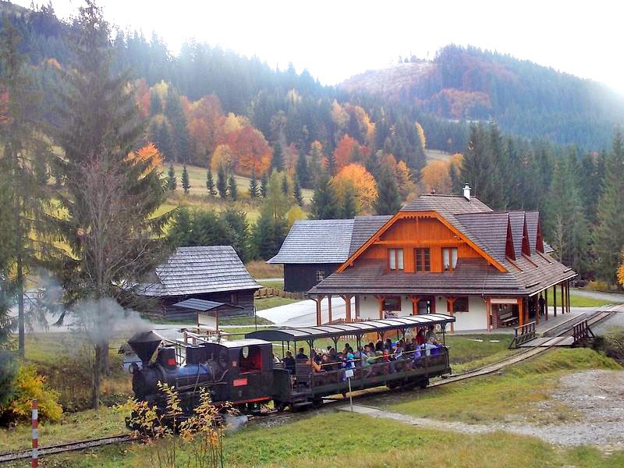
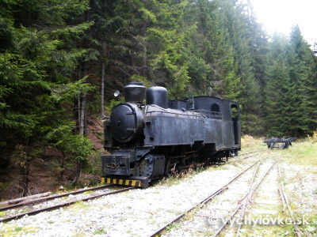
Vychylovka
Skanzen Vychylovka is the closest to our town. The tourists can take a ride through this place with historical train that has a steam locomotive.

Slide 9
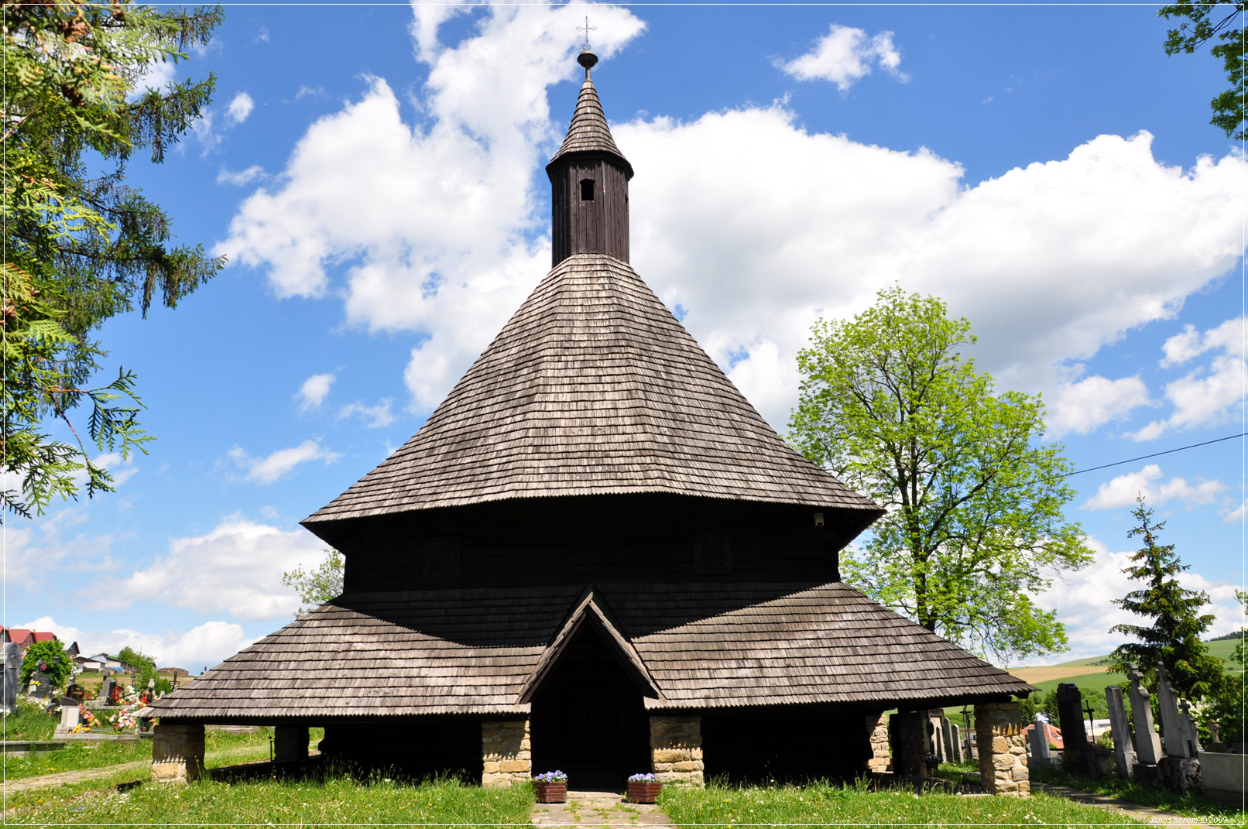
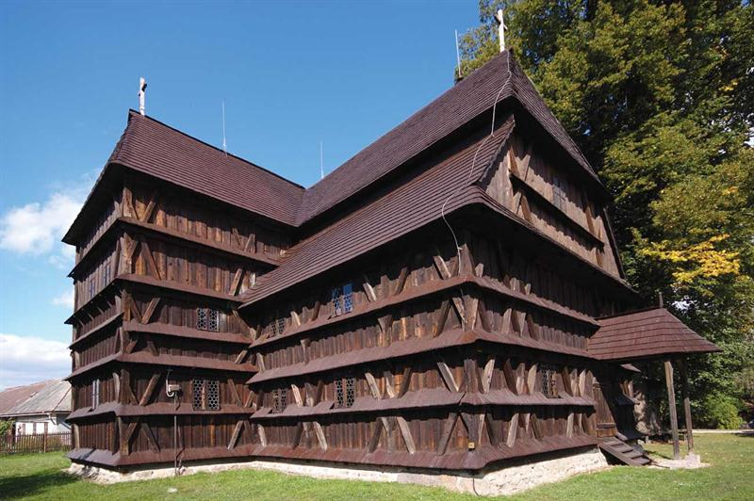
Wooden churches
A wooden church in Tvrdošín
There are 50 wooden churches from 16th - 18th century in Slovakia. Most of them are located in eastern Slovakia.
They are usually situated on the hills, outside the villages.
All of them are made only from wood.An interesting fact is that not a single nail was used during their construction.
A wooden church in Hronsek

