Slide 1
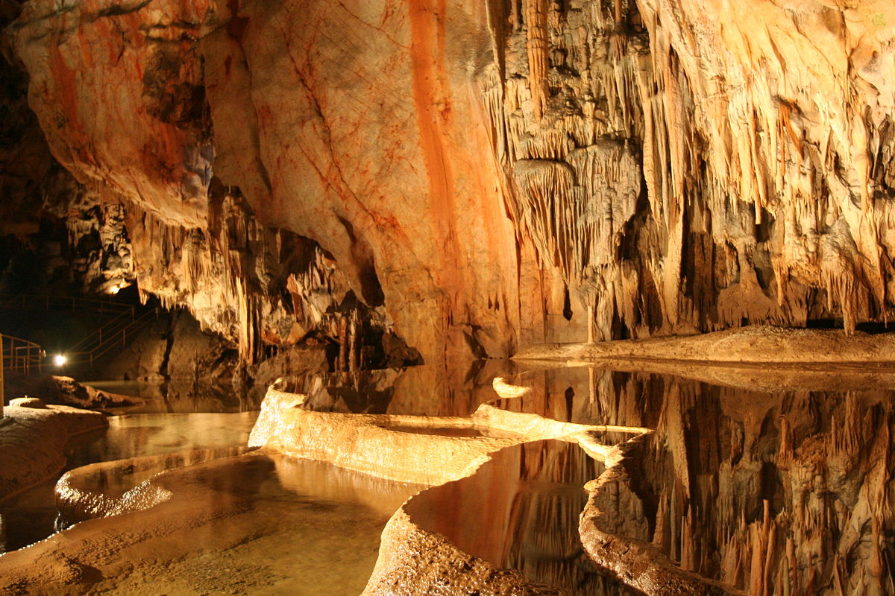
Caves in Slovakia

Slide 2
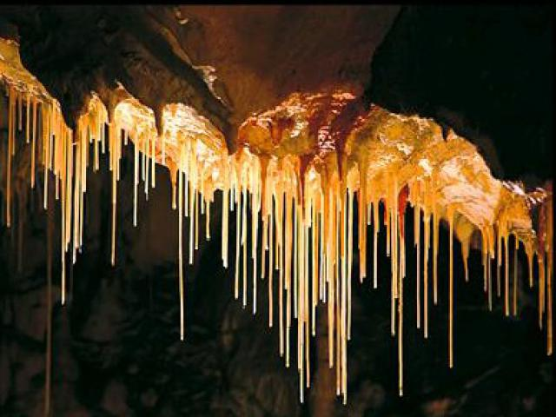
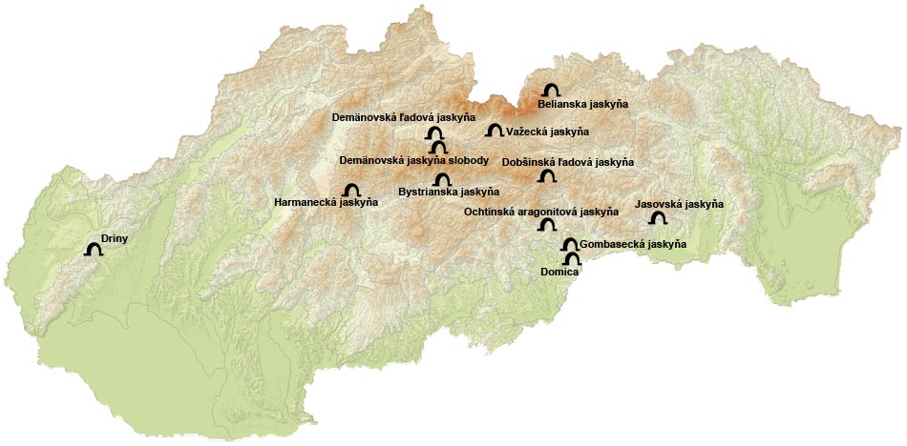
In Slovakia there are 7014 caves. Some of them are big but some of the are very small. People can visit only 18. The deepest cave has499,8 metres. The longest caves is 40 453 meter long.

Slide 3
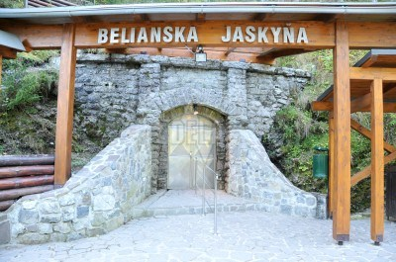
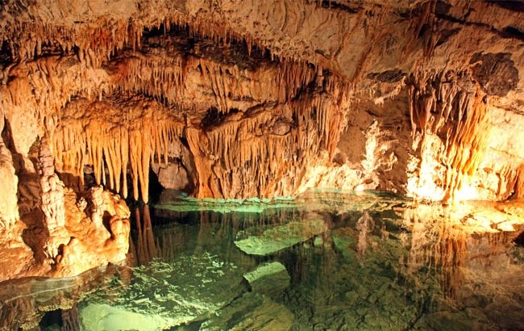
Belianska jaskyňa –Belianska cave
Belianska Cave is a stalactite cave in the Slovak part of the Tatra mountains, the largest and the only one open to the public in the Tatras. It is located above the settlement of Tatranská Kotlina, which is a part of the town of Vysoké Tatry.
The cave was discovered in the 18th century, although it is presumed that it was used by pre-historic people. The cave was opened in 1884 and electrically lit in 1896.
Entrance to the cave is located at an altitude of 890 metres. The cave is 3,641 m long, with two circuits available to the visitors, with the longer one having the length of 1,752 m.

Slide 4
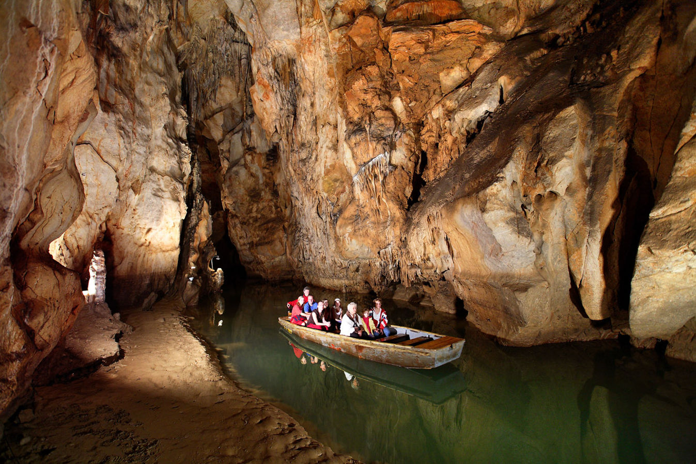
This is cave is in the east of Slovakia. Its name is Domica. You can sail in the boat and see beautiful interior. There are many lakes inside and many bats live there.

Slide 5
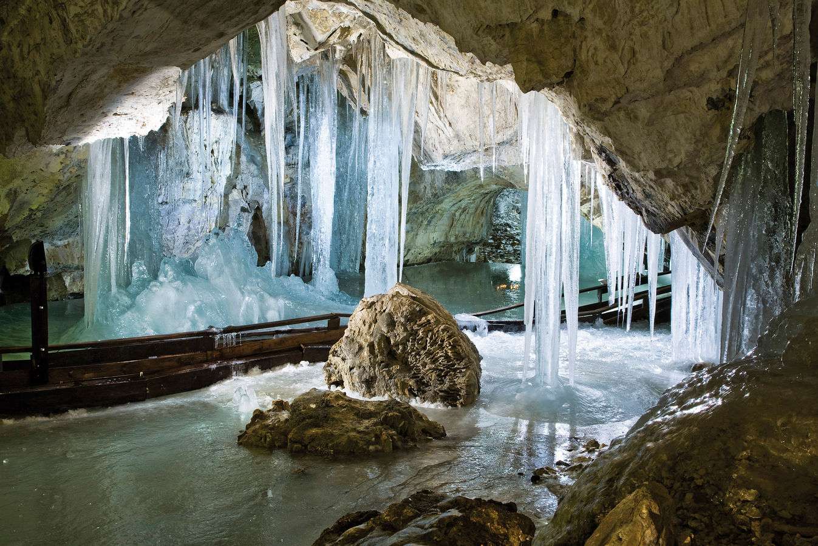
This is ice cave in the middle of Slovakia. There are 4 floors under ground. People walk 2,5 kilometres on the paths.

Slide 6
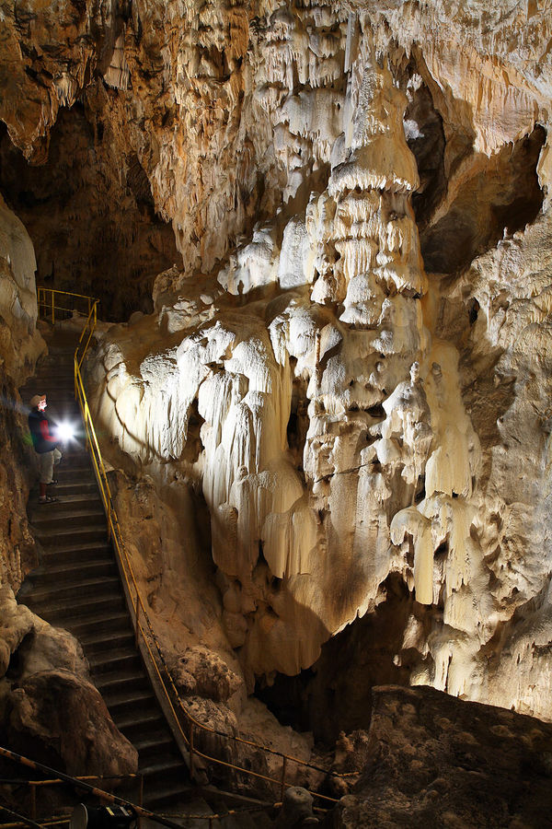
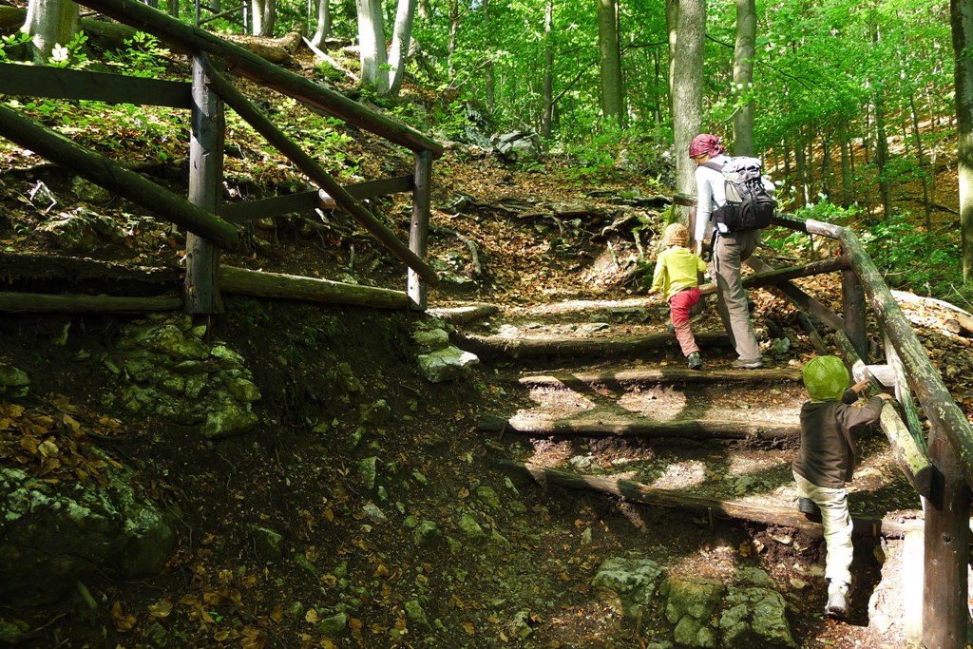
This is our nearest cave – Harmanecká . There are many stairs inside and it is difficult to get there - it is on the hill. You can´t park your car in front of it, you must walk on the path.

