Slide 1
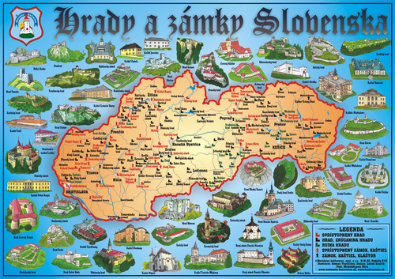
In Slovakia there are many castles. A lot of tourists visit them in summer.
Children go to the castles on their school trips.
You can see all of them in the map..

Slide 2
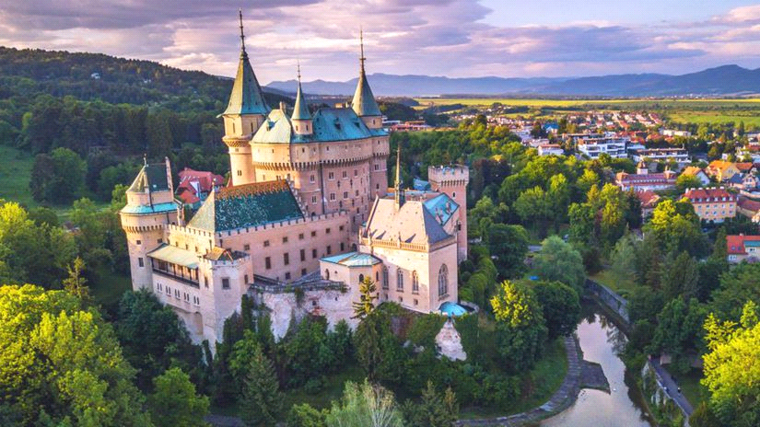
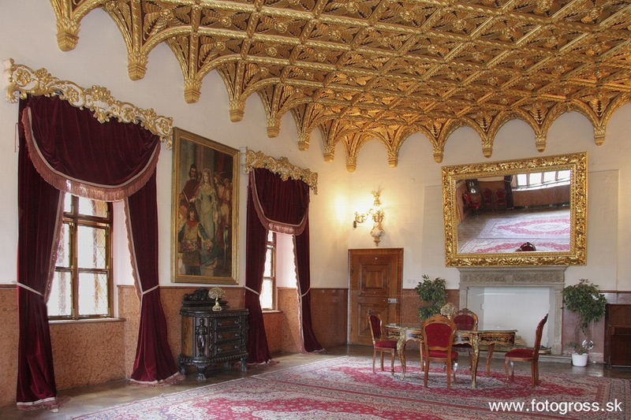
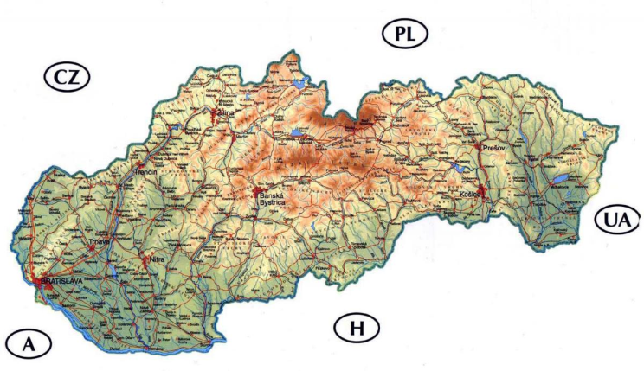
This is our beautiful castle in Bojnice. This castle is romantic. It is located in the Trenčín region.
There are beautiful rooms inside.

Slide 3
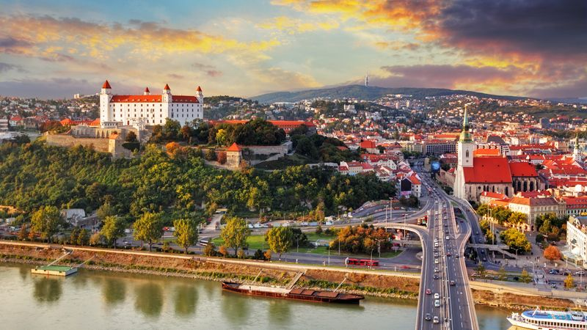
This is castle in Bratislava – in our capital city
This castle is big.
It has got four towers.
Its color is white and red.
Its height is above : 152 metres
There is a museum inside and president use it for visitors.

Slide 4
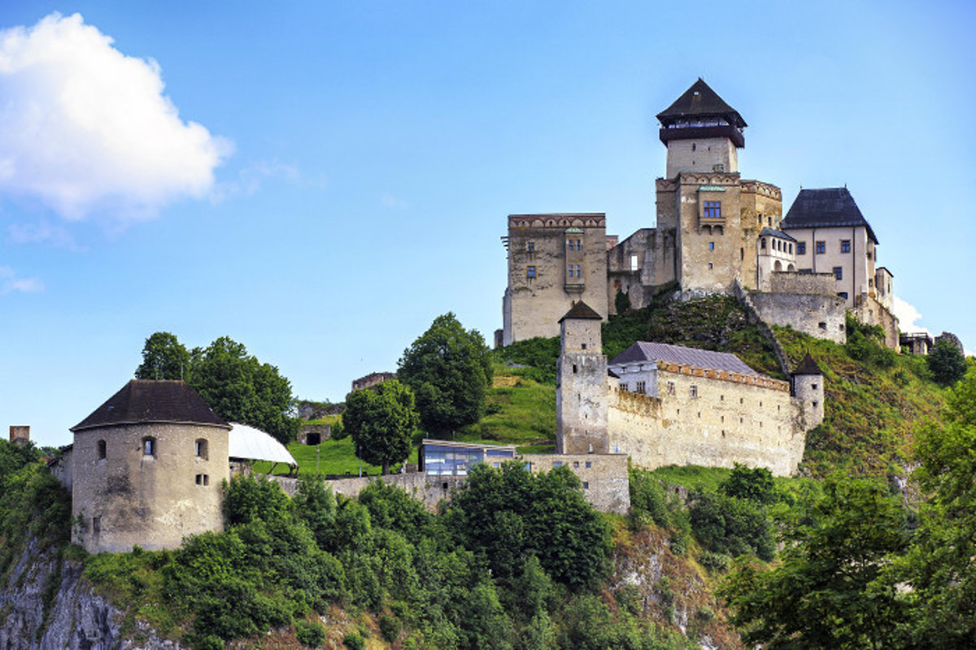
This castle is in town Trenčín.
It is very old. People built it in 11th century.
You can see the town and country from the tower. There is our longest river under the castle.

Slide 5
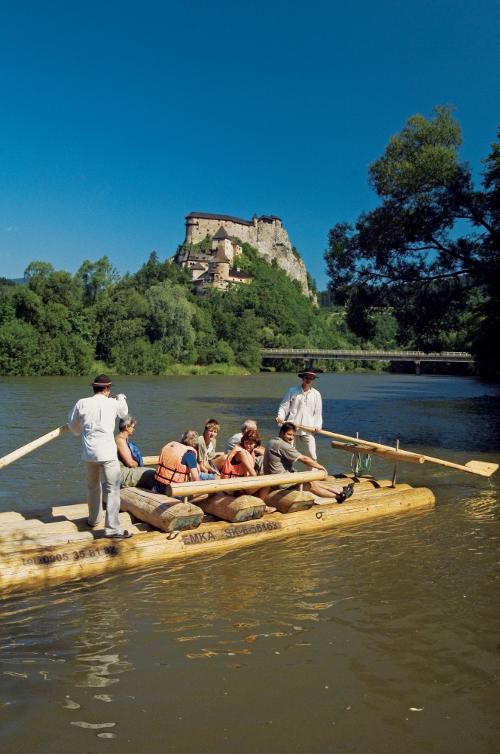
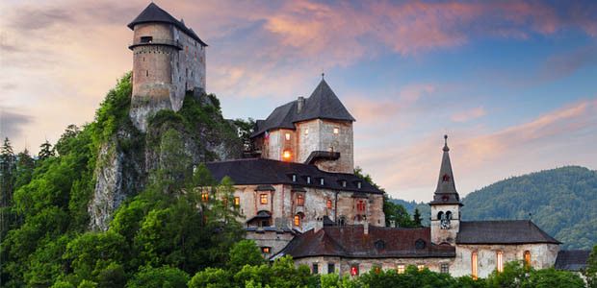
This castle is in the north of Slovakia. It is very big and there are many stairs. There is a river under the castle. You can sail on wooden boats.

Slide 6
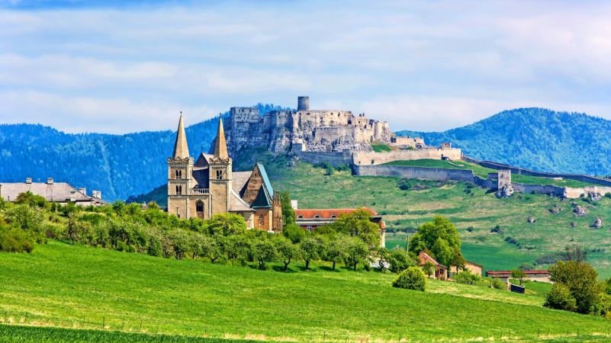
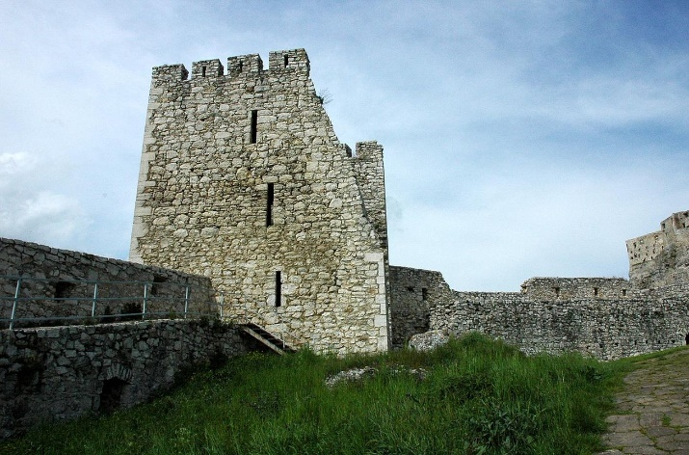
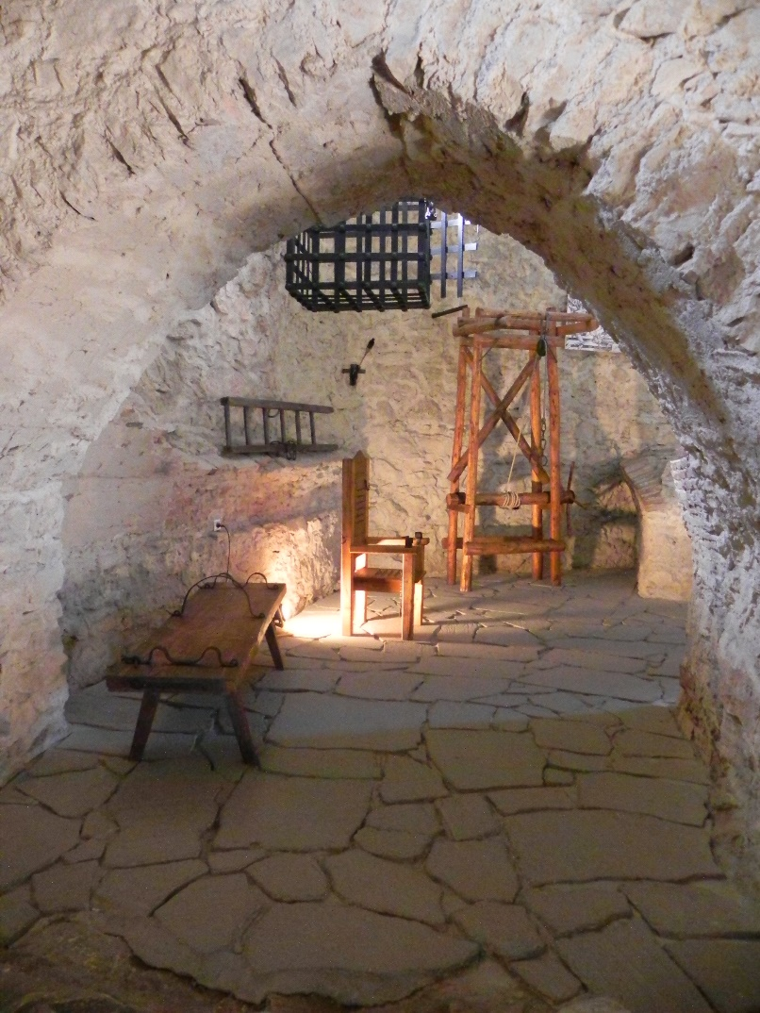
This castle is in the east of Slovakia. It is very big. It is not very beautiful inside, it is a ruin but people re-build it. You can find it in the list of UNESCO.

