Slide 1
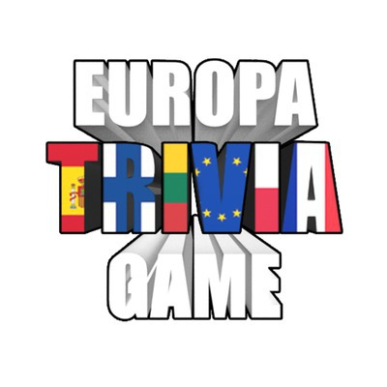
Global story of Lithuania
Erasmus+ project ‘Europa Trivia Game‘ virtual meeting

Slide 2
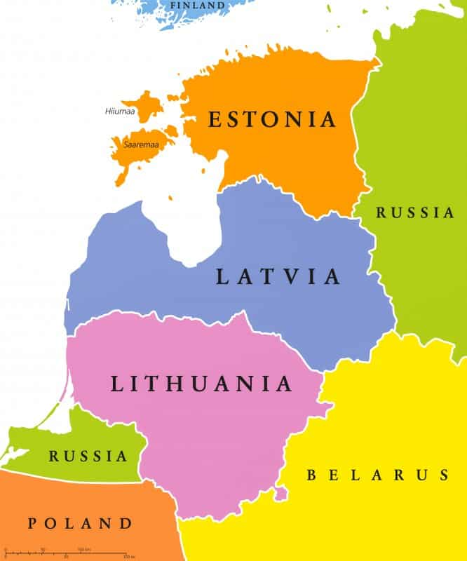
If so, let me introduce you to a beautiful country called Lithuania! It’s a small but very unique country located in Northern Europe, along the shores of the Baltic Sea; on the border with Latvia to the North, Belarus to the East and South, Poland to the South, as well as Russia to the Southwest.

Slide 3
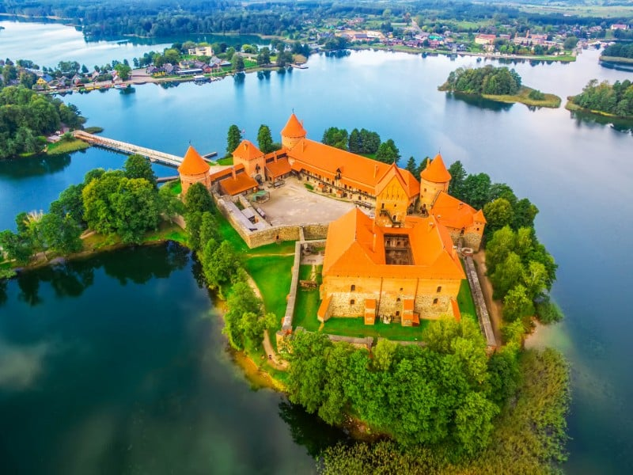
What is the name?
The name Lithuania was mentioned for the first time in the Annals of Quedlinburg in 1009. By the end of the 14th century, Lithuania was the largest country in Europe. The Kingdom of Lithuania was formed by numerous tribes living in the area at that moment.
The Kingdom quickly expanded outwards into the Russian lands, which were then controlled by the Mongols, as well as parts of Belarus, Poland, and Ukraine. By the late 14th century the Grand Duchy of Lithuania was the largest and most powerful kingdom in Europe.
The downfall of the Grand Duchy of Lithuania came at the end of the 18th century, when the Commonwealth was terminated and Lithuania was effectively split between Prussia’s and Russia’s empires.
Today Lithuania has a population of about 2,850,400 people, and the land area of 65,300 square kilometers (25,212 square miles).

Slide 4
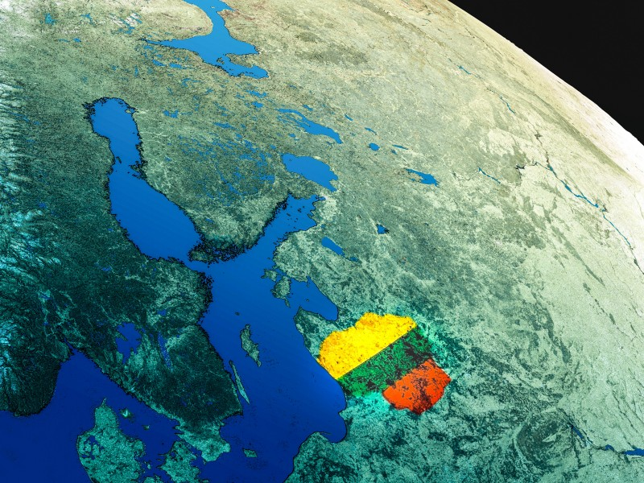
The centre of Europe
According to a study made by a French scientist in 1989, Lithuania is positioned in a geographical center of Europe. After he re-estimated the boundaries of the continental Europe in 1989, Jean-George Affholder, a scientist from the French National Geographic Institute determined that the geographic center of Europe is located at 54°54′N 25°19′E, near a Lithuanian village named Purnuškės. The method that he used for calculating this point was based on the center of gravity of the geometrical figure of Europe.

Slide 5
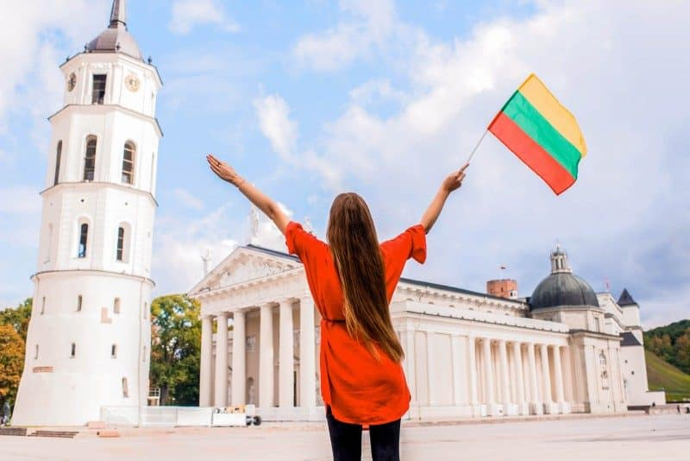
The oldest language
The Greek, Latin, German, Celtic, and the Slavic are one of the oldest languages in the World, but they are not even nearly as old as the Lithuanian tongue, which is the most ancient one from them all. It belongs to an Indo-European language group and of all the tongues spoken today – Lithuanian is the closest one to the ancient Sanskrit.
The longest Lithuanian word is: “nebeprisikiškiakopūsteliaujantiesiems” which has 37 letters and the exact meaning of the word is something like: “a group of people who used to go to a forest, to pick up some rabbit grass, but are no longer doing that”. It makes very little sense nowadays and is rarely used in context.

Slide 6
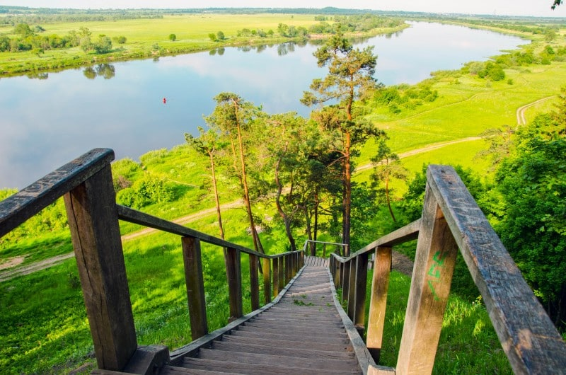
The Land of Nature
Lithuania is the land of nature. Forests cover 1/3 of the country, including many protected regions, nature reserves and the national parks. Lithuania is also known as ‘the land of storks’, which is our national bird. It has the oldest oak tree in Europe, called The Stelmuze Oak, which is 23 meters high, and is more than 1,500 years old. It requires 8-9 people just to hug its trunk.
Moreover, the country is home to one of the largest moving sand dunes in Europe. Holidays in Lithuania must always include this spot! The Curonian Spit is a unique, vulnerable, sandy cultural landscape, that was formed and shaped by the sea, wind and some human activity. The Spit is located on a seashore, and also features small Curonian lagoon settlements.

Slide 7
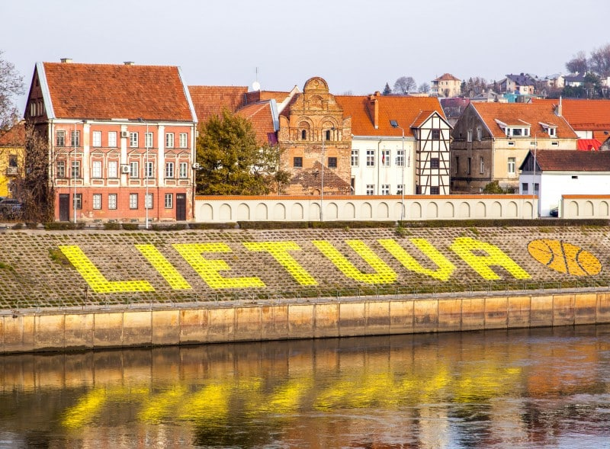
Basketball
Basketball is the most popular sport in Lithuania, and it is said to be the second religion of our people. Lithuania has the fourth best basketball team in the World, which has won three bronze medals at the Olympics.
Several Lithuanian basketball players have gone up to the NBA’s Hall of Fame, though the greatest star that the nation is particularly proud of is Arvydas Sabonis. The Lithuanian players who are currently in the NBA include: Jonas Valanciunas, Mindaugas Kuzminskas and Domas Sabonis.

Slide 8
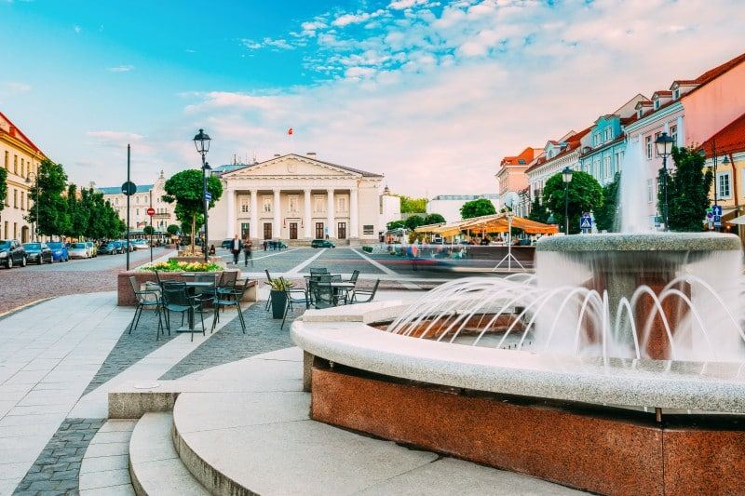
The Internet
Lithuania has one of the fastest Internet connections in the World. It has the fastest broadband – with the download speeds of up to 30 Mbps. There are many free WiFi hotspots around the biggest cities, therefore if you’re visiting this country on business – you no longer need to sit with your computer in hotels or in conference halls. Take it anywhere with you like cafes or the city’s main streets, where you can easily connect to the free public Internet.
In addition, according to the latest findings – Lithuania is the first country in Europe which has introduced the Local Breakout (LBO) technology, offering cheap mobile internet for travelers and allowing them to avoid big data roaming charges.

Slide 9
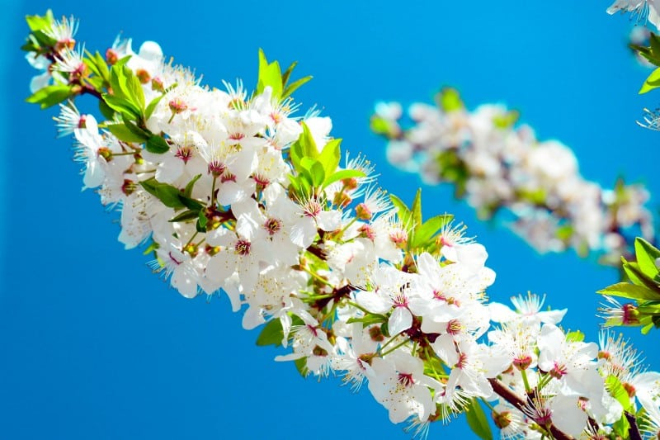
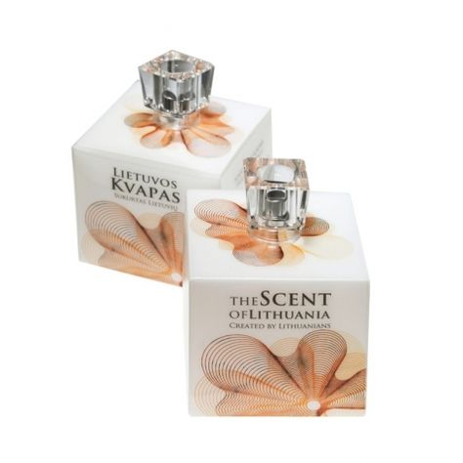
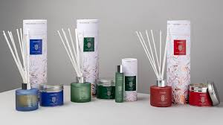
The National Perfume
Lithuania is famous for being the only country in the World… with its own official scent, called “The Scent of Lithuania”. The scent was released in 2010 and was widely discussed all over the Internet, press and the local media. The aroma includes some wild flowers, ginger, raspberry, sandalwood and musk scents, which add a sweet and fresh touch to the perfume.
Recently the collection was expanded with two more additions, called “Barbora” and “The Kingdom”. So now you can buy your own bottle of the Lithuanian national scent!

Slide 10
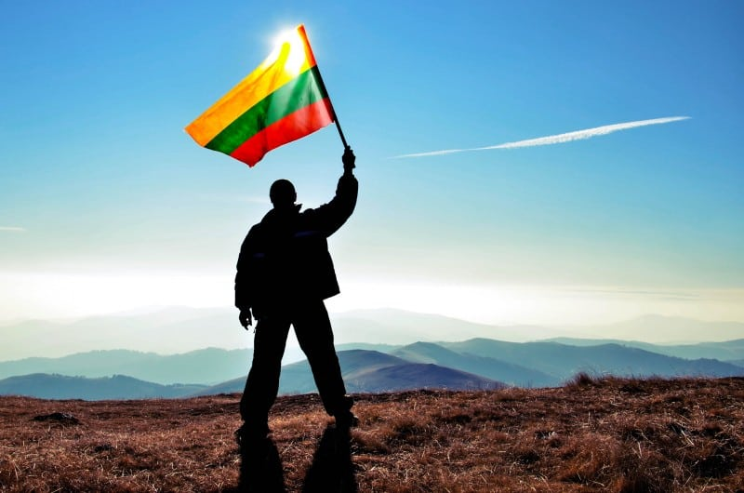
Famous Lithuanians
Many famous people across the World have Lithuanian roots. Just to name a few – the famous American singer, artist, writer, and actor’s Bob Dylan‘s mother was of Lithuanian-Jewish ancestry. The Red Hot Chilli Peppers lead singer’s Anthony Kiedis’s grandfather was Lithuanian. The well-known American actor and comedian Jason Sudeikis is a quarter Lithuanian, and his last name remains to be very Lithuanian.
The famous American actor’s Sean Penn‘s paternal grandparents were Jewish-Lithuanians. Moreover, the mother of Pope John Paul II was of Lithuanian descent. Even Hannibal Lecter, the fictional villain and the main character from ‘The Silence of the Lambs’ was born in Lithuania! So I shouldn‘t be wrong saying that Lithuanians are basically everywhere! Čia galima išskirstyti skaidrę į kelias ir įdėti tų įžymybių foto.

