Slide 1
The Lithuanian cuisine
Erasmus+ project ‘Europa Trivia Game’ virtual meeting 10th-12th May

Slide 2
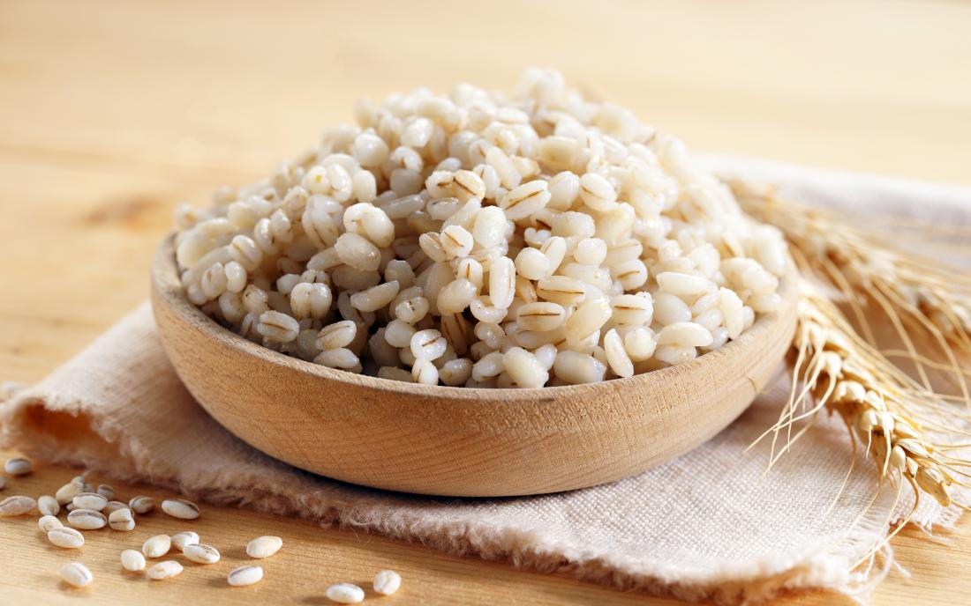
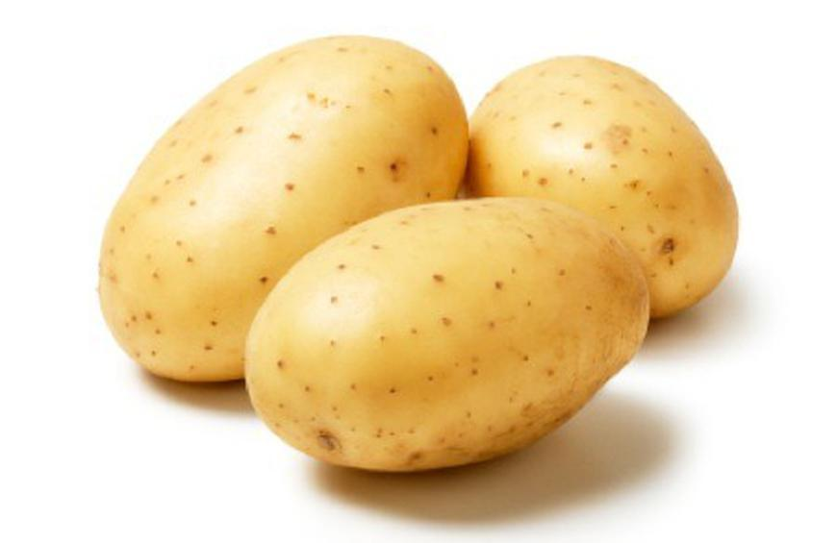
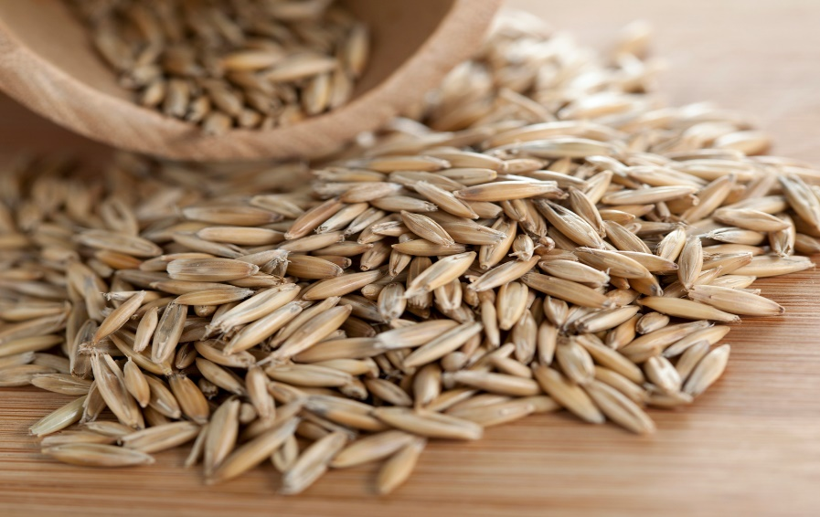
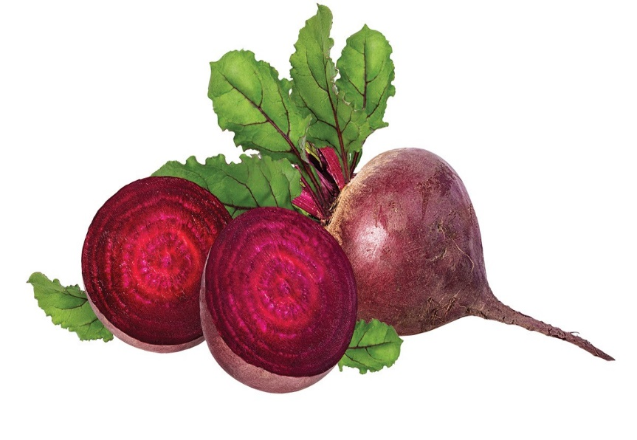
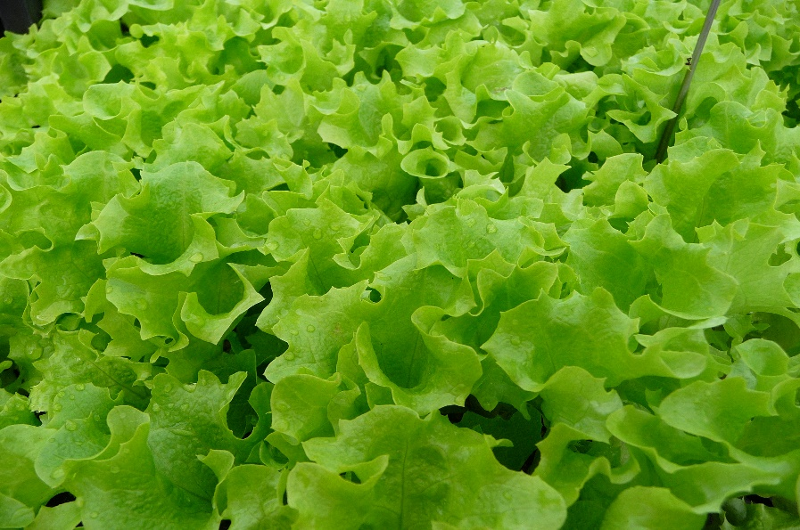
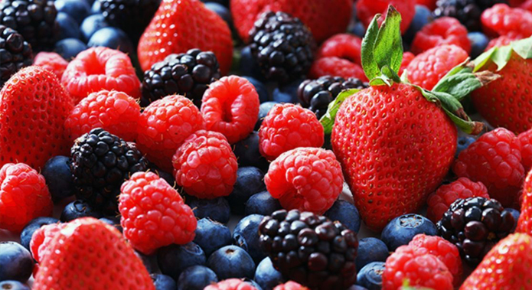
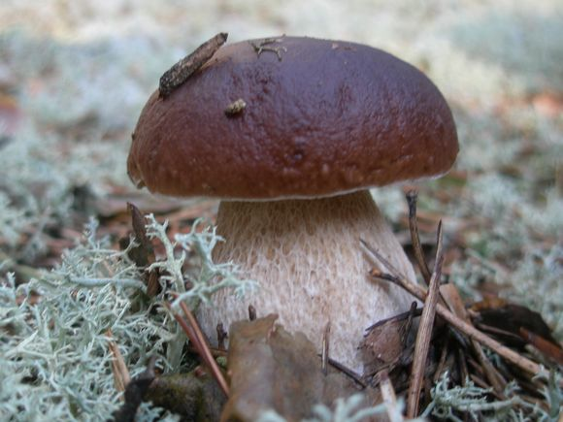
Lithuanian cuisine features products suited to the cool and moist northern climate of Lithuania, many of which are locally grown:
barley,
potatoes,
rye,
beets,
greens,
berries,
mushrooms

Slide 3
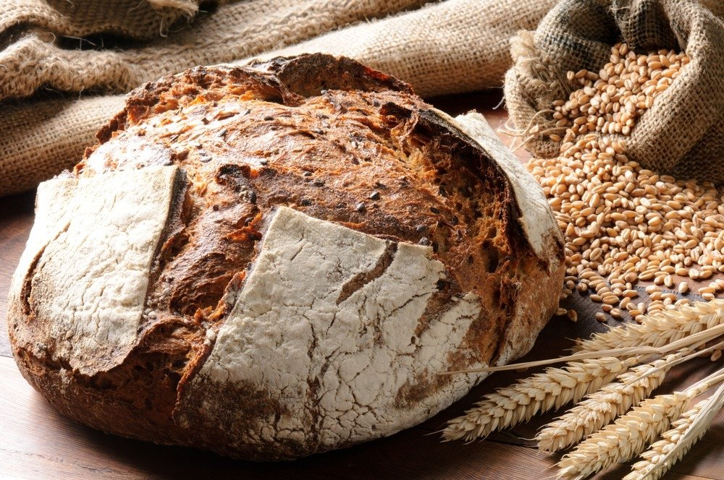
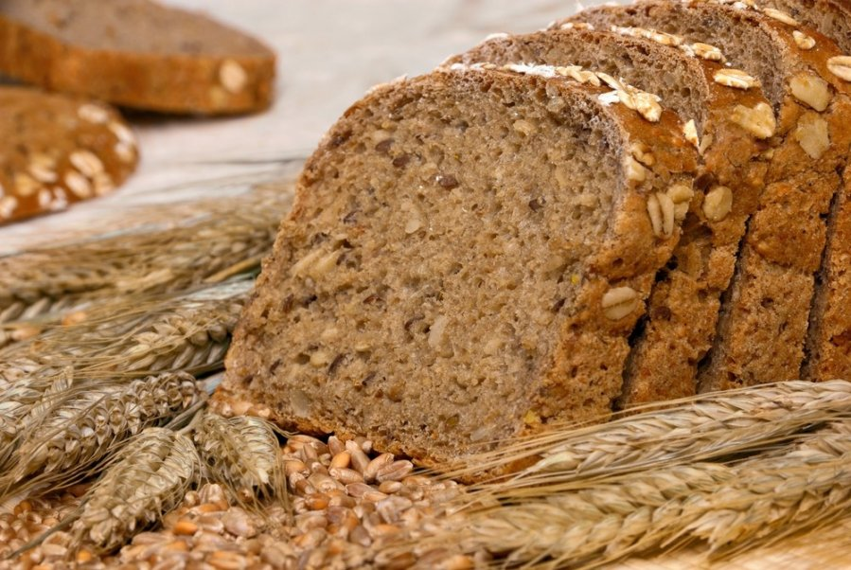
One of the oldest and most fundamental Lithuanian food products was and is rye bread.

Slide 4
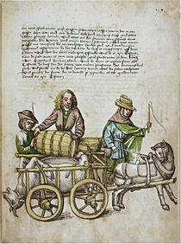
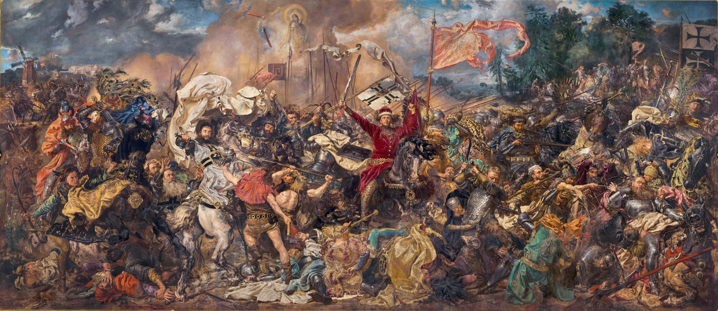
In the Middle Ages, hunting was the main way to provide oneself with meat. It is known that Vytautas The Great before the Battle of Žalgiris organized a big hunting and prepared salt-cured meat for the army.

Slide 5
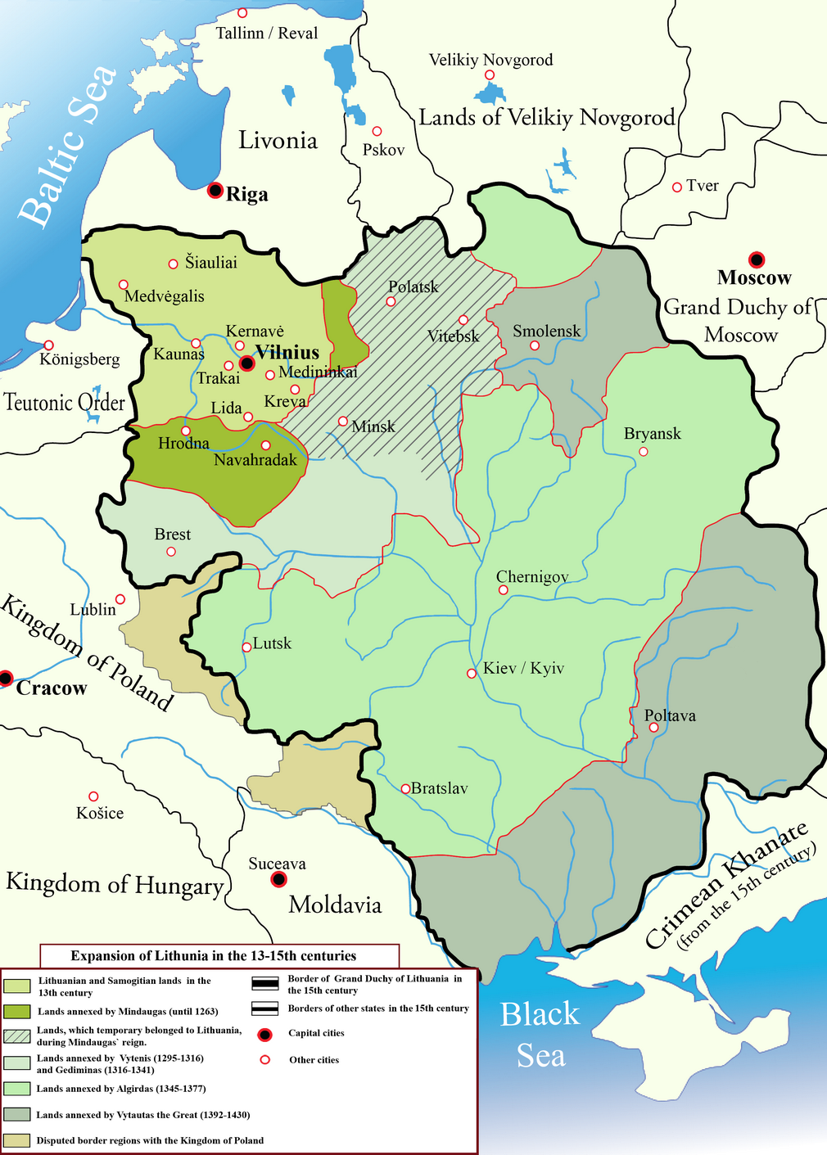
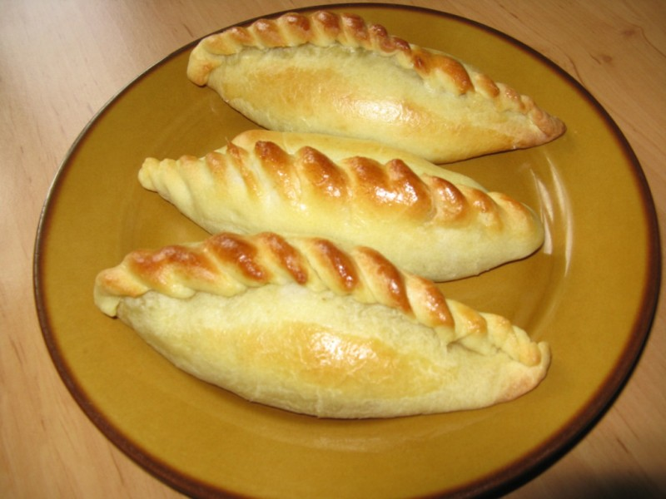

Slide 6
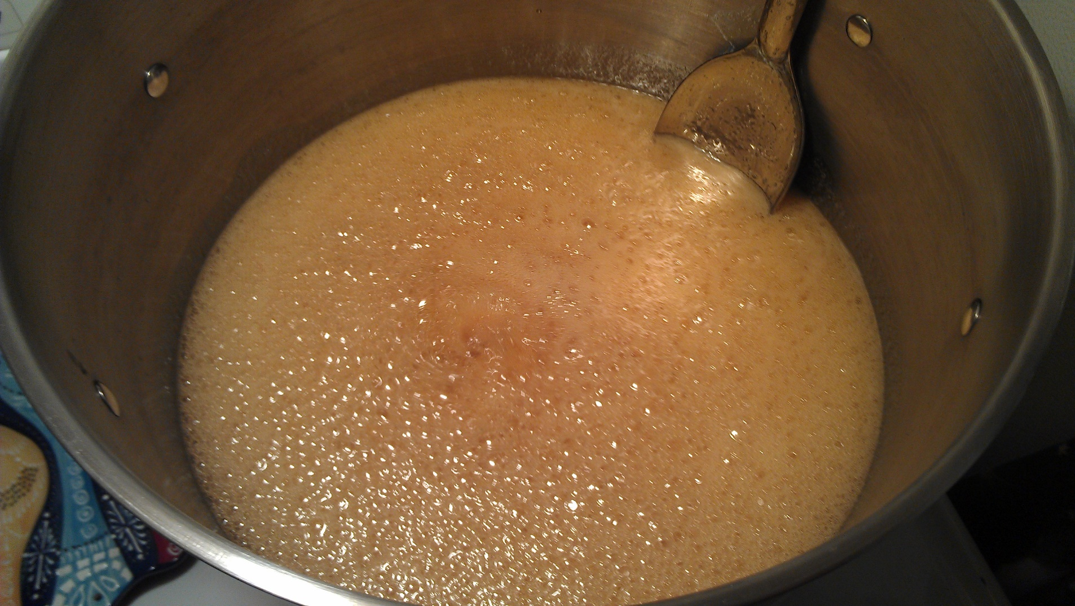
Mead is said to be the most ancient Lithuanian beverage; it is made from honey. Old Lithuanian mead was made from a solution of honey and water simmered with various spices, such as thyme, lemon, cinnamon, cherries, linden blossoms, juniper berries, and hops.

Slide 7
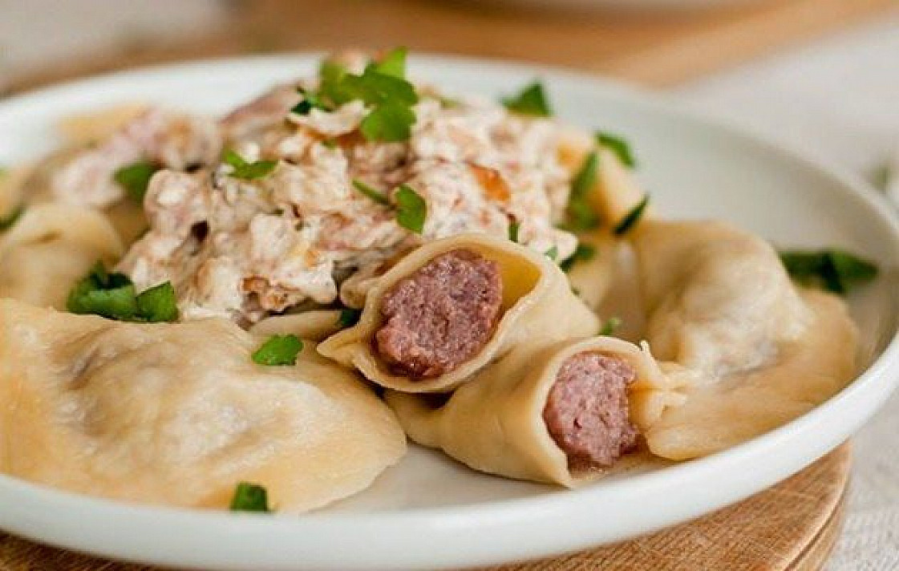
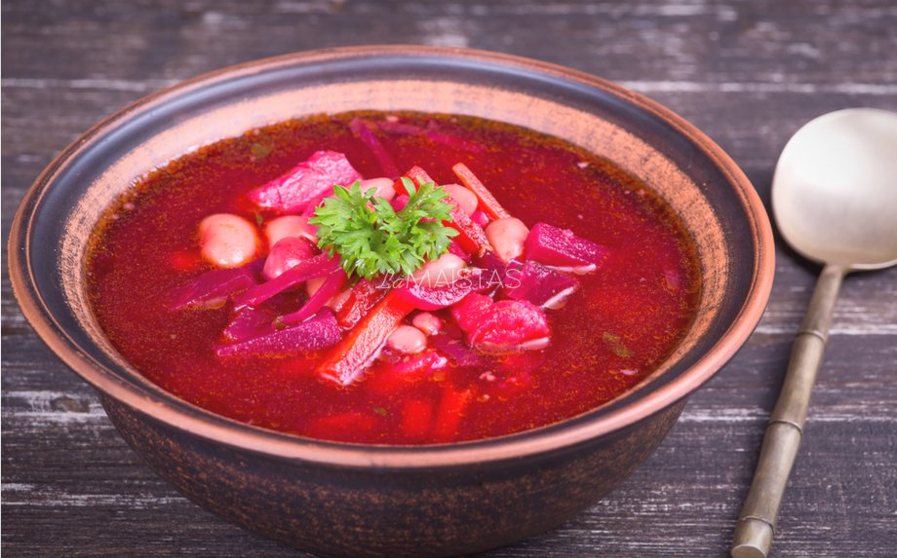
We have a long history with our neighbour Poland, here are some of the dishes we share.

Slide 8
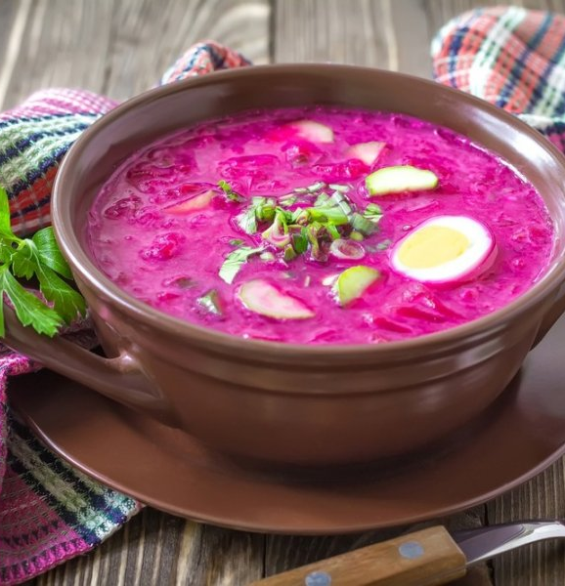
Šaltibarščiai/ cold beetroot soup
You will experience the real taste of Lithuanian cuisine if you taste this easy-to-cook soup, especially popular in Lithuania – „šaltibarčiai“ (cold beetroot oup, pink soup)!
The soup has a shocking bright pink colour due to the natural beetroot juice and an incredibly fresh taste due to the most important ingredient in the cold soup – kephir, recognized by nutritionists as one of the healthiest products in the world.
Šaltibarščiai is also knows as Lithuanian Gazpacho

Slide 9
It‘s so famous that we even put it on clothes

Slide 10
Dumplings
filled dumplings made by wrapping unleavened dough around a savoury or sweet filling and cooking in boiling water. They are often then pan-fried before serving.

Slide 11
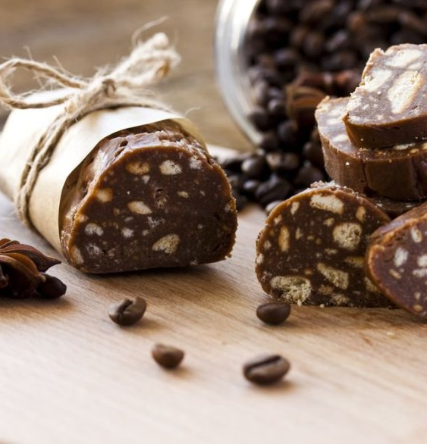
Tinginys
Tinginys is a popular dessert in Lithuania. The dish is typically prepared with biscuits or crackers, cocoa, butter, sugar and solidified milk.

Slide 12
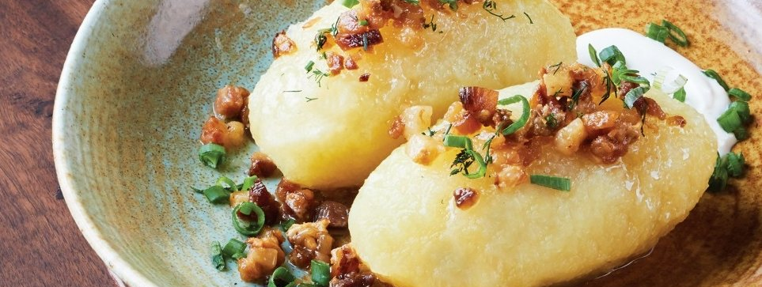
Cepelinai/ zeppelins
Cepelinai are dumplings made from grated and riced potatoes and stuffed with ground meat, dry curd cheese or mushrooms. It has been described as a national dish of Lithuania.

Slide 13
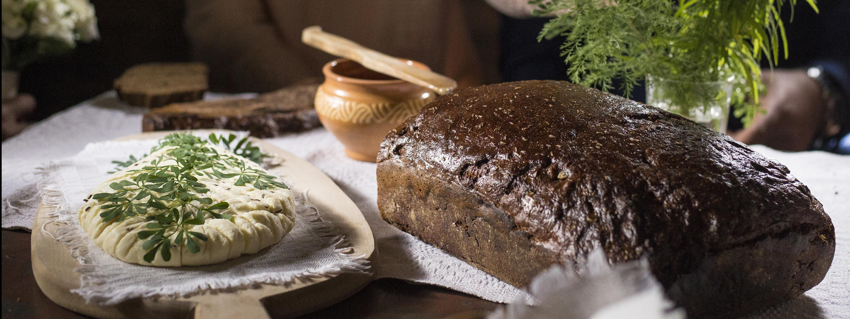
Black bread
Black rye bread made without yeast in a real oven.
Our rye bread has been recognised as part of our national heritage.

Slide 14
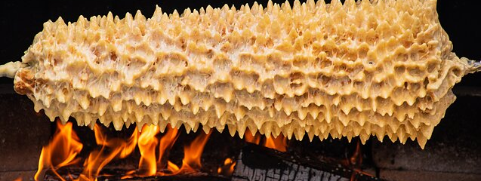
Šakotis
Lithuanian šakotis or raguolis is a Polish, Lithuanian and Belarusian traditional cake. It‘s a cake made of butter, egg whites and yolks, flour, sugar, and cream, cooked on a rotating spit in an oven or over an open fire.

Slide 15
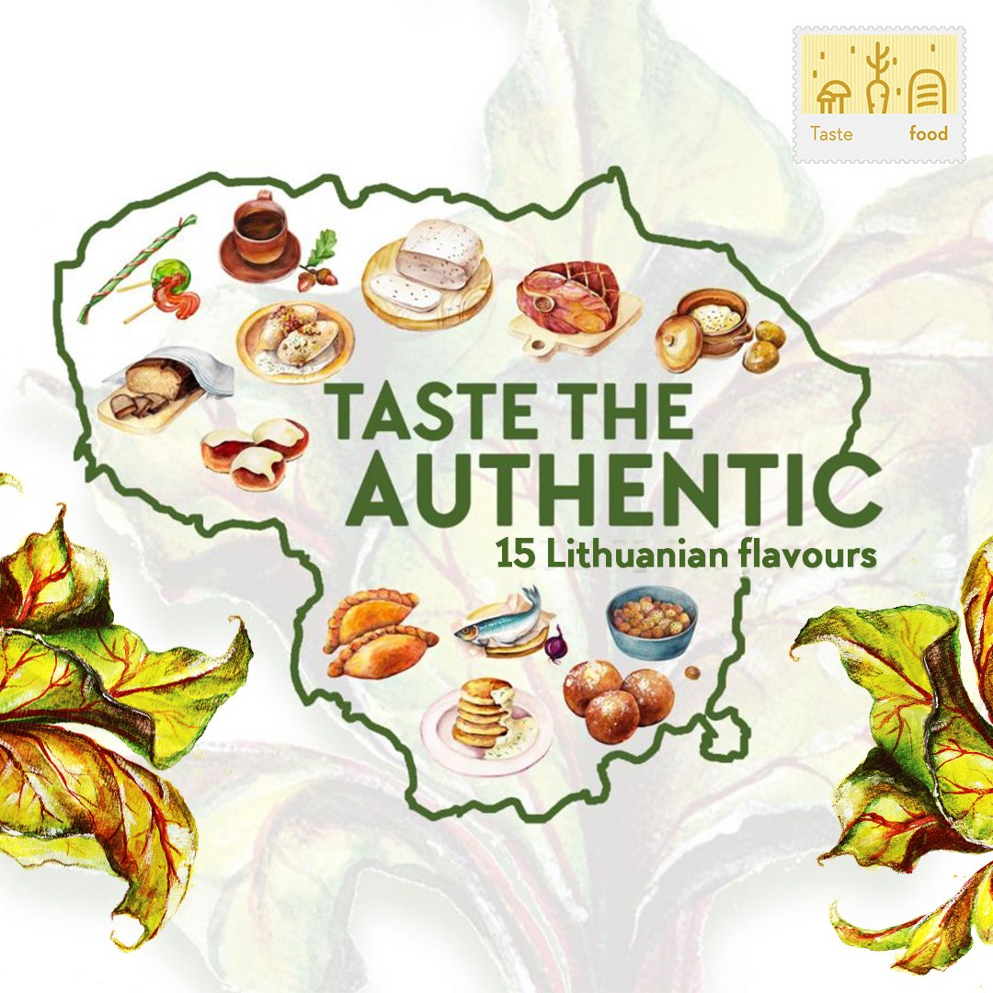
During the past years, restaurants in Lithuania emerged which specialize in historic Lithuanian cuisine, culinary heritage and its interpretations.

