Slide 1
The power of music
Karolina Belickaitė
‘Europa Trivia Game’ virtual meeting in Lithuania
May 10-12

Slide 2
The begining
Lithuania has a very rich and old culture.
Konstantinas Čiurlionis (1875–1911) was the most famous Lithuanian artist during this time.
His work continues to provide inspiration to the national consciousness and the national culture today. Čiurlionis was a professional composer, who studied at the Music Institute in Warsaw and at the Leipzig Conservatory. His early compositions echo Romantic traditions, while his later piano preludes are already harbingers of Modernism, and even Serialism.
The interwar period saw the performance of his symphonic poems In the Forest (Miške, 1901) and The Sea (Jūra, 1907), and other works, and the founding in 1921 of the M.K. Čiurlionis Art Museum in the temporary capital Kaunas.

Slide 3
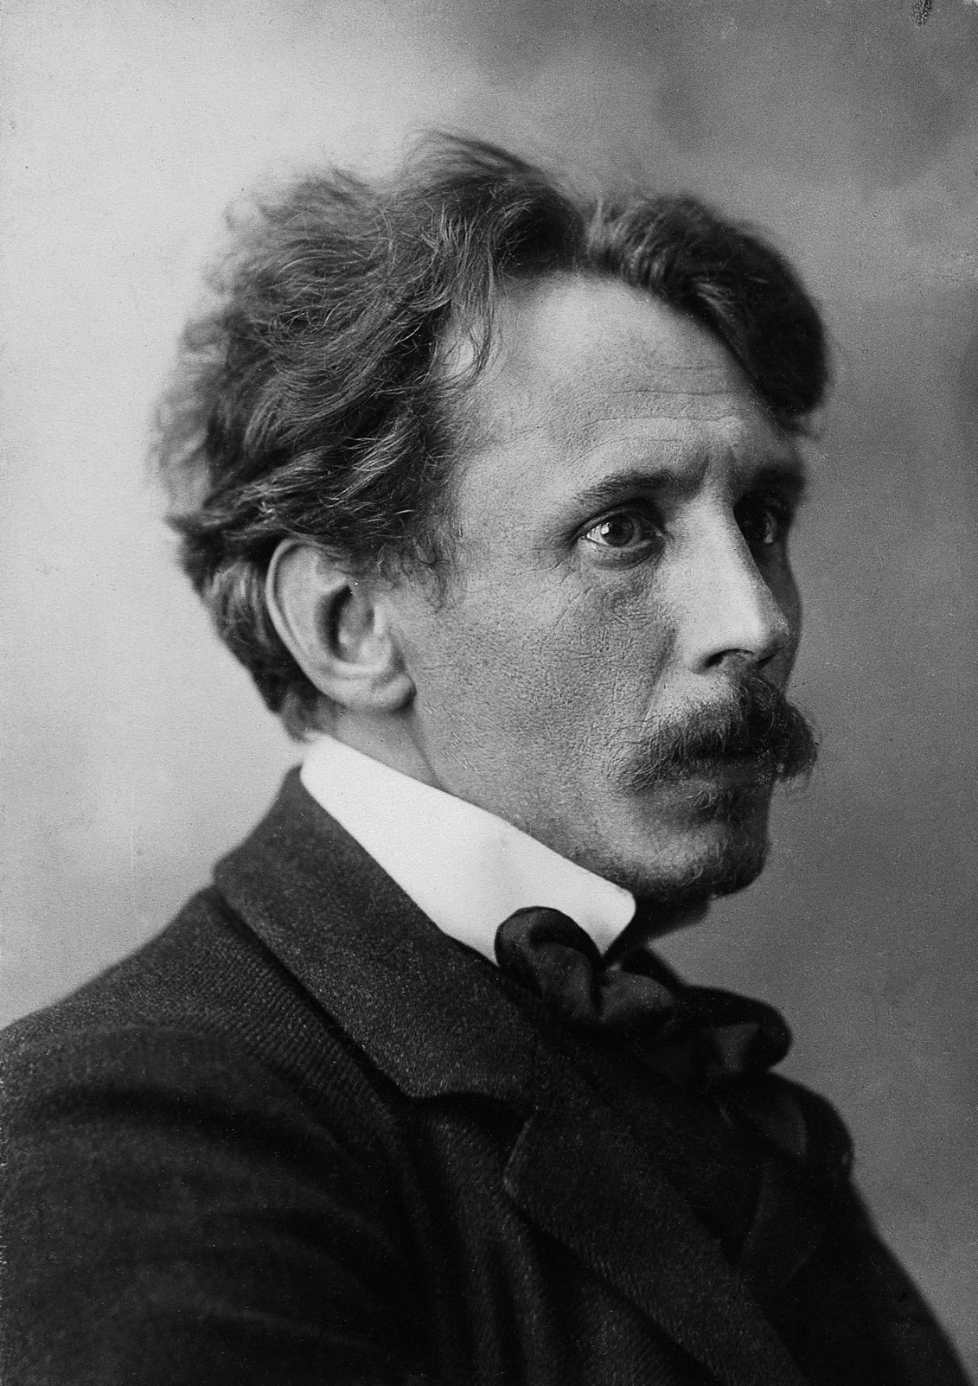
Mikalojus Konstantinas Čiurlionis
https://www.youtube.com/watch?v=BY4o2G6hmaQ

Slide 4
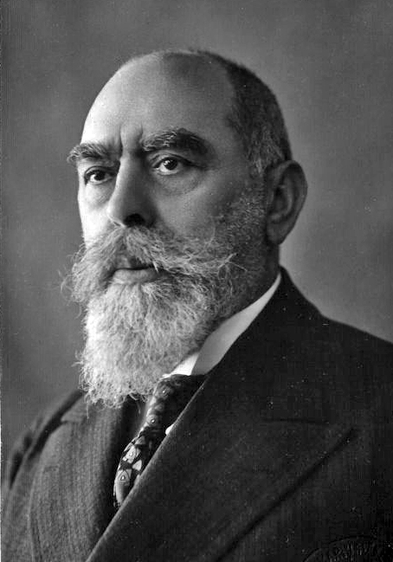
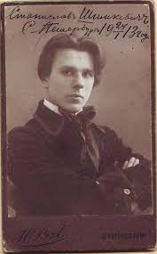
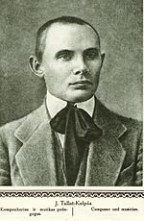
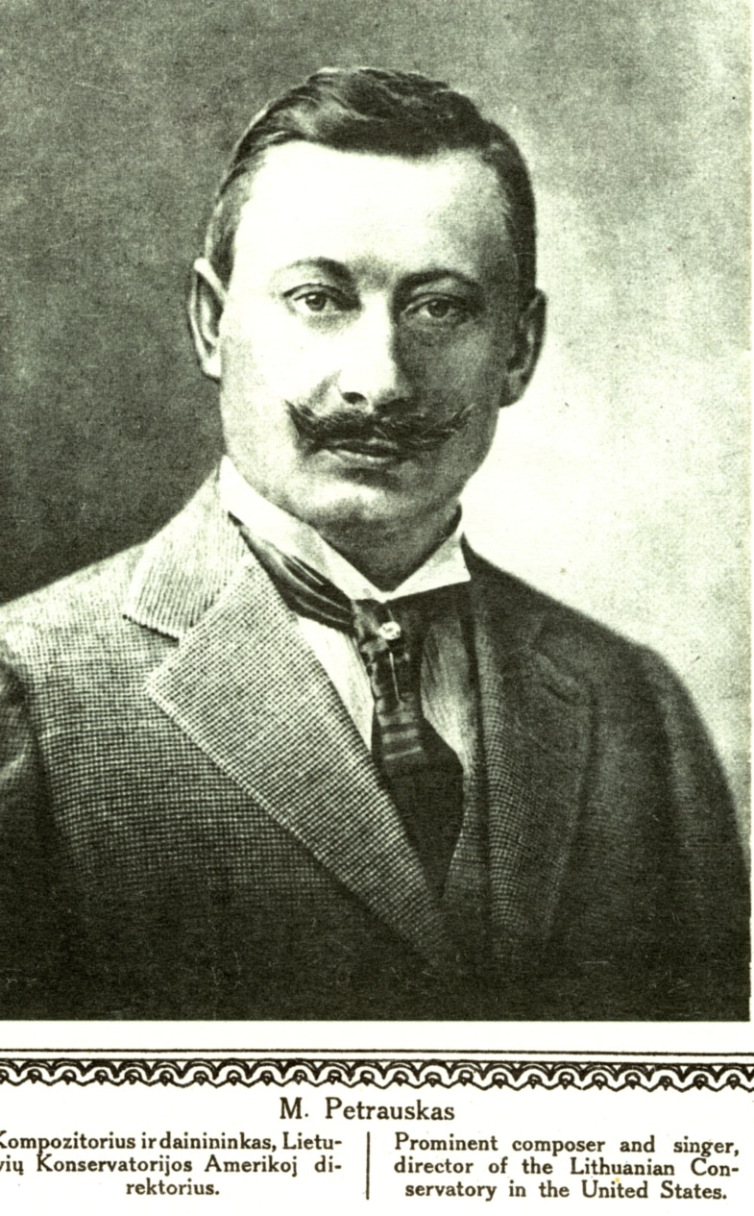
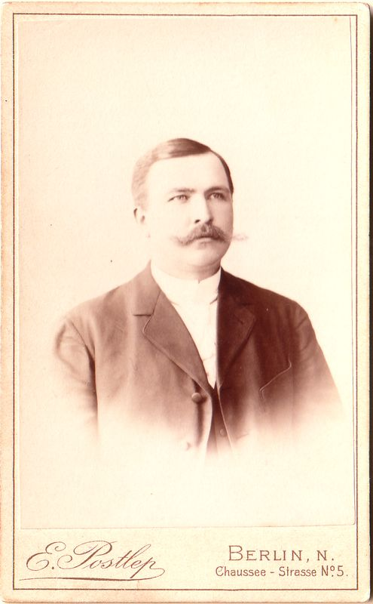
A country of songs
As with other nations, folklore has played an important role in the Lithuanian national consciousness. Equally important were the underground choirs that started springing up in opposition to Imperial Russian oppression. Lyrical, expressive and sonorous songs were written by Vincas Kudirka (his Tautiška giesmė, composed in 1898, became the official national anthem when Lithuania was established), Česlovas Sasnauskas, Mikas Petrauskas, Juozas Tallat- Kelpša, Stasys Šimkus and Juozas Naujalis.
Juozas Naujalis
Stasys Šimkus
Juozas Tallat - Kelpša
Mikas Petrauskas
Česlovas Sasnauskas

Slide 5
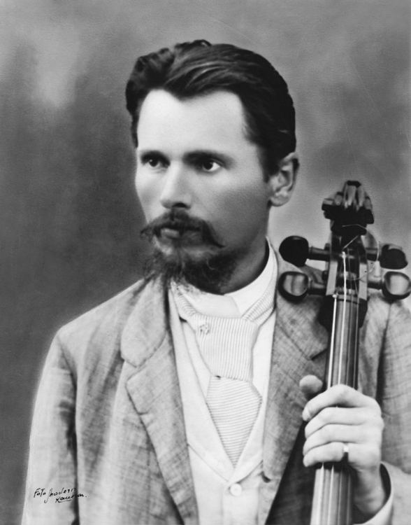
https://www.youtube.com/watch?v=vH4zvGZ7jCY

Slide 6
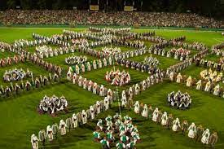
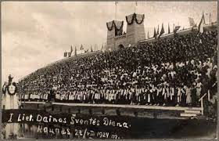
„Dainų šventė“
The choral movement became even more active in 1918 when Lithuania became an independent state, and produced a phenomenon unique to the Baltic States, the song festivals. The first Song Festival was held in Kaunas in 1924, with 86 participating choirs.

Slide 7
The interwar Modernists
The first period of Lithuanian independence lasted for just 22 years, but in that short time the country made an incredibly big economic, social and cultural leap.
As culture and art developed, a number of museums, a university and a drama theatre opened. In 1933, Juozas Gruodis (1884-1948), the first professor of composition, founded the Kaunas Conservatory, which trained over 100 composers and performers up till the end of the war.
As the front line approached in 1944, a lot of artists moved to the West, and continued their creative work in the USA.

Slide 8
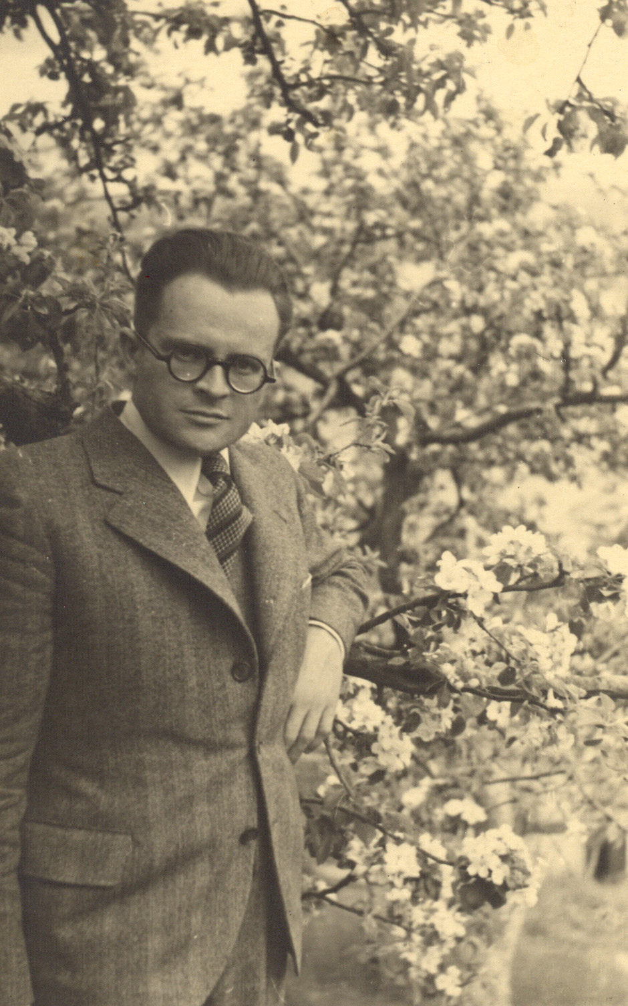
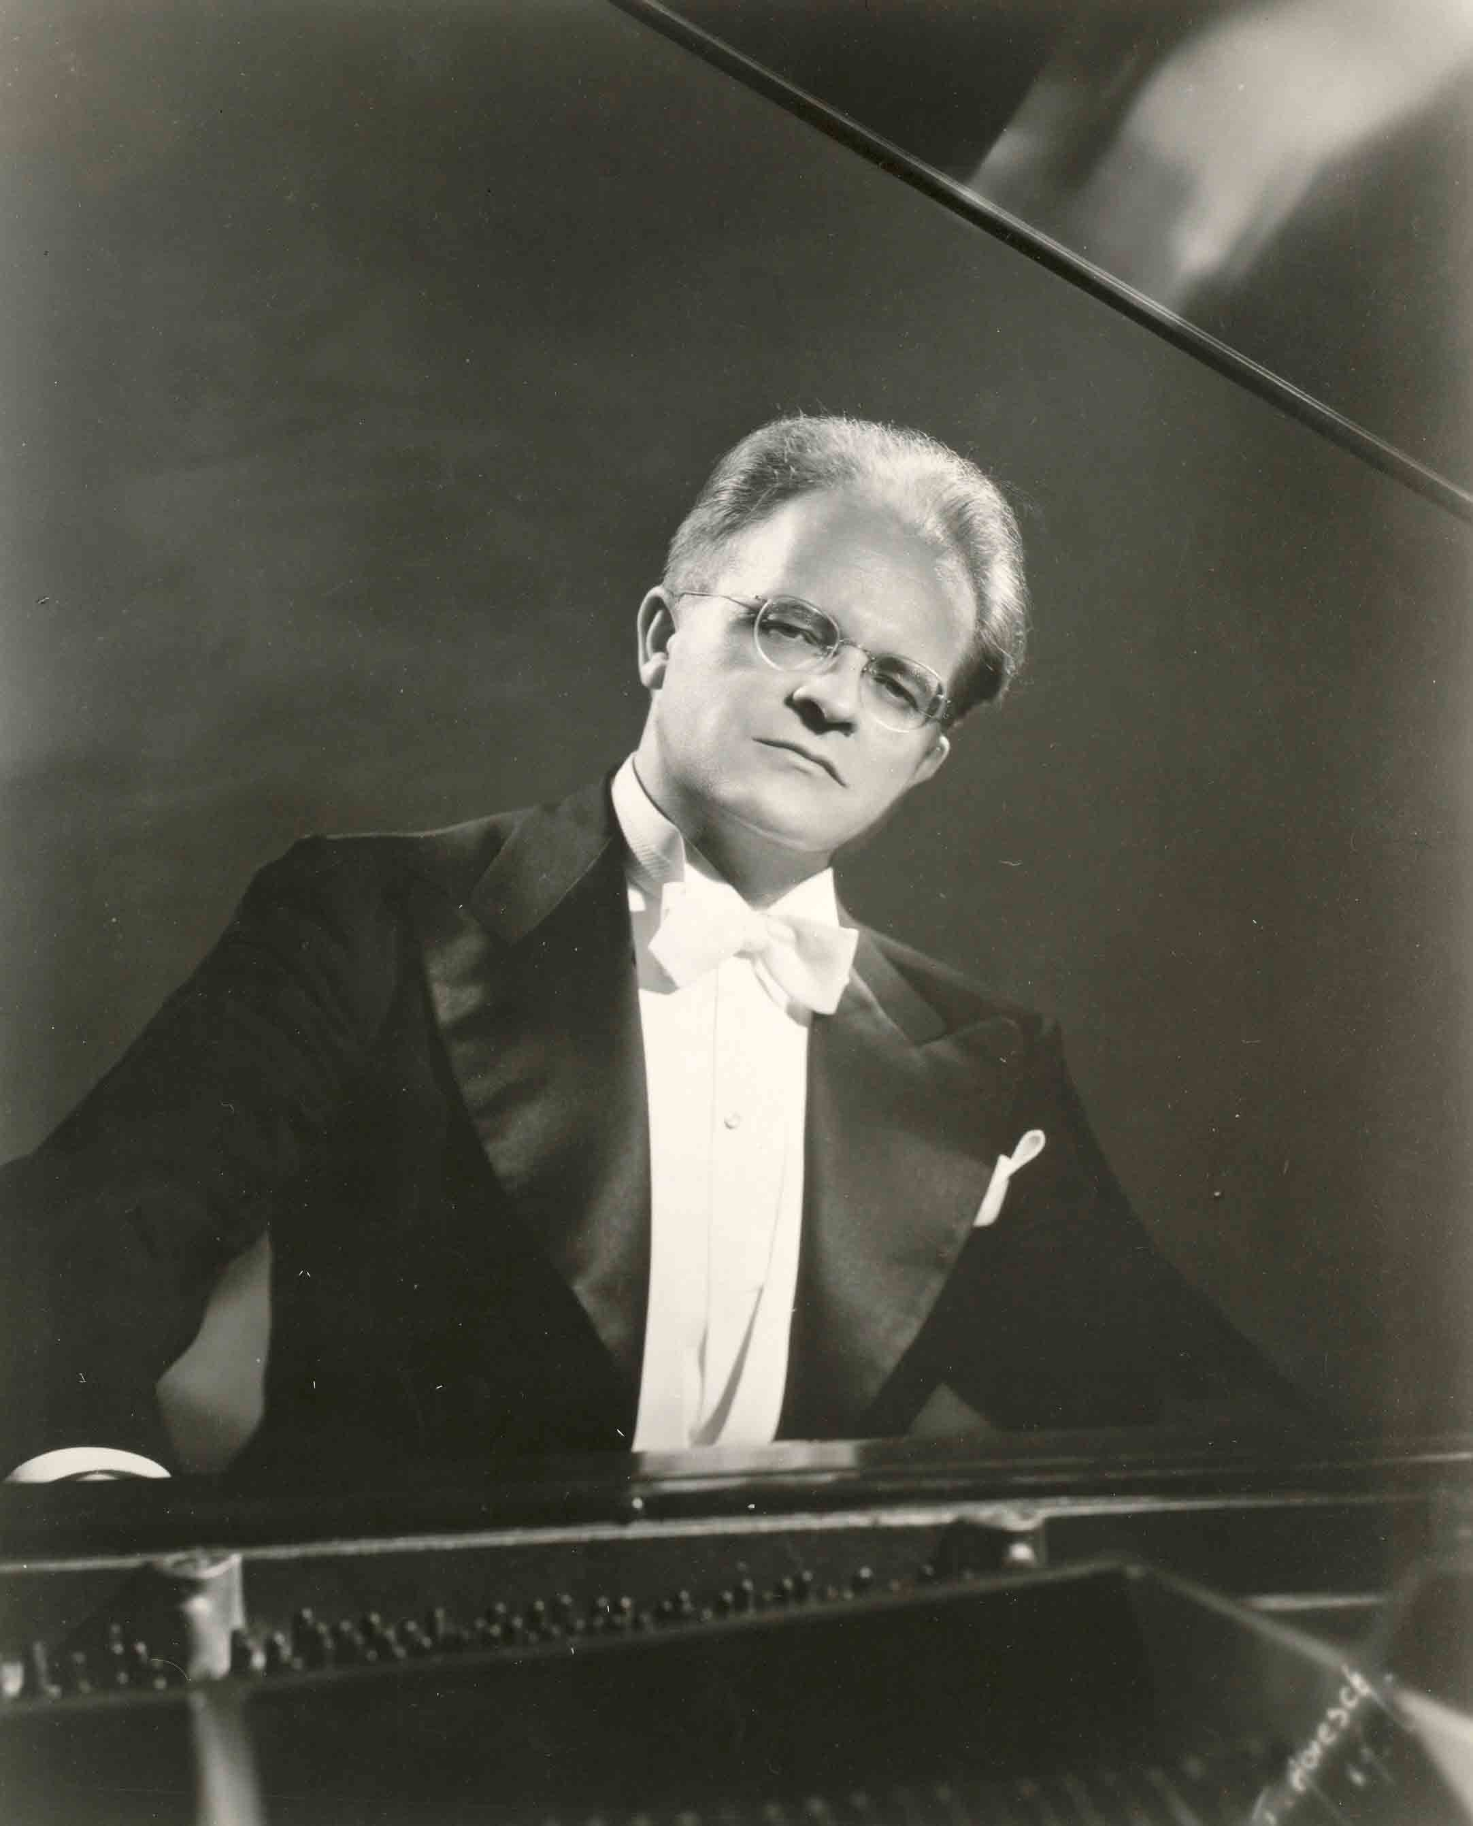
Vytautas Bacevičius (1905–1970) was the composer and pianist. Bacevičius did not change his style in order to adapt to the American market, but developed his idea of cosmic music further, and after some time gave up his career as a pianist and devoted himself fully to composing works of a mystical character. It is now finally returning both to the musical memory and reflection, and to concert halls.

Slide 9
Towards authenticity
At the end of the Second World War, many composers and performers moved to the West to escape Soviet rule. After some time, particularly gifted composers, found a way to express themselves authentically.
One of the most outstanding and talented composers of the postwar decades is Eduardas Balsys, whose music charms audiences with its romantic flight, emotionality, modern musical language, and impressive orchestral features. His works: orchestra "Dramatic frescoes"; ballet "Egle, Queen of the Grass Snakes"; opera "Journey to Tilsit" .

Slide 10
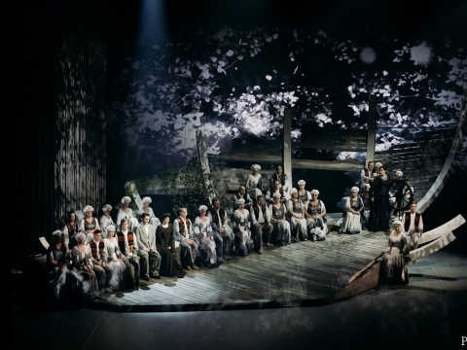
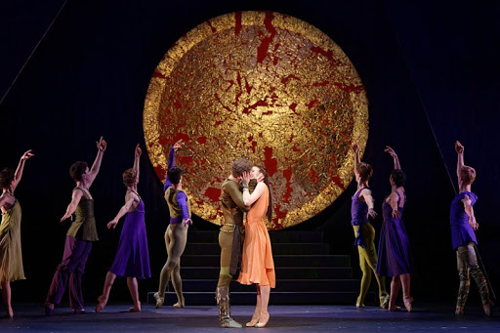
Opera "Journey to Tilsit"
Ballet "Egle, Queen of the Grass Snakes“
https://www.youtube.com/watch?v=dOgC0tHOUUw

Slide 11
The music performing tradition
National institutions are the most important supporters of Lithuania’s musical life. The main role in promoting music is played by the Lithuanian National Philharmonic Society. It is responsible for the Lithuanian State Symphony Orchestra, the Lithuanian Chamber Orchestra, the chamber music ensemble Musica Humana, the Vilnius State Quartet, and the M.K. Čiurlionis Quartet. The Lithuanian Chamber Orchestra travelled on tour around the globe while it was run by its founder Saulius Sondeckis, and now performs both Classical music and Lithuanian compositions at international festivals.

Slide 12
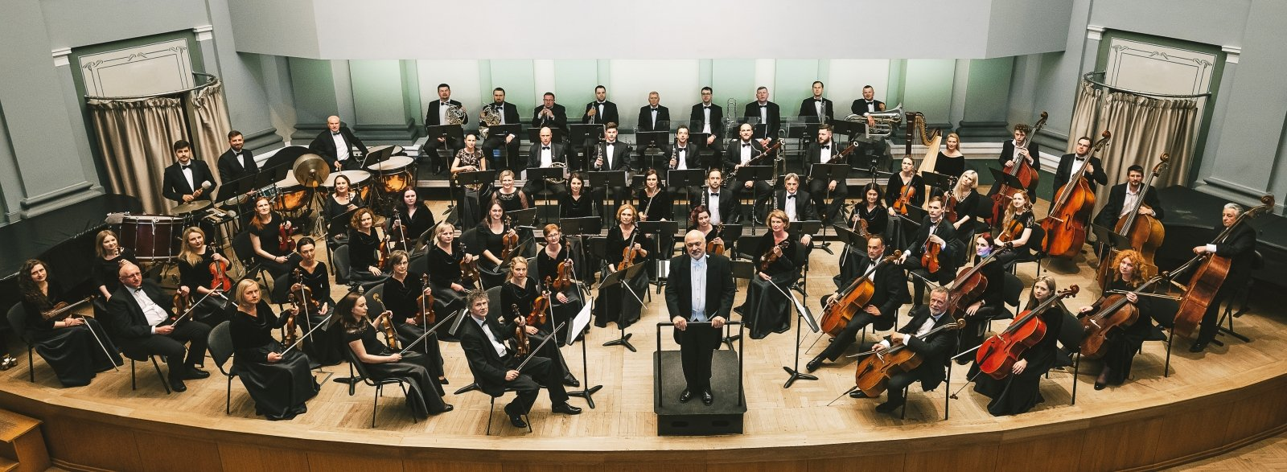
Kaunas City Symphony Orchestra, together with the Kaunas State Choir, is not only a formative presence on the music scene in the second largest city in Lithuania, but also an active participant in prestigious international projects.

Slide 13
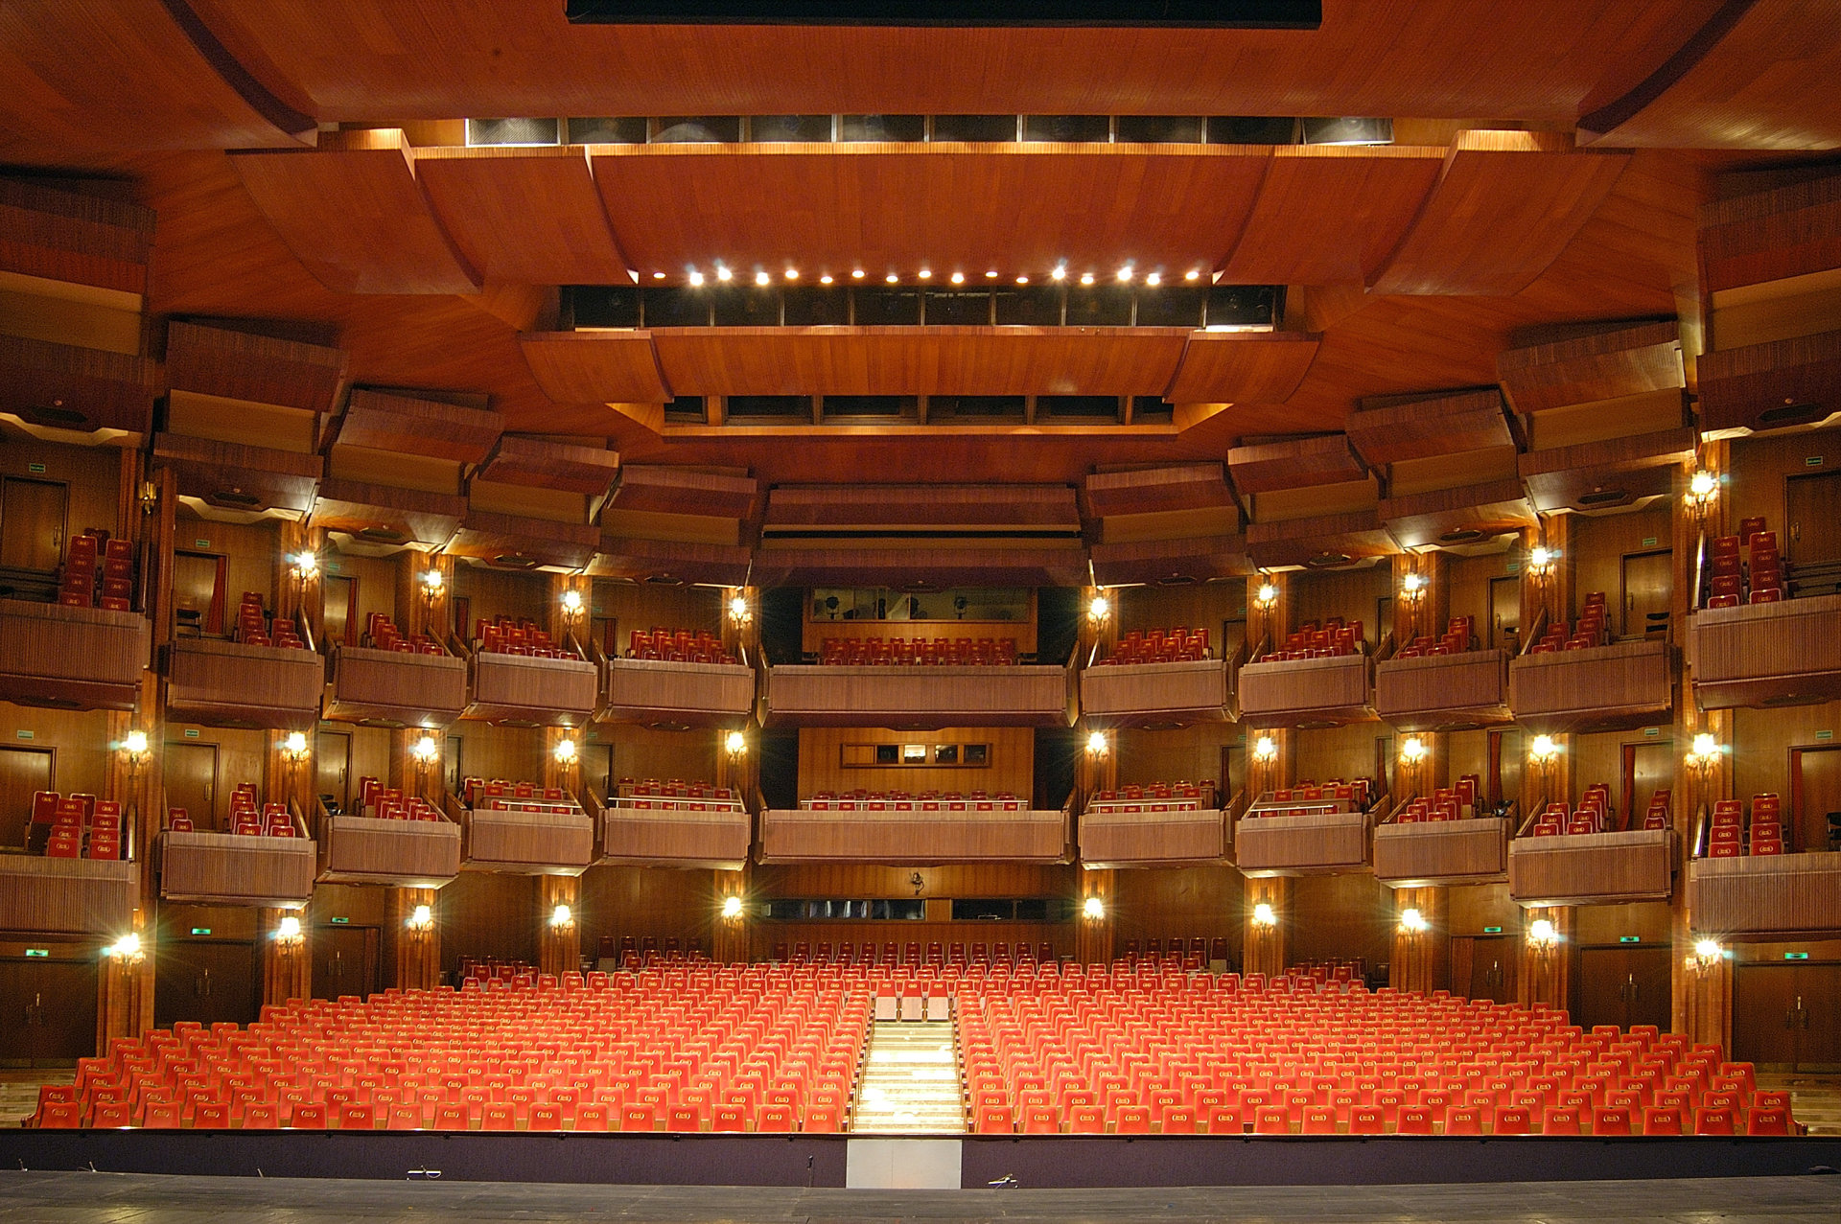
Musical theatre
The Lithuanian National Opera and Ballet Theatre, the country’s main stage, began its history in 1920, with the first stage play in Kaunas. After the war, the theatre moved to Vilnius. It has permanent opera and ballet troupes, but also invites independent solists and directors. Kaunas State Musical Theatre was known as the State Theatre before the war, and had opera, ballet and drama theatre troupes. Also, several more informal troupes are developing their activities.

Slide 14
Jazz: the music of free spirits
Lithuania was part of swinging Europe during its earlier period of independence from 1918 to 1940, and nearly every town had its own jazz band. After the war, when it became dangerous even to use the word jazz, bands vanished from Soviet-occupied Lithuania.
The Ganelin Jazz Trio (or GTC Jazz Trio) was formed in 1971, and achieved European fame. The group was the driving force behind the evolution of jazz in Lithuania, and laid the foundations for what was later to be known as the Vilnius school of jazz. In 2017, 30 years after they stopped performing, the group won the country’s top award, the National Prize for Culture and Arts, for forming the Vilnius school of jazz.
https://www.youtube.com/watch?v=v1gh3MTSExA

Slide 15
At a time when the quest for independence was growing, jazz musicians sought increasingly to express their identity through their creativity, and explored connections between jazz and folk music, by improvising on folk melodies and even citing actual folk songs, using folk instruments in jazz bands.

Slide 16
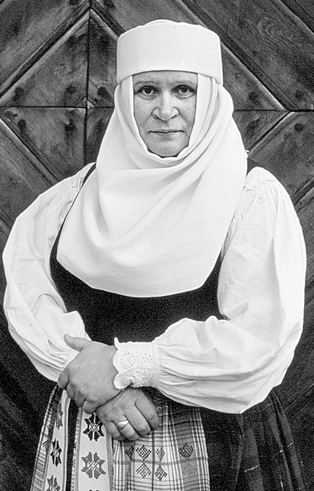
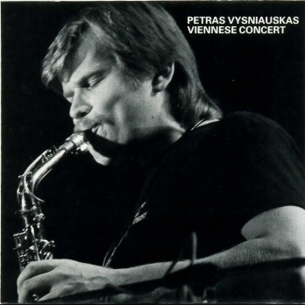
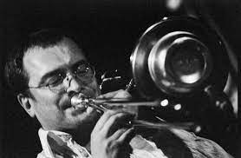
Veronika Povilionienė
Skirmantas Sasnauskas
Petras Vyšniauskas
Joint projects between jazz and folk musicians might be considered a separate genre, represented by distinctive collages of the two musical styles, such as the fusions by the jazz saxophonist Petras Vyšniauskas and the folk singer Veronika Povilionienė, Skirmantas Sasnauskas’ jazz ensemble and others.
Today, Lithuania is part of a world that enjoys a fully developed musical scene, in which jazz is highly prominent. Lithuanian jazz is a vibrant, colourful, constantly changing and intriguing world of musical ideas, forms and structures.

Slide 17
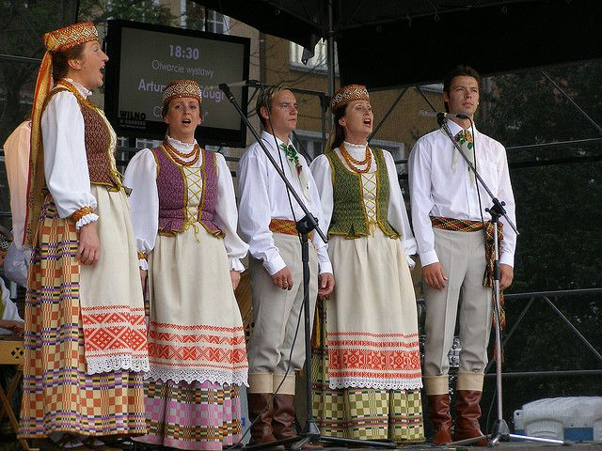
Lithuanian folk music: between the woods, the city and the world
Every tradition must have two elements to be vibrant. First, it has to date back long enough that it connects the present generation with its ancestors and their way of life, ensuring continuity. Music is perhaps one of the most intuitively and easily adopted and practiced forms of cultural heritage.
Lithuanian National Song and Dance Celebration, a massive festival happening every four years, has the longest history, and remains as relevant and uniting as it was in interwar Independent Lithuania and even during the Soviet years.

Slide 18
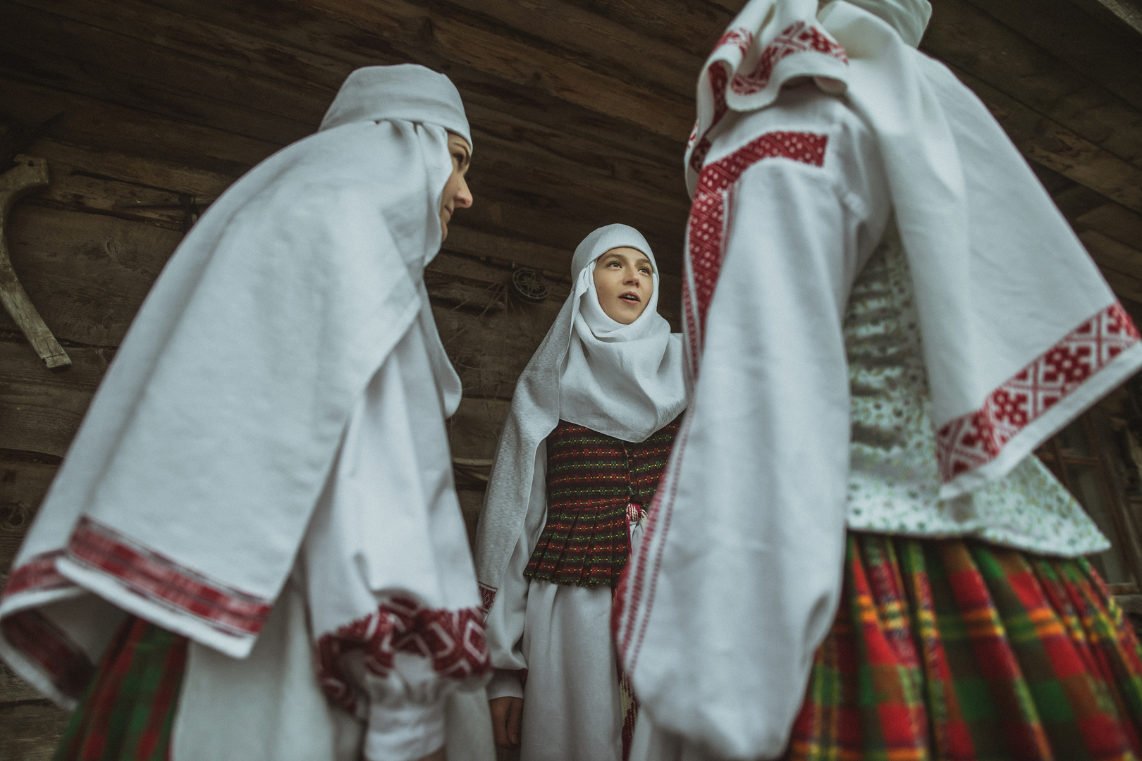
Sutartinės
Sutartinės in particular and folk music in general are currently becoming something of an urban trend, leading young Lithuanians to rethink their stereotypes of folk music as boring and stuck in the past, and make it a part of their eclectic and global contemporary lifestyle.
Sutartinės are now on UNESCO’s Representative List of the Intangible Cultural Heritage of Humanity.
Folk music finds such unlikely bedfellows as techno or hip hop, a phenomenon that is practically unparalleled in many other countries.
https://www.youtube.com/watch?v=nrCgicL2KIQ

Slide 19
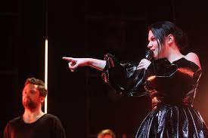
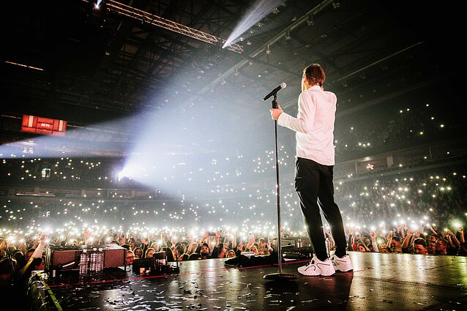
POP, Rock and basketball
Lithuania hosted the 37th European Basketball Championship in 2011. Basketball is sometimes called the country’s second religion. The national men’s basketball team has won EuroBasket three times, and brought home bronze medals from the Olympics three times.
Six years down the line, at least a dozen Lithuanian acts regularly tour arenas, drawing huge crowds, from Leon Somov & Jazzu to Andrius Mamontovas, Marijonas Mikutavičius.

Slide 20
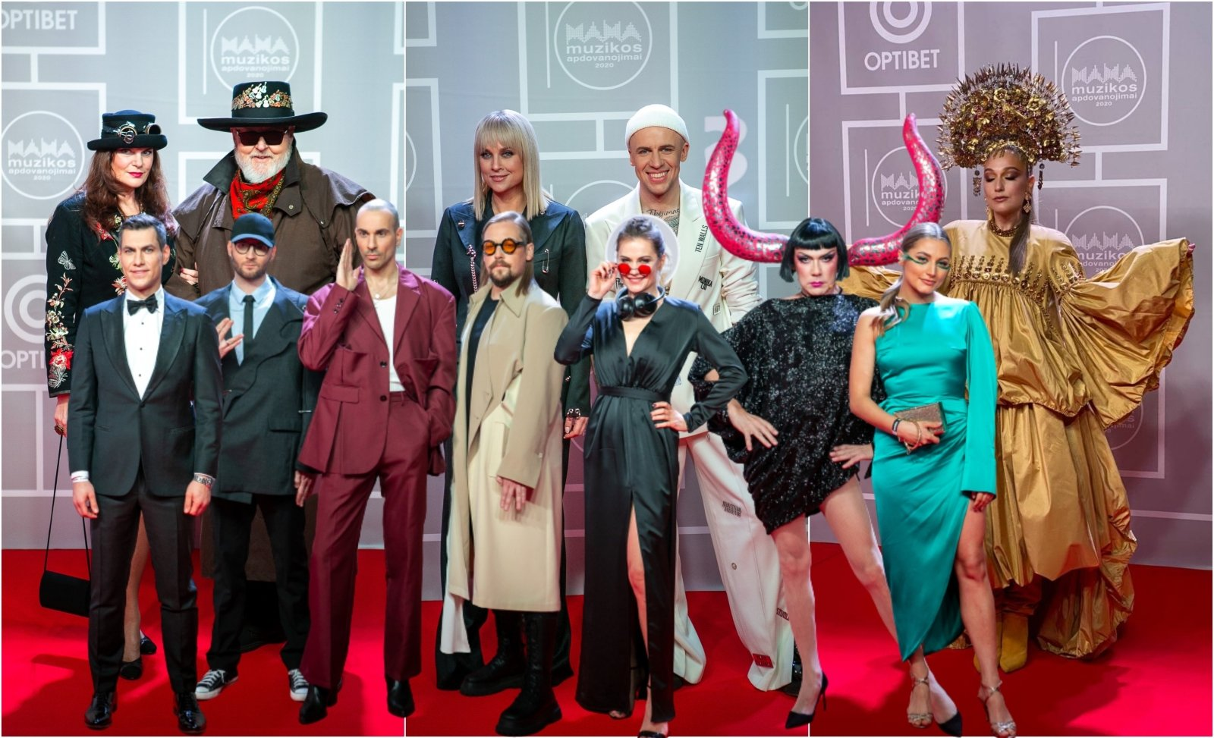
Žalgiris Arena, the biggest venue in Lithuania, now hosts the MAMA(The year awards of music association) awards ceremony. The most important event of its kind nationally, it draws 10,000 music fans every year, and is transmitted live by one of the country’s biggest television channels.

Slide 21
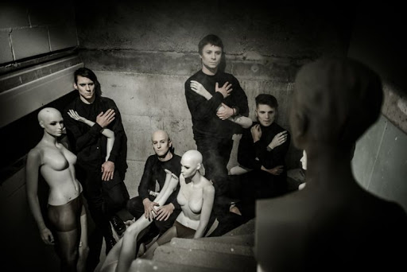
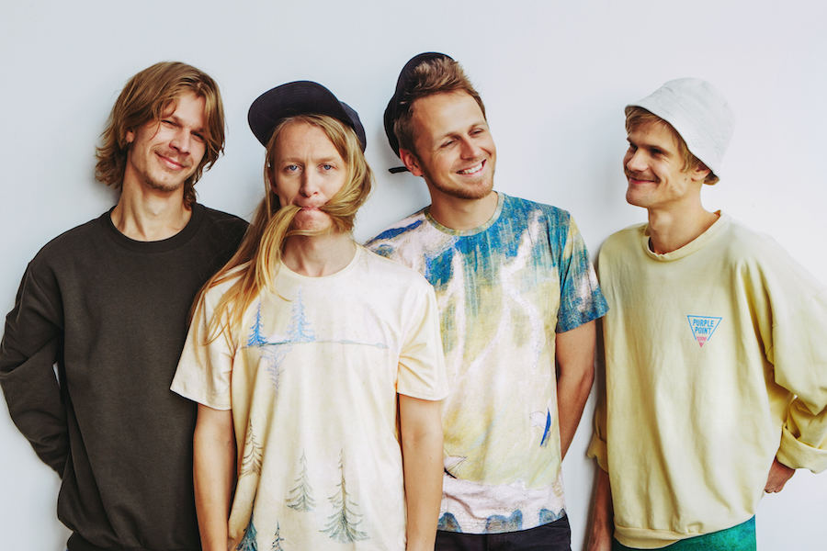
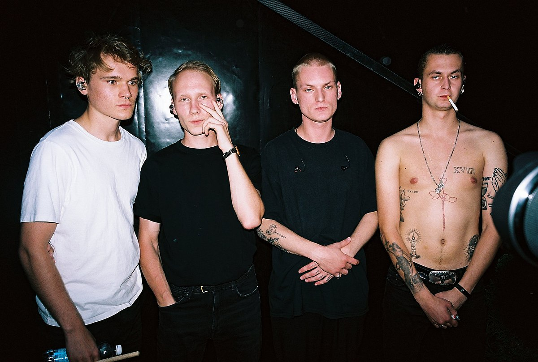
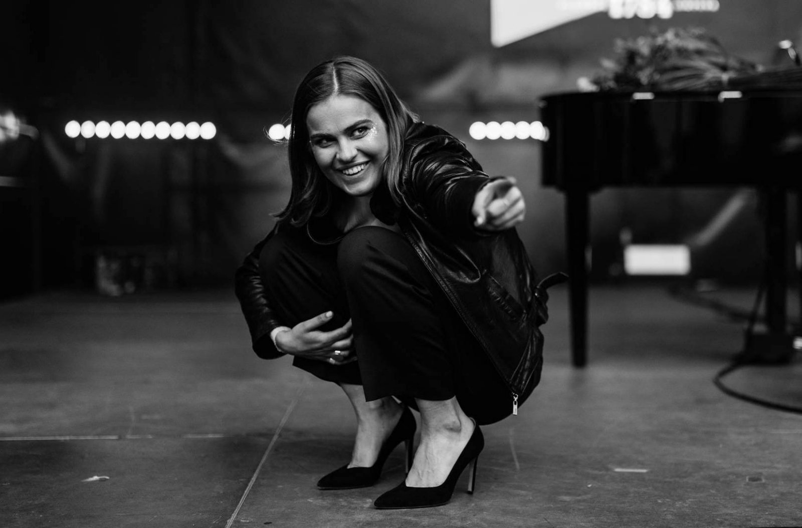
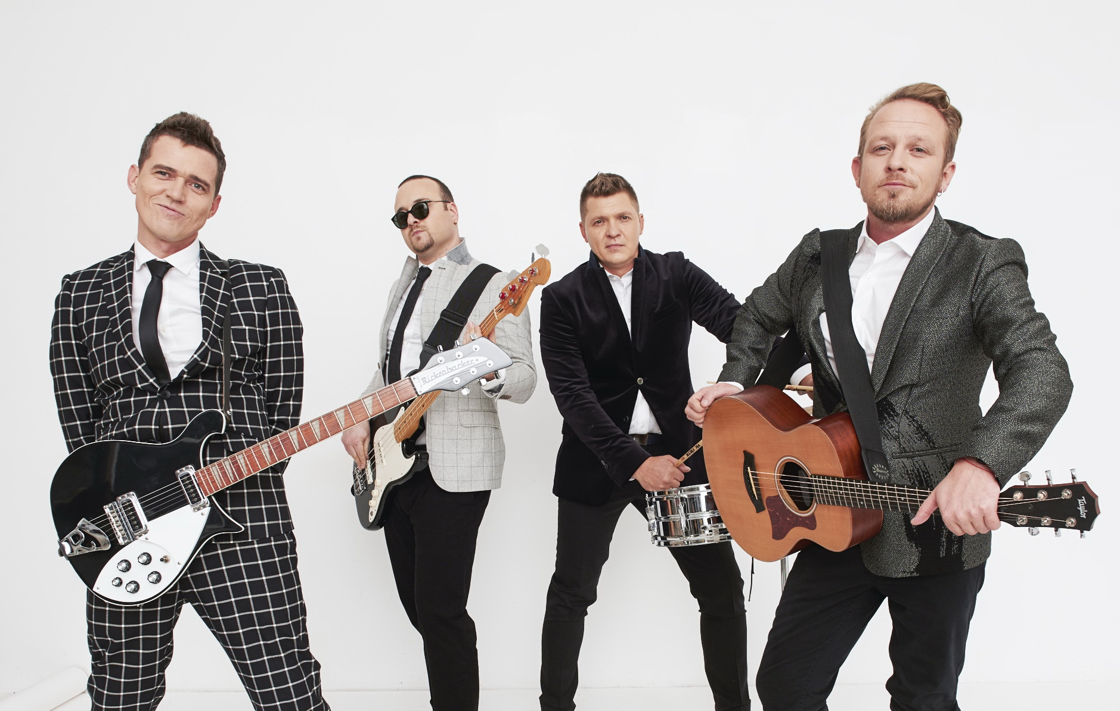
Bands
Solo
Ansamblis
Under the radar, things are going fine, as well. The alternative music scene is booming, with musicians like ba., Garbanotas Bosistas, Gabrielė Vilkickytė, Biplan and Solo Ansamblis expanding their fan base. It is not uncommon to see Lithuanian bands at Europe’s biggest showcase events, from Eurosonic to The Great Escape. This music is full of honest ideas and great ambitions.
Garbanotas
BA
Gabrielė
Vilkickytė
https://www.youtube.com/watch?v=DKjLuqeUzCw&ab_channel=TWODICKSKLAN
Biplan
https://www.youtube.com/watch?v=dYKCDvytEyM&ab_channel=Garbanotas
https://www.youtube.com/watch?v=DKjLuqeUzCw&ab_channel=TWODICKSKLAN
https://www.youtube.com/watch?v=Ltc6vrrsXeE&ab_channel=Gabriel%C4%97Vilkickyt%C4%97
https://www.youtube.com/watch?v=JVPCQnFOnUY&ab_channel=Biplan

Slide 22
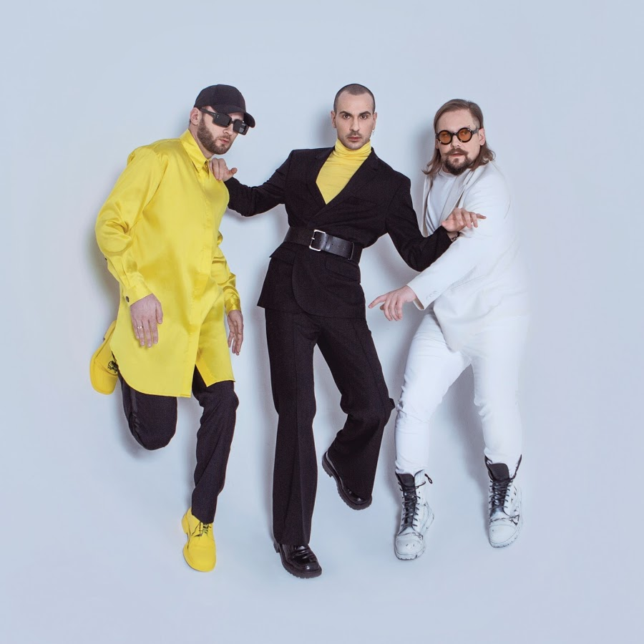
The Roop
THE ROOP certainly take their work seriously. This fresh-sounding dance-rock / pop band was formed in 2014 by singer Vaidotas Valiukevičius, drummer Robertas Baranauskas, and guitarist Mantas Banišauskas. In 2020 Lithuanian choice for the Eurovision song contest – “On Fire” – gained huge numbers of fans worldwide. The videos of “On Fire” have over 30 million views and the number keeps growing. Even though the band couldn’t participate in the main Eurovision event because of the pandemic, they unanimously won most of the alternative online Eurovision song contests and took 1st place in the alternative German Eurovision TV live show.
https://www.youtube.com/watch?v=YFzcmH1kDj8&ab_channel=THEROOPBand

