Slide 1
Lithuanian Education System Kaunas ‘Vyturys‘ gymnasium
Erasmus+ project ‘Europa Trivia Game‘ virtual meeting in Lithuania
2021

Slide 2
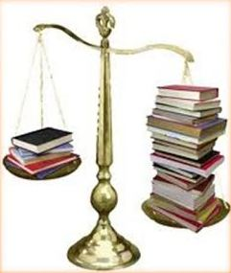
Educational principles
School education is free of charge (except private institutions);
Education is compulsory for children from 6 to 16 years;
The official language at schools is Lithuania.

Slide 3
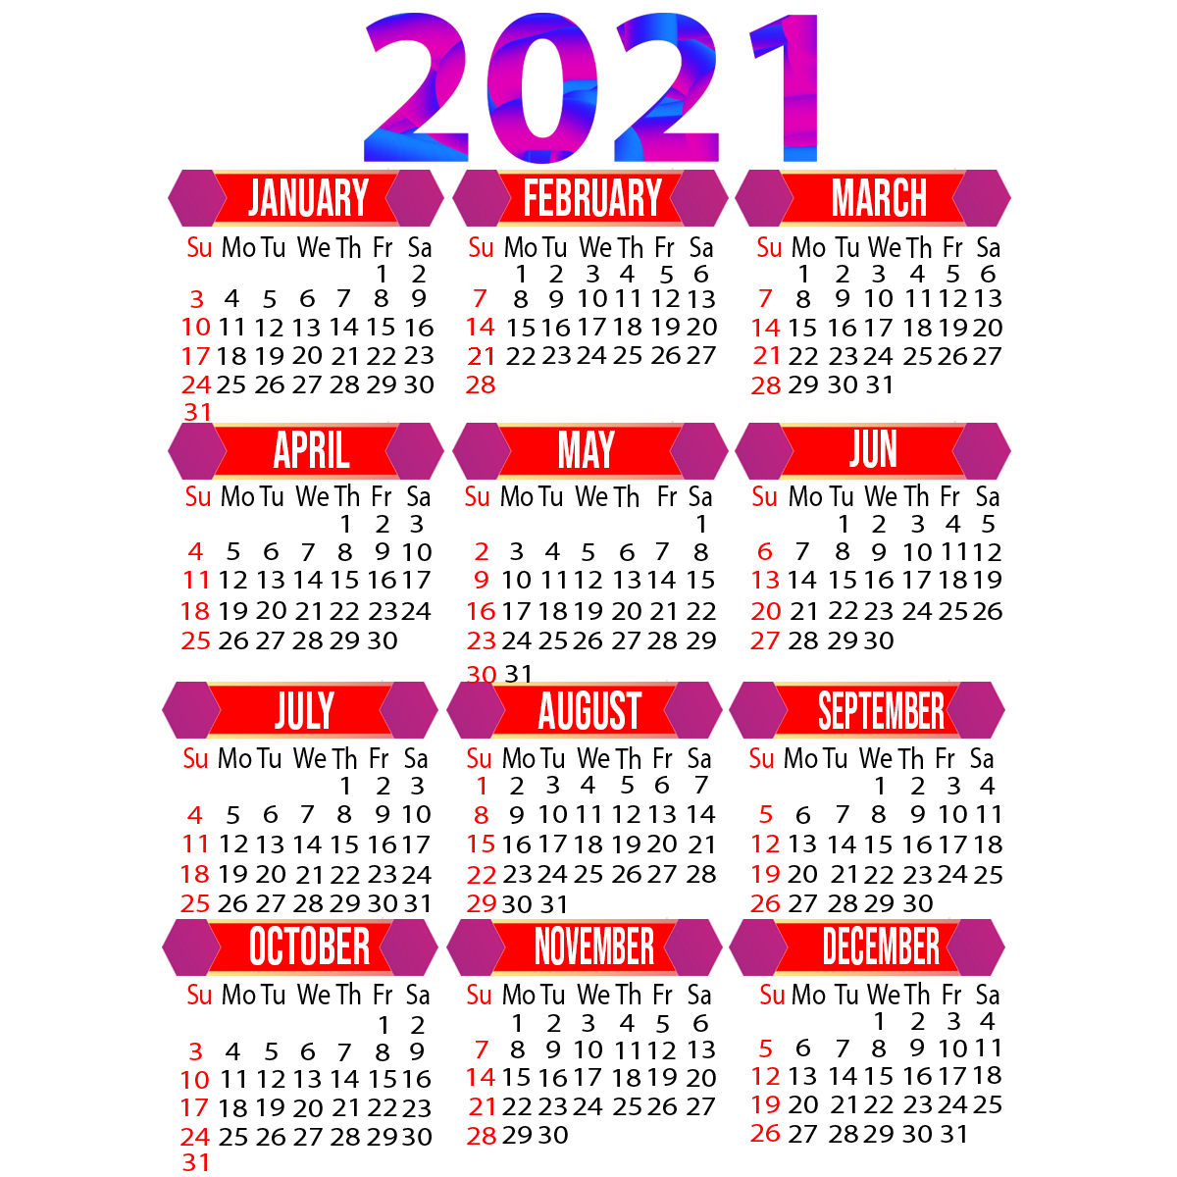
General principles
1st of September is the beginning of a school year;
The end of May – the end of a school year for the 12th formers;
The beginning of June – the end of a school year for primary school students
23rd of June – the end of a school year for all the rest of the students;
There are two semesters or three terms per year.

Slide 4
General principles
A lesson lasts for 45 minutes; but for 30 – 35 minutes for pre-school pupils and the first formers;
Students have 22 – 31 lessons per week (from Monday – to Friday);
There are 24 – 30 students in a class, as a rule.

Slide 5
Structure of the educational system in Lithuania
Pre-primary education (1 – 5 years old);
Pre-school (5 – 6 years old);
Primary (7 – 11 years old);
Basic (11 – 16 years old);
Secondary (16 – 18/19 years old);
Vocational education and training (14 – 21);
Higher education (18 /19 – 26).

Slide 6
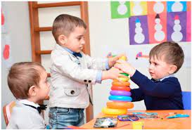
Pre-primary education
It is considered a part of non-formal education;
It caters for children from 1 year to 5/6 years of age;
Attendance is optional.

Slide 7
Compulsory education

Slide 8
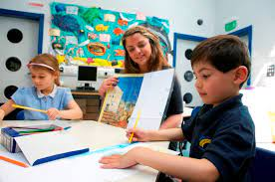
Pre-school education
6-7 years old

Slide 9
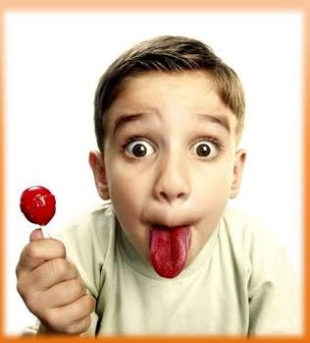
Primary education
Provided for children between 6/7 – 11/12 years of age;
Duration is 4 years (from the 1st to the 4th forms);
Early foreign language teaching is offered from the 2nd form;
Subjects taught at a primary school are compulsory;
Primary education is gained.

Slide 10
Basic education
Provided for children between 11 – 16 years of age;
Students learn at a progymnasium (from the 5th to the 8th form), at a gymnasium (from the 9th to the 10th forms), basic, vocational or other types of schools;

Slide 11
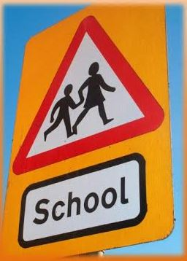
Basic education
Duration of the curriculum is 6 years (from 5th to 10th forms);
Around 17 subjects are taught.
All subjects are compulsory;
At the end of the 10th form students have to take two exams: The Lithaunian language and literature and one of their choice;
Basic education is gained.

Slide 12
Achievements
Students’ progress and achievements are measured through standardized testing in the 2nd, 4th, 6th and 8th grades.
The standardized testing is not compulsory. It can be initiated by schools or municipalities.
The assessment of lower secondary education achievements in grade 10 (grade II in gymnasium schools) is mandatory.
Upper secondary education is concluded by mandatory Matura examinations, which are used both to evaluate pupils’ achievements and to enter higher education institutions.

Slide 13
Non-compulsory education

Slide 14
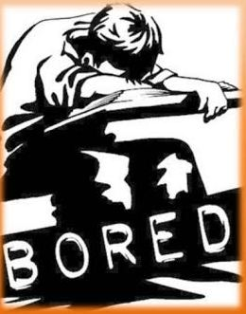
Secondary education
Provided for children between 16 – 18/19 years of age;
Curriculum consists of compulsory and optional modules of general education;
Students learn at a gymnasium, secondary, vocational or other types of schools;

Slide 15
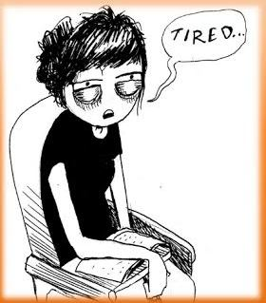
Secondary education
Duration of the curriculum is 2 years (from the 11th to the 12th forms / or from the 3rd to the 4th gymnasium classes).
At the end students take A or B level school – leaving (or maturity) examinations (they must choose at least 2 exams, but some choose up to 6) so as to get a certificate.
Secondary education is completed.

Slide 16
Vocational education
It is provided to students who have basic education starting from the age of 14 (the 8th form) or 16 (the 10th form);
Students learn at a vocational school;
Upon completion of studies a student gets primary professional qualification and / or completes secondary education.

Slide 17
Higher education
For those who are at least 18 years – old and have completed secondary education;
Learn at:
a college, where study programmes are based on practise;
University, where university study programmes prevail;

Slide 18
Higher education
for Bachelor’s degree students study 3 – 5 years;
for Master’s degree they have to study from 1,5 to 2 years more.

