Slide 1
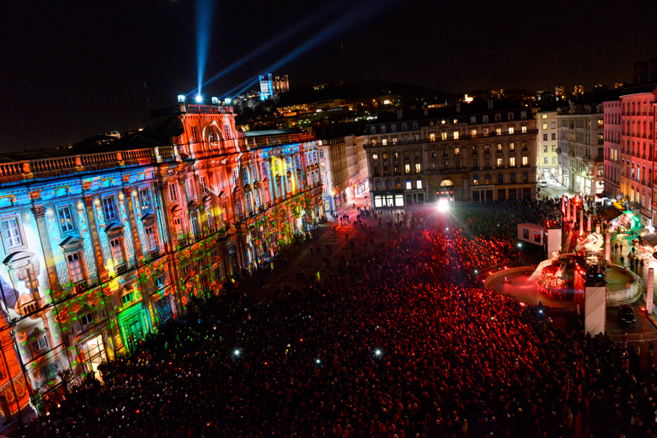
Festival of lights
Crowded Place des Terreaux during the traditional festival of lights on December 8th

Slide 2
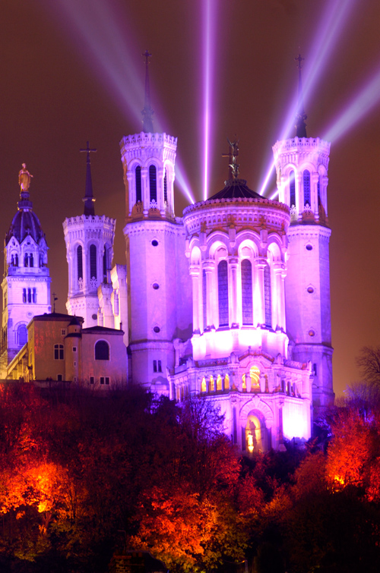
Fourviére Basilica
Basilica of Notre-Dame de Fourvière, a large 19th-century basilica on the top of Fourvière Hill in place of the ancient Roman forum of Trajan

Slide 3
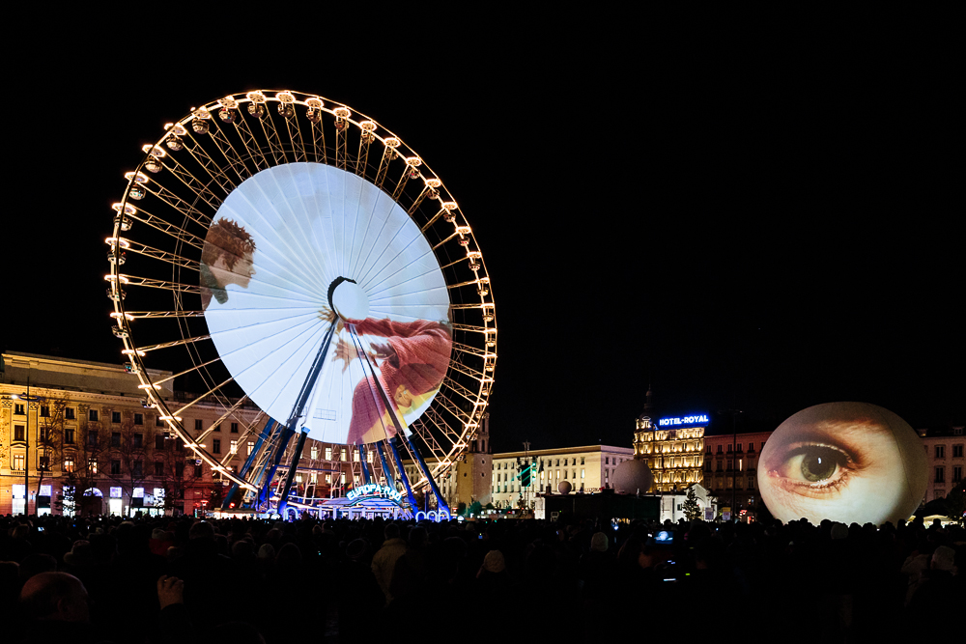
Bellecour square during the festival of lights

Slide 4
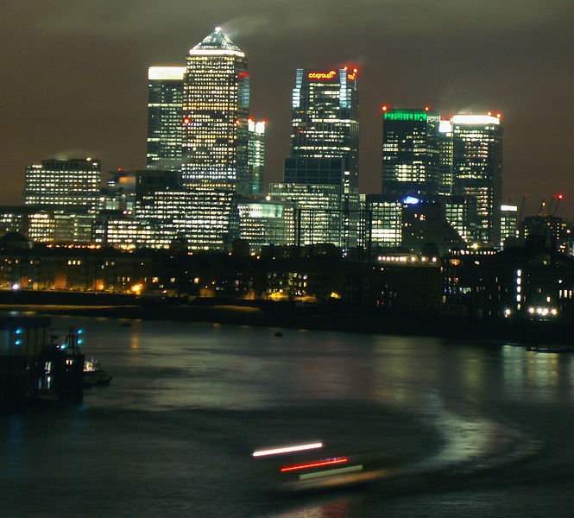
La Part-dieu district
The central business district of Lyon. The second largest business district of France

