Slide 1
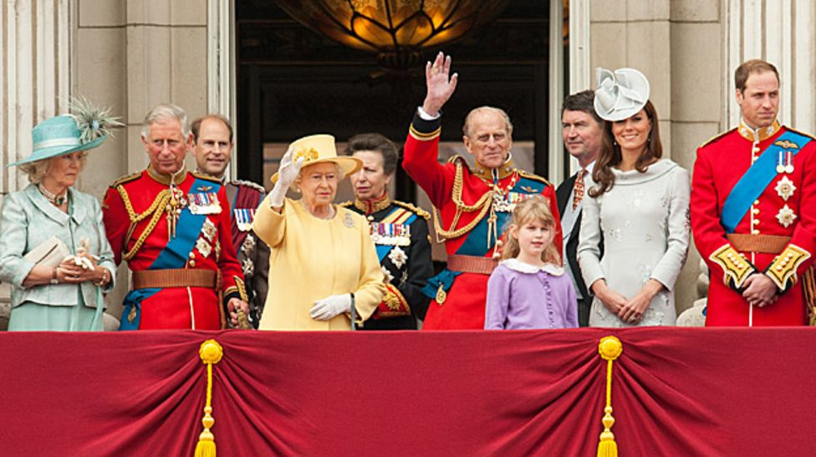
ENGLISH ROYAL FAMILY MEMBERS

Slide 2
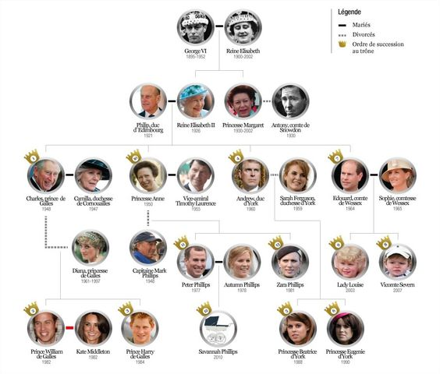
FAMILY TREE OF ROYALS

Slide 3
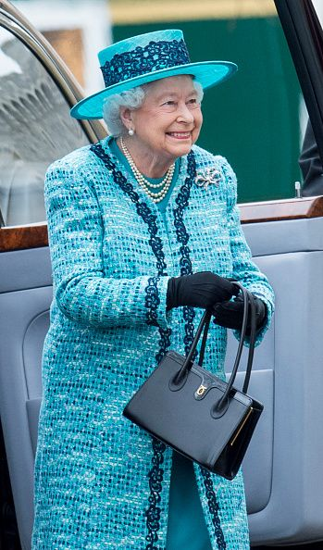
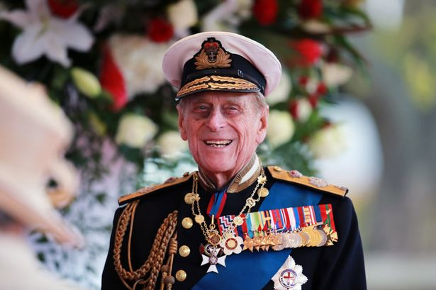
Prince Philip, Duke of Edinburgh
Queen Elizabeth II
Elizabeth Alexandra Mary; born 21 April. She was educated privately at home.Reign 6 February 1952 – present.
born on 10 June 1921 .He is the husband of Queen Elizabeth II. Tenure 6 February 1952 – present

Slide 4
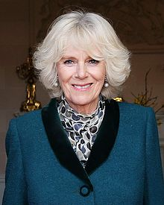
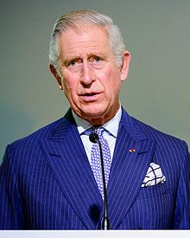
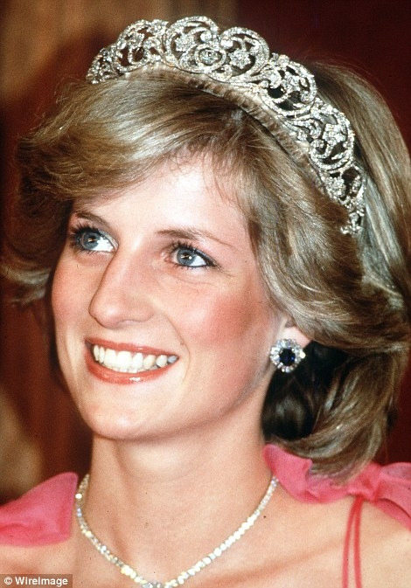
The Duchess of Cornwall at Hillsborough Castle in April 2014
Prince of Wales Charles
Born: 1948
The Prince of Wales Charles is the Queen’s eldest son and first in line to the throne. On 29 July 1981 he married Lady Diana Spencer, who became the Princess of Wales. The couple had two sons, William and Harry. They later separated and their marriage was dissolved in 1996. On 31 August 1997 the Princess was killed in a car crash in Paris.

Slide 5
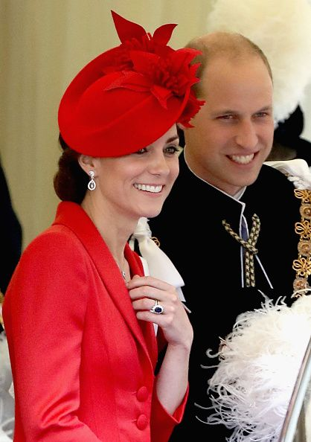
Catherine, Duchess of Cambridge("Kate"
Middleton )
born ; 9 January 1982)
Duke of Cambridge
Born: 1982
Prince William is the eldest son of the Prince of Wales and Diana, Princess of Wales. The Duke was 15 years old when his mother was killed in a Paris car crash.

Slide 6
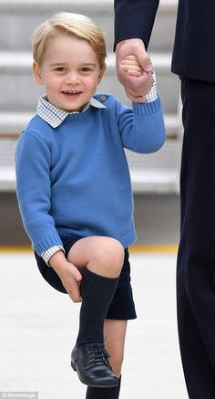
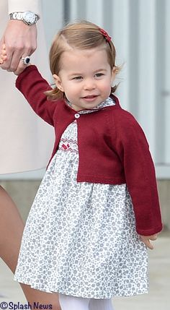
Prince George of Cambridge
Born: 2013
Princess Charlotte of Cambridge
Born: 2015

Slide 7
Prepared by
Irem BİLGİN
Ezgi ÇOBAN
THANKS ☺ ☺ ☺

