Slide 1
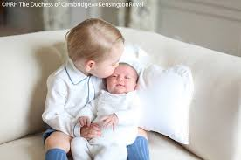
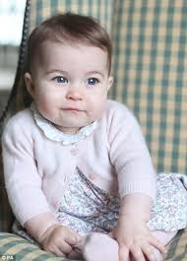
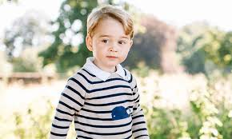
How to bring up a Royal baby?
Prince George
Princess Charlotte

Slide 2
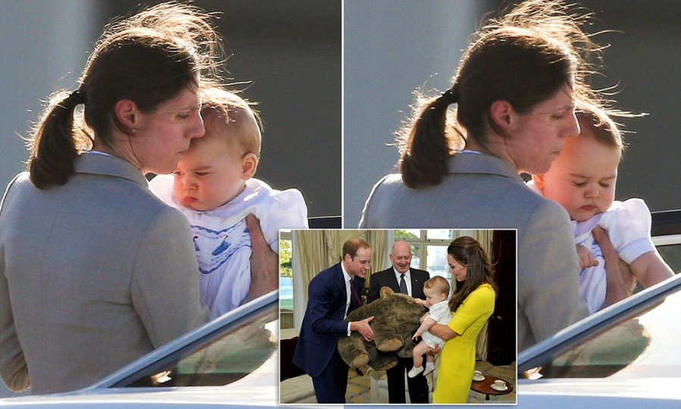
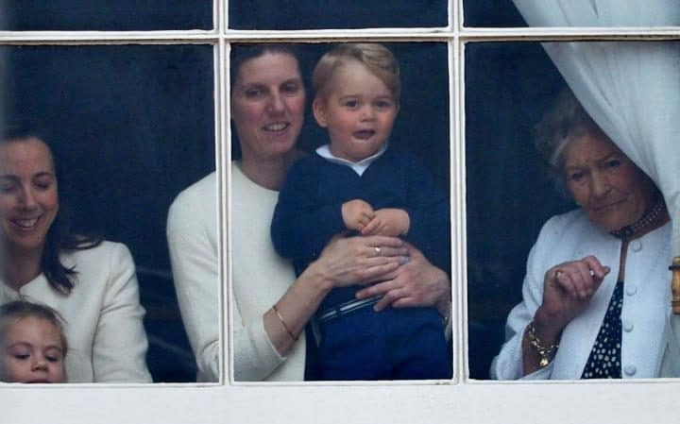
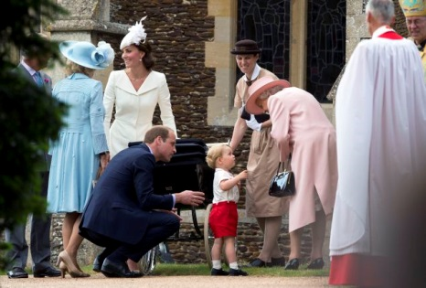
Nanny
It is Maria Teresa Turrion Borrallo who takes daily care of the royal children . She arrives at the house at 7.45am, gives the children breakfast and gets them ready for the day. Next, after the school run, she and Princess Charlotte come home and the nanny does her nanny chores, later she collects the little boy from school and they do homework. In the evening the kids have dinner, get in the bath and have some wind-down time. Normally she leaves at 6.45pm they’re both in PJs, bottles done, ready for the parents to put them to bed.
Maria Borrallo says that: „At the end of the day I feel tired, but rewarded. I love coming to work knowing that I will smile and laugh and be happy – that’s a rare find.”

Slide 3
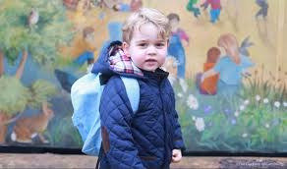
Education is a tradition
Education of the royal baby is probably not a simple matter. ... Courtly etiquette, media, the future heir to the throne. The child is in the public eye.
On 6th January 2016 Prince George started at the Westacre Montessori Nursery School in Norfolk, the school, which his father William and grandfather Charles attended.
The Montessori method of nursery education, invented by the Italian Maria Montessori, places an emphasis on independence, freedom and social development. Children learn here through play and discovery rather than by instruction.

Slide 4
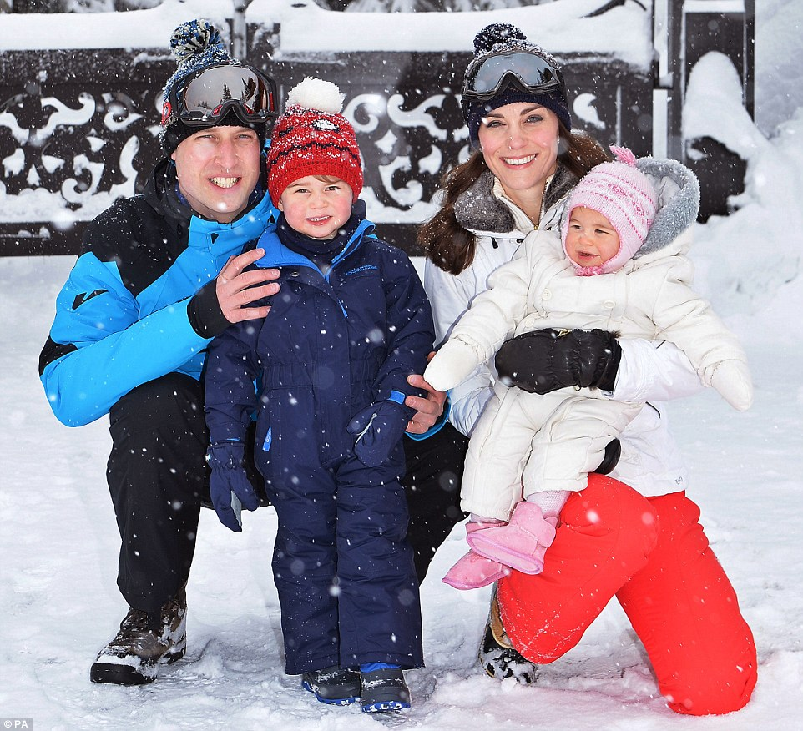
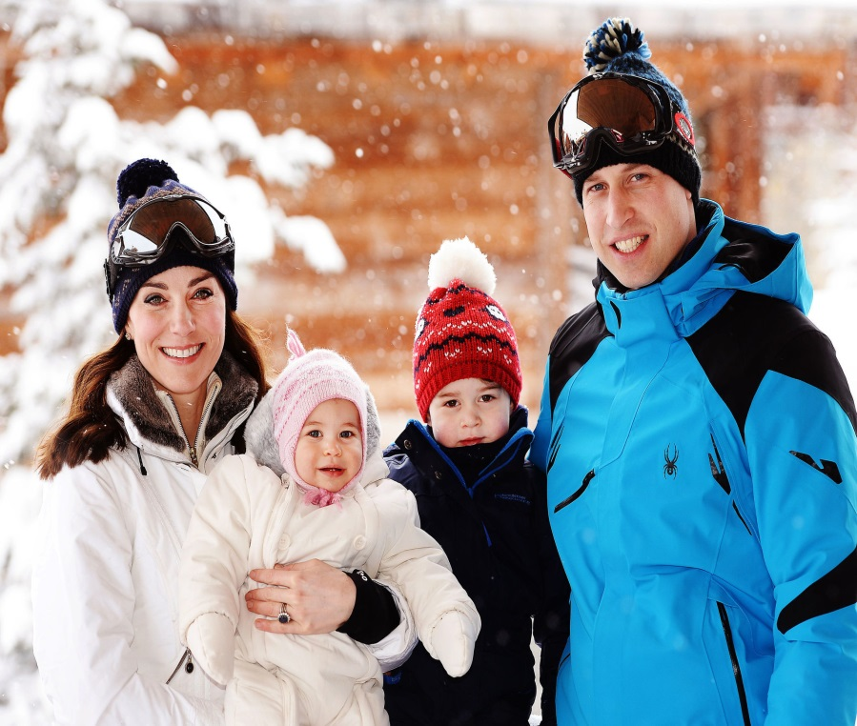
the Royal Family holidays
In March 2016, the Duke and the Duchess of Cambridge took Prince George and Princess Charlotte to the French Alps - their first holiday as a family. It was the first time the children had played in the snow, and it was a very special time for them.

Slide 5
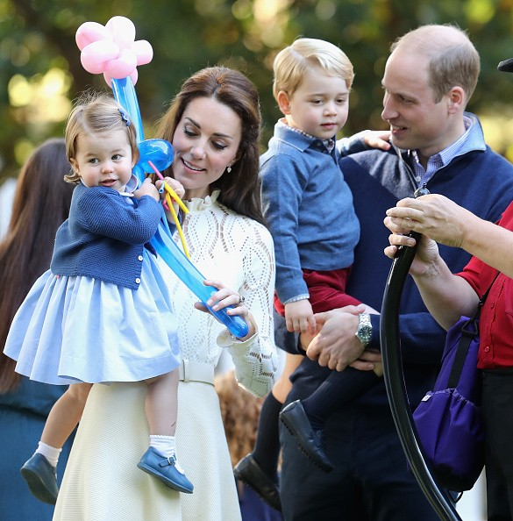
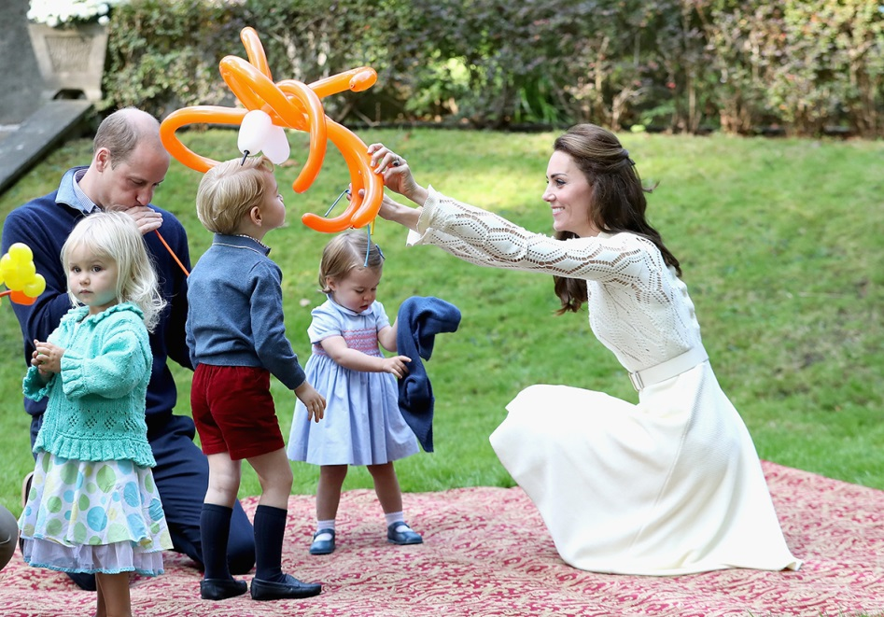
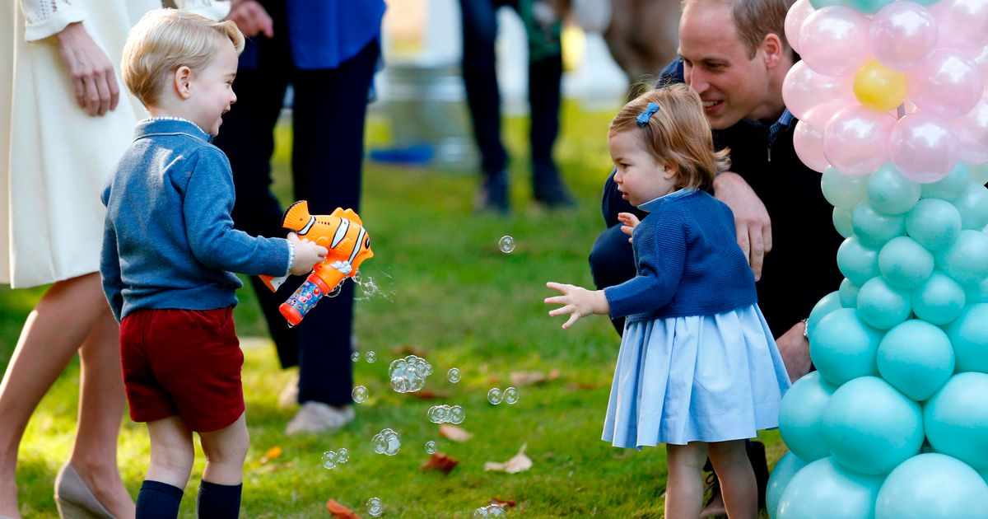
The first Royal Canada tour
in September 2016
Typical for the young couple with children, Kate and William attended the children’s party for military families in Victoria.
Interestingly, George was photographed happily blowing bubbles from a squirt gun, while Charlotte made a beeline for a collection of colourful balloons.
As she hugged the balloons she could be heard to utter her first words in public: 'Pop’. ☺

Slide 6
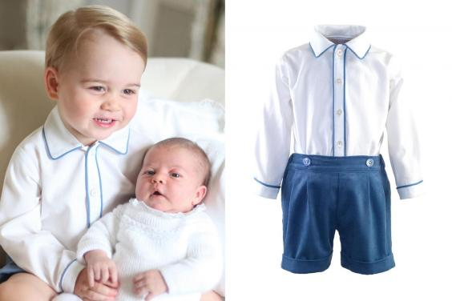
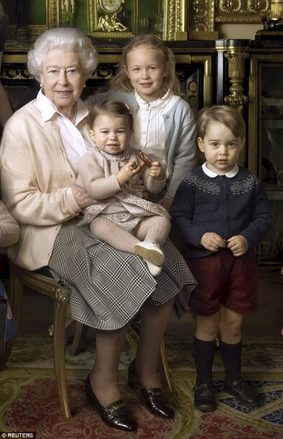
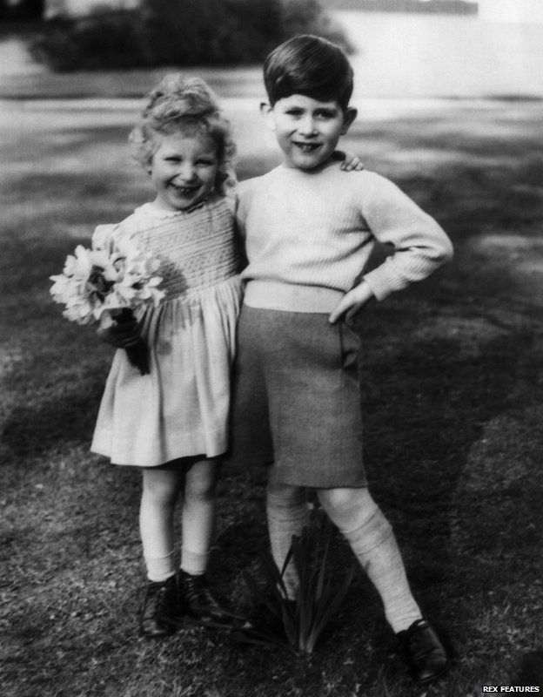
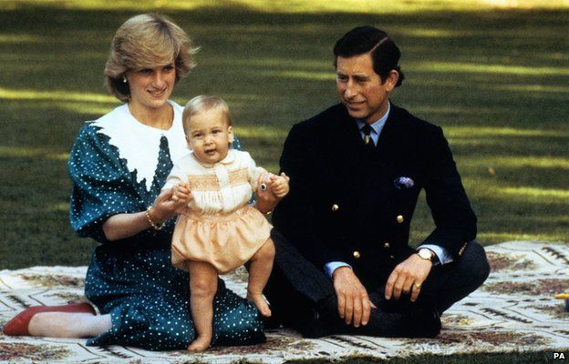
Traditional clothes of the Royal children
Typical clothing for Prince George is in knee-length light-blue socks, smart black shoes and a white and blue shirt.
The outfit had echoes of that worn by a five-year-old Prince Charles
- including long socks and shorts - in a photograph taken with three-year-old sister Anne.
The focus on continuity of dress is important to the "royal brand”, because the pictures could have been taken in the 1920s, 1930s, in fact any decade up until the present day," says public relations expert.

Slide 7
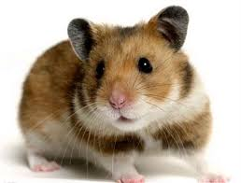
Prince George and Princess Charlotte have got a pet.
Prince George and Princess Charlotte have got her first pet. You expect a cat or dog? Nothing of that!
It is a hamster! And it has already a name-Marvin.

