Slide 1
Customs in the Royal Family

Slide 2
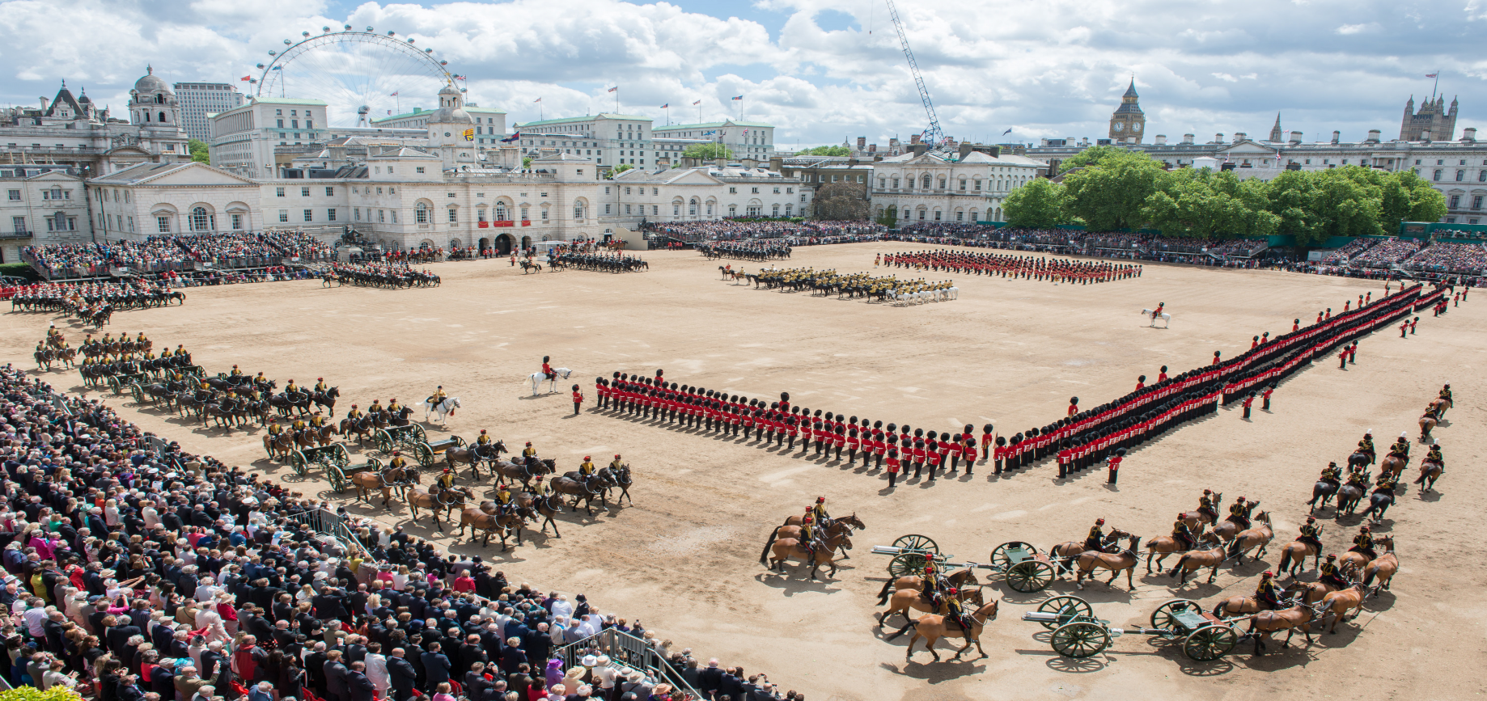
Quenn’s birthdays
The Queen is the only person in Britain with two birthdays. Her real birthday is on April 21st, but she has an „official” birthday, too. That’s on the second Saturday in June.

Slide 3
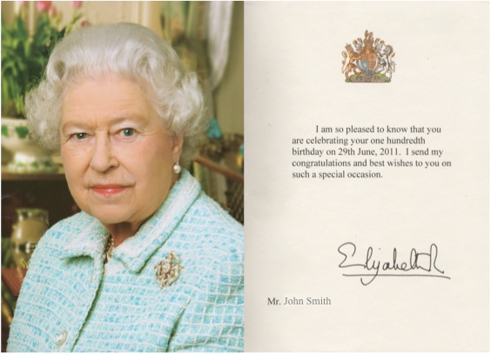
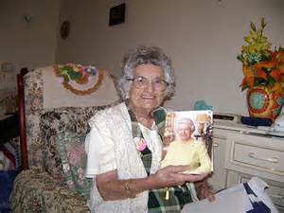
The Queen’s telegram
This custom is not very old, but it’s for very old people. On his or her one hundredth birthday, a British person gets a telegram from the Queen.

Slide 4
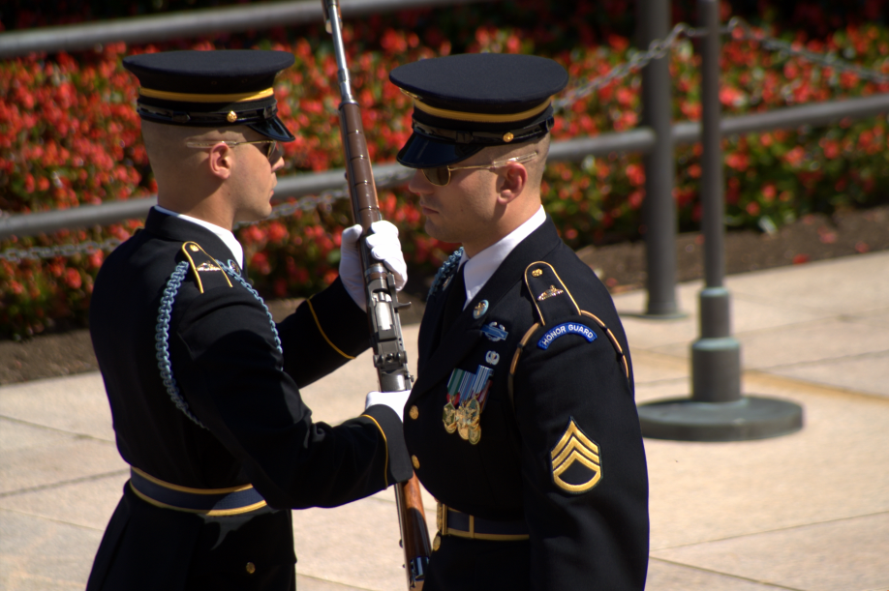
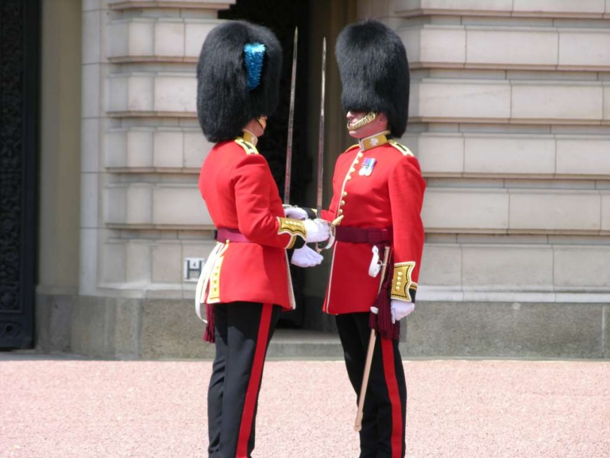
The changing of the guard
This happens every day at Buckingham Palace. Soldiers stand in front of the palace. Each morning these soldiers ( the „guards” ) change. In summer and winter tourists stand outside the palace at 11.30 every morning and watch the Changing of the Guard.

Slide 5
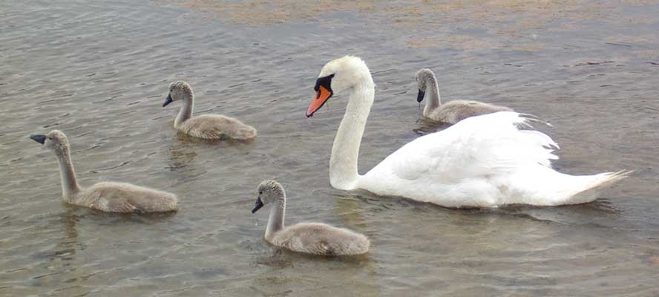
Swan Upping
Here’s a very different royal tradition. On the River Thames there are hundreds of swans. A lot of these beautiful white birds belong, traditionally, to the king or queen. In July the young swans on the Thames are about two months old. Then the Queen’s swans keeper goes, in a boat, from London Bridge to Henley. He looks at all the young swans and marks the royal ones. The name of this strange but interesting custom is Swan Upping.

Slide 6
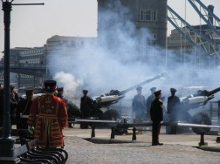
Gun salutes
Gun salutes are used in the 21st century to herald royal and state occasions across the country. The Tower of London happens to hold the record for the most shots fired in a salute. 124 shots are fired when the Duke of Edinburgh’s birthday is on the same day as The Queen’s official birthday

Slide 7
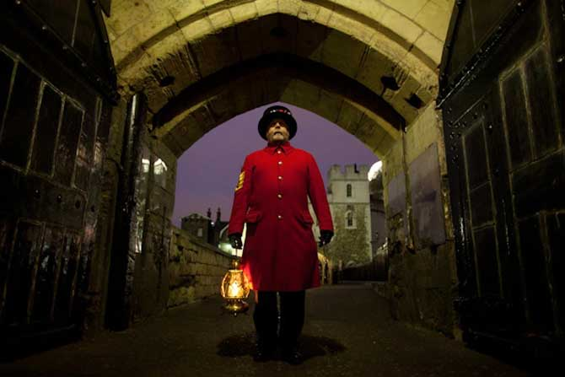
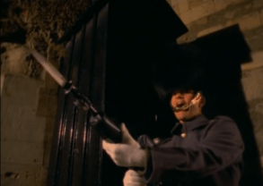
The Ceremony of the keys
Despite the strength of modern security techniques, for over 700 years – and without missing a single day – a traditional ceremony has been performed to ensure the tower is locked and secured for the night from any unwanted intruders.

Slide 8
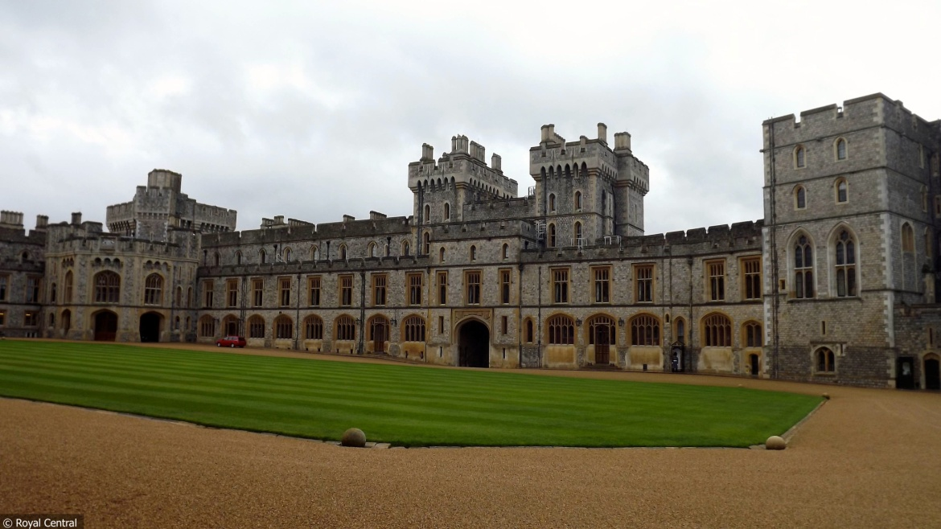
Paying the rent
Every June, a tradition takes place at Windsor Castle called ‘the Waterloo Ceremony’. During this ceremony, the Duke of Wellington travels up to Windsor to pay The Queen his rent for his home, Stratfield Saye House – originally a gift from the grateful people of Britain for defeating the French at the Battle of Waterloo.(1815)

Slide 9
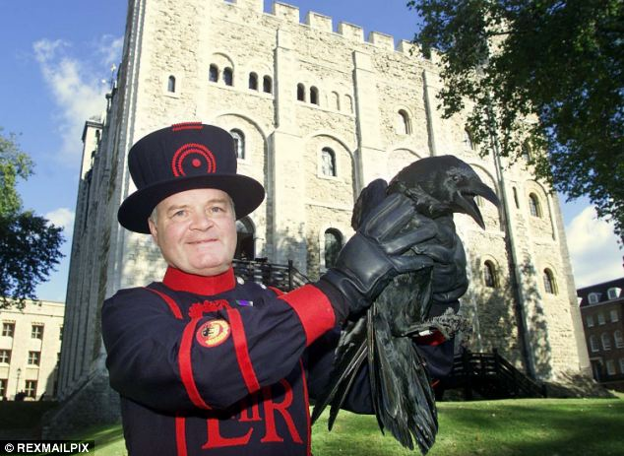
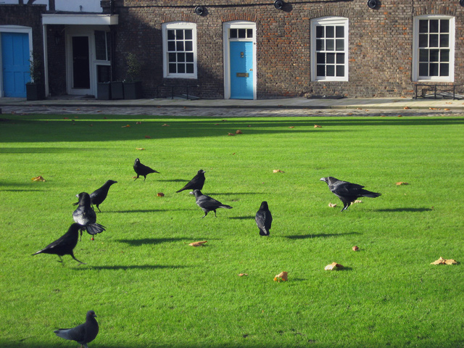
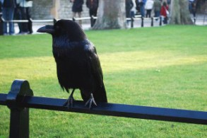
Ravens- the guardians of the Tower
“if the Tower of London ravens are lost or fly away, the Crown will fall and Britain with it”.

Slide 10
The Tower of London is one of the most famous places in the United Kingdom. It is also home to some of the most bizarre customs in the world.

