Slide 1
The art and painting
of the
Buckingham Palace

Slide 2
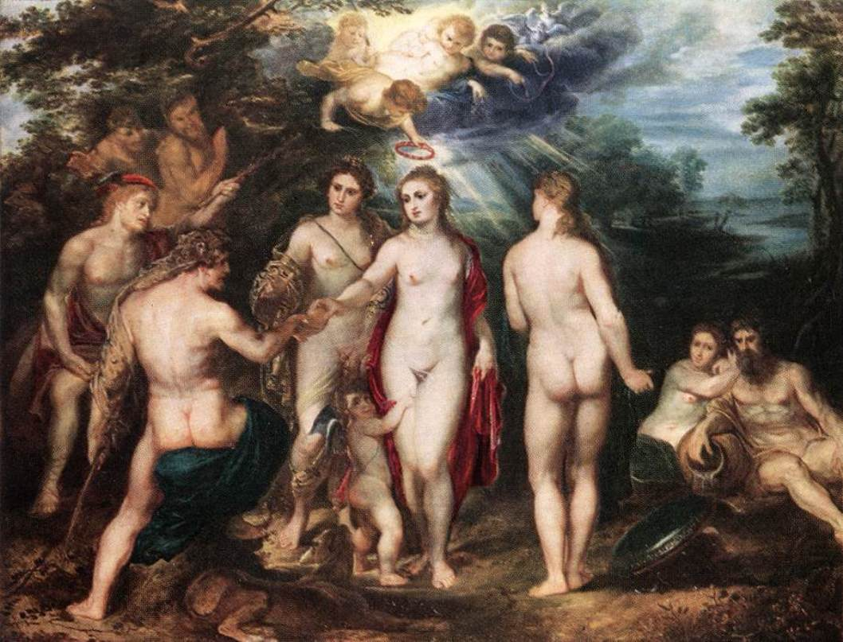
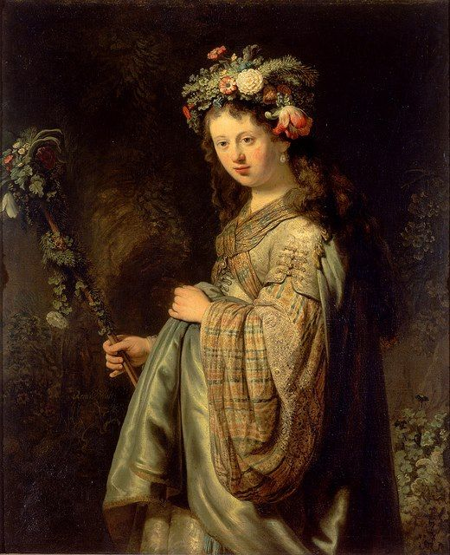
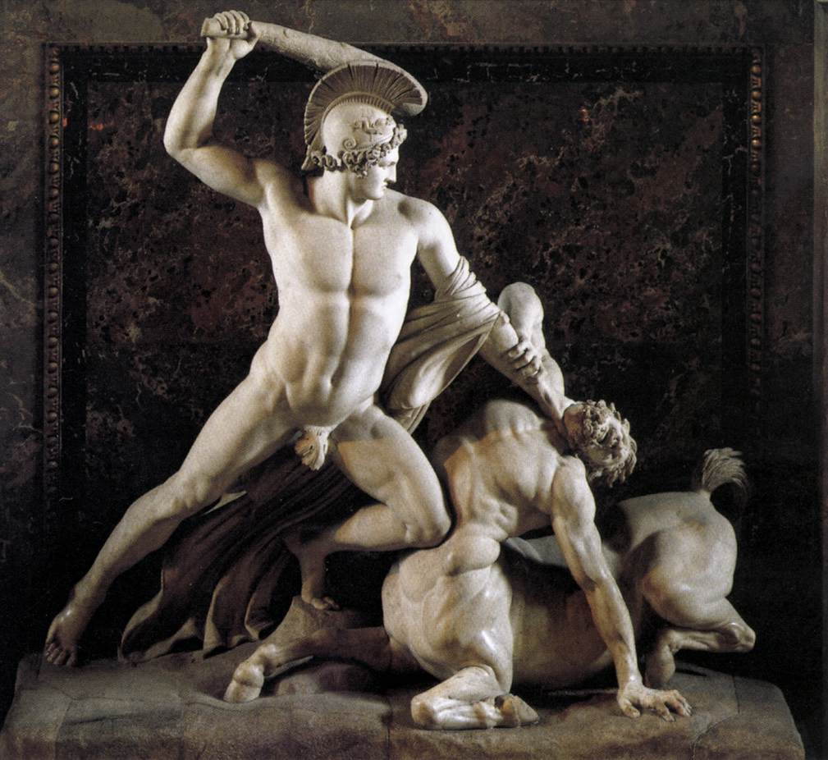
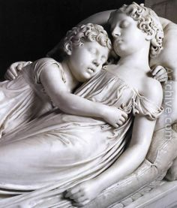
Fine art and painting of Buckingham Palace
Besides the architecture there are also paintings by Van Dyck, Rubens, Rembrandt, Vermeer, Poussin, Canaletto and Claude as well as sculpture by Canova and Chantrey, which are breathtaking.
The judgement of Paris, Rembrandt
Tenzej in Kentaver, Canova
The sleeping children, Chantrey
Flora, goddess of spring and flowers

Slide 3
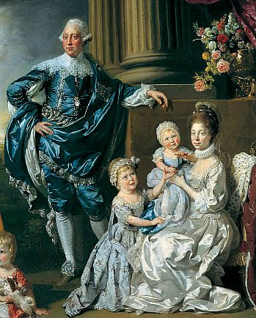
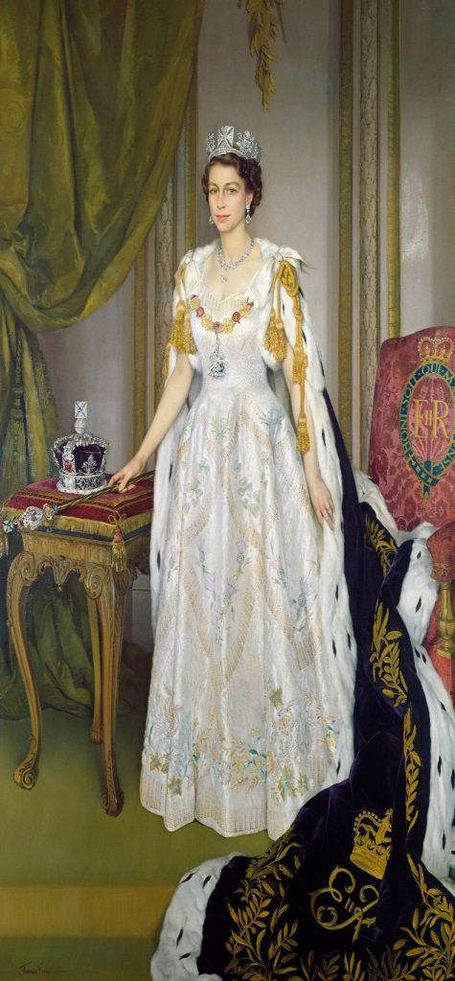
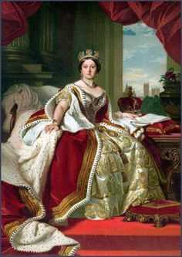
The paintings in the State Rooms of the Monarchs The paintings in the State Rooms also include some wonderful portraits of past and present royals including Queen Victoria, George III and Queen Charlotte, William IV and his wife Queen Adelaide and, of course, the current Royal Family.
Queen Victoria
George III and Queen Charlotte with children
The Queen’s Coronation

