Slide 1
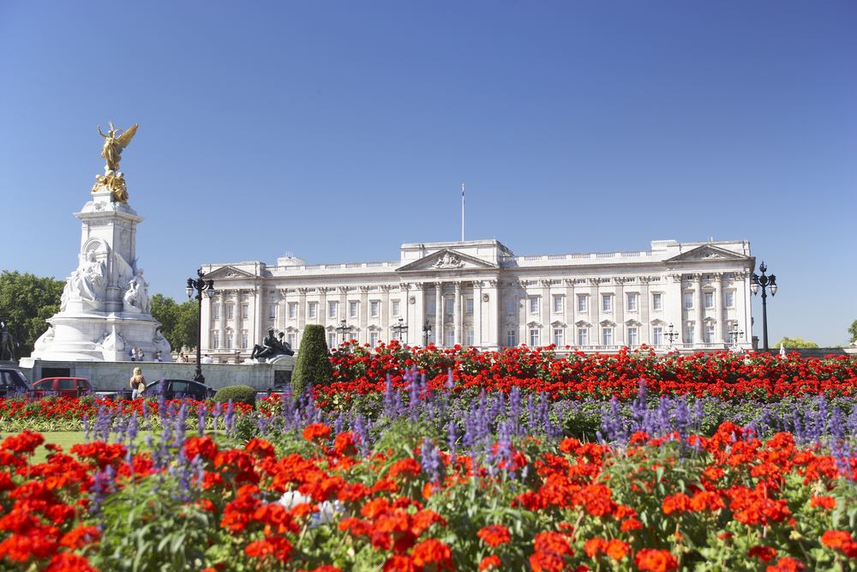
Buckingham Palace
The world's largest Royal Palace. Since 1837 has applied to the official seat of the monarch. One of the architectural gems of the late Baroque.

Slide 2
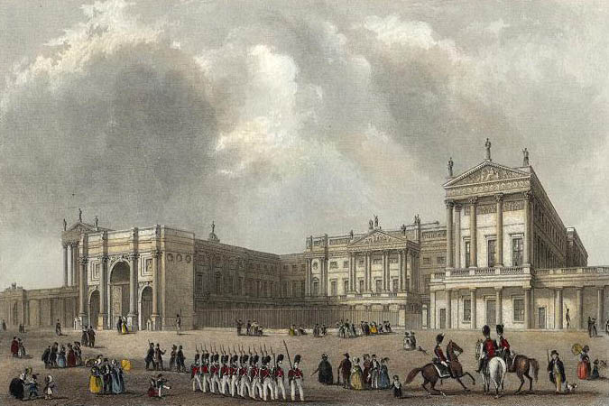
A historical background…
The Buckingham Palace was built in 1703 as a townhouse for the duke of Buckingham- John Sheffield. In 1761, King George the III-rd of Great Britain took possession of the palace and converted into his private residence. During next 75 years he rebuilt the palace several times.
Buckingham Palace in 1703

Slide 3
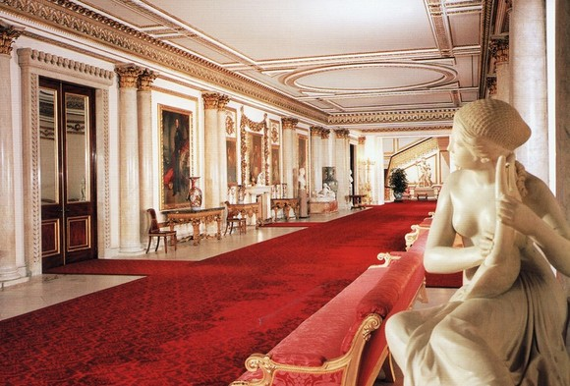
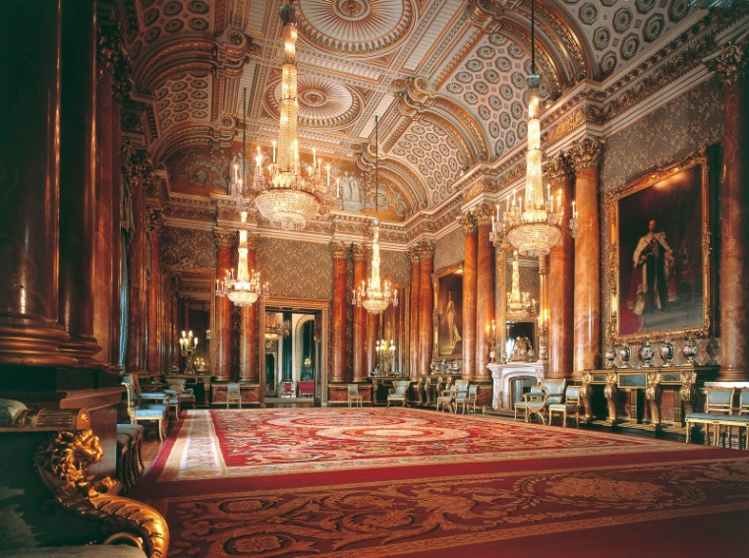
Rooms
Buckingham Palace has a total of 775 rooms . There are 19 state rooms, 52 royal and guest bedrooms, 188 staff bedrooms, 92 offices, and 78 bathrooms. The palace is 108 meters long across the front, 120 meters deep, and 24 meters high.

Slide 4
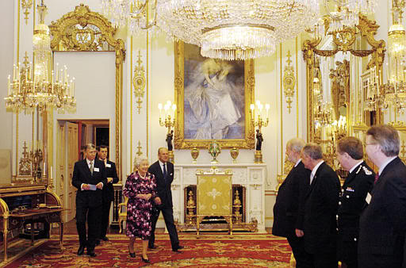
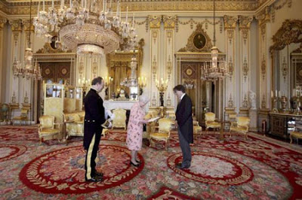
Buckingham Palace today
Today’s Buckingham Palace is very much a building „at work” and the centerpiece of the UK’s constitutional monarchy. It serves as a venue for many royal events and ceremonies from entertaining foreign heads of state to celebrating significant national events.

Slide 5
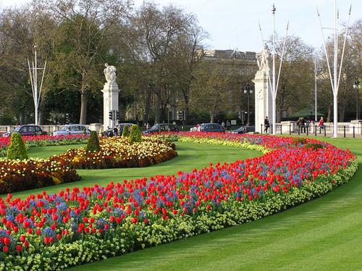
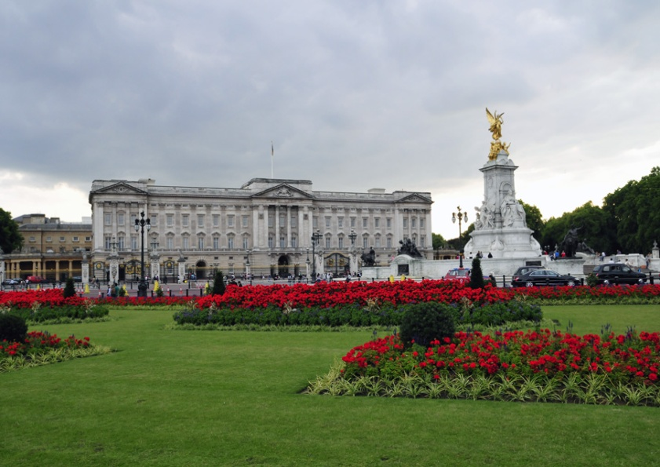
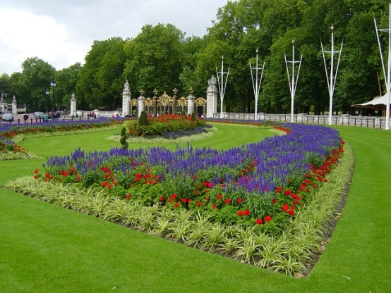
Garden at Buckingham Palace
The palace garden occupies 42 acres
( 17 hectars) in the City of Westminster outside of London. It has two-and-one half miles of gravel paths. The garden is bound by Constitution Hill to its north, the Hyde Park Corner to its west, the Grosvenor Place to its south-west, and the Royal Mews, Queen's Gallery and the Buckingham Palace to its south and east. The garden’s flora is varied and exotic, with a mulberry tree dating back to the time of James the I-st of England.

Slide 6
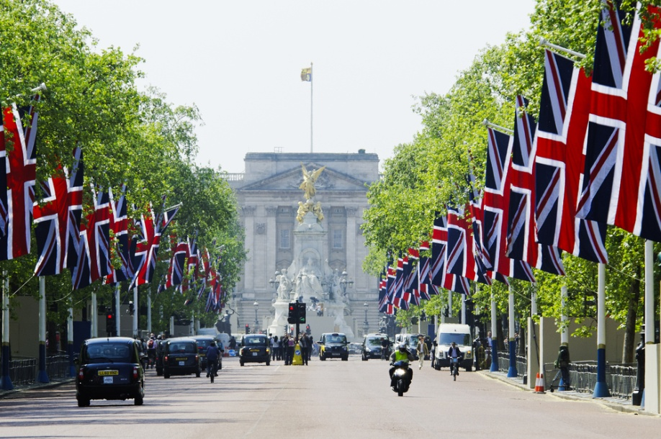
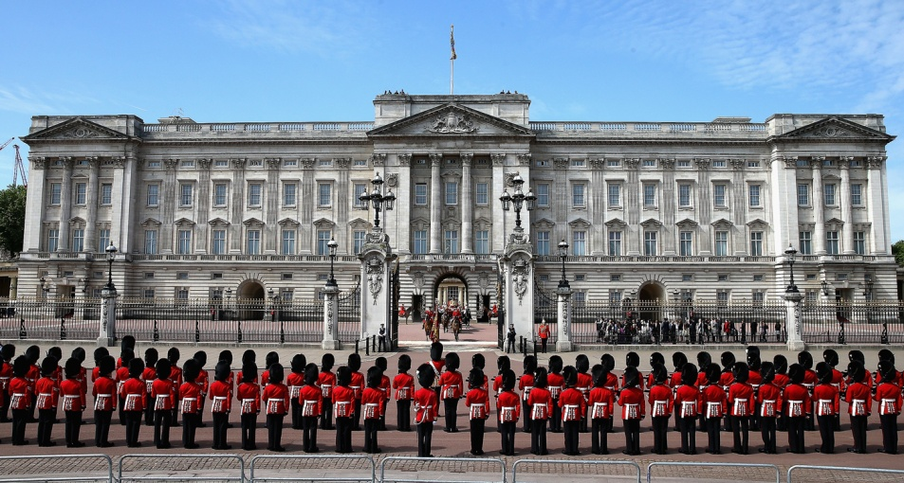
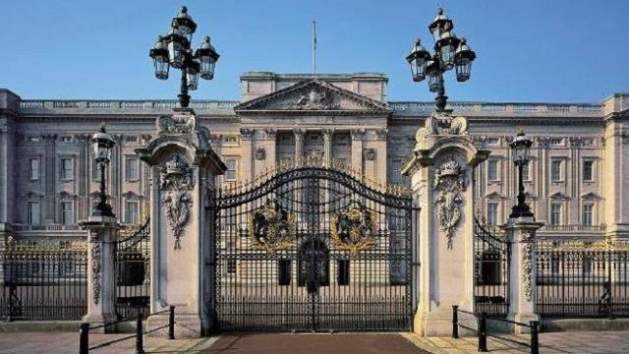
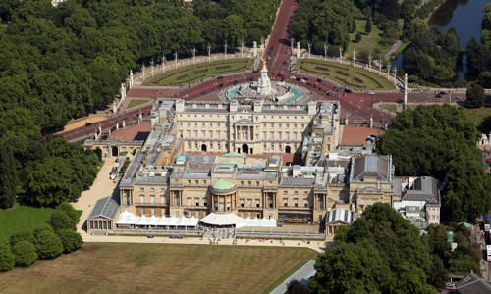
PHOTOS

Slide 7
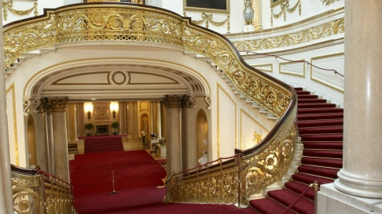
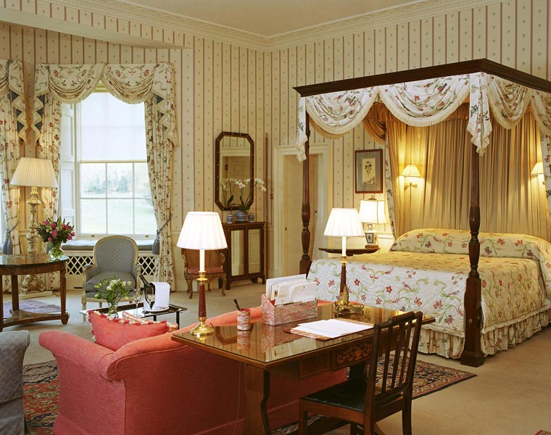
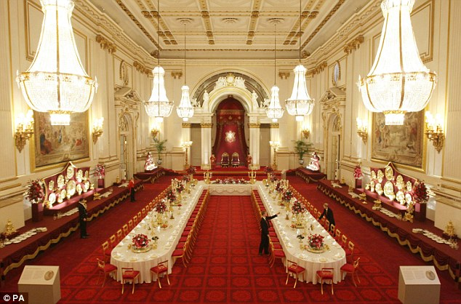
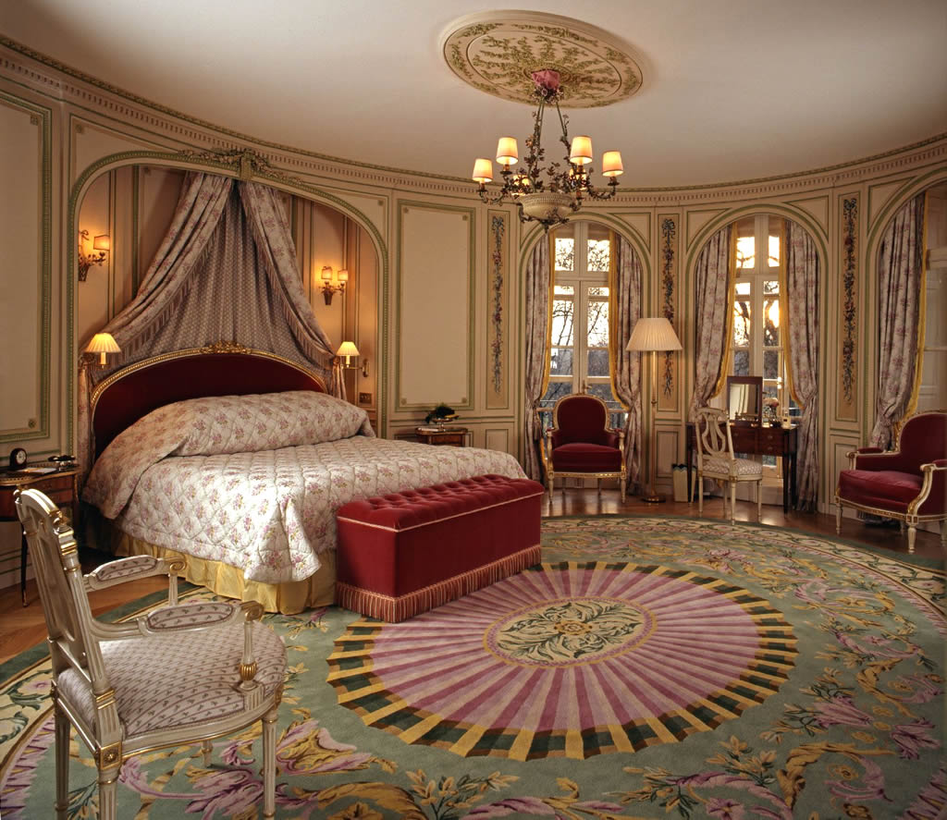
Some photos of rooms at Buckingham Palace

