Slide 1
Customs of the Royal Family

Slide 2
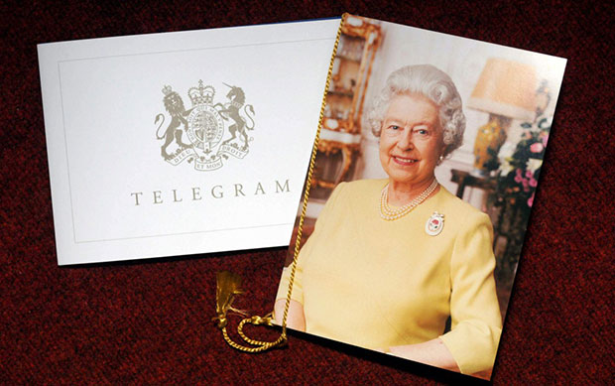
TELEGRAM FROM THE QUEEN ON 100 BIRTHDAY
On his or her hundredth birthday, a British person gets a telegram from the Queen.

Slide 3
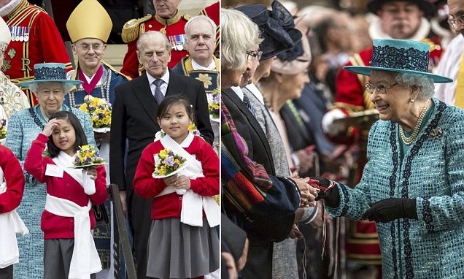
MAUNDY THURSDAY
Maundy Thursday is the Christian holy day falling on the Thursday before Easter. On that day the Monarch ceremonially distributes small silver coins known as “Maundy money” to a group of old people.

Slide 4
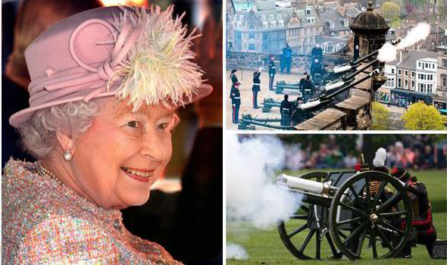
THE QUEEN'S BIRTHDAY GUN SALUTES
The Queen usually celebrates her actual birthday, 21st April, privately, but the occasion is marked publicly by gun salutes in central London: there's a 41-gun salute in Hyde Park, a 21-gun salute in Windsor Great Park and a 62-gun salute at the Tower Of London, all taking place at midday. The Queen's Birthday Gun Salutes take place on her actual birthday, ahead of her official birthday in June which is marked by Trooping the Colour.

Slide 5
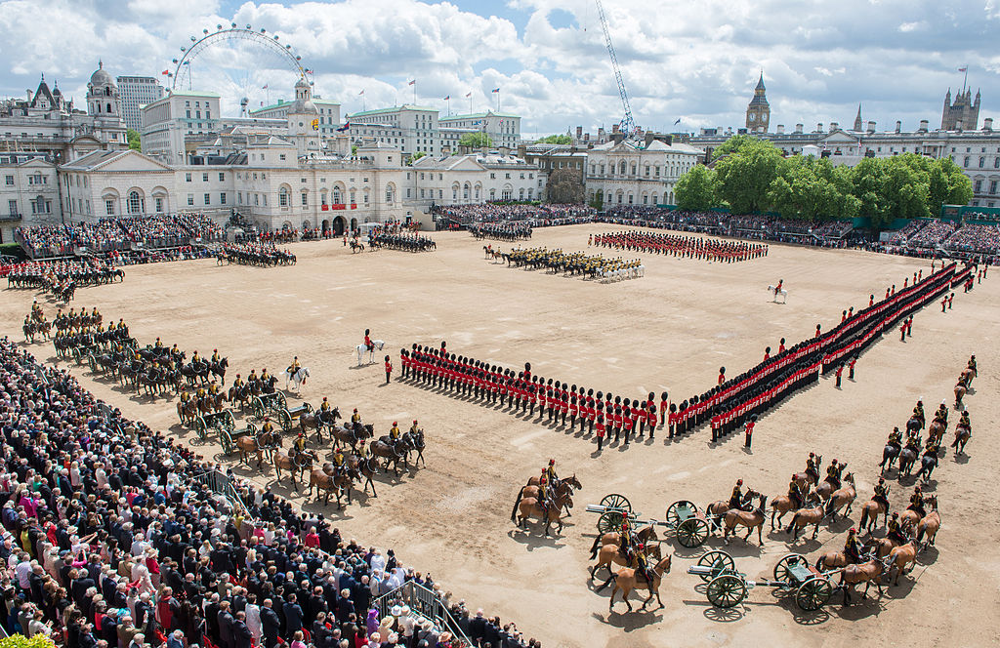
TROOPING THE COLOUR
The Trooping the Colour marks the 'official' birthday of the Queen. Her actual birthday is 21st April but it is a long-standing tradition to publicly celebrate her birthday on a summer day.
Trooping the Colour takes place in June when the Queen leaves Buckingham Palace to her arrival at Horse Guards Parade when a gun salute is fired from Green.

Slide 6
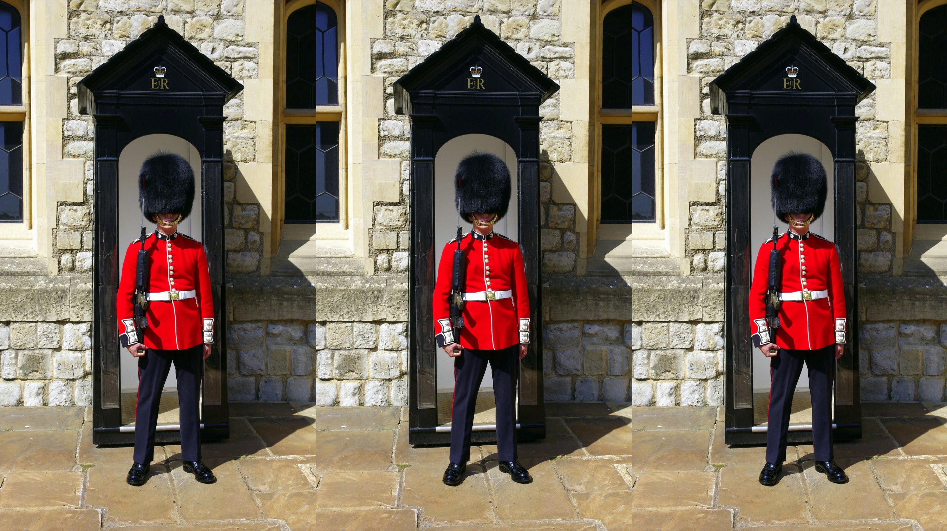
CHANGING OF THE GUARD
The Changing of the Guard takes place at a range of royal locations in and around London daily during the summer (April-July) and on alternate days for the rest of the year.

