Slide 1
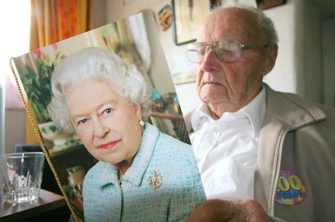
SPECIAL DELIVERY
The Queen has sent approximately 110,000 telegrams to centenarians and 520,000 telegrams to couples celebrating their diamond wedding anniversary.

Slide 2
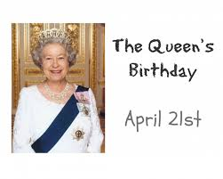
HAPPY BIRTHDAY!
The Queen celebrates her birthday twice a year.

Slide 3
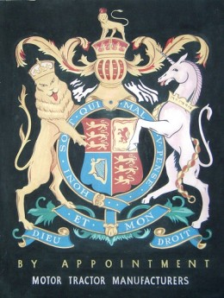
Anything labelled ‘by appointment’ means that certain members of the Royal Family eat, drink or use it.

Slide 4
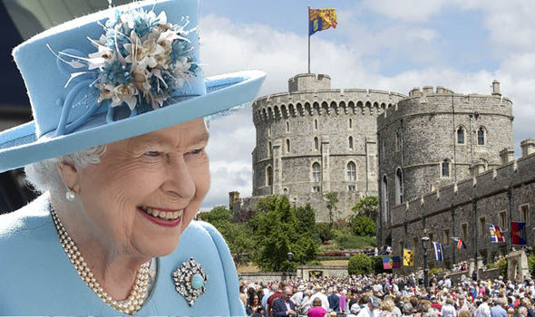
The Queen does not require a British passport. Because passports are issued in the name of Her Majesty, I guess it seemed a bit odd to allow herself to issue one for herself.

Slide 5
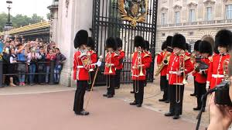
The Changing of the Guard ceremony takes place between three locations – Buckingham Palace, St James’s Palace and Wellington Barracks
Changing of the Guard at Buckingham Palace is the ceremony where the Old Guard hands over responsibility for protecting Buckingham Palace and St. James's Palace to the New Guard.
The ceremony begins on the forecourt of Buckingham Palace at 11:30 sharp, following a march by a detachment of the Old Guard
Watching the Changing of the Guard is free of charge and no tickets are required.

Slide 6
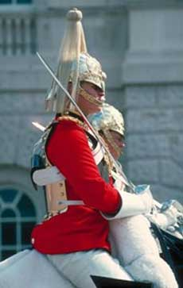
Life Guards have stood guard at Horse Guards, since 1660. The Changing of the Queen's Life Guard ceremony has remained virtually unchanged for centuries.

Slide 7
Thanks…..

