Slide 1
Paintings and Art in Buckingham Palace
The Royal Collection provides an unparalleled history of portrait painting in Britain, from Hans Holbein in the 16th century to Lucian Freud in our own time.

Slide 2
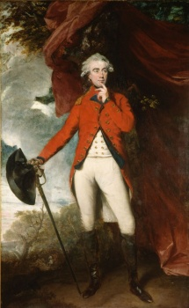
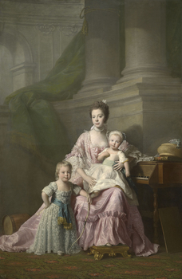
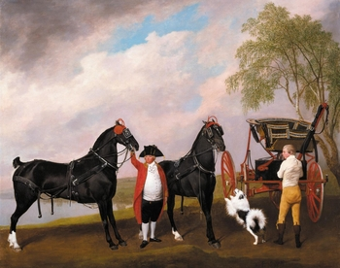
Jacques-Laurent Agasse (1767-1849) The Nubian Giraffe Oct 182
Sir Joshua Reynolds (1723-92)
Francis Rawdon-Hastings (1754-1826), Second Earl of Moira and First Marquess
Allan Ramsay (1713-84)
Queen Charlotte (1744-1818) with her two Eldest Sons
George Stubbs (1724-1806)
The Prince of Wales's Phaeton Signed and dated 1793

Slide 3
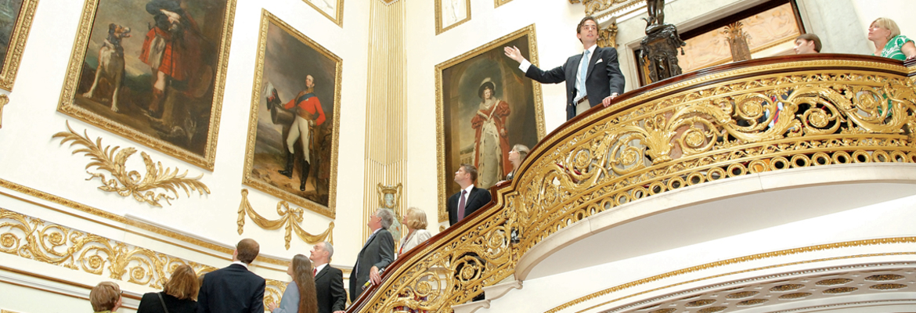
With the gilded ceilings and glittering chandeliers, the State Rooms at Buckingham Palace provide a perfect setting for the many famous masterpieces from the Royal Collection

Slide 4
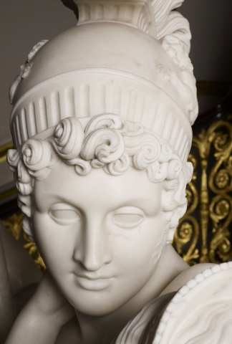
Her Majesty Queen Elizabeth II 2016

Slide 5
Vase japon 1792-93 Hard paste porcelain, porphyry ground, gilded decoration and gilt bronze

Slide 6
Grand piano 1856 Gilded, painted and varnished mahogany, satinwood and pine with brass and gilt bronze mounts

Slide 7
council chair 1812

Slide 8
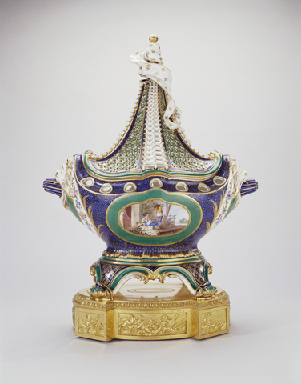
Pot-pourri vase and cover (pot-pourri à vaisseau or pot-pourri en navire) 1758-59 Soft-paste porcelain, bleu lapis and green ground overlaid with gilded œil-de-perdrix decoration, further gilding and gilt bronze

Slide 9
Barometrical Clock 1763-65 Oak case with padouk veneer and gilt bronze mounts, ivory interior columns

Slide 10
THANKS ☺ ☺ ☺

