Slide 1
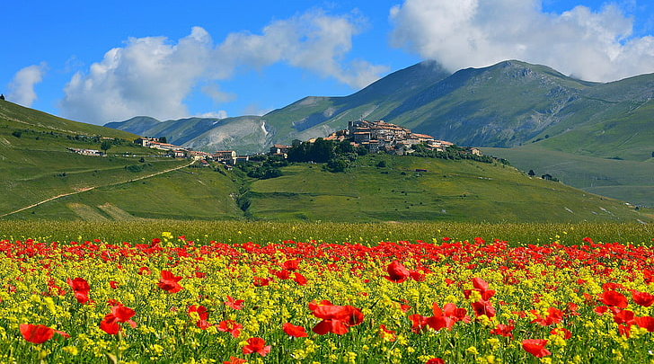
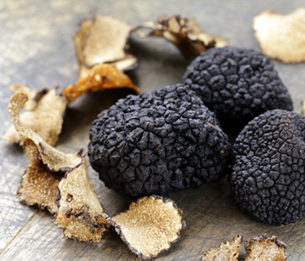
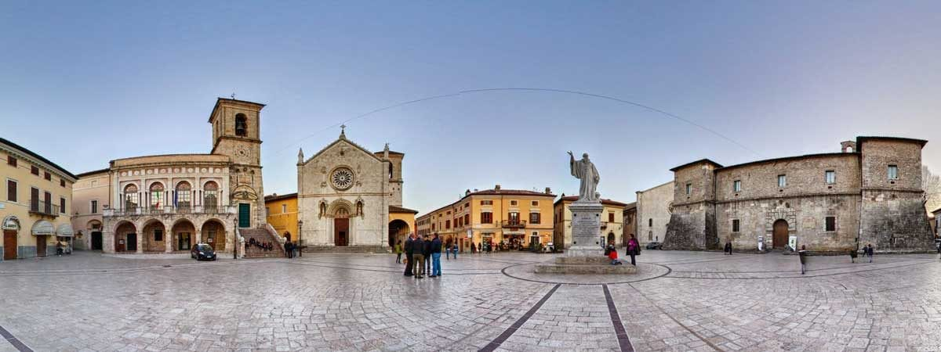
ITINERARY UMBRIA

Slide 2
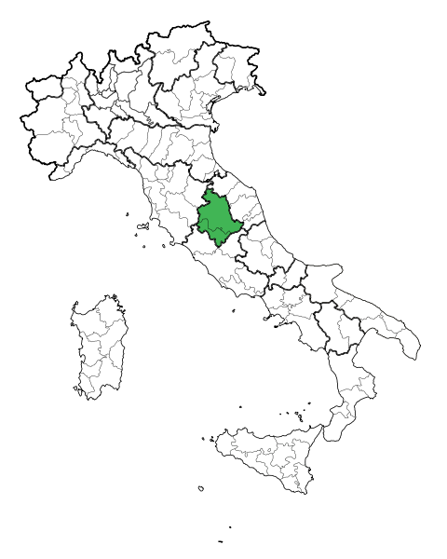
UMBRIA, THE GREEN
HEART OF ITALY
Umbria is a region located in the center of Italy, entirely crossed by the Umbria Marche Apennines; it is the only one not to be bathed by the sea.
Land rich in beauty called the:
"green heart of Italy"
is able to give beautiful views of nature through its green oases and natural parks.
https://www.youtube.com/watch?v=tu_iwPTqMo8

Slide 3
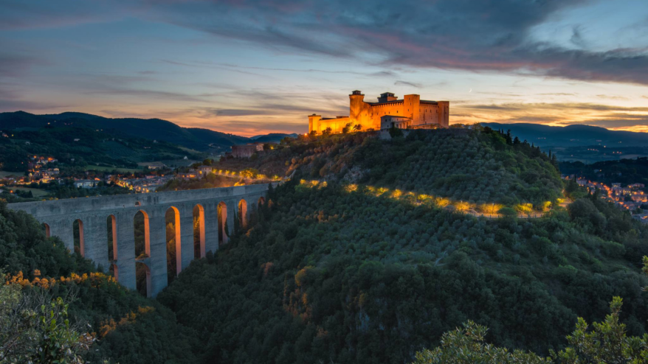
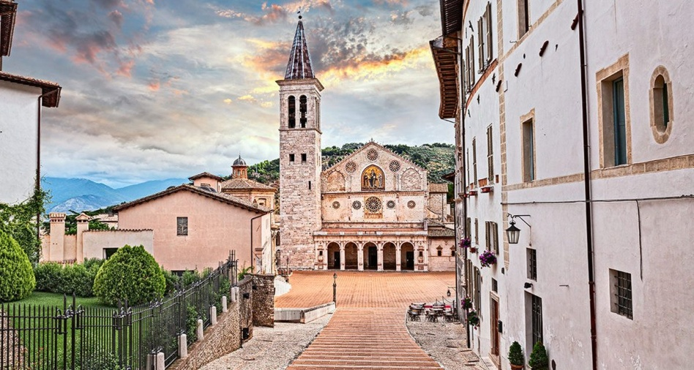
FIRST DAY
Departure from London to the airport of London-City at 06:00 am
Flight to Rome Fiumicino at 08:00 am
Arrival in Rome Fiumicino at 10:30 am
Car rental for the whole holiday period
Drive towards your first destination: Spoleto
Arrival in Spoleto at 12:00 am
Arrival at the Albornoz Palace Hotel Spoleto at 12:30 am check in
Lunch in recommended restaurants - Ristorante Pecchiarda
- Osteria 2 Chiacchiere
- Cantina de’ Corvi
Visit of the Cathedral of Spoleto at 2:00 am
Admire the Rocca Albornoziana at 4:00 am
Walk on the Ponte delle Torri
Visit of the Roman Theatre 5:00 am
Return to the hotel dinner and overnight stay

Slide 4
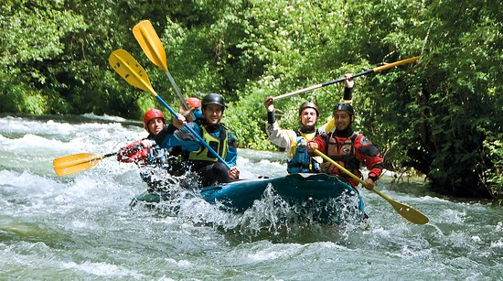
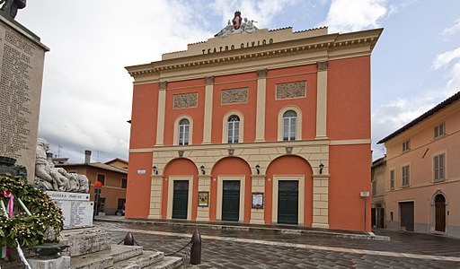
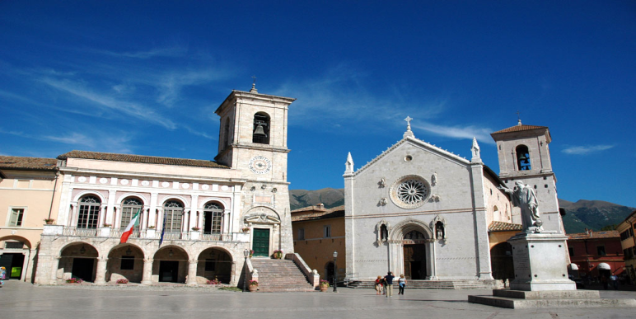
SECOND DAY
Departure from Albornoz Palace Hotel at 09:00 am
Move towards Norcia
Arrival in Norcia at 10:00 am
Visit of the Town Hall at 10:30 am
Tour of the Norcia Civic Theatre at 11:30 am
Lunch booked at Maiale Brado di Norcia restaurant at 1:00 pm
Fiume Nera heading for rafting adventure at 3:00 pm
Return to Les Dependances hotel at 7:00 pm check in, dinner and overnight stay

Slide 5
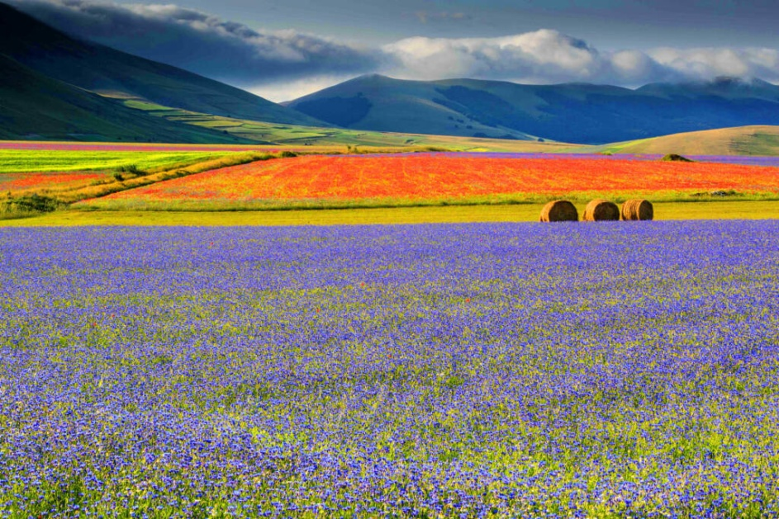
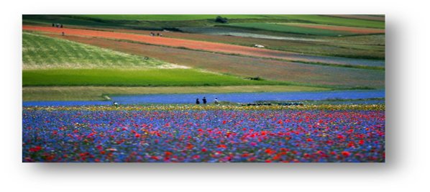
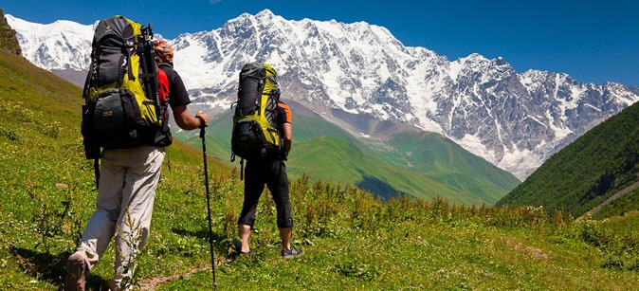
THIRD DAY
Departure from Les Dependances hotel at 09:30 am
Head to Castelluccio
Arrival in Castelluccio at 10:10 am
Admire the flowering of Castelluccio at 10:30 am
Horseback riding on the plain at 11:30 am
Lunch in recommended restaurants -Taverna Castelluccio
-Osteria del Vettore
Hiking on the Mount Vettore ore 4:00 pm
Return to Les Dependances hotel at 7:00 pm dinner and overnight stay

Slide 6
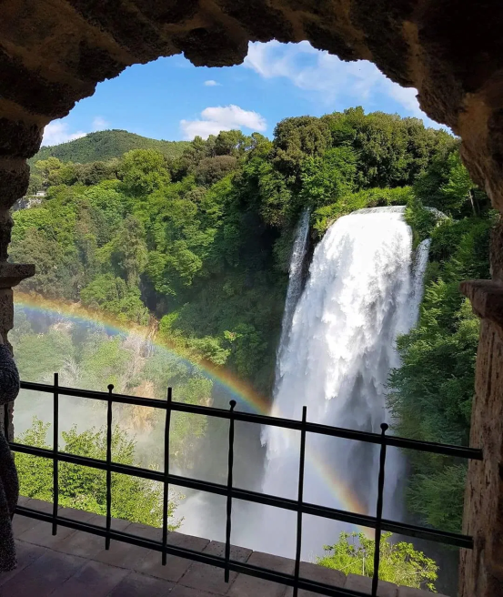
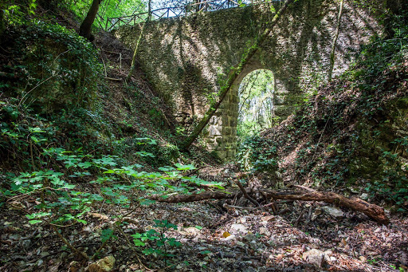
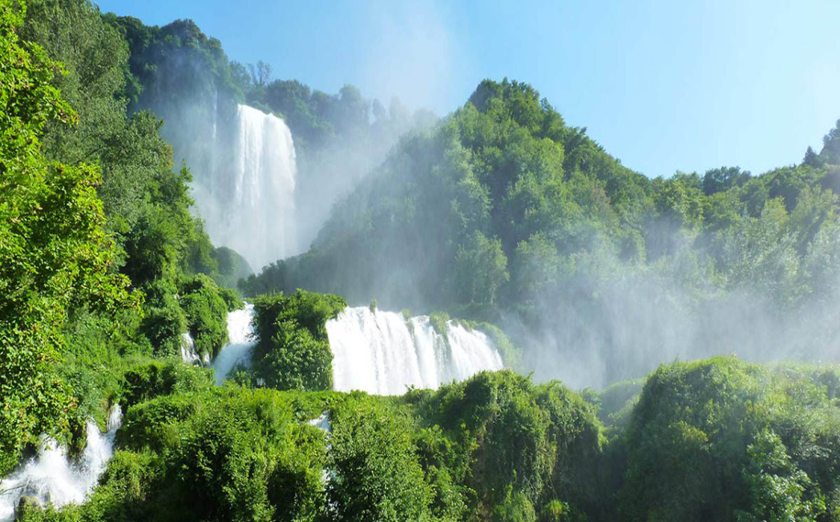
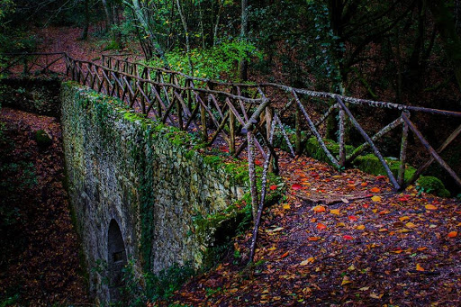
FOURTH DAY
Check out from Les Dependances hotel at 09:00 am
Departure to Terni
Boat ride at Piediluco lake at 10:30 am
Lunch booked at the Trattoria Teresa at 12:30 am
Visit of the Marmore Falls at 3:00 pm
Walk on the bridge Cardona at 5:30 pm
Way back and check in at Classic Hotel Tulipano at 6:30 pm
Dinner and overnight stay

Slide 7
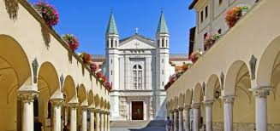
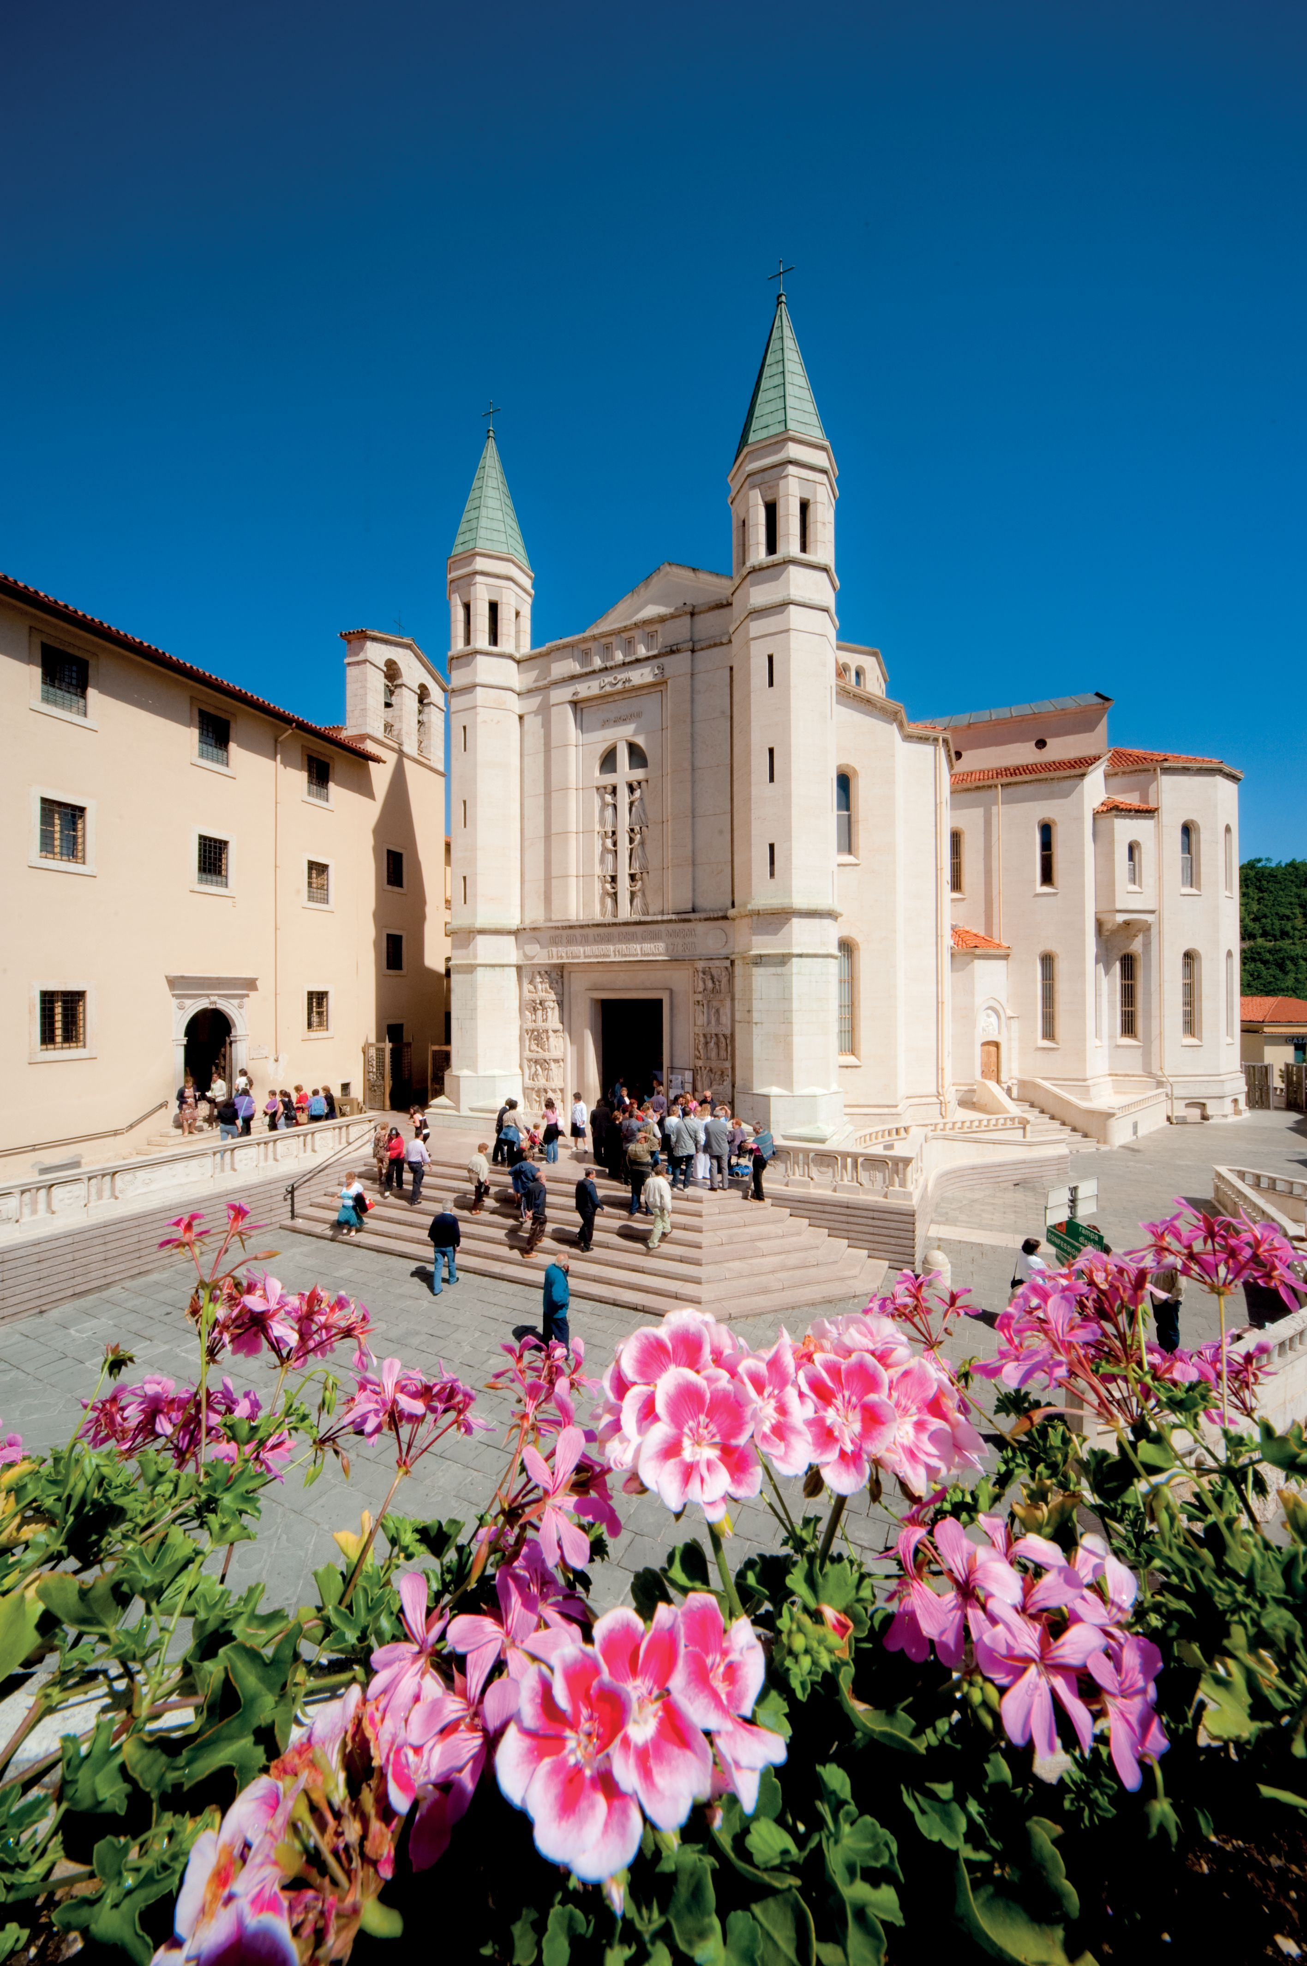
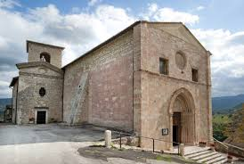
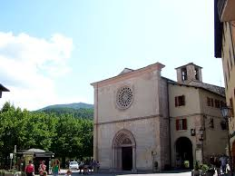
FIFTH DAY
Departure from Classic Hotel Tulipano at 9:00 am to Cascia
Arrival in Cascia at 10:15 am
Visit of the: Church of Sant’Agostino at 10:20 am
Church of San Francesco at 11:00 am
Basilica of Santa Rita at 11:30 am
Lunch booked at the restaurant “La tavernetta” at 12:30 am
Head to Roccaporena at 3:00pm
Walk in the Tazzo Forest at 5:00 pm
Check in at the Mini Hotel “La Tavernetta” at around 7:30 pm

Slide 8
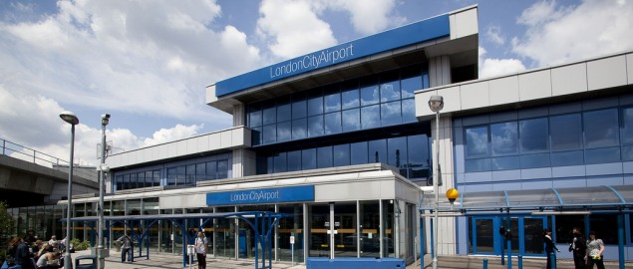
SIXTH DAY
Check out from the Mini Hotel “La Tavernetta”
Departure from Cascia and to the airport Roma Fiumicino at 8:00 am
Flight to London City at 11:30 am
Arrival in London at 2:30 pm

Slide 9
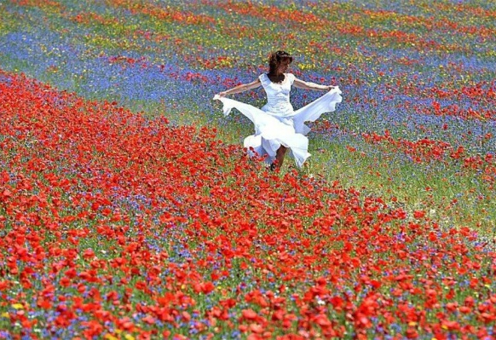
FLOWERING OF CASTELLUCCIO
Castelluccio di Norcia is more than just a small Umbrian village. Castelluccio is considered an emotion, a mystical and almost magical place where man and nature merge to find a primordial harmony.
The flowering of the lentil fields is extraordinary: usually, in June it sees its splendor but, depending on the season, it is possible to admire it also in the months of May and July, considering that nature is not used to respect conventions and precise dates.
The development and the course of the flowering are entrusted to many factors: from how much it has rained in the winter and spring periods; from the period of exposure to the sun; from the period of the sowing, above all of the lentil. Not to mention that every flower species has a different time to bloom.

