Slide 1
Plan a Trip and Gain Experience
GROUPS - DREAM TRIP

Slide 2
Work plan
Greet the students in your group
Choose a place of your dream tour
Share the tasks – decide who is responsible for the particular tasks in your group
Write everything that you have planned with your partners in your Framapad
Each group has its own Framapad
You have 15 minutes for work in your group

Slide 3
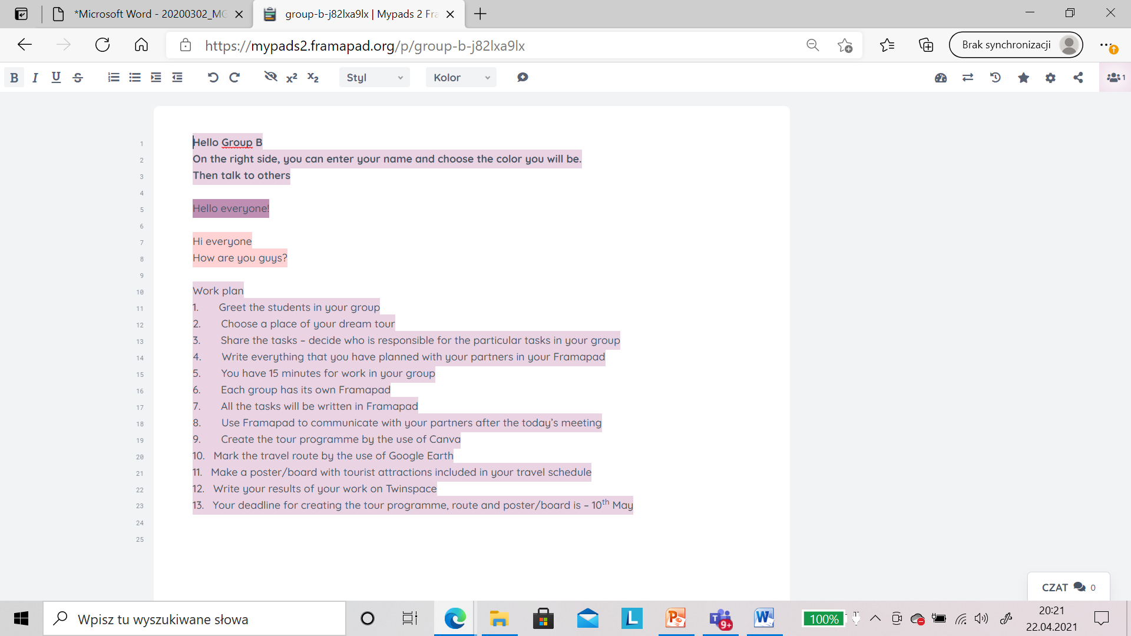
7. All the tasks will be written in Framapad 8. Use Framapad to communicate with your partners after the today’s meeting

Slide 4
Tasks to share 1. Tour schedule 2. Travel route 3. Tourist attractions

Slide 5
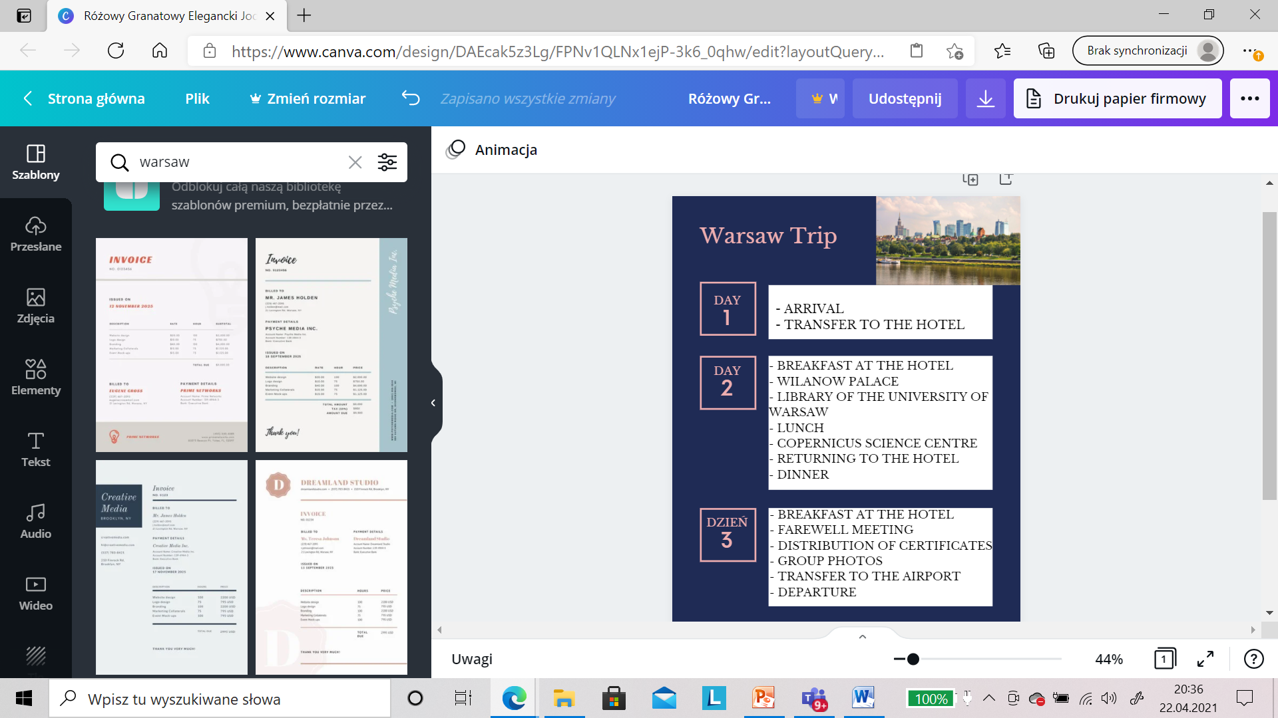
9. Create the tour schedule by the use of Canva

Slide 6
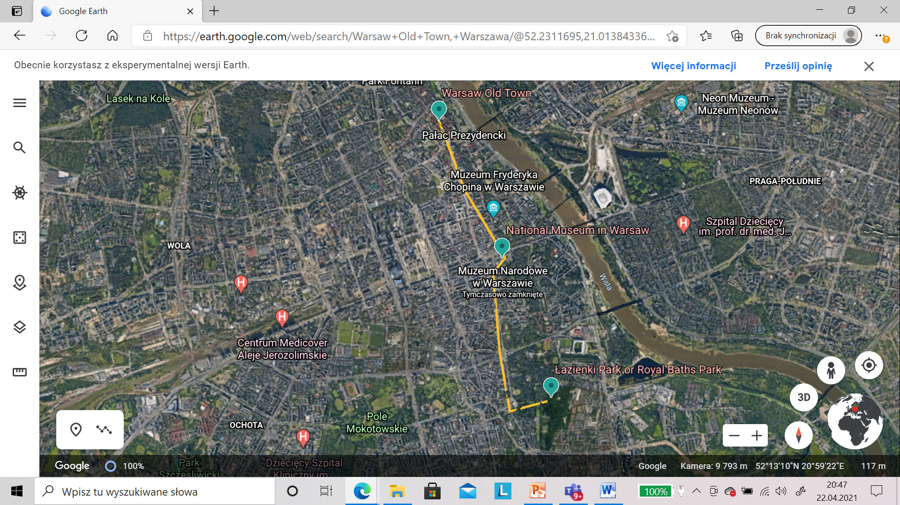
10. Mark the travel route by the use of Google Earth

Slide 7
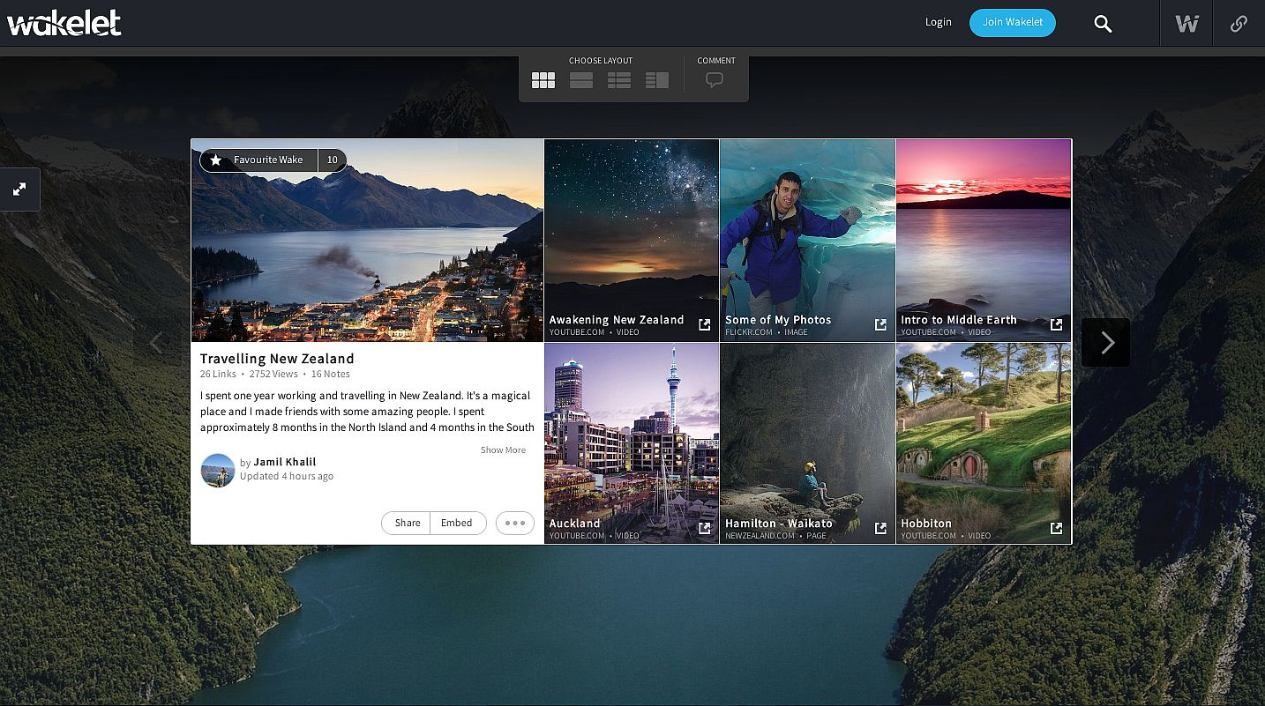
11. Make a poster/board with tourist attractions included in your travel schedule

Slide 8
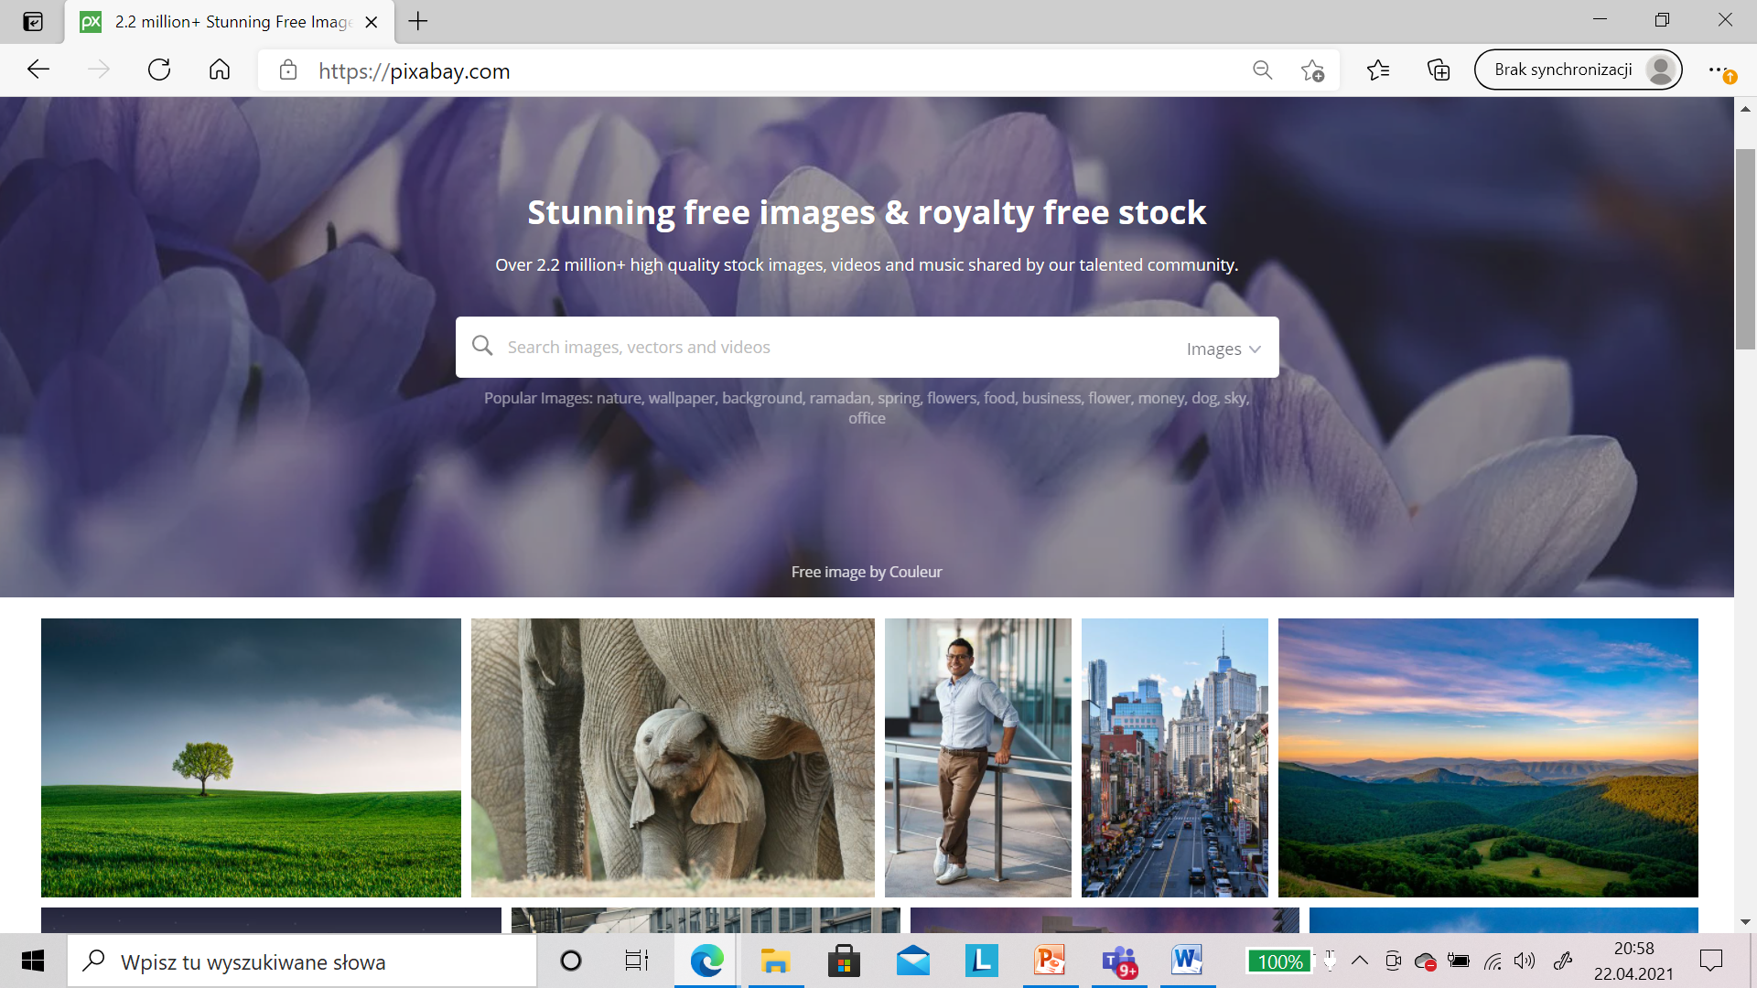
pixabay.com

Slide 9
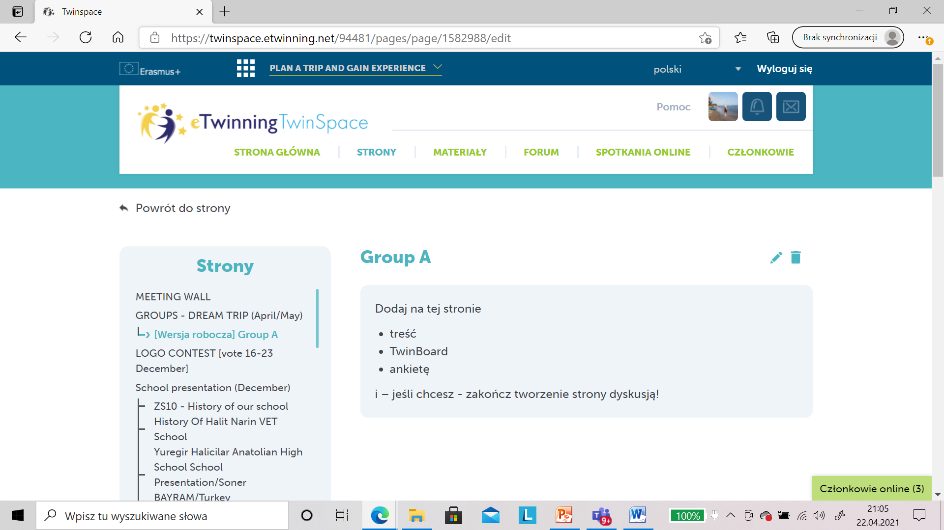
12. Write your result of your work on Twinspace 13. Your deadline for creating the tour programme, route and poster/board – 10th May

Slide 10
Good Luck ☺

