Slide 1
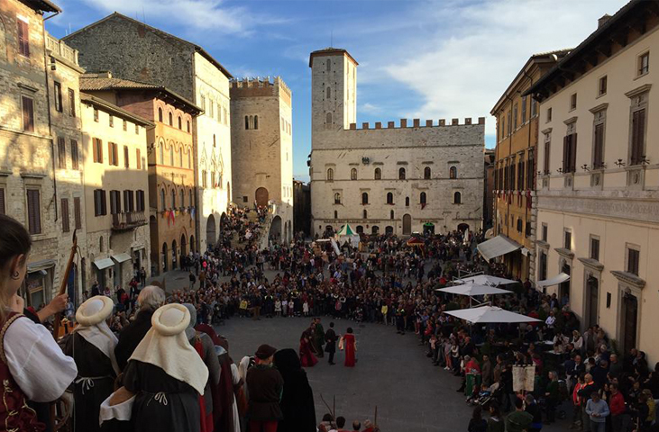
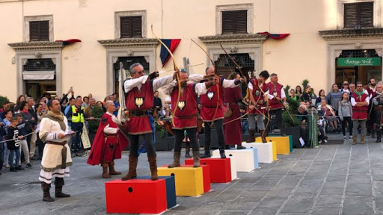
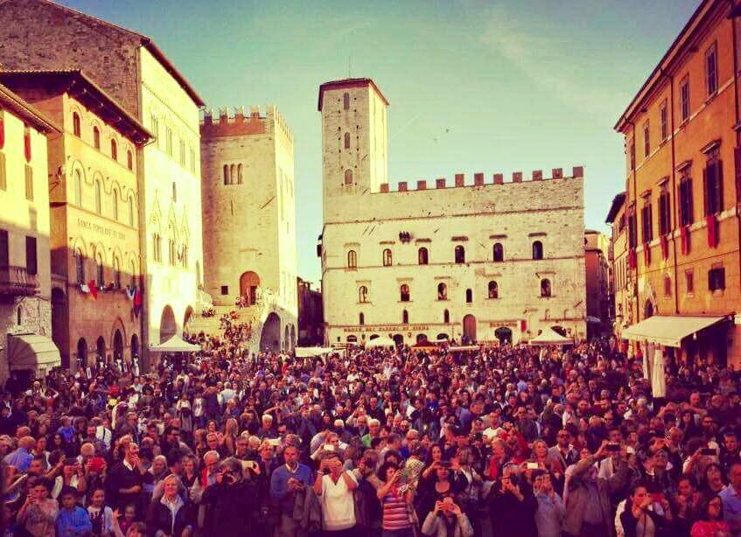
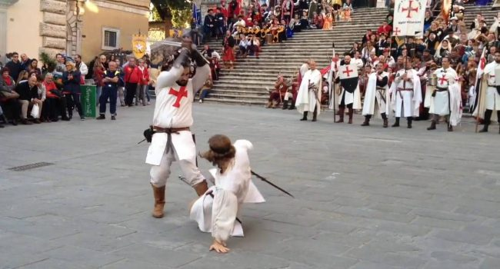
Traditions in Todi – ITALY
“ The CHALLENGE of SAN FORTUNATO ”
Notes:
1

Slide 2
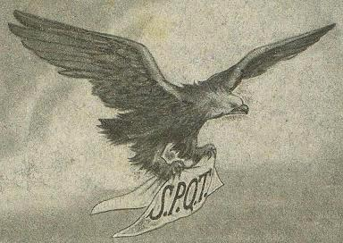
THE LEGEND OF TODI
The legend of the construction of Todi tells that, while the Umbrians were building the city on the plain, an eagle had removed the tablecloth from the table prepared by the new settlers and came to place it on the top of the Todi hill, as if to indicate that it must rise up there. the new town.
Notes:
2

Slide 3
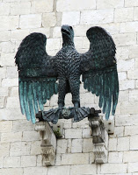
THE SYMBOL OF THE EAGLE
The Eagle of the legend can be found in every part of Todi, its symbol tells the story of a lucky event that led to the creation of one of the most influential cities of central Italy in the Middle Ages (1000-1250 AD).
In the 12th century the city experienced a new urban expansion, extending from Terni to the east and to the south, from the Forello gorges (not far from Orvieto) to the west reaching Deruta to the north.
In 1244, given the increase in population over thirty thousand inhabitants (greater than the population of Rome at the time), the three villages created by the artisanal classes were surrounded by walls about 4 km long, completed with gates and bastions at all sides. Today Todi is almost identical to medieval Todi.
Notes:
3

Slide 4
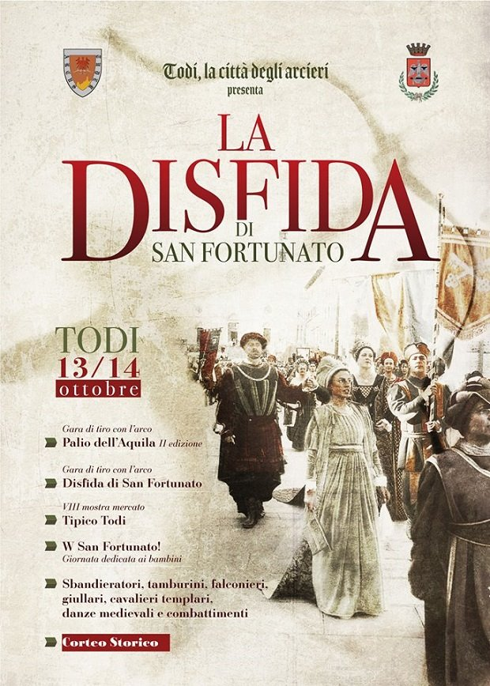
VARIOUS EVENTS
Every year, in October, on the occasion of the feast of San Fortunato Patron of the city of Todi, the archery company Arcus Tuder organizes competitions and historical re-enactments. various types of activities are celebrated: historical archery competitions, medieval fights, investiture of the Knights Templar, flag-wavers, drummers, jesters, falconers and a historical procession with over three hundred figures.
A formidable historical re-enactment in the splendid setting of the City of Todi, where you can attend the Palio dell'Aquila, an archery competition between the archers of the six districts, and the "La Disfida di San Fortunato" shooting competition with the historical and traditional bows.
Notes:
4

