Slide 1
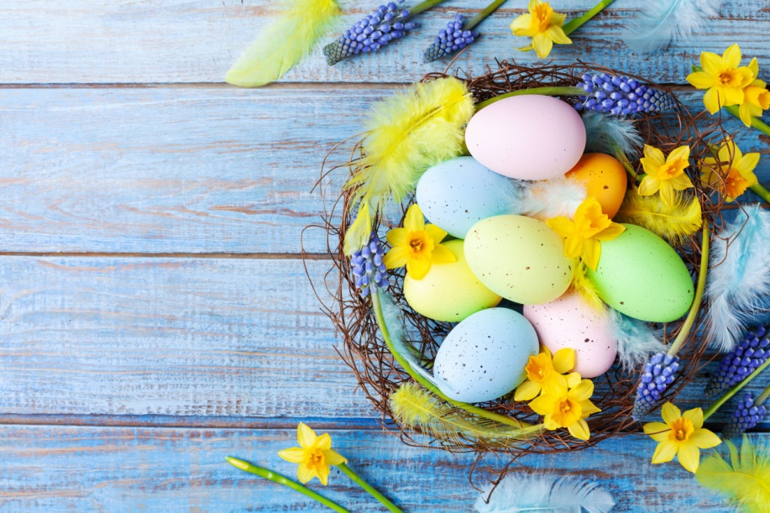
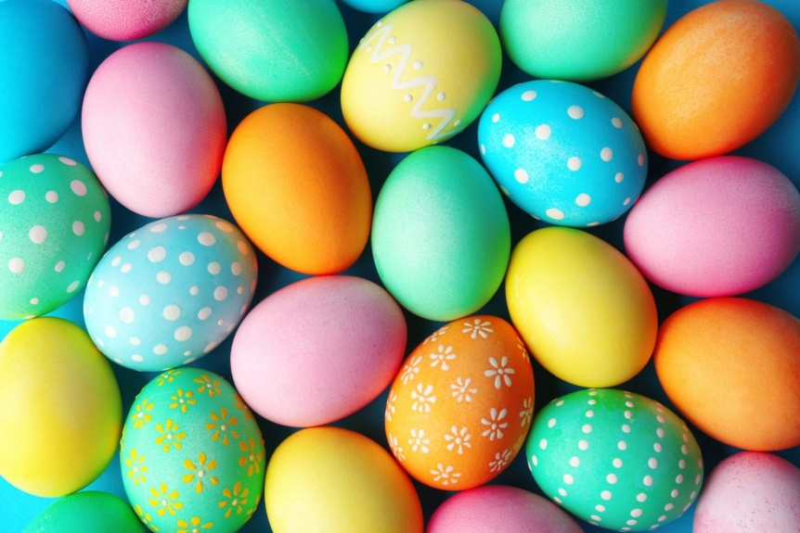
Easter holiday in Romania
By Gheorghes Rares
Liceul Economic de Turism Iasi – Class 9H

Slide 2
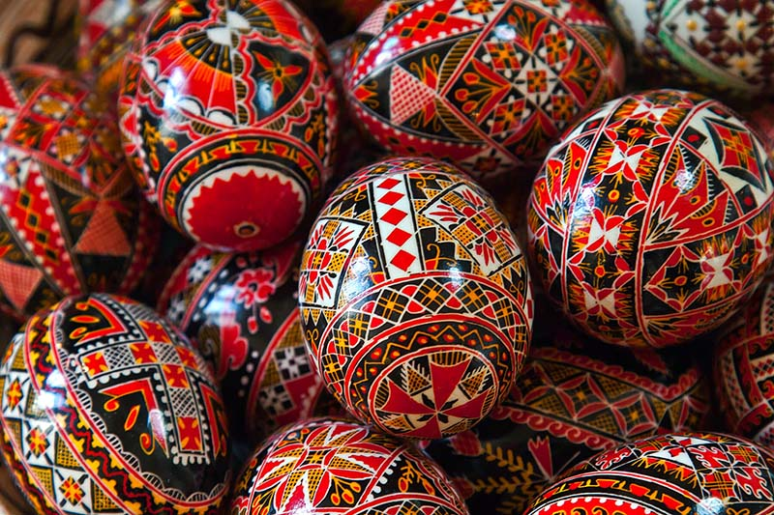
Romanian Easter – Traditions
In the Orthodox tradition, the beginning of the holiday
is marked with the fast of seven weeks.
A very important significance is the Holy Thursday of Passion Week.
From this day on, the peasants stop working in the fields and focus on the house and the yard, so that
everything is clean.
Also on Maundy Thursday, the women begin to prepare the Passover and paint the eggs.

Slide 3
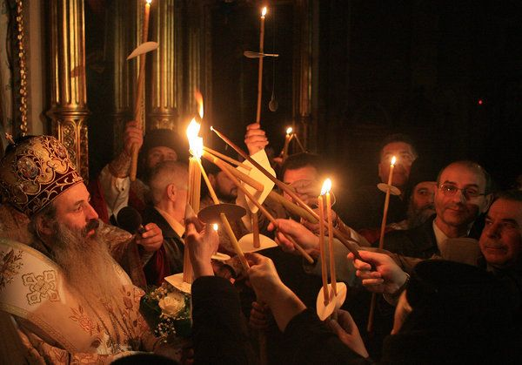
Romanian Easter – Traditions (2)
According to tradition, at midnight
between Saturday and Sunday, people wake up from the ringing of bells
They wash themselves with clean water, put on new clothes, take a candle
and go to the church where the priest, with the Holy Gospel and the cross
in his hand, followed by the procession of believers, comes out with the lighted
candle and surrounds the church three times. When the priest says,
"Christ has risen!" all those present at this religious service say, "He has truly risen!"

Slide 4
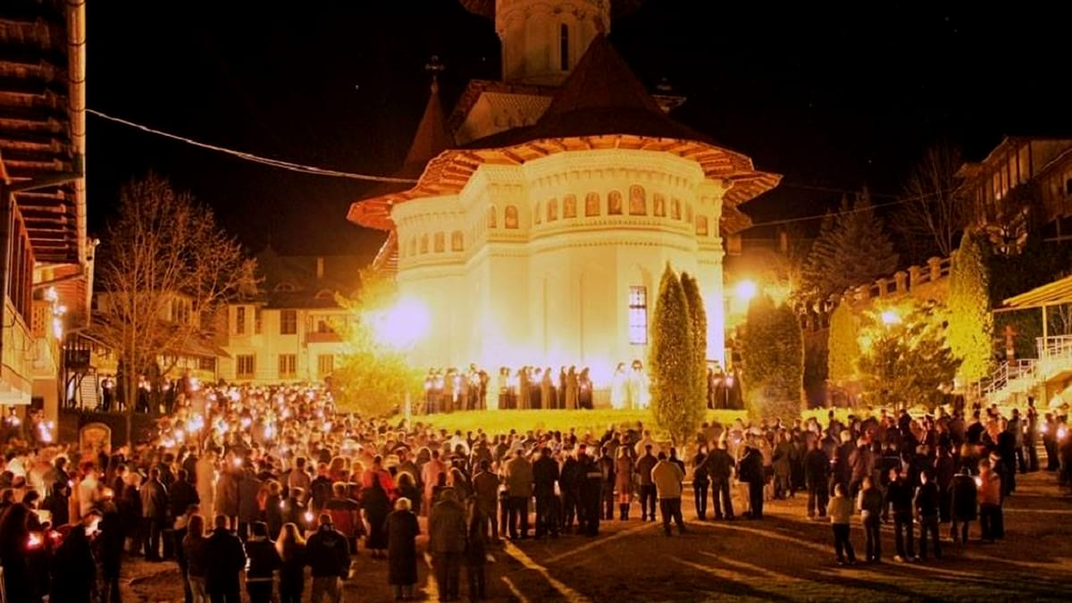
Romanian Easter – Traditions (3)
With the candle lit, everyone returns home and makes a small cross on the east wall,
smoking it with the candle, which he will keep for the rest of the year.
People are allowed to eat (Easter / bread, red eggs,
lamb, salt and wine) only after they are sanctified and after each person participates in the Liturgy.

Slide 5
Easter customs in the regions of Romania
Probably the most notorious is usually the one from the Transylvania area
, known as "sprinkled". According to him - taken from the Hungarians –
the boys go to the families where there is a girl or more,
which they sprinkle with perfume, "so that they do not wither".
The "sprinkling" is still preserved today and is a good opportunity for a reunion
with friends, and, after all, fun.
Easter traditions in some areas of Romania
In Banat, at breakfast on the first day of Easter, the tradition of incense is
practiced. Then, each diner receives a teaspoon of Easter (wine + holy bread).
The menu of this festive meal includes boiled pork chops,
white eggs and traditional dishes, followed by a meal with lamb steak.

Slide 6
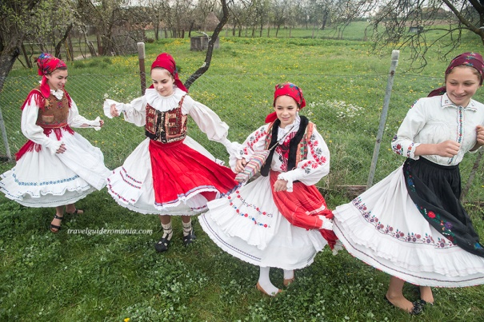
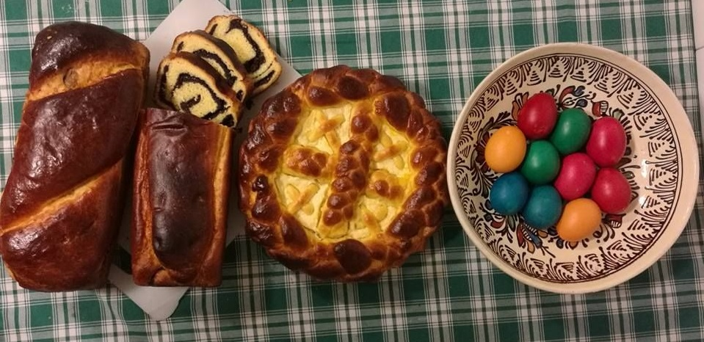
Easter in Romania
Project By Gheorghes Rares
Liceul Economic de Turism Iasi – Class 9H

