Slide 1
Turkeys touristic places

Slide 2
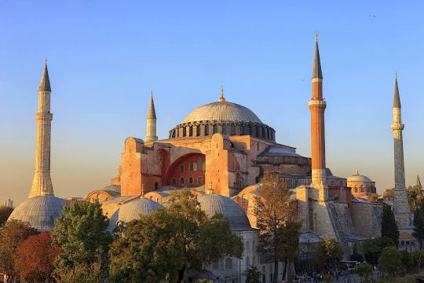
THE AYASOFYA MOSQUE

Slide 3
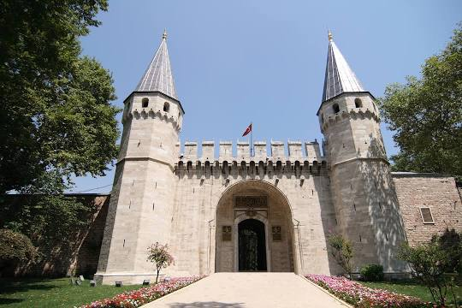
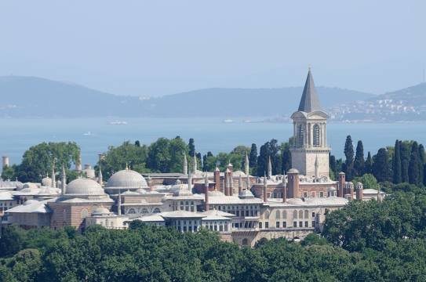
TOPKAPİ PALACE

Slide 4
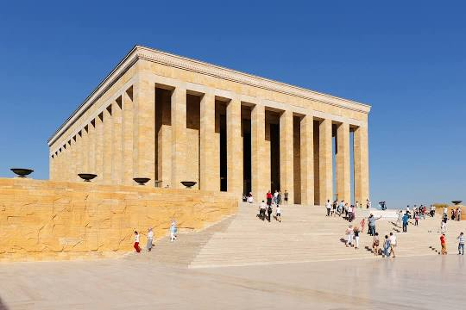
ANITKABİR

Slide 5
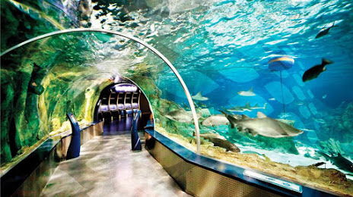
THE İSTANBUL AQUARİUM

Slide 6
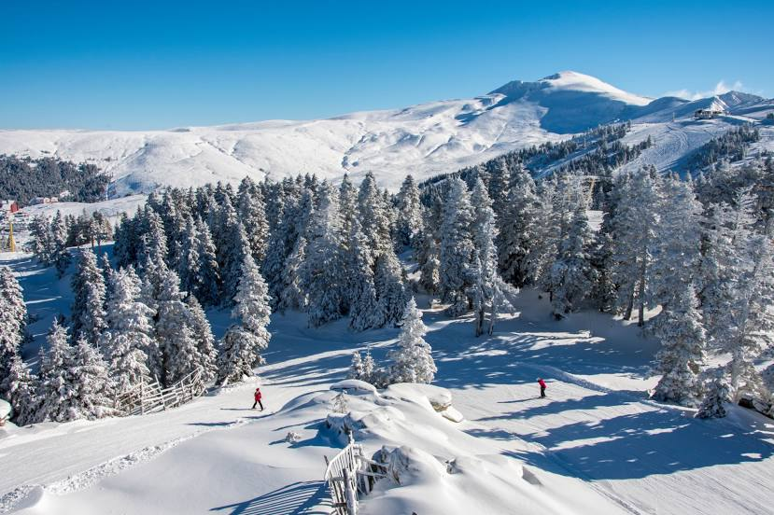
ULU MOUNTAİN

