Slide 1
“Plan a trip & gain experience”

Slide 2
Italy
Italy, officially the Italian Republic, a EU member state, is situated in the south, overlooking the Mediterranean Sea.
It is also known as the "Boot" because of the form and as the "Beautiful Country" because of the climate and its natural and artistic beauty.
https://www.youtube.com/watch?v=M3re6nsan88
https://youtu.be/zGlpMEUZv3U

Slide 3
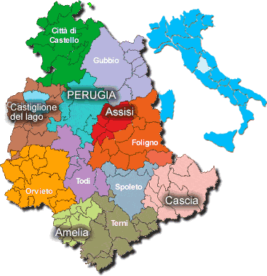
…Umbria
Umbria is a region situated in the centre of Italy. It is the only central Italian region having neither a coastline nor a border with other countries.
https://youtu.be/tu_iwPTqMo8

Slide 4
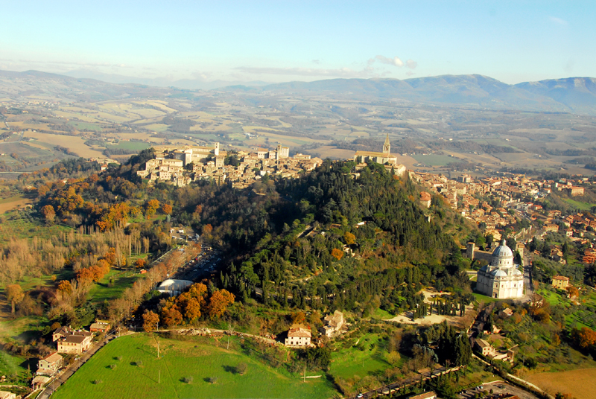
Our town: TODI
Todi is a beautiful town in Umbria, in the province of Perugia, It’s situated on a hill overlooking the Tiber Valley. It has a fabulous square with the Duomo and it is Monumental Palaces. It is surrounded by three walls of three different periods. It is medieval appearance has remained unchanged over the centuries and today you can admire its artistic beauties and its intact city walls. The country, which gave birth to Jacopone da Todi, is defined as one of the most livable cities in the world.
https://www.youtube.com/watch?v=s7Yw0Wyn9jA
Notes:
4

Slide 5
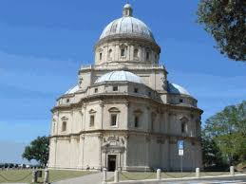
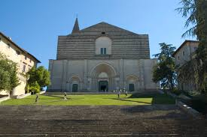
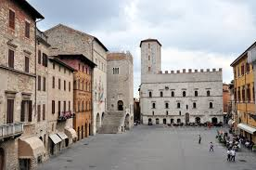
Some photos of Todi
“Consolazione”
“San Fortunato”
“Piazza Del Popolo”

Slide 6
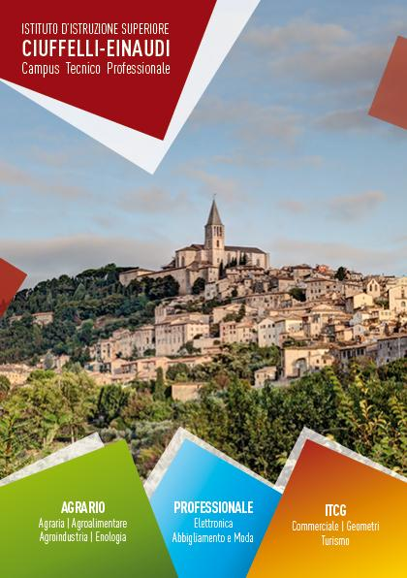
Our school has about:
900 students
150 staff
Our students are 14-19 years old and they can choose between six Courses of studies:
Tourism
Business
Agriculture
Architecture
Electronics
Fashion

Slide 7
EINAUDI BUILDING

Slide 8
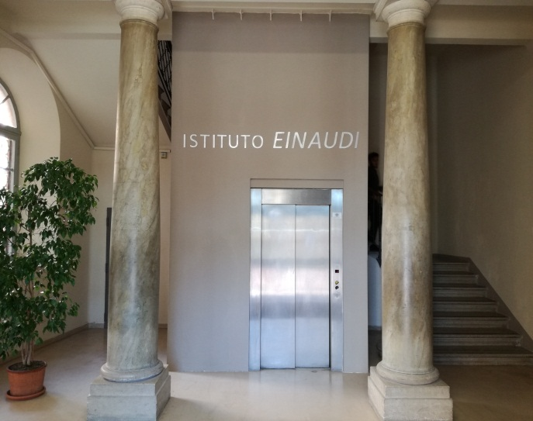
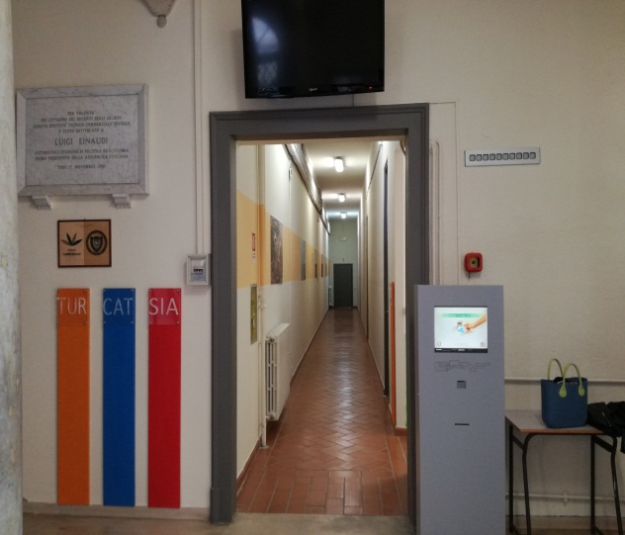
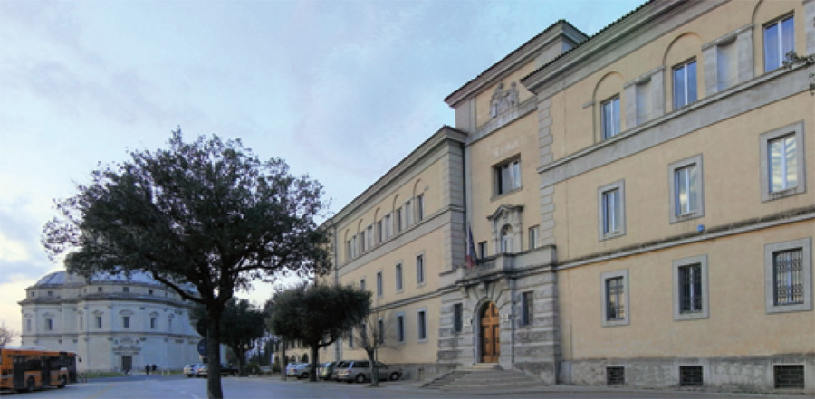
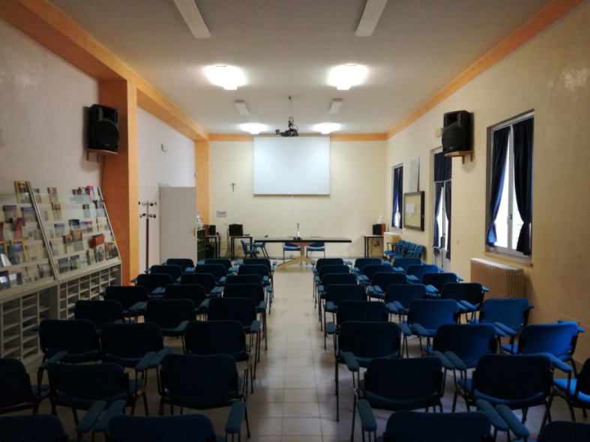
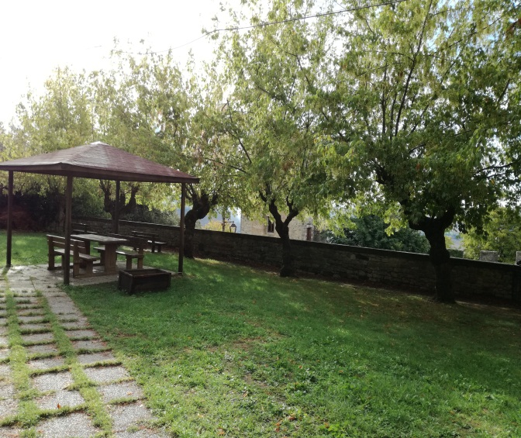
Our school

Slide 9
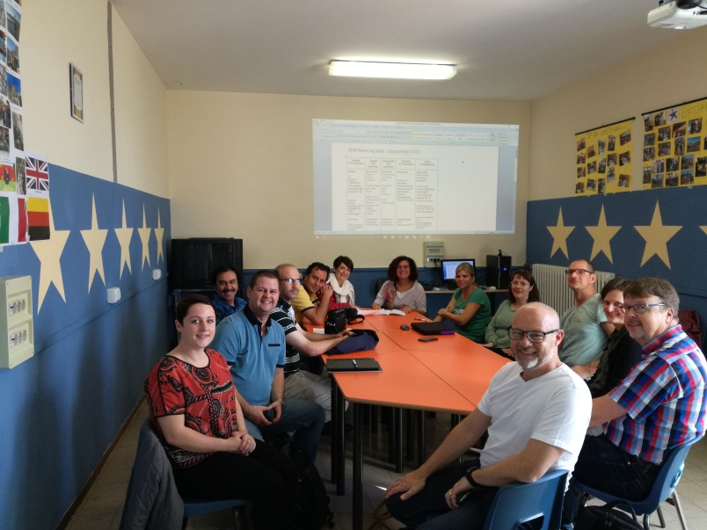
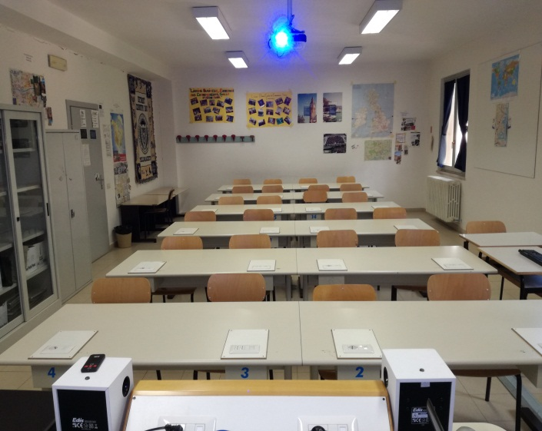
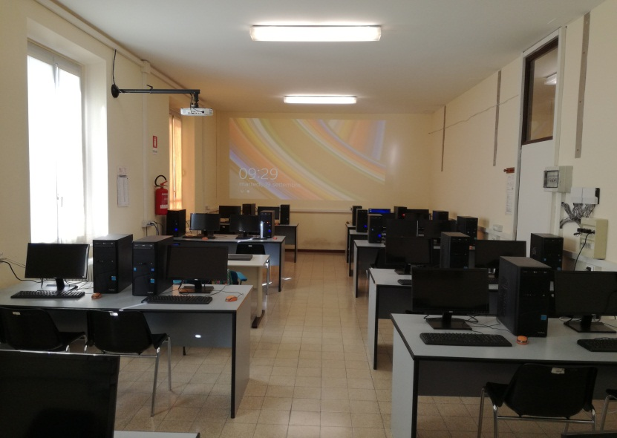
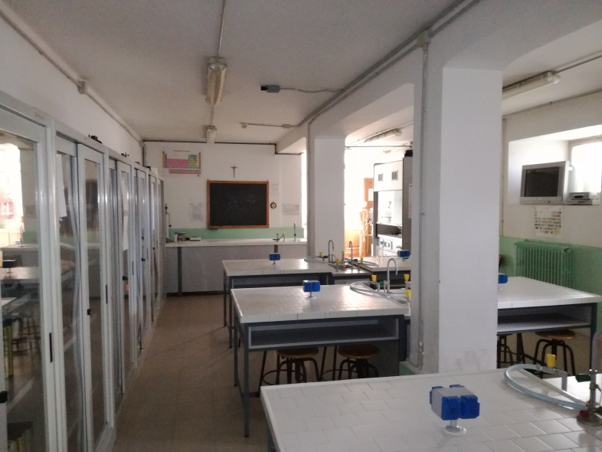
Our workshops

Slide 10
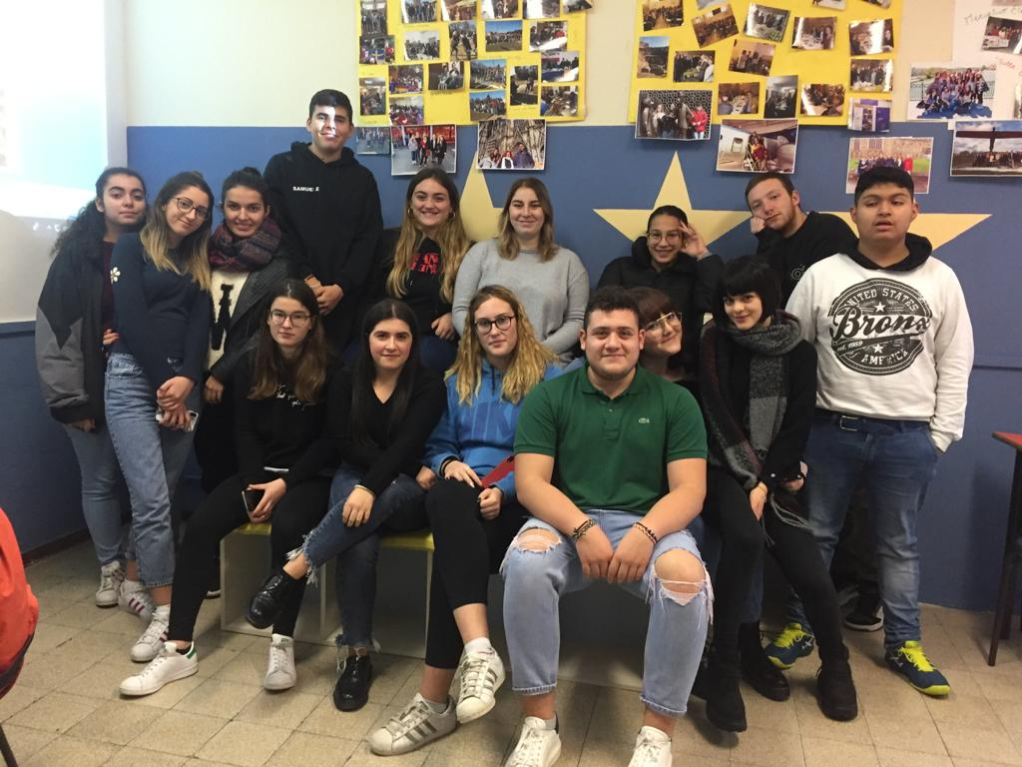
Class 4th B Tourism

Slide 11
THANKS FOR YOUR ATTENTION

