Slide 1
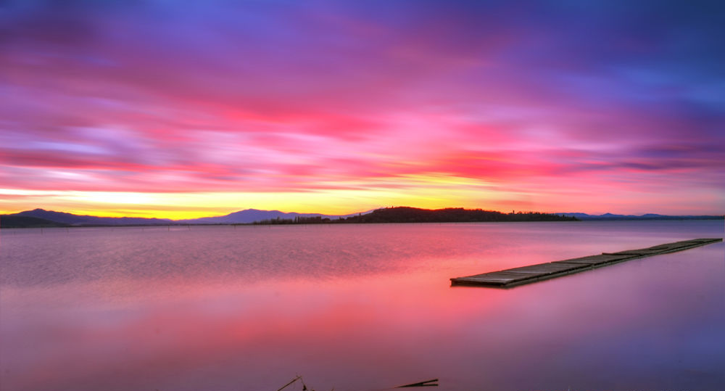
Umbria

Slide 2
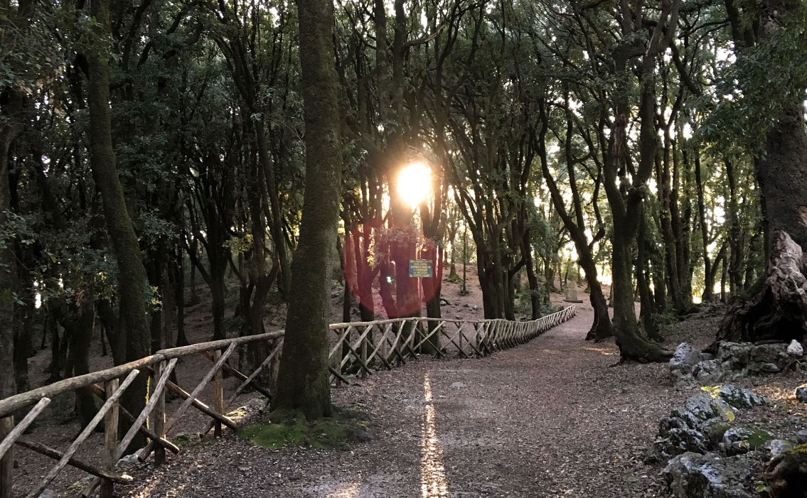
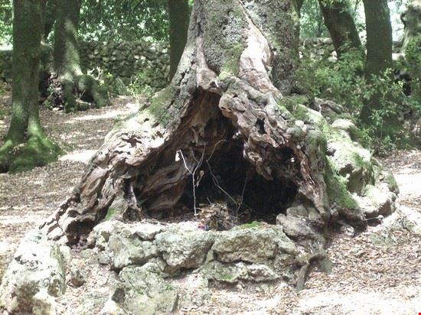
FIRST DAY
8:00 am Departure from Vienna airport
10:00 am Arrival at Rome FCO airport and departure to Perugia
12:00 am Arrival in Spoleto and free visit of the city
2.00 pm Free lunch in the center of Spoleto
3.30 pm Guided tour of the Bosco Sacro
6:00 Departure from Spoleto
6:30 pm Arrival at I Granai farmhouse and check-in
8:00 pm Dinner at the farmhouse and overnight stay

Slide 3
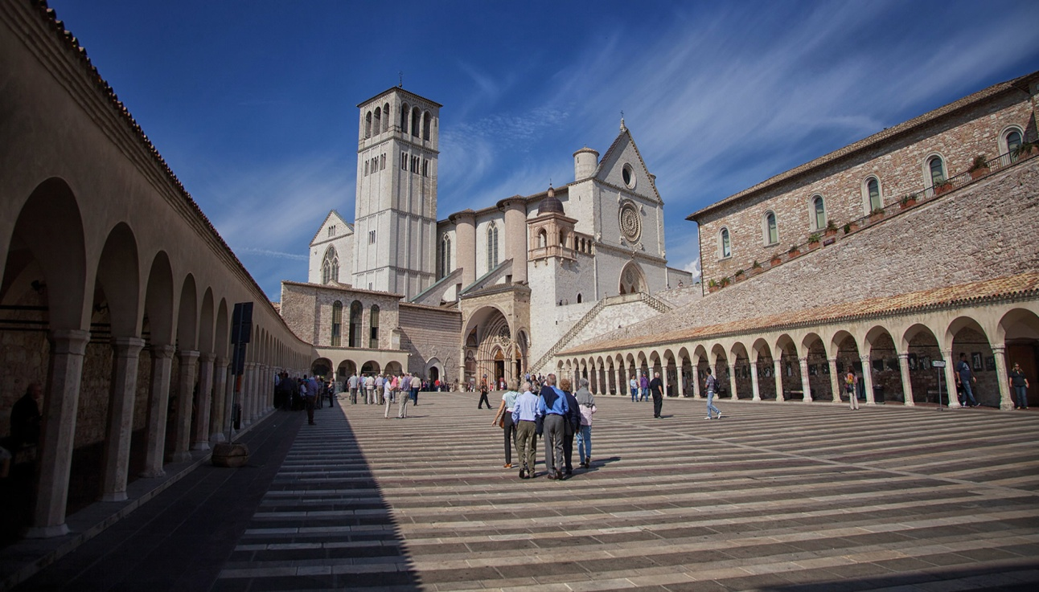
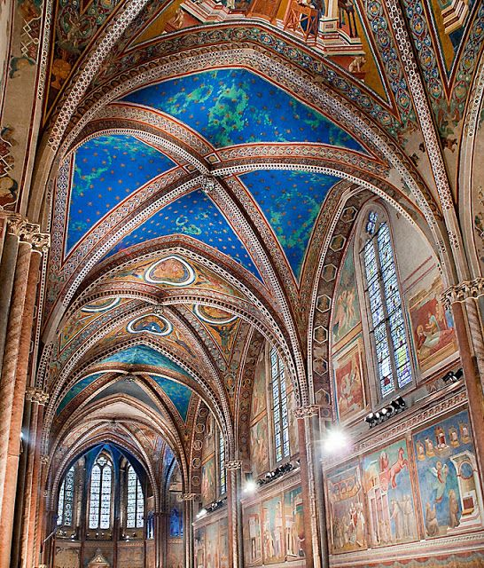
SECOND DAY
8:00 am Breakfast at the farmhouse
9:00 am Departure to Assisi
10:00 Arrival in Assisi and guided tour of the Basilica of San Francesco
12:00 pm Visit of the city of Assisi
2:00 pm Free lunch
3:30 pm Visit to the Basilica of Santa Maria degli Angeli
6:30 pm Departure from Assisi and return to the farmhouse
8:00 pm Dinner and overnight stay

Slide 4
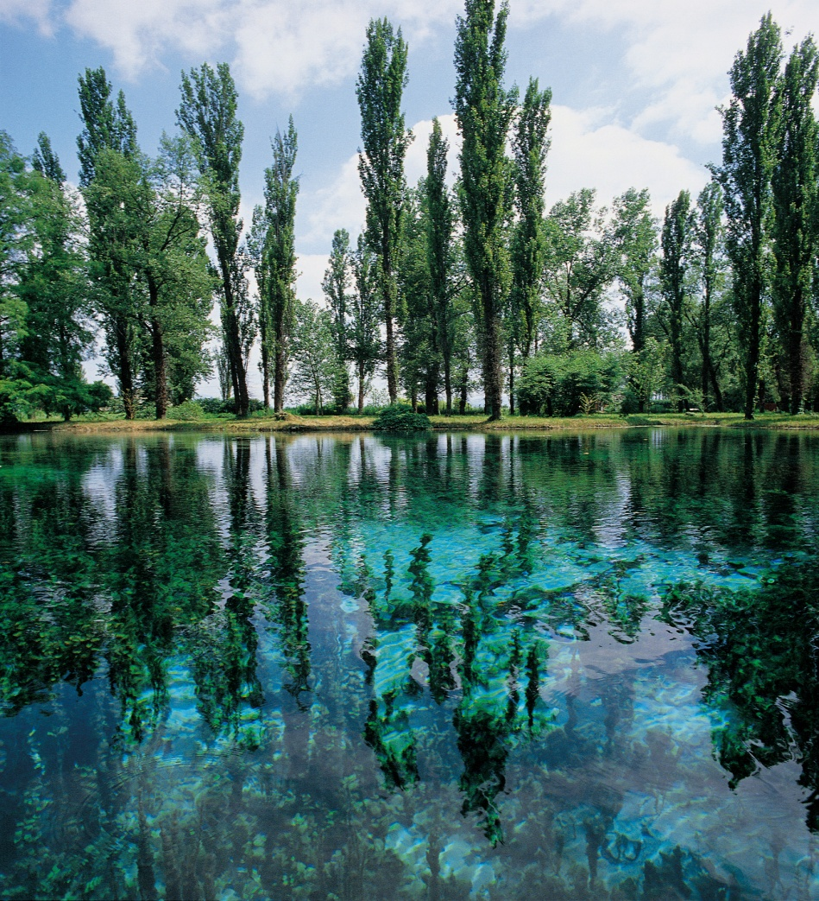
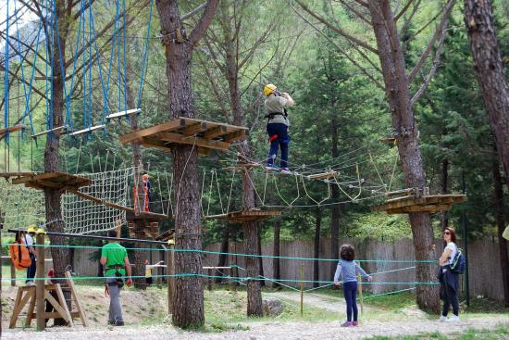
Third day
9:00 am Breakfast at the farmhouse
9:30 am departure towards Spoleto
10:00 am arrival in Spoleto and visit of the Fonti del Clitunno
11:30 am visit of the Tempietto del Clitunno
12:30 pm departure towards the center of Spoleto
1:30 pm free lunch at the Active Park restaurant
3:00 pm activities at the Active Park (including amusement park, adventure trails,
6:00 pm return to the farmhouse
8:00 pm dinner and overnight stay

Slide 5
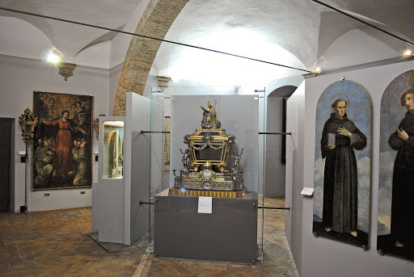
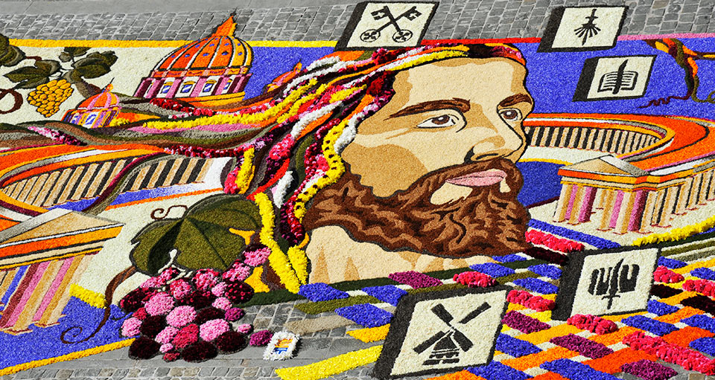
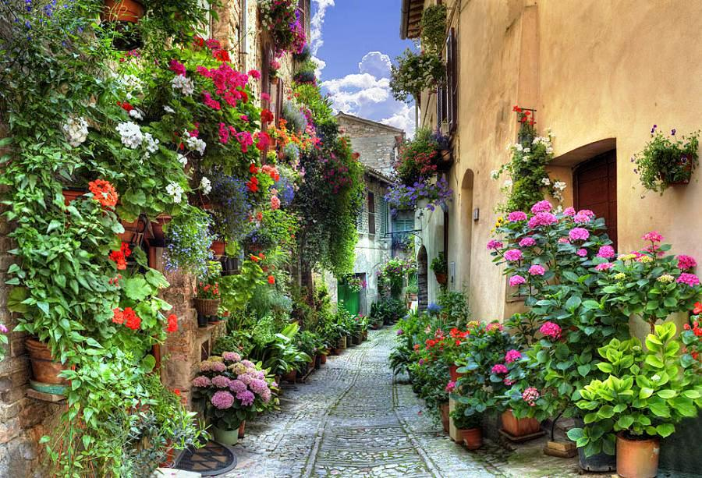
Fourth day
9:00 am Breakfast at the farmhouse
9:30 am Departure towards Spello
10:00 am Visit of the municipal art gallery of Spello
11:00 am Visit to Villa Fidelia and relaxing walk in the adjoining park.
1.00 pm Free lunch
3.00 pm Free afternoon in the city of Spello with free admission to the flowery alleys of the city
7:00 pm Return to the farmhouse
8:30 pm Dinner and overnight stay

Slide 6
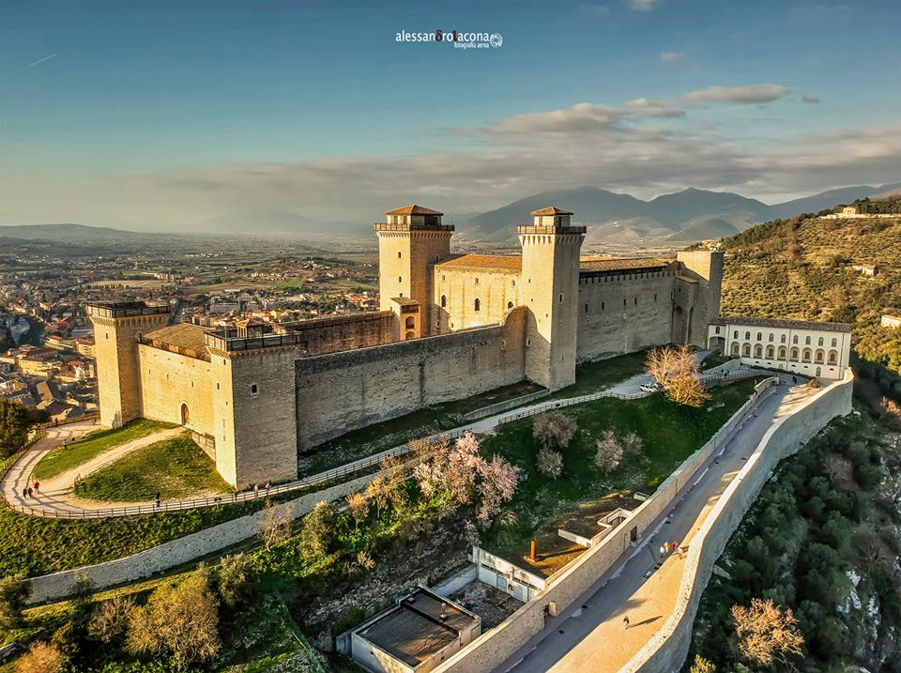
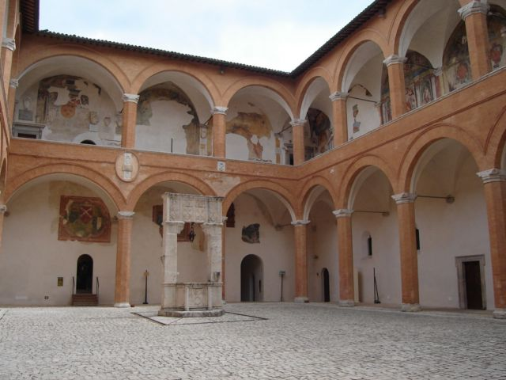
Fifth day
9:00 am Breakfast at the farmhouse
9:30 am Arrival in the center of Spoleto
10:00 am Visit of the Rocca Albornoziana
12:30 pm Return to the farmhouse
13:00 pm Lunch in the farmhouse
3:00 pm Check-out and departure to Rome airport
5:00 pm Arrival at the airport and check-in
6:00 pm Departure from Rome towards Vienna
7:30 pm Arrival in Vienna

Slide 7
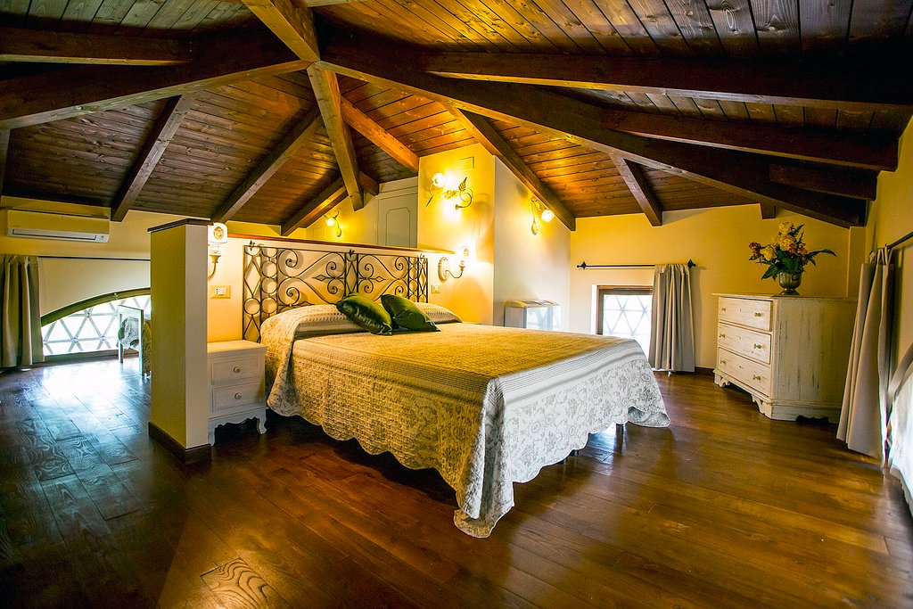
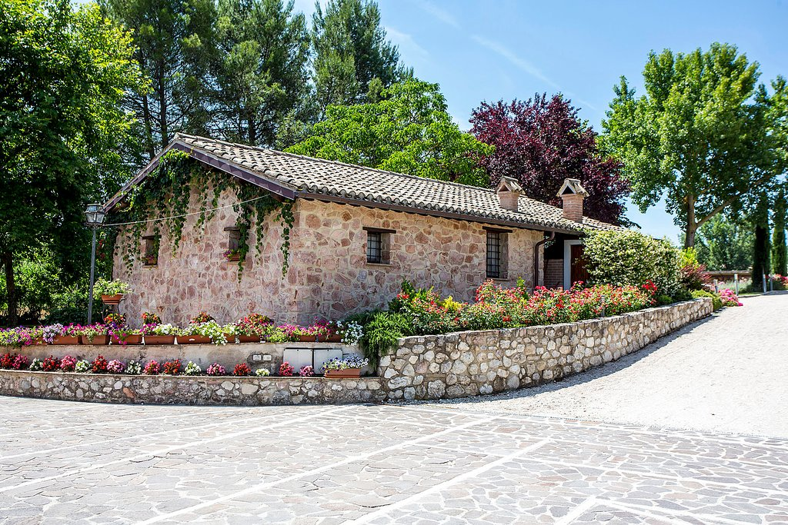
Accommodation:
I Granai farmhouse
https://www.tripadvisor.it/Hotel_Review-g194924-d4931379-Reviews-Agriturismo_I_Granai-Spoleto_Province_of_Perugia_Umbria.html
Vocabolo Crocemarroggia 69, 06049, Spoleto Italy
four people (adults aged 35/50)
HB set-up (breakfast, dinner and overnight stay)

