Slide 1
General Info
Duration: 4 nights and 5 days
Period:. from 30/04 to 04/05
Tourist target: 4 young people (20/30 years)
Costs: 550 euros per person
Accommodation: Rented apartment

Slide 2
FIRST DAY
( Friday, April 30th )
Flight from London Heathrow to Rome Fiumicino. Departure at 08:20am, expected arrival at 12:00pm.
13.00pm bus from the airport to Rome Termini station. Expected arrival at 14:05pm.
14.30pm train to Terni. Expected arrival at 15.30pm.
Arrival, check-in and accommodation in the apartment. ( 800m from the station )
16.30pm, short visit of the surrounding area.
Dinner of your choice.
Return and overnight in the apartment.

Slide 3
Flight Details
From London to Terni
2 hours and 40 minutes - Direct
08:20 London Heathrow
Airline: British Airways
Aircraft: BA0548 (Airbus A319 jet)
Departure London: Terminal 5, Friday, April 30, 2021, 08:20
Arrival Rome: Terminal 3, Friday, April 30, 2021, 12:00
Duration: 2hrs 40mins
Economy Basic Fare Class: V
12:00 Rome Fiumicino

Slide 4
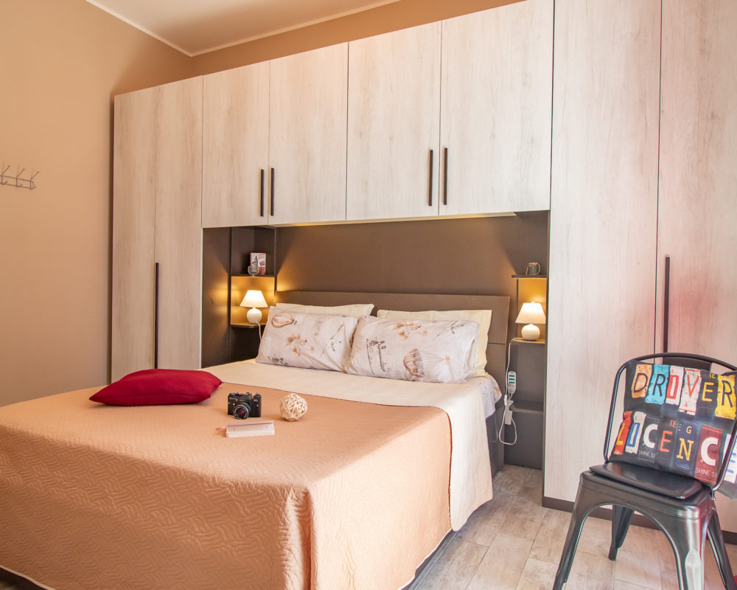
Apartment "La casa Rosa"
The apartment is located on the first floor and consists of entrance hall, living room with kitchenette, two bedrooms, bathroom and terrace. A simple, welcoming and spacious environment.
Viale Benedetto Brin, 34 I 05100 - Terni (TR)
320 353 16 40 - 320 353 15 44
info@lacasarosaappartamenti.it

Slide 5
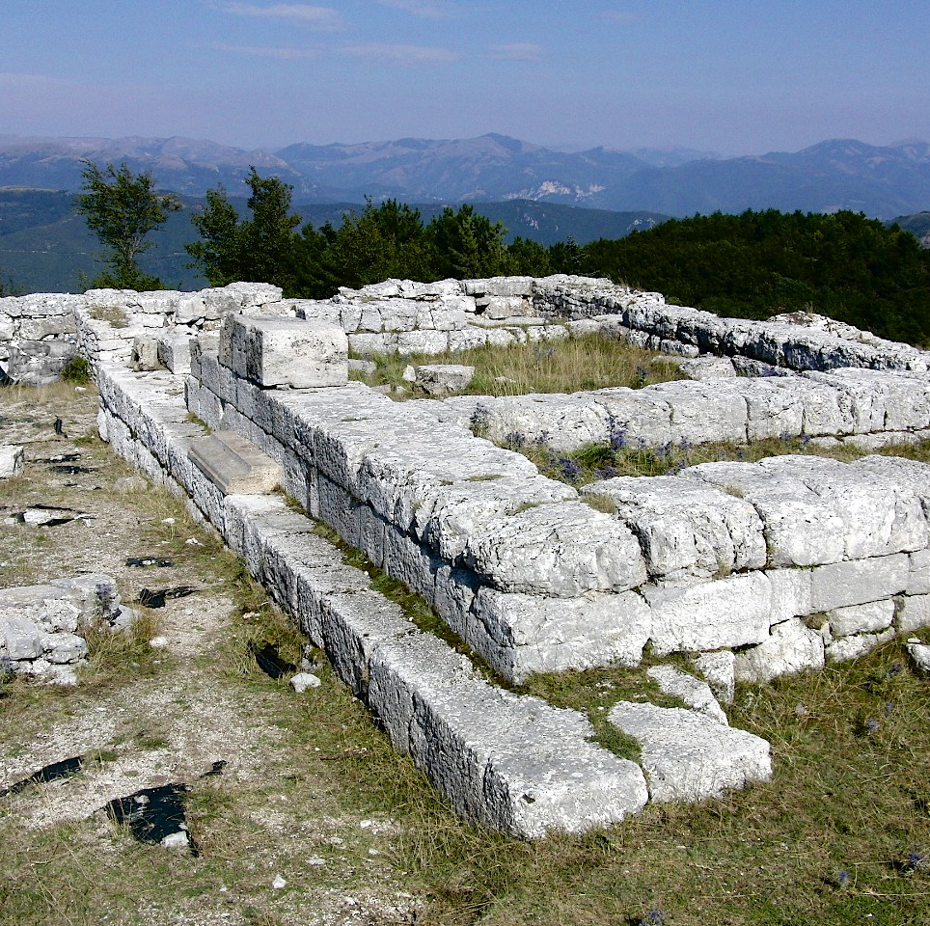
Terni
Terni is a modern city that has its roots in a thousand-year history of which remain important testimonies that continue to live in the context of the Dynamic City.
Recommended places to visit:
The Roman city of Carsulae
Basilica San Valentino
Sant'Erasmo

Slide 6
The Roman city of Carsulae
Covering an area of over 20. hectares, the ruins of the Umbrian-Roman city of Carsulae are a unique site in Umbria for lovers of Archaeology. An authentic open-air museum inside which you can walk along a stretch of the route of the Via Flaminia. On the sides of the road, the forum with the original twin temples dedicated to Castor and Pollux, the basilica, the baths, the theater and the amphitheater and finally the area of the monumental tombs.

Slide 7
SECOND DAY ( Saturday, May 1th )
-Breakfast in the apartment.
9:00am, take the Bus Italia bus and get off at the Marmore Falls.
10:00am guided tour of the marble waterfall.
12:00pm lunch with street food.
2:30pm rafting activity.
18:00pm, take the Bus Italia bus back to Terni.
Return, dinner and overnight in the apartment.

Slide 8
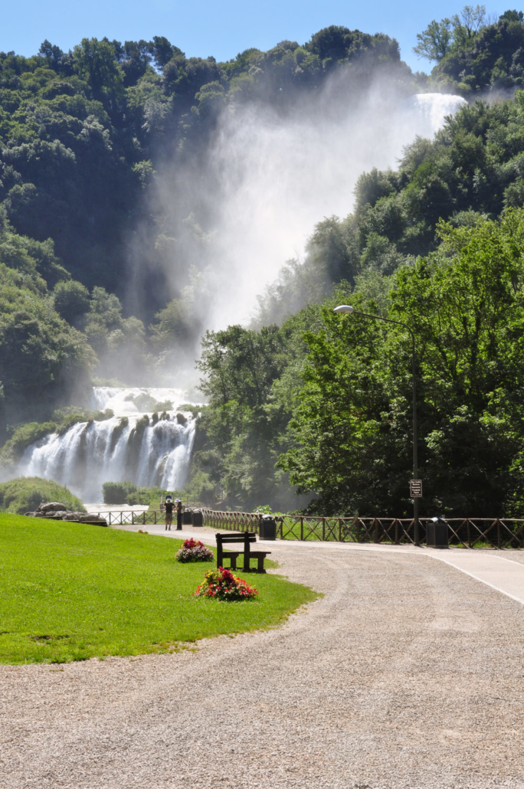
The Marmore Falls
The Marmore Waterfall is unique because its 165 meters jump is the highest in Europe. It is unique because a river, the Velino, is thrown on another great river, the Nera. The spectacle of the Marmore Falls can be enjoyed from various points and also the discovery of the Park is an enchanting experience. There are also caves, lakes and guided trails that make the visit interesting and enjoyable. The park offers many attractions and activities such as hiking, caving, canyoning and rafting.

Slide 9
THIRD DAY ( Sunday, May 2nd )
Breakfast in the apartment.
9:00am, take the Bus Italia bus and get off at Narni.
Expected arrival at 9:45am and visit of the city of Narni.
Lunch of your choice.
15:00pm guided tour of Narni underground.
18:00pm, take the Bus Italia bus back to Terni.
Return, dinner and overnight in the apartment.

Slide 10
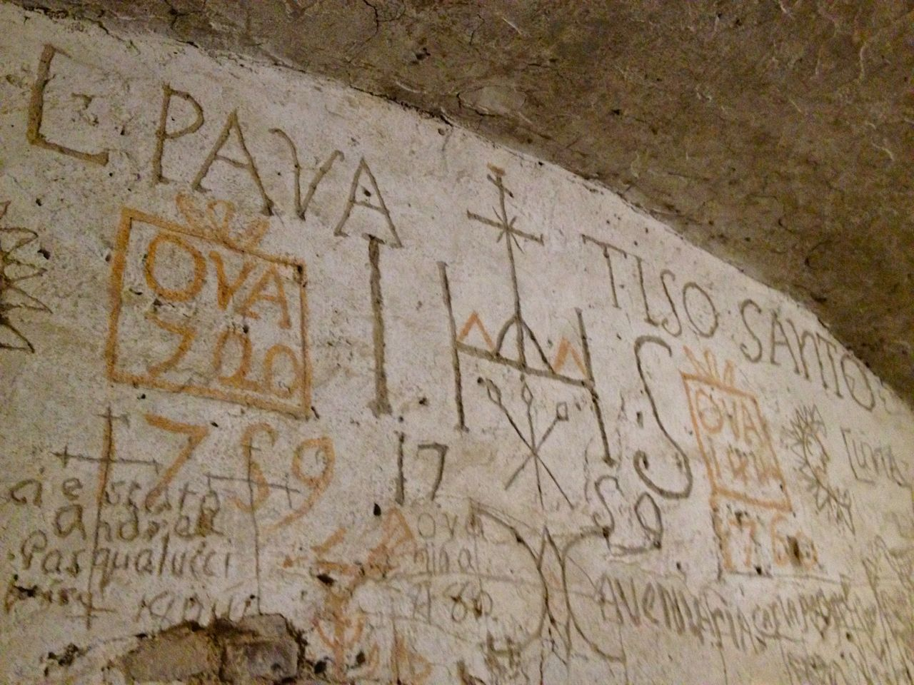
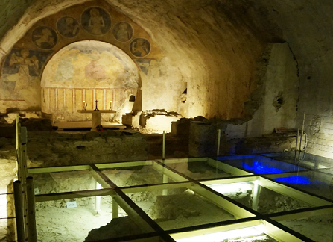
Narni Underground
The guided tour begins in the Monastery of San Domenico. Crossing an opening in the walls, the visit proceeds to space of an ancient Roman house. Then we arrive in the basement of Roman aqueduct "Formina". It is the only Roman aqueduct that has been opened in Italy. The visit proceeds in a large space, where the interrogators of the Court of the Inquisition were located. In this environment there is also a single cell: its walls are completely decorated with signs and graffiti made by the prisoners.

Slide 11
FOURTH DAY (Monday, May 3rd)
Breakfast in the apartment.
9:00am, take the BusItalia bus and get off at Piediluco.
Expected arrival at 9:30am and visit to the city of Piediluco.
Lunch of your choice.
14:30pm tour of Lake Piediluco by boat with explanations about the lake.
18:00pm, take the Bus Italia bus back to Terni.
Return, dinner and overnight in the apartment.

Slide 12
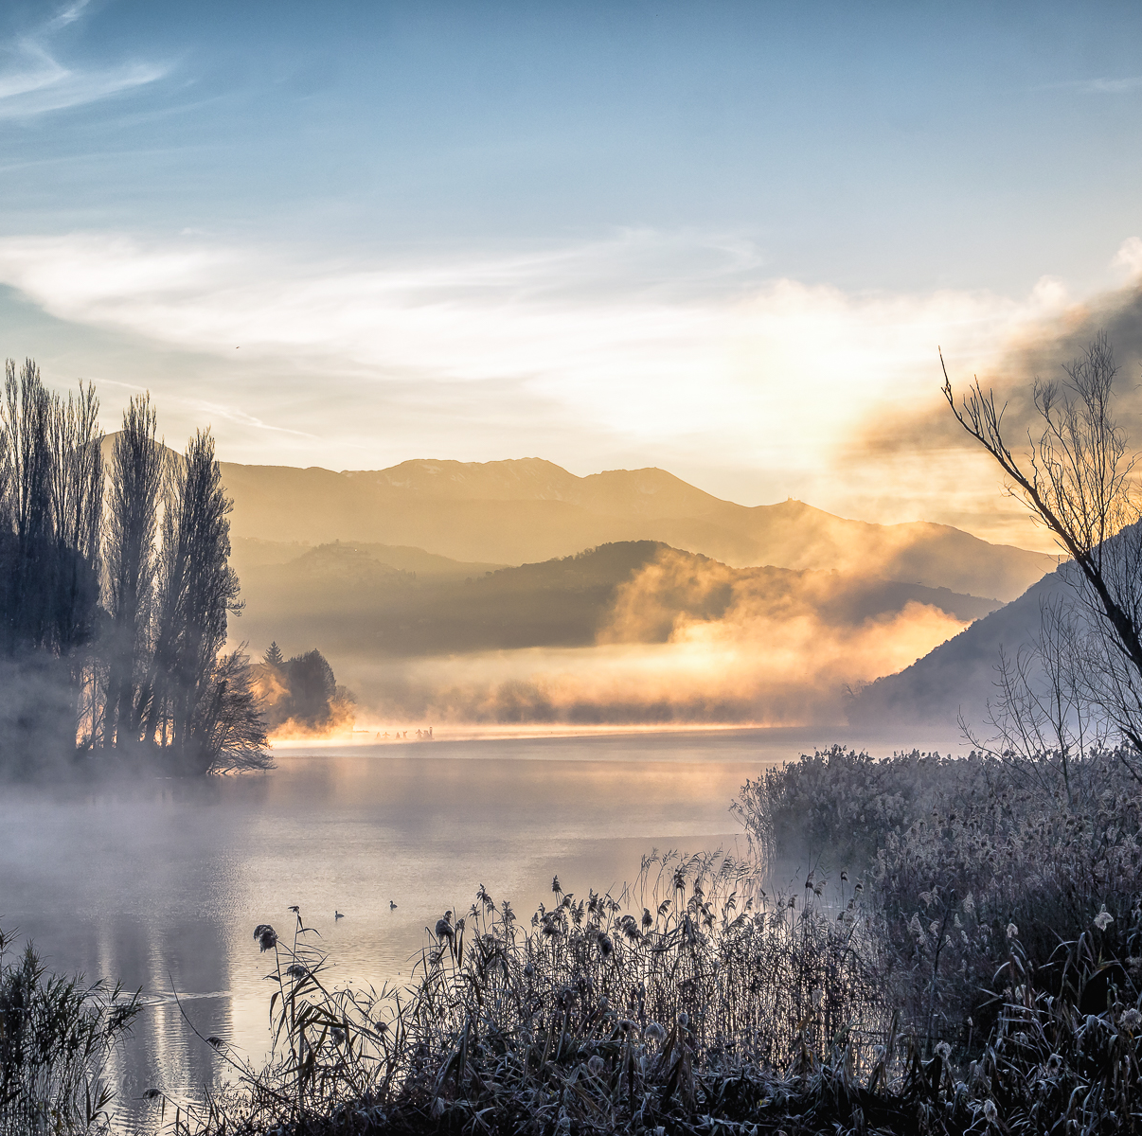
Piediluco Lake
Piediluco is a picturesque town whose name means "at the foot of the sacred wood". With a structure that has remained that of the Middle Ages, with its low colored houses, it is actually located in the narrow strip of land that runs between the lake and the mountain. The lake, set among wooded hills, has the appearance of an Alpine stretch of water.

Slide 13
FIFTH DAY ( Tuesday, May 4th )
Breakfast in the apartment.
10:00am check out in the apartment and visit of the center of terni.
14.30pm train to Rome Termini. Expected arrival at 15.30pm.
16:30pm bus from the station to airport. Expected arrival at 17.45pm.
Flight from Rome Fiumicino to London Heathrow. Departure at 20:00, expected arrival at 22:50pm

Slide 14
Itinerary designed by Simion Martina-Elena, Romani Arianna, Gramaccia Gabriele, Tremolani Giorgia, Real-Avila Stefano

